Slide 1
Some Thoughts on Switch Queue Management and Buffer Size in Data Centers
Chuanxiong Guo
Bytedance Inc

Slide 2
Data Center Switches
Output-queue switches
Single box
Shallow buffer (SRAM)
Buffer size: 12-32MB
VoQ switches
Chassis
Deep buffer (small SRAM + big DRAM)
Buffer size: several GBs per FAP

Slide 3
We know the tradeoffs
But not the exact values
High network utilization
Large queueing latency
Low packet drops
High cost (power and device)
Up
Queue length
Buffer size
Down
Low network utilization
Small queueing latency
High packet drops
Low cost (power and device)

Slide 4
VoQ Switches Do not Support ECN Well
Ingress
Fabric
Egress
ECN in VoQ switches
Marking can only be done at the ingress side
The worst-case egress queue may be n times worse, where n is the number of ingress ports
The marking may be started too late
Threshold

Slide 5
Do Output-queue Switches Do Better? No …
ECN
Threshold
ECN
Threshold
ECN does not work even for output-queue switches in network setting
The queue length of an output port is the sum of all the packets in the network (minus some delta)
In the worst-case, ECN cannot control delay or buffer usage
ECN
Threshold
Egress queue

Slide 6
Viewpoint #1: Queue management needs a global view

Slide 7
Buffer Size in Data Centers
Go small or go big: It is a tradeoff
We typically toke a network centric view
Focused on throughput, latency, packet drops
But it is complicated:
Our optimization goal
Applications’ traffic pattern
Application protocol
Transport protocol
Queue management (FIFO, WFQ, ECN, AQM, etc.)

Slide 8
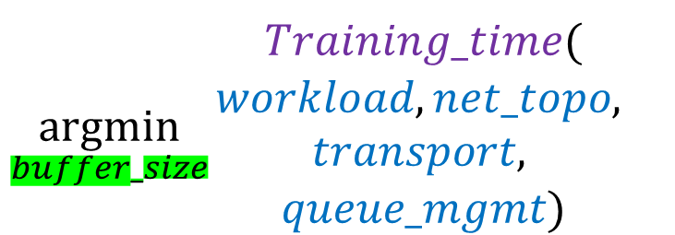
Buffer Size in Data Centers: an application view
PS
Network
$${\underset{buffer_size}{argmin}{\begin{aligned}Training_time( \\ workload, net_topo, \\ transport, \\ queue_mgmt)\end{aligned}}}^{}$$
Worker
Machine learning training

Slide 9
Viewpoint#1: Queue management needs a global view
Viewpoint#2: Buffer size should be decided by application optimization goal

