Slide 1
Software Defined Networks and the
Maturing of the Internet

Slide 2



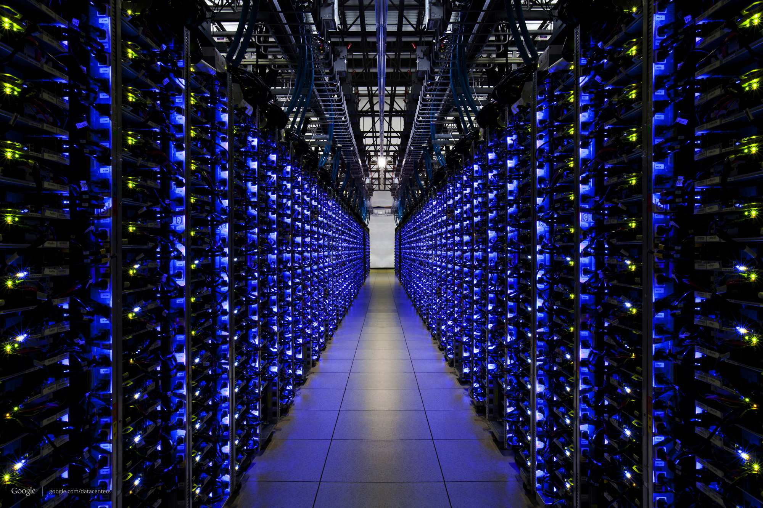
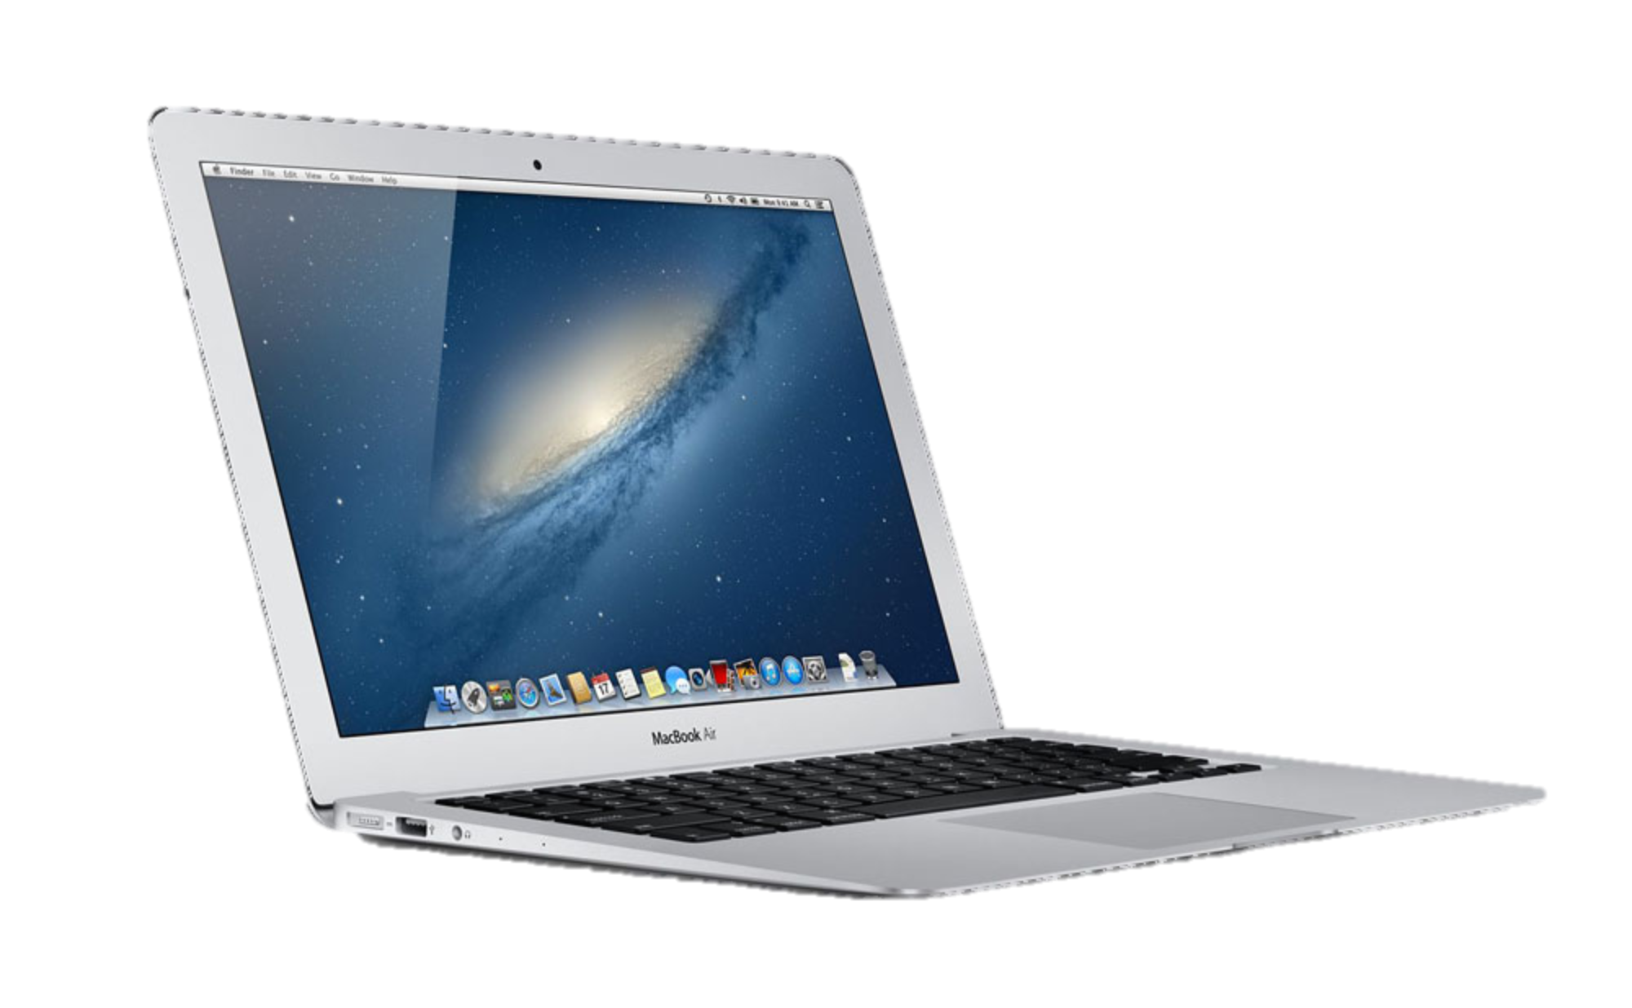

Slide 3
Router
Link

Slide 4
Data
Address
Data

Slide 5
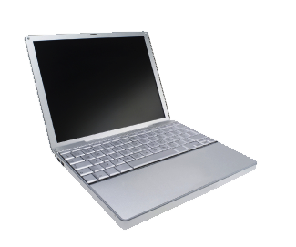
Data
Data

Slide 6
Packets may be corrupted
?!%%*
Data
Data

Slide 7
Packets may arrive out of order
1
2

Slide 8
Packets may be duplicated
Duplicate
Data
Data

Slide 9
They may not arrive at all
Data
Data
Full

Slide 10
Why was an Internet so simple and dumb so successful?

Slide 11
The Internet was successful because it was simple and dumb

Slide 12
Application
Application
Transport
“TCP”
Reliable end-to-end delivery
Transport
Network
“IP”
Unreliable datagram service
Network
Data

Slide 13
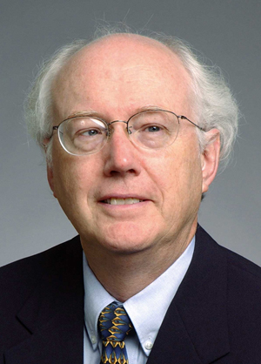
David D. Clark
Chief Protocol Architect, Internet
1981 - 1989

Slide 14
Architectural Principles
1
Dumb and simple
i
Streamlined, fast, low-cost, easy to maintain, infrequent upgrades.
Reliable in-order delivery can be built on top, at the end-points.
i
Intelligent end-points (computers).
2

Slide 15
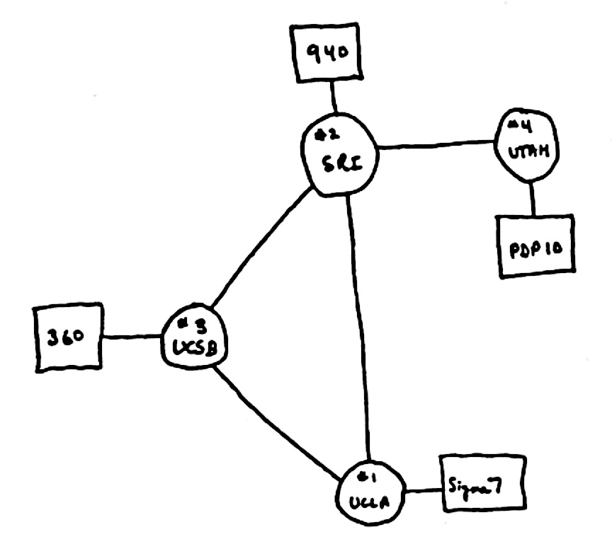
Architectural Principles
3
Decentralized control
i
Rapid organic growth
1969

Slide 16
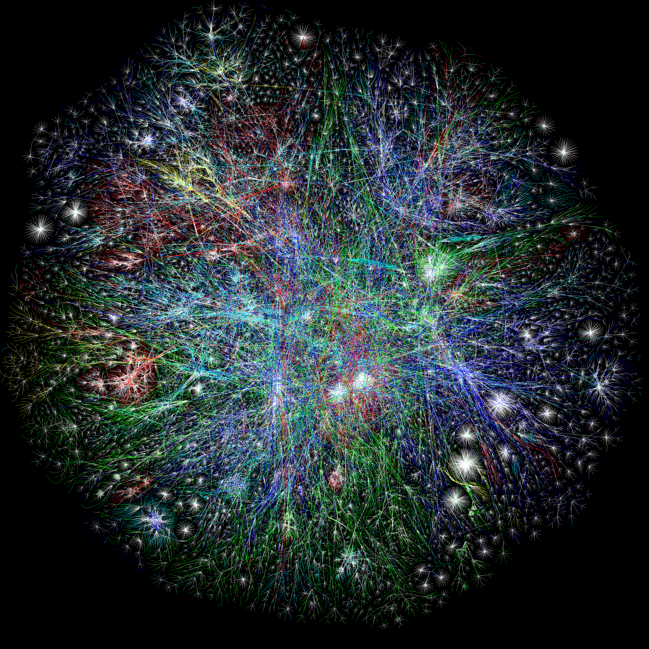
The Opte Project

Slide 17
Computers connected to Internet
1 Billion
Millions
Source: ISC

Slide 18
Summary so far
The Internet was deliberately designed …
To be simple and streamlined.
To have decentralized control: Lots of individually controlled pieces.
Which led to …
Explosive organic growth of the Internet.
A great business for companies selling routers.
simple and streamlined
A great business

Slide 19
Number of published Internet Standards

Slide 20
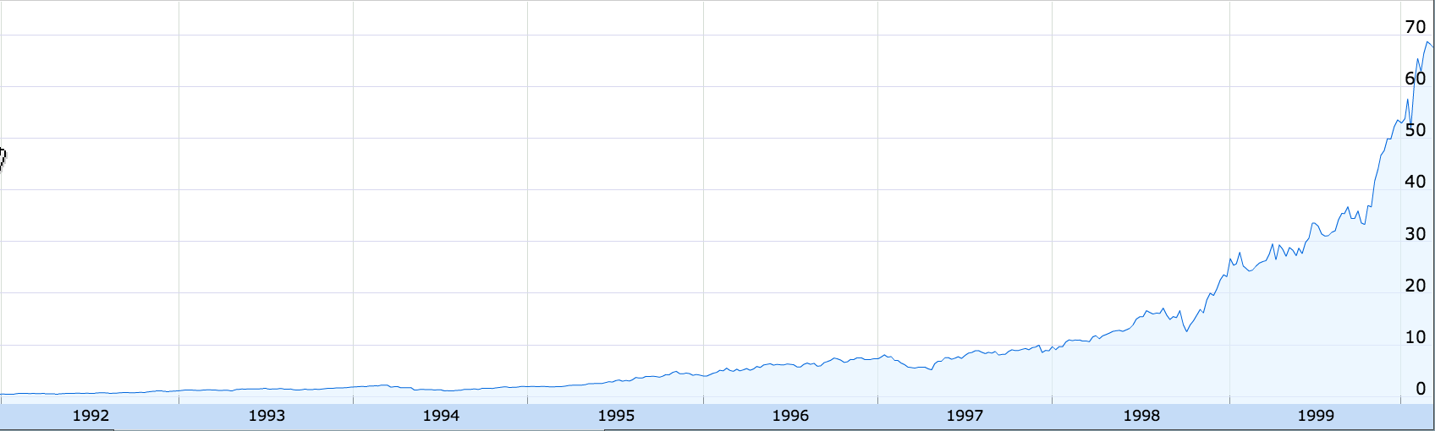
Cisco Stock Price
200x
1991
1999
Google Finance

Slide 21
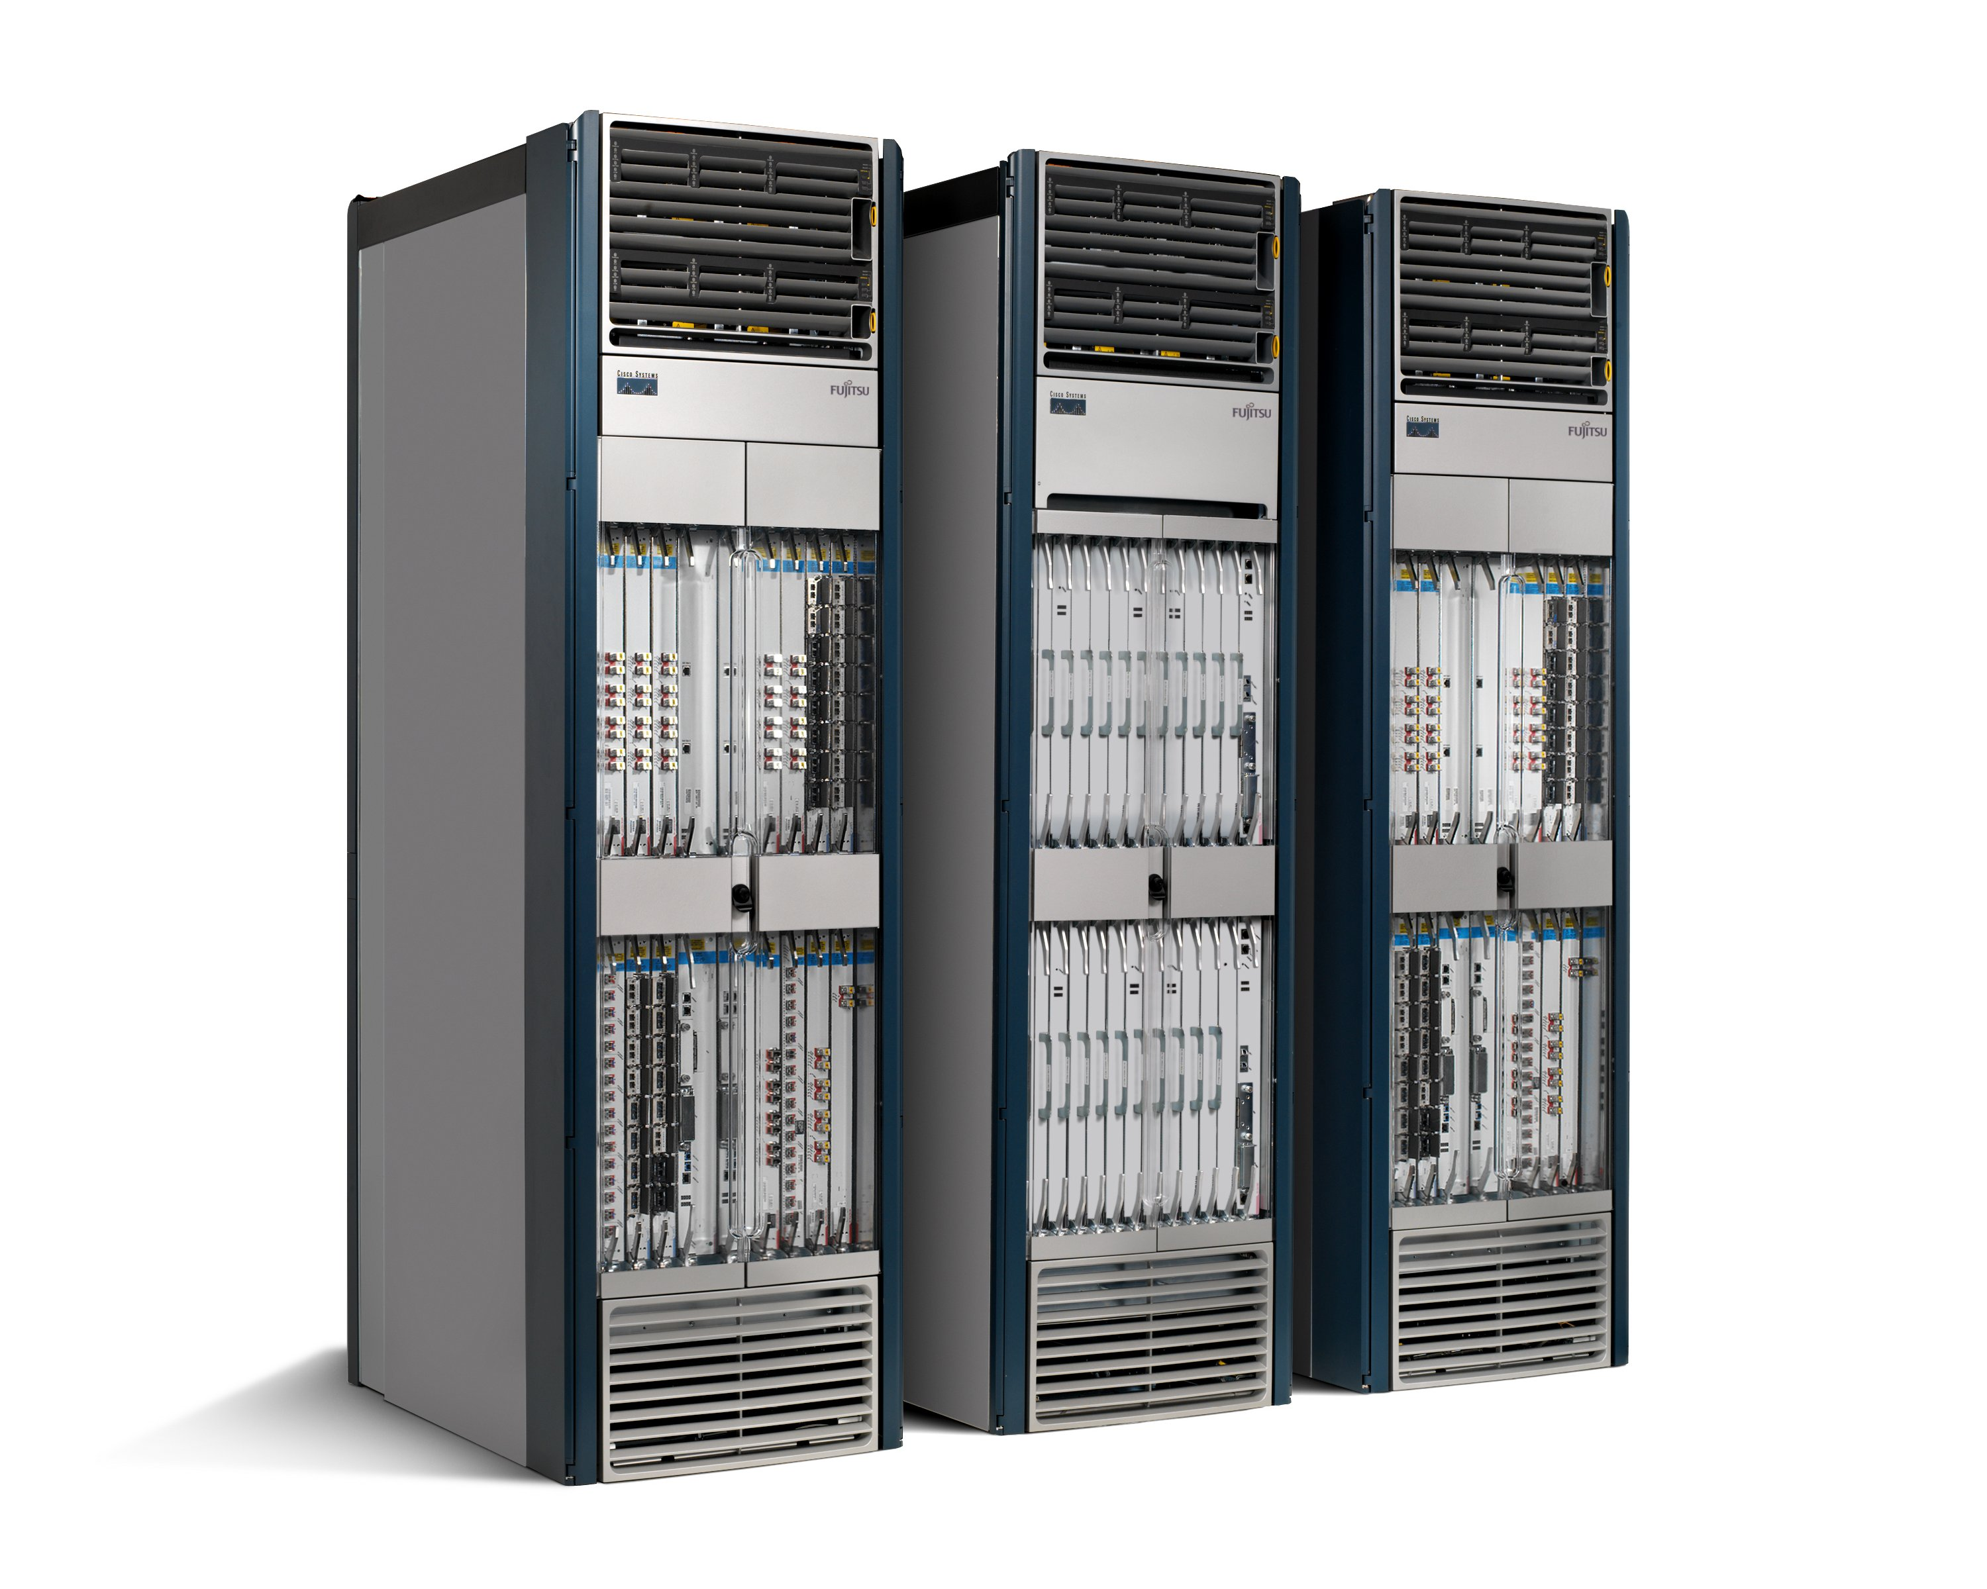
50+ million lines of code
Software
Tens of billions of transistors
Hardware
Routers are fragile and insecure
Bloated and power hungry
Like the computer mainframes of the 1980s

Slide 22
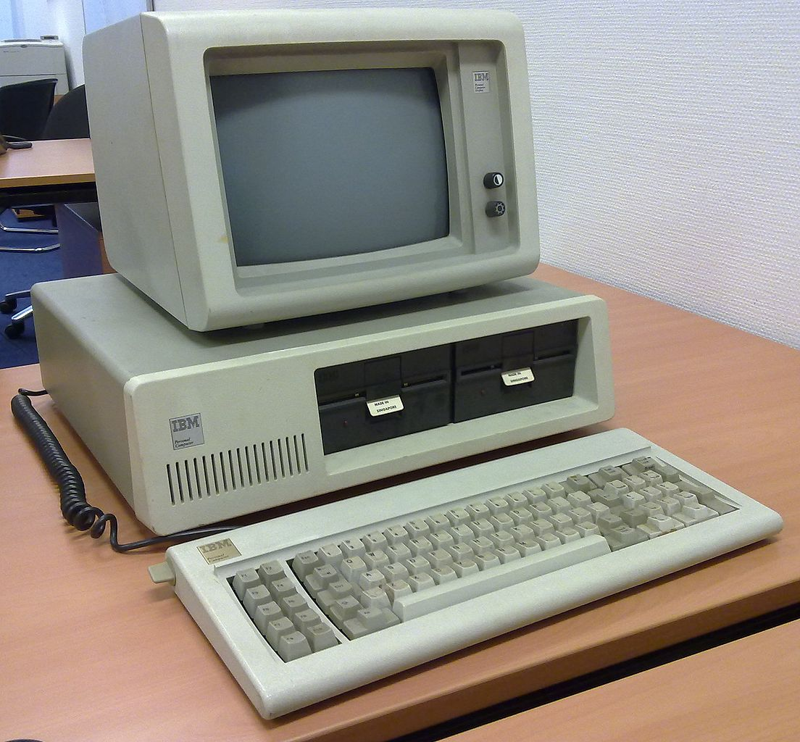
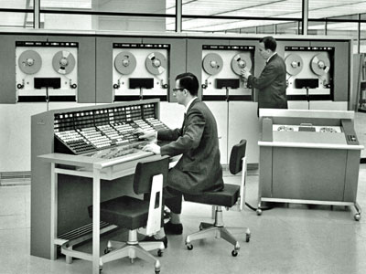
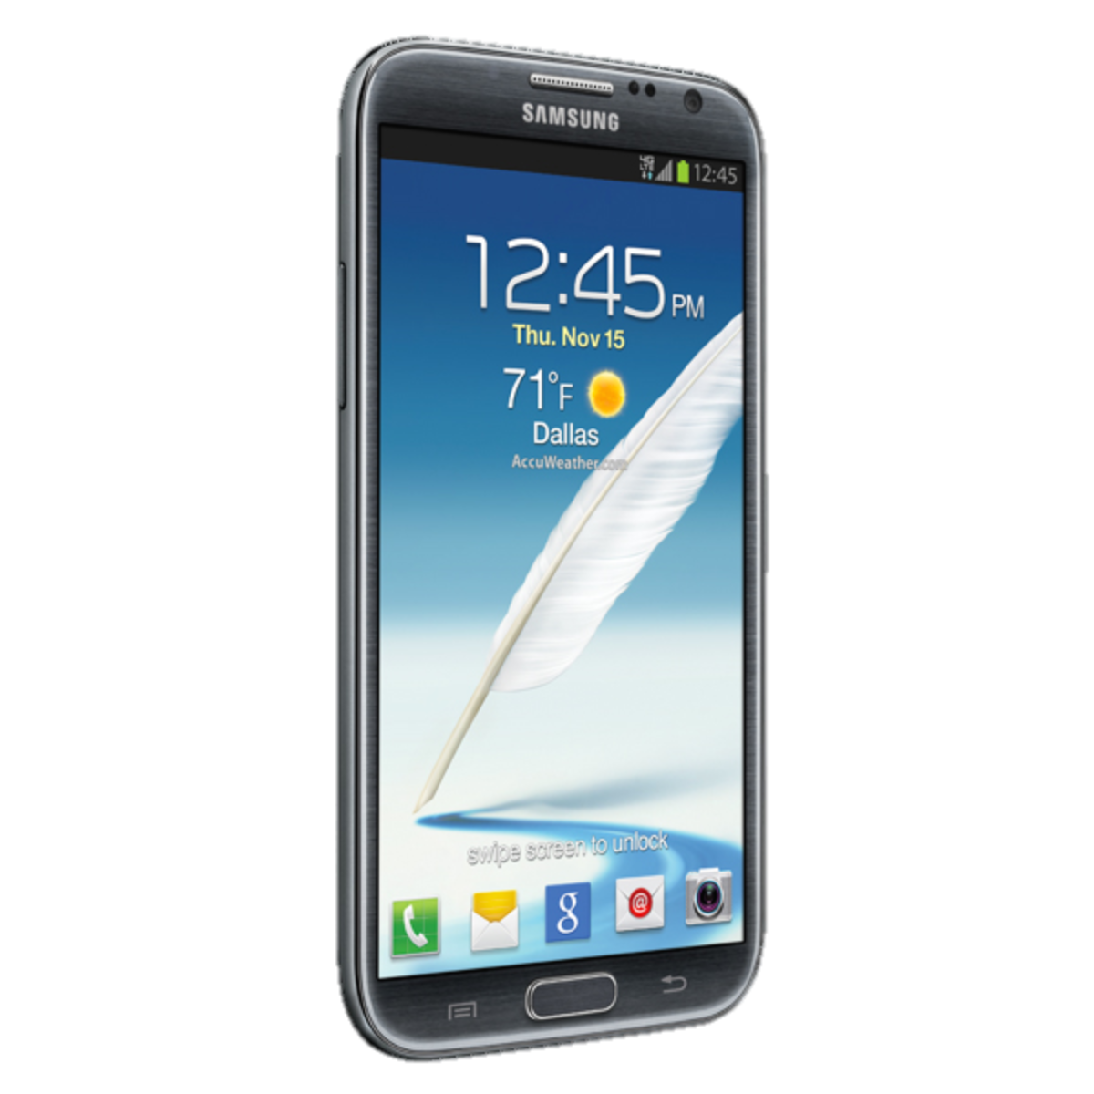
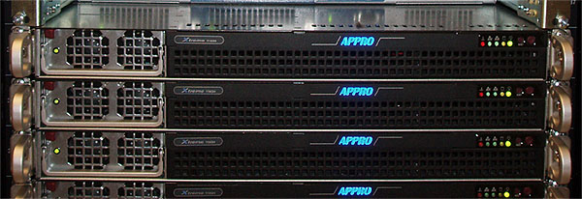
Computers became easier to use and more reliable…
2000s
1960s
Now
1980s
2000s
1960s
Now
1980s

Slide 23
Networks became harder to manage and less reliable…
Now
Now

Slide 24
Making Software Work
Specification
$10B tool business
supports a
$300B S/W industry
Functional Description (Code)
Testbench
Static Code Analysis
Invariant
Checker
Model Checking
100s of Books
>100,000 Papers
10s of Classes
Run-time Checker
Interactive Debugger

Slide 25
Making Networks Work (Today)
traceroute, ping, tcpdump, SNMP, Netflow
…. er, that’s about it.

Slide 26
Networks are kept working by
“Masters of Complexity”
A handful of books
Almost no papers
No classes

Slide 27
Complexity means networks have become too expensive to own and operate

Slide 28
Example 1: Internet Service Providers
Global IP traffic growing 40-50% per year
End-customer monthly bill remains unchanged
Therefore, cost of ownership needs to reduce 40-50% per Gb/s per year
But in practice, reduces by <20% per year
Revenue
£20/month
Total cost
Growth in traffic
time

Slide 29

Example 2: Data Center Owner
Cost
400,000 servers
20,000 switches
$5k per switch = $100M
$1k commodity switch = $20M
Savings in 10 data centers = $800M
Control
More flexible control
Tailor network as needed
Quickly improve and innovate

Slide 30
Chapter 2: Lessons from the computer industry

Slide 31
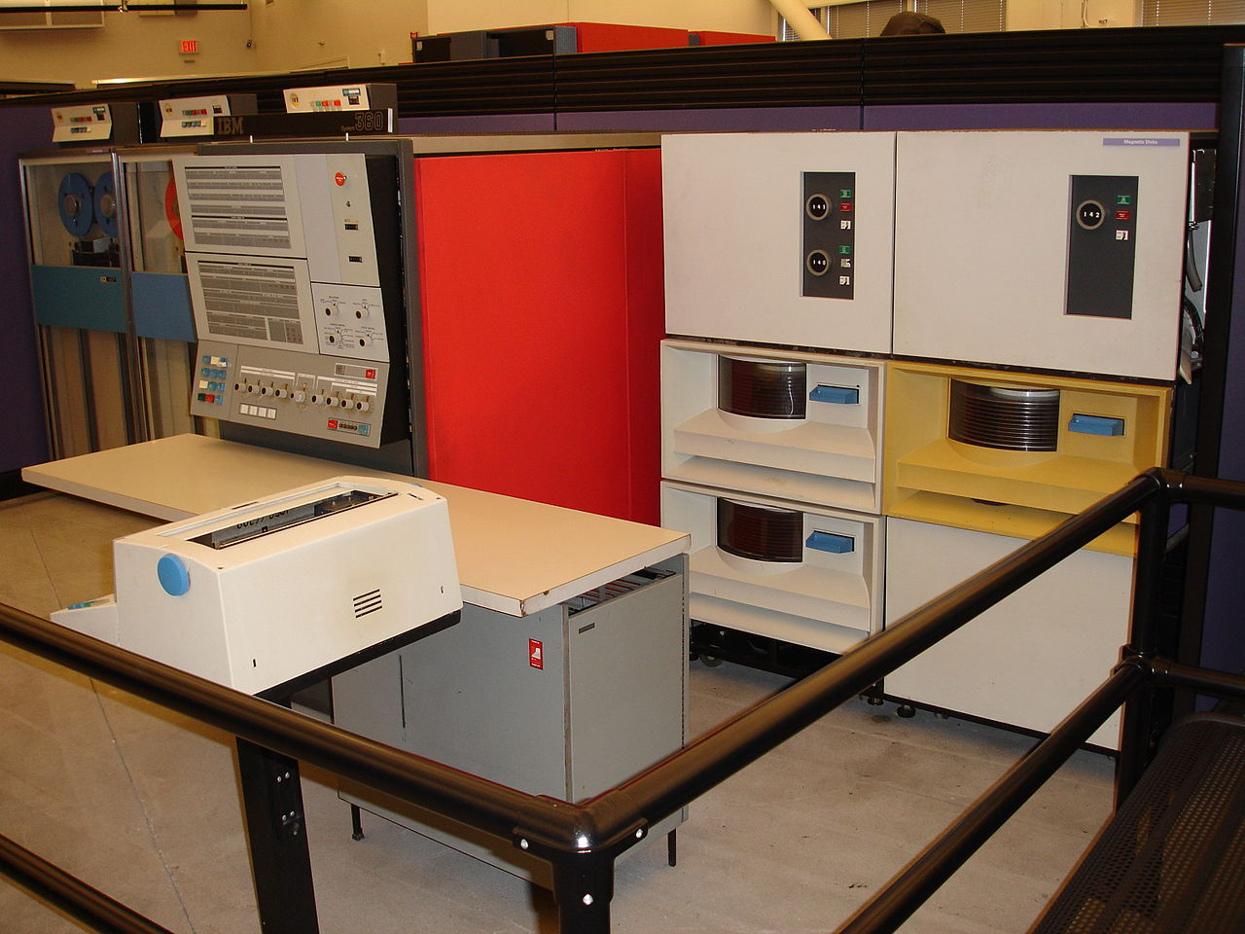
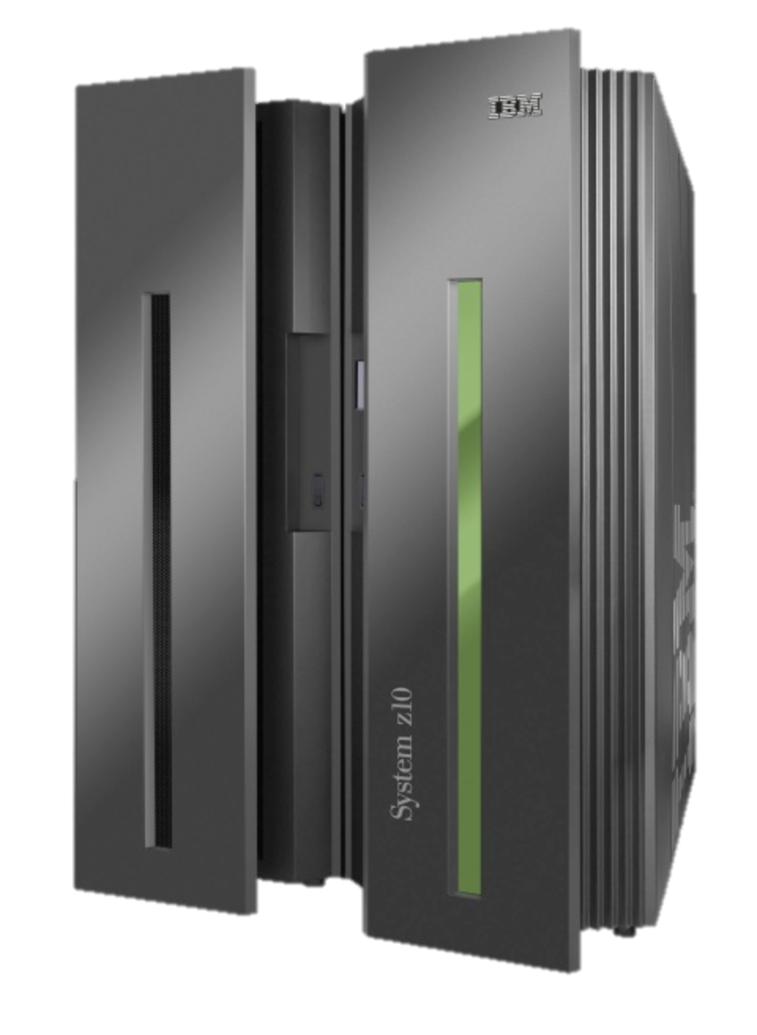
1964-1979: The mainframe computer

Slide 32
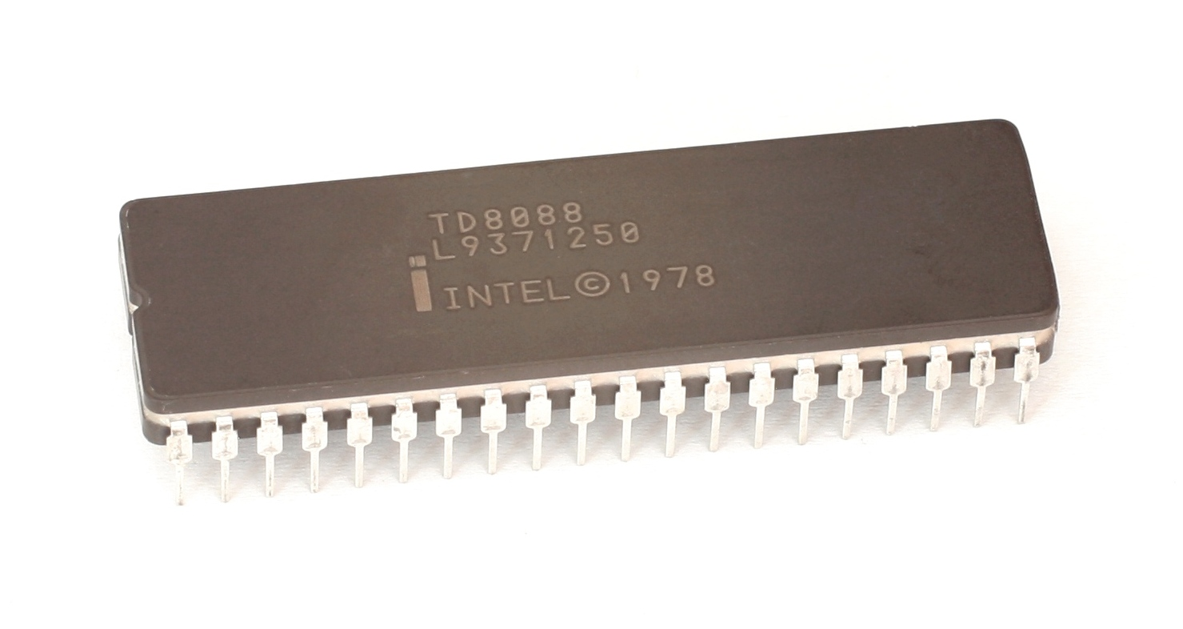
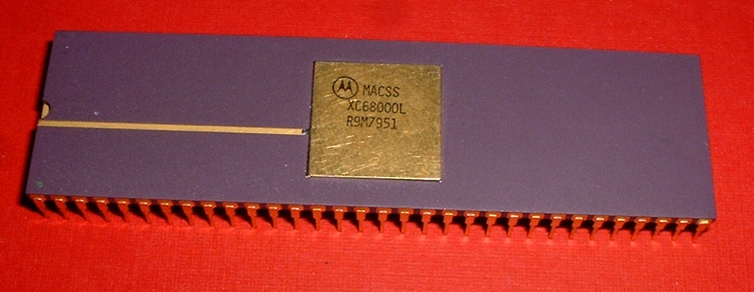
1979: The microprocessor
Intel 8088
Motorola 68000

Slide 33
1981: The personal computer
IBM PC

Slide 34
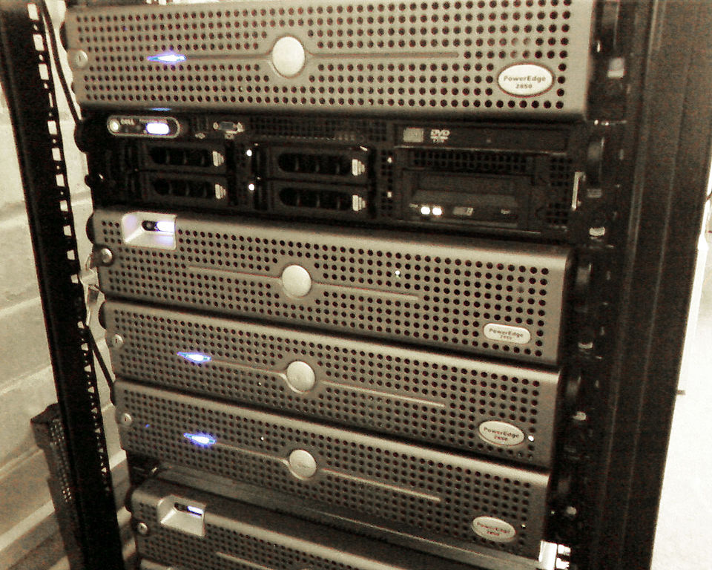
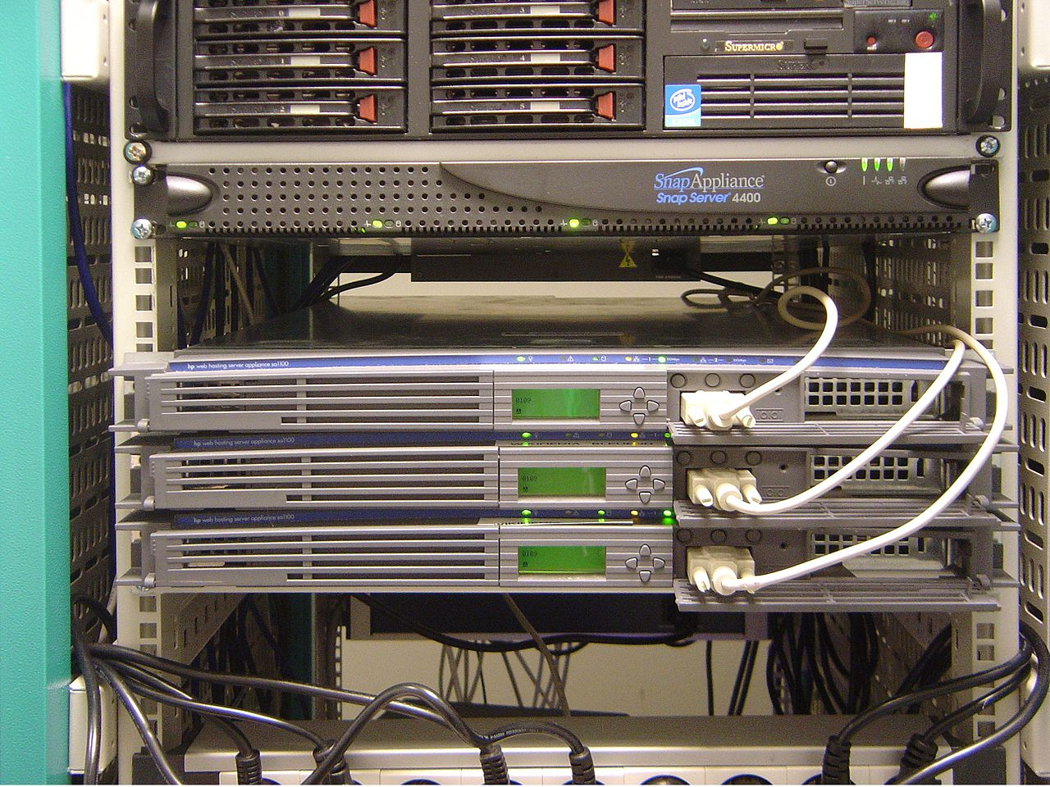
2000: Rack-mounted Servers
Dell Servers
HP Servers

Slide 35
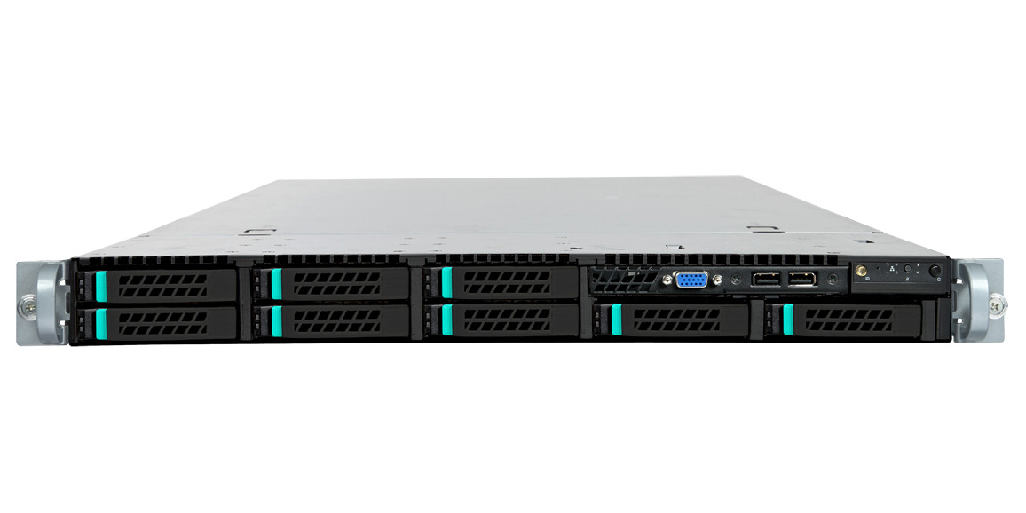
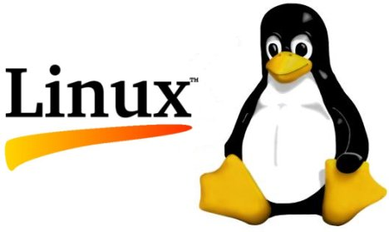
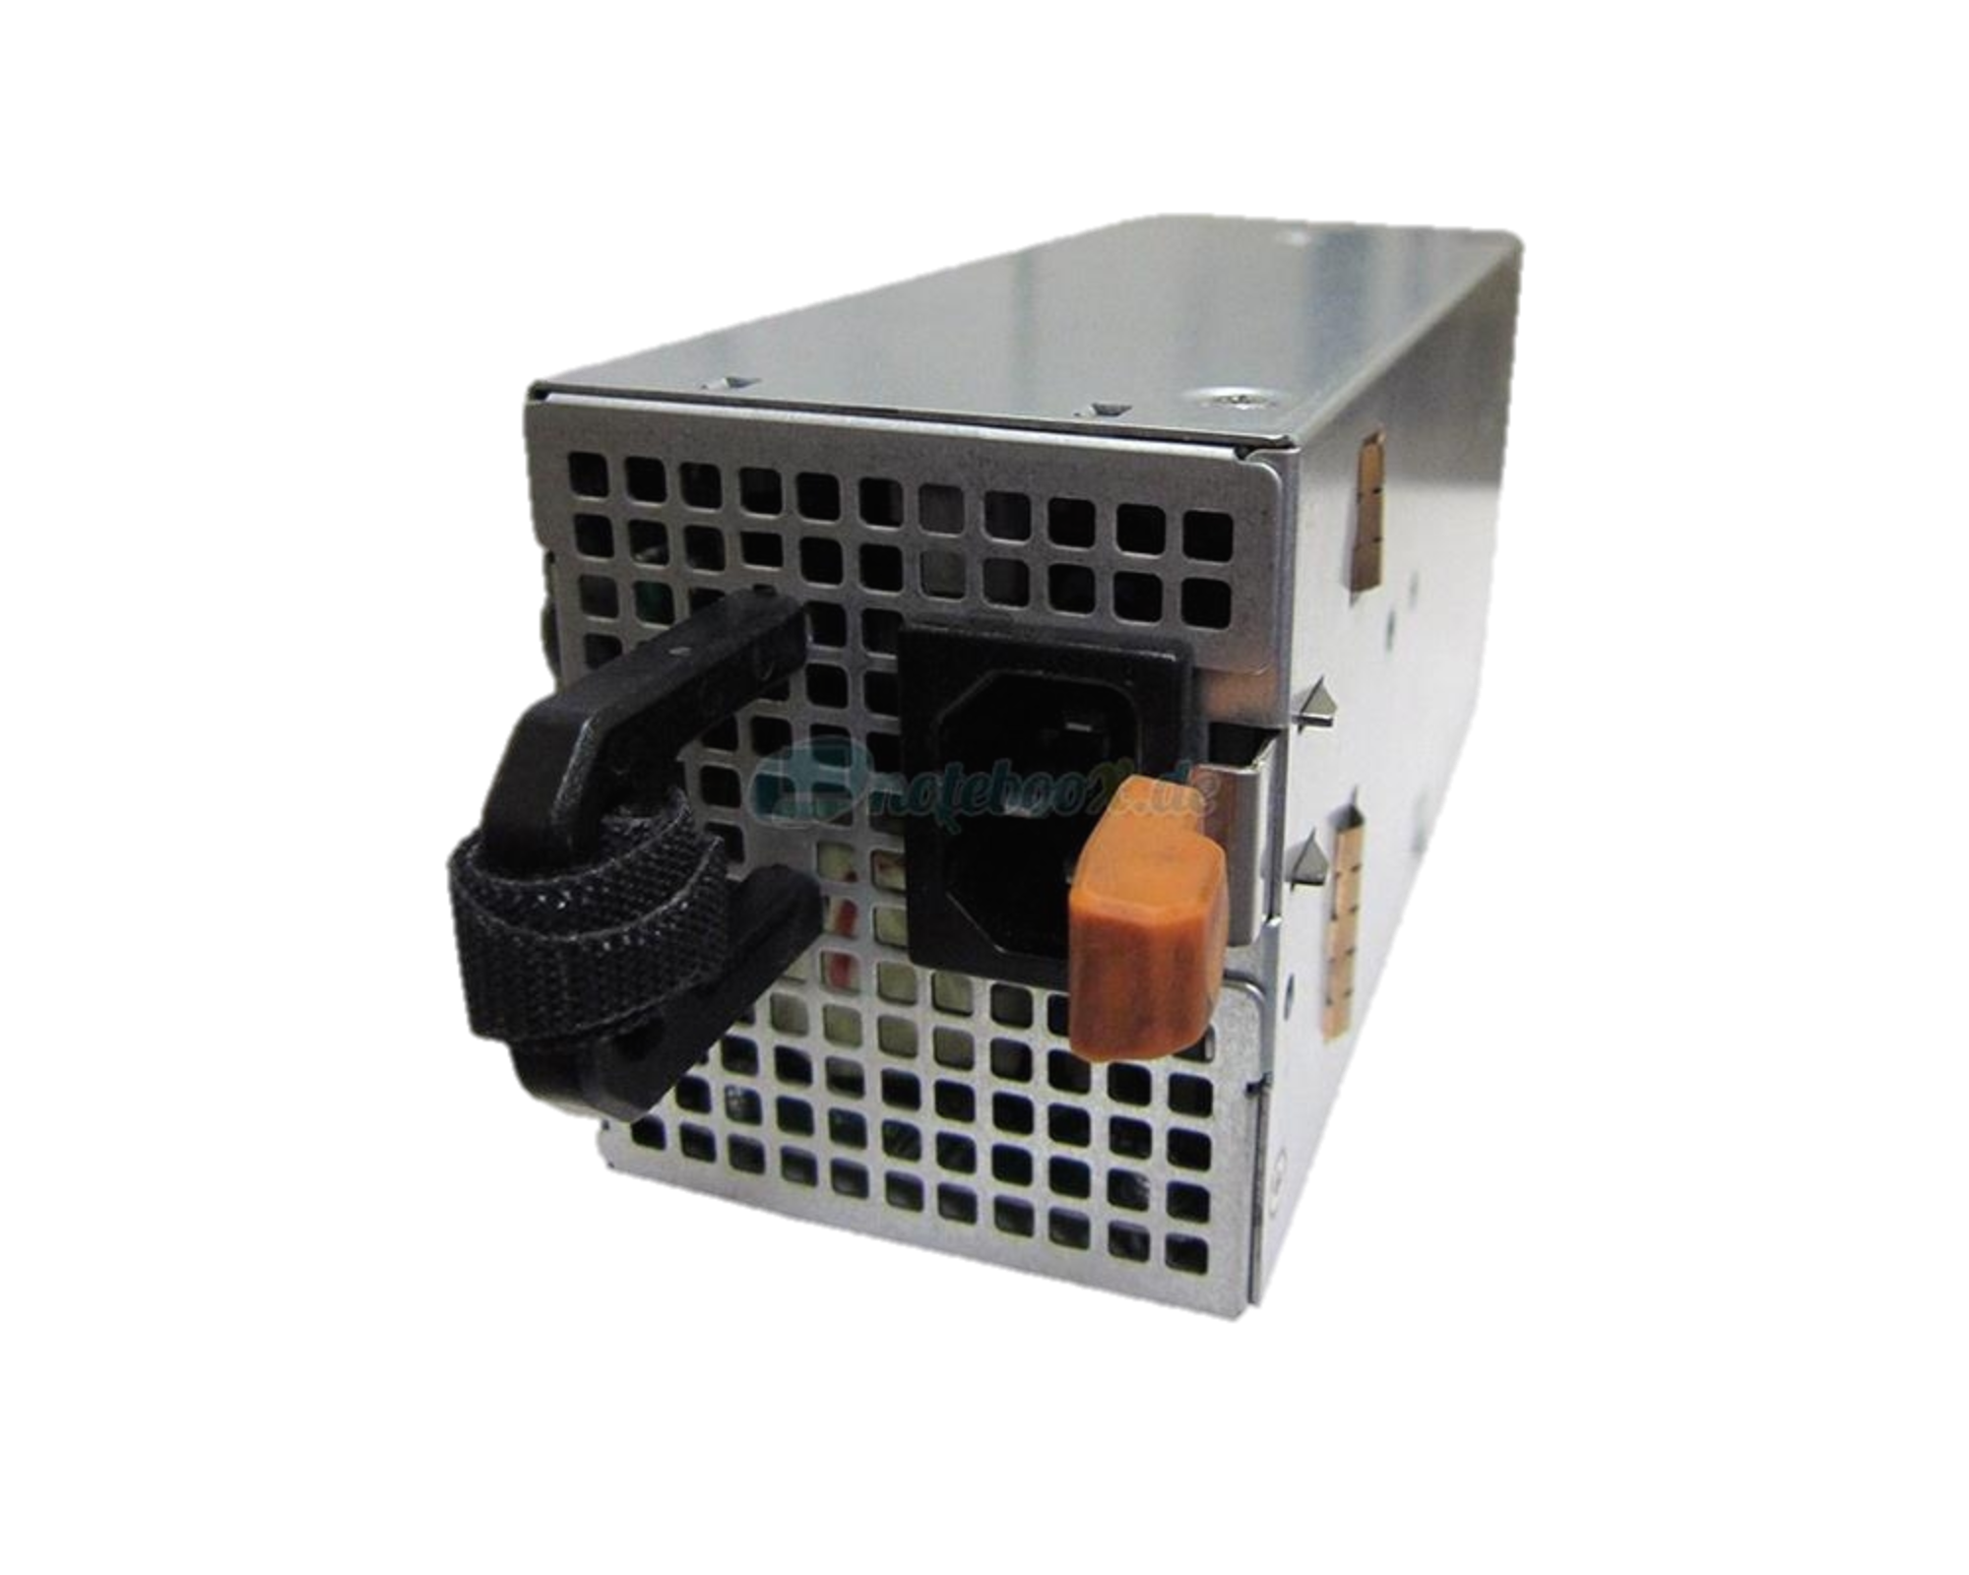
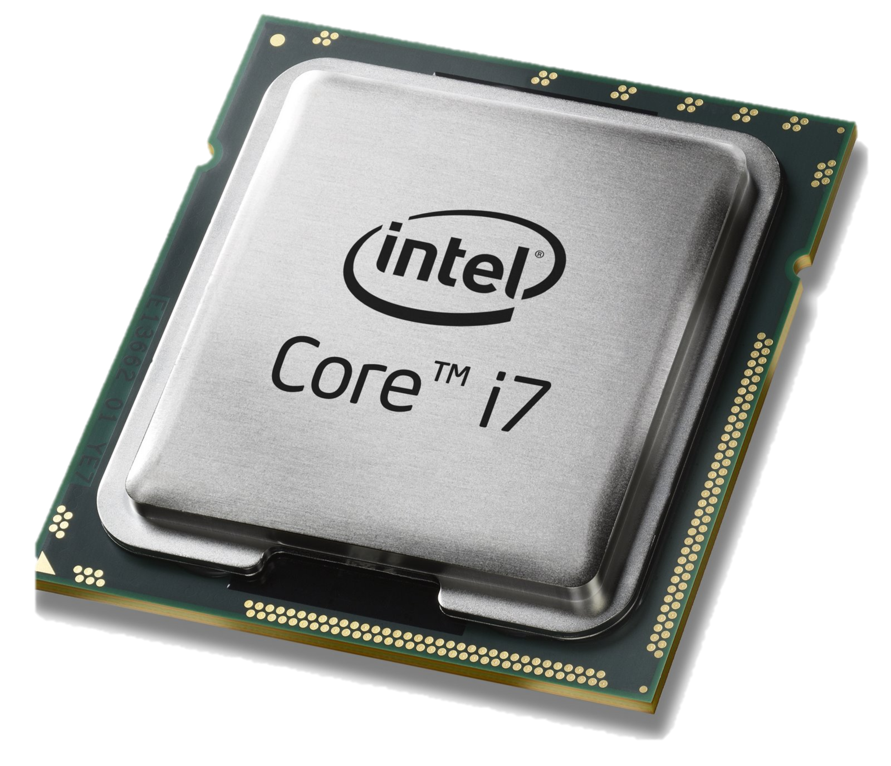
2005: The whitebox server
Sheet metal
DRAM

Slide 36
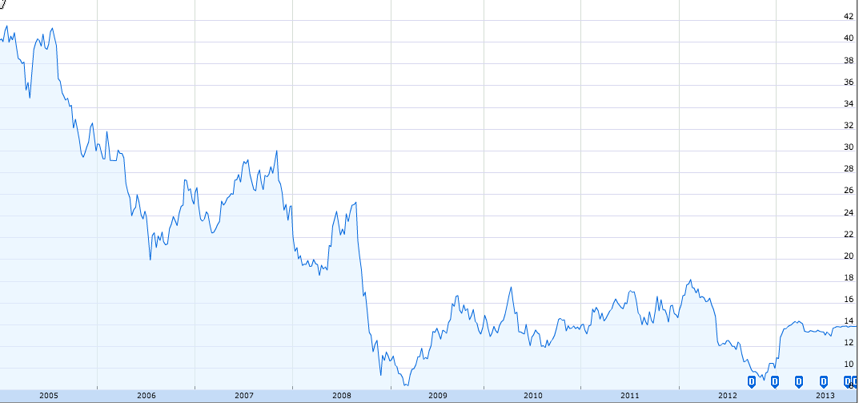
Dell Stock Price
$42
$14
2005
2013
Google Finance
Notes:
Dell stock price from google finance.

Slide 37
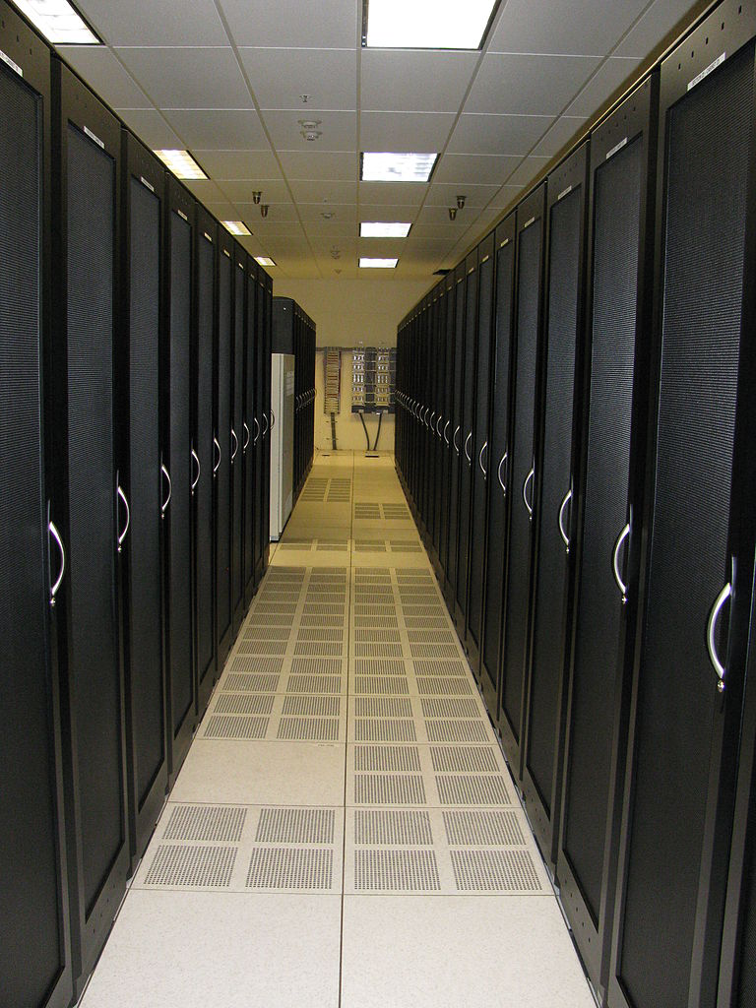

Slide 38
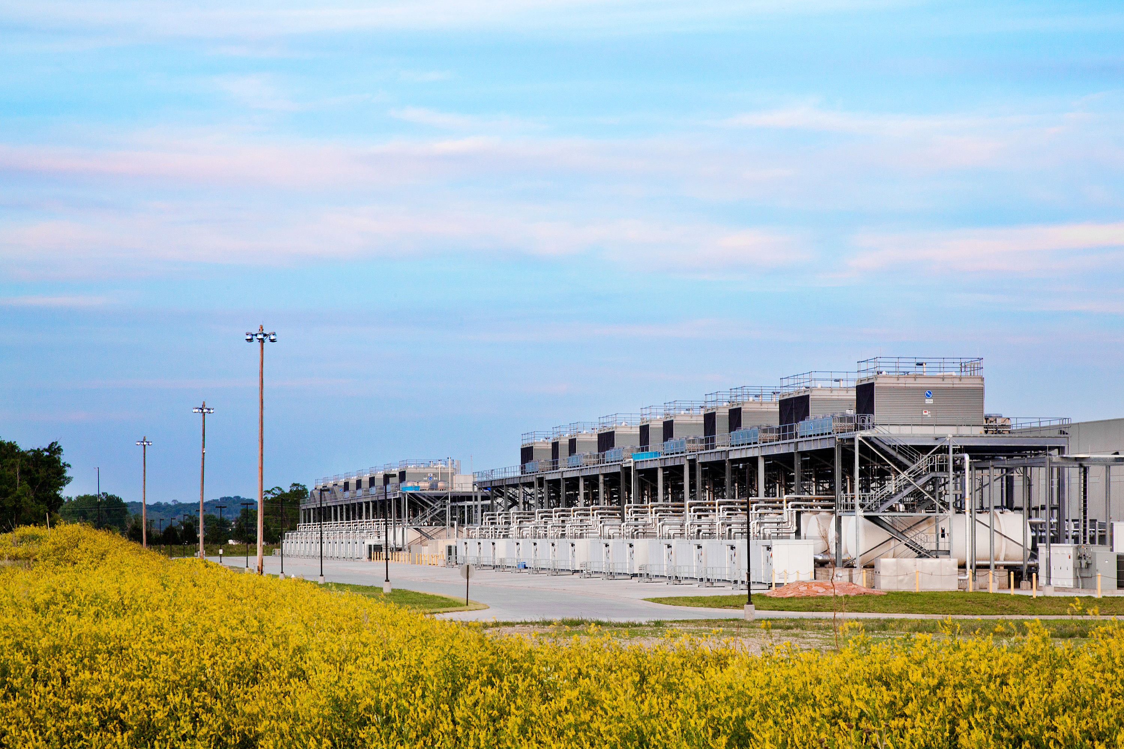

Slide 39
Computer Industry
App
App
App
App
App
App
App
App
App
App
App
Specialized
Applications
Open Interface
Specialized
Operating System
Windows
(OS)
Linux
Mac
OS
or
or
Open Interface
Specialized
Hardware
Microprocessor

Slide 40
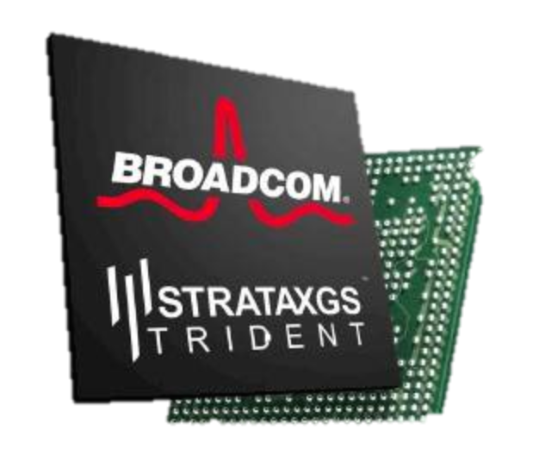
Networking Industry
App
App
App
App
App
App
App
App
App
App
App
Specialized
Features
Open Interface
NOX
Beacon
ONIX
POX
ONOS
Flood
light
Trema
ODL
Ryu
Control
Plane 1
Control
Plane 2
Specialized
Operating System
Open Interface
Switch Chips
Specialized
Hardware

Slide 41
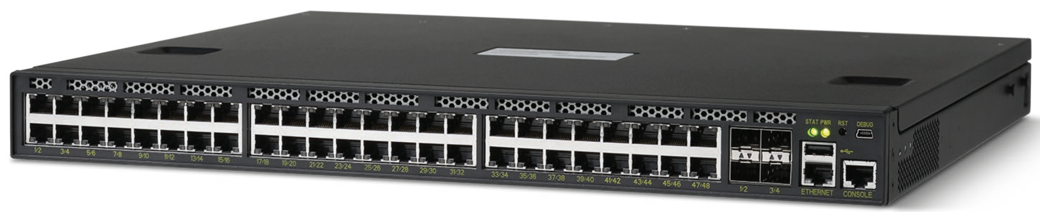
2010: The whitebox switch
Sheet metal
DRAM

Slide 42
Software
Software
Hardware
Software
Hardware
Software
Hardware
Hardware

Slide 43
Forwarding Plane
Software
Software
Hardware
Software
Hardware
Software
Hardware
Hardware

Slide 44
Control Plane
Software
Software
Hardware
Software
Hardware
Software
Hardware
Hardware

Slide 45
Software Control Plane
Software
Software
Hardware
Data
B
Software
Hardware
Software
Hardware
B
Hardware

Slide 46
Software Defined Network
A network in which the control plane is
physically separate from the forwarding plane.
and
A single control plane controls
several forwarding devices.
(That’s it)

Slide 47
Software Control Plane
SDN:
Forwarding
Forwarding
Forwarding
Forwarding
Immediate consequences...
Puts network owners and operators in control of their destiny.
Networks are more reliable and more secure.
Networks cost less: hardware is simple and streamlined again.
Networks cost less to operate: customized.

Slide 48
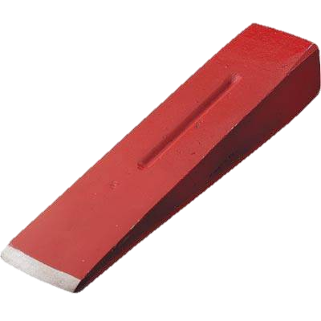
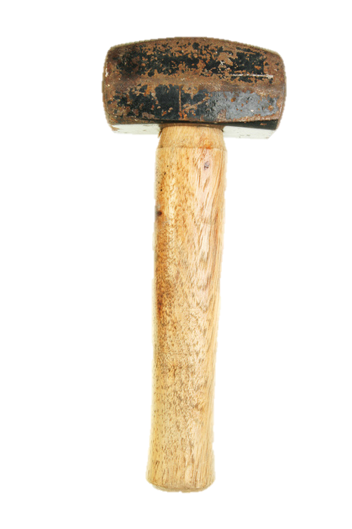
OpenFlow specification
Startup company (Nicira)
200 universities
Open Networking Foundation (ONF)
Control Program
Global Network Map
Network Operating System
Software
Very simple hardware
OpenFlow
Forwarding
Forwarding
Forwarding
Forwarding

Slide 49
Chapter 3: The technical rationale for SDN

Slide 50
What routers do
Route packets to the correct destination

Slide 51
B
A

Slide 53
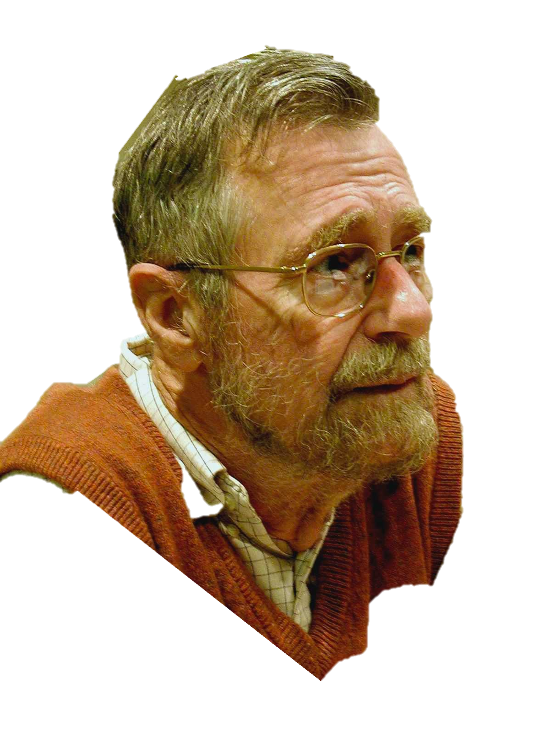
function Dijkstra(Graph, source):
for each vertex v in Graph:
dist[v] := infinity ;
previous[v] := undefined;
dist[source] := 0 ;
Q := the set of all nodes in Graph ;
while Q is not empty: // The main loop
u := vertex in Q with smallest distance in dist[] ;
remove u from Q ;
if dist[u] = infinity:
break ;
for each neighbor v of u:
alt := dist[u] + dist_between(u, v) ;
if alt < dist[v]:
dist[v] := alt ;
previous[v] := u ;
decrease-key v in Q;
return dist[], previous[];
end function
Edsger Dikjstra
1930-2002
Photo: Hamilton Richards

Slide 54
A
B
The Opte Project

Slide 55
Software
Software
Hardware
Software
Hardware
Software
Hardware
Hardware

Slide 56
Figure out which routers and links are present.
Run Dijkstra’s algorithm to find shortest paths.
B
“If a packet is going to B,
then send it to output 3”
Software
Software
Hardware
Data
B
2
Software
1
Hardware
B
“If , send to 3”
Hardware
B
Software
3
Hardware

Slide 57
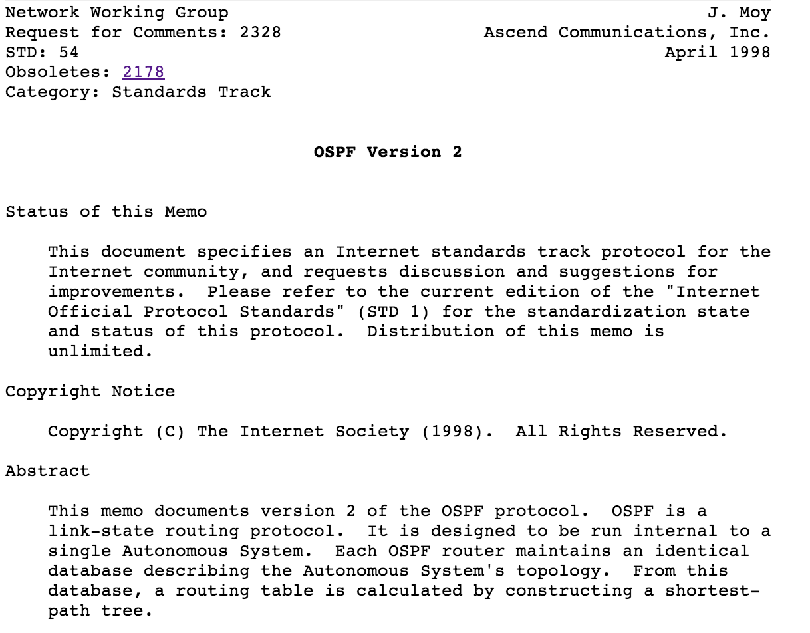
95%
Figure out which routers and links are present.
Run Dijkstra’s algorithm to find shortest paths.
5%
Software
Software
Hardware
2
Software
1
Hardware
B
“If , send to 3”
Hardware
B
Software
3
Hardware

Slide 58
95%
Figure out which routers and links are present.
Run Dijkstra’s algorithm to find shortest paths.
5%
50,000 lines of code
50,000 lines of code
Software
Software
50,000 lines of code
Hardware
Software
Hardware
Software
Hardware
Hardware
Building a reliable distributed system is really hard!

Slide 59
Dijkstra
IS-IS
BGP
MPLS
Firewall…
Global Network Map
Network OS
Forwarding
Forwarding
Forwarding
Forwarding

Slide 60
Chapter 4: How is SDN being used?

Slide 61
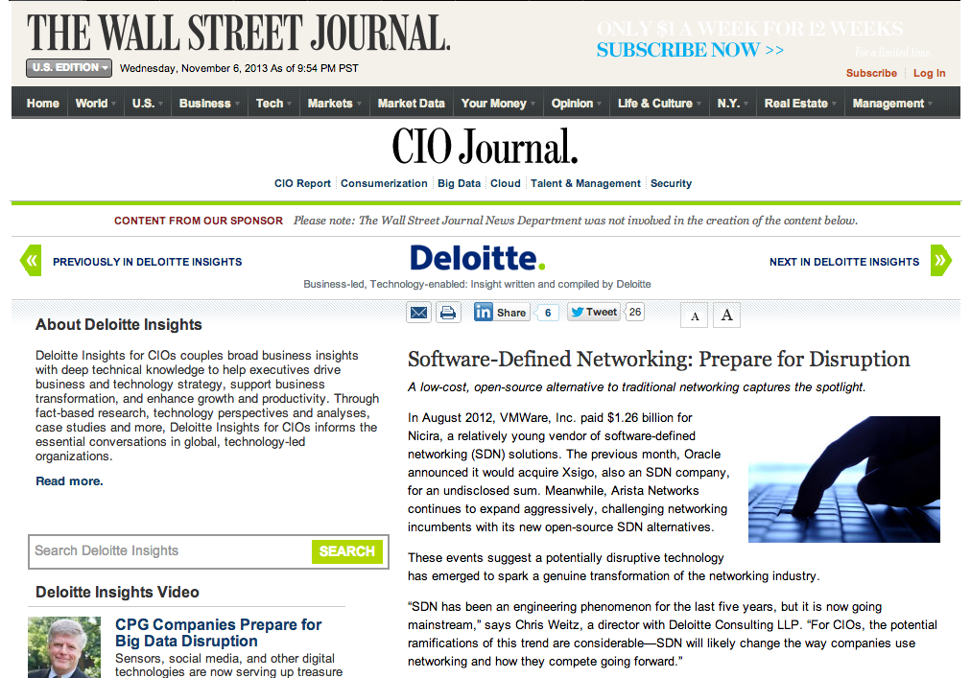
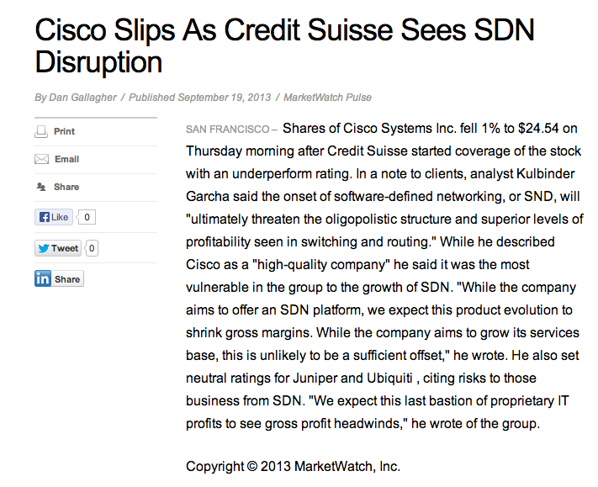
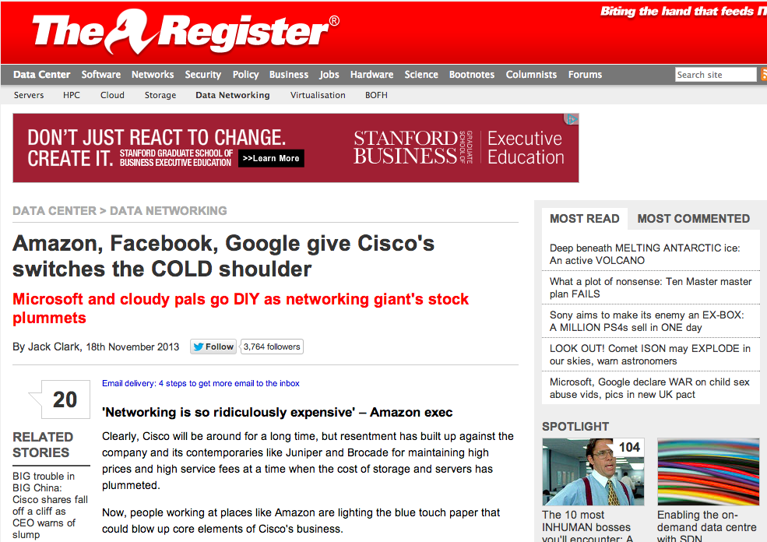

Slide 62
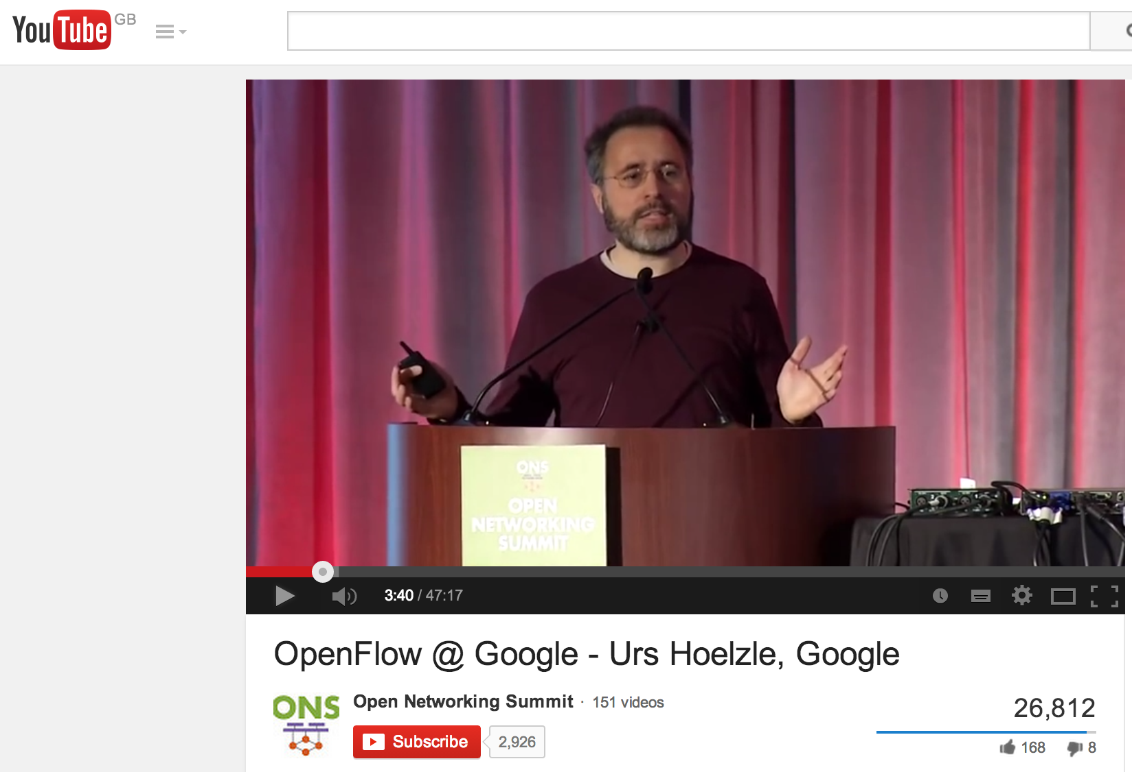
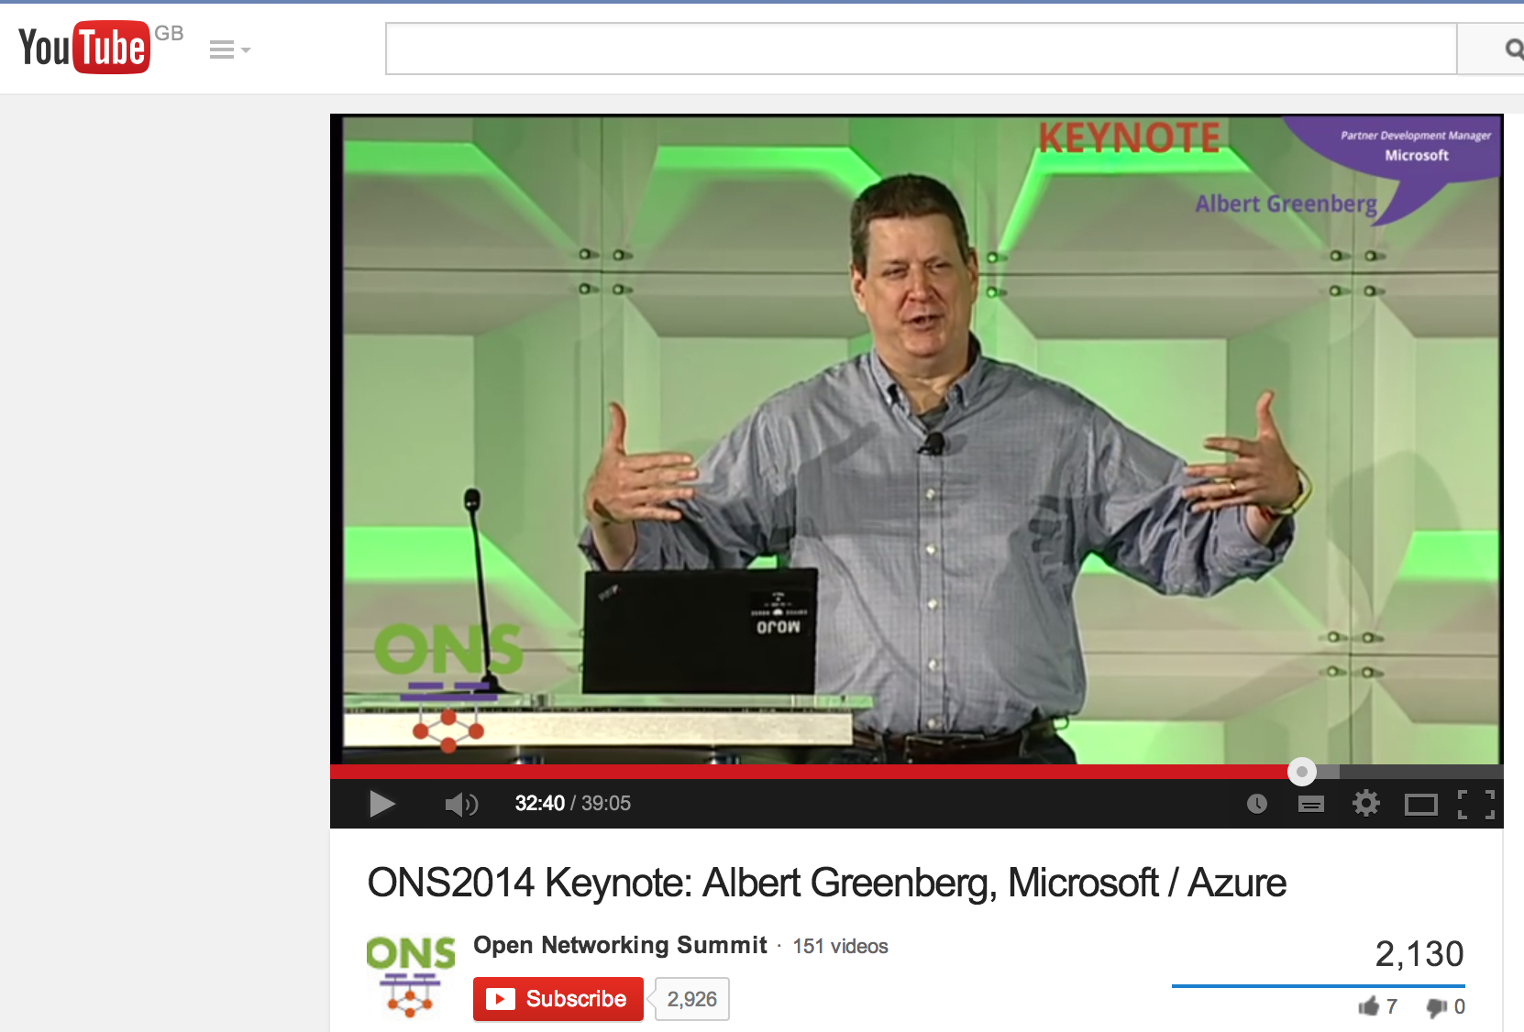
Today’s deployments
Inter data center networks
Intra data center networks
Google
Microsoft

Slide 63
Upcoming deployments
Public service provider networks (AT&T, NTT, China Telecom, DT, BT, …)
Enterprise and campus networks
WiFi networks
Cellular networks
Home networks

Slide 64
Researchers can now try out new
ideas in the Internet, at scale

Slide 65
Problem
  Many good research ideas
  on college campuses…
  No way to test new ideas at scale, on real networks, with real user traffic
  Consequence: Almost no
  technology transfer
With SDN, this is changing very rapidly...

Slide 66
Research Example #1
Load-balancing as a network primitive
Nikhil Handigol, Mario Flajslik, Srini Seetharaman

Slide 67











Slide 68
Experiment
Nationwide experiment:
500 lines of code
Global Network Map
Network OS
Forwarding
Forwarding
Forwarding
Forwarding

Slide 69
Research Example #2
Using all the
wireless capacity around us
KK Yap, Masayoshi Kobayashi, Yiannis Yiakoumis, TY Huang

Slide 70


Slide 71
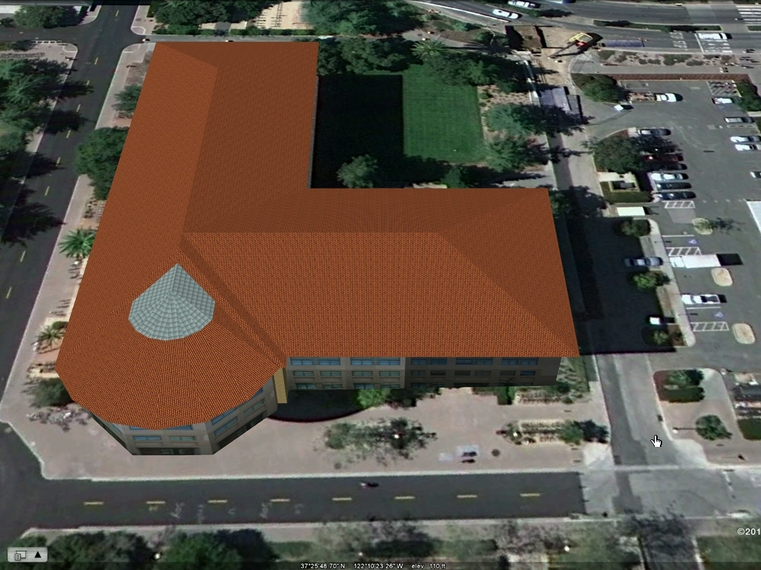
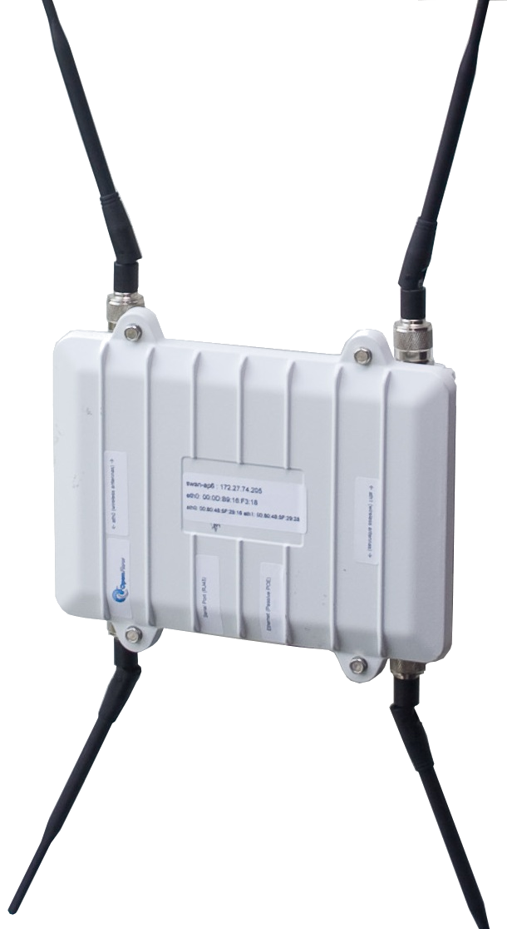
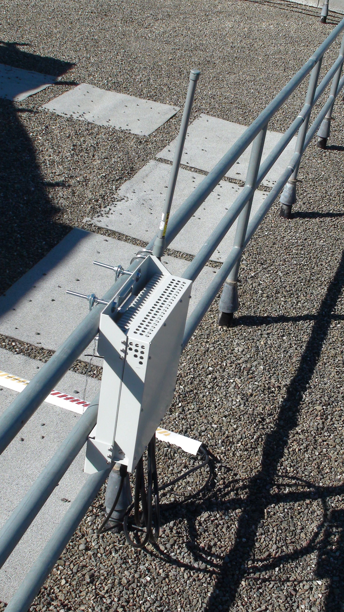
KK’s Experiment
<250 lines of code
Network OS
WiMax

Slide 72
More videos openflow.org/videos

Slide 73
Chapter 5: What’s next?

Slide 74
What’s next?
Networks will be virtualized.
Network behavior will be provably correct.
Software defined networks will run on programmable hardware.

Slide 75
What’s next?
Networks will be virtualized.
Network behavior will be provably correct.
Software defined networks will run on programmable hardware.

Slide 76
Control
Control
Forwarding
Data
B
2
Control
1
Hardware
B
“If , send to 3”
Forwarding
B
Control
3
Forwarding
All the rules are in the Forwarding Plane – possibly millions.
How did the rules get there?

Slide 77
Software
Software
Hardware
Software
Hardware
Software
Hardware
Hardware
Conventionally: Lots of features and protocols populate the tables.
Forwarding rules neither observable or controllable.

Slide 78
Well-defined roles and abstractions means we can mathematically prove correctness across boundaries.
Control Program
Global Network Map
Network Operating System
B
“If , send to 3”
Forwarding
Forwarding
Forwarding
Forwarding

Slide 79
What’s next?
Networks will be virtualized.
Networks will be more reliable.
Software defined networks need to run on programmable hardware.

Slide 80
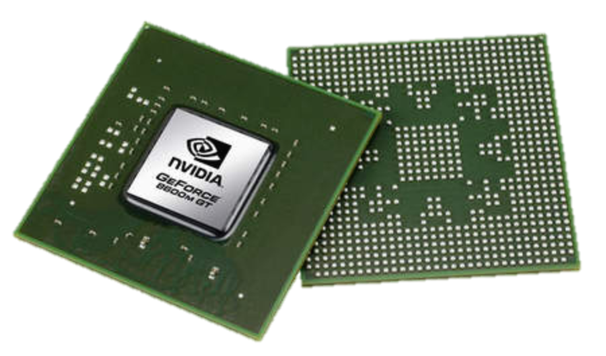
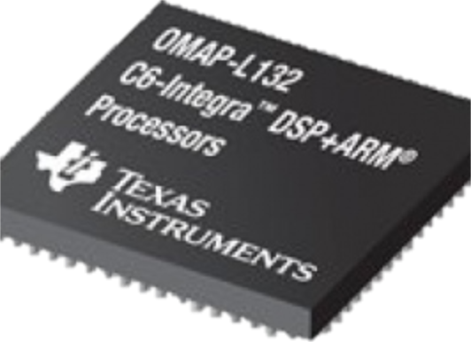
Software Defined Everything
Cellular
Base Stations
Computers
Graphics
Software
Software
Software
CPU
GPU
DSP

Slide 81
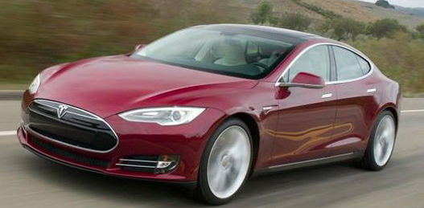
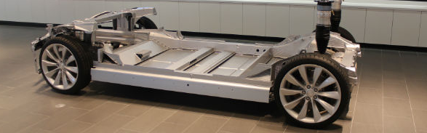
Software Defined Everything
Self-driving car
Software

Slide 82
Software Defined Everything
Cellular
Base Stations
Networks
Computers
Graphics
Software
Software
Software
Software
?
CPU
GPU
DSP
“TBD”

Slide 83
Summary
Well-functioning plumbing should be invisible.
The Internet plumbing became too complex to be invisible.
SDN:
Is inevitable – for business and technical reasons
Will make networks cheaper
Will place control in the hands of network owners and operators
Networks will be come more reliable and more secure
…and invisible.

Slide 84
Q: Why SDN?
“Because there is no army that can hold back an economic principle whose time has come.”
– John Donovan, AT&T

