Slide 1

Programmable forwarding planes are here to stay
Nick McKeown
Stanford University

Slide 2
SDN
Act 1
In which network owners take
charge of their control plane

Slide 3
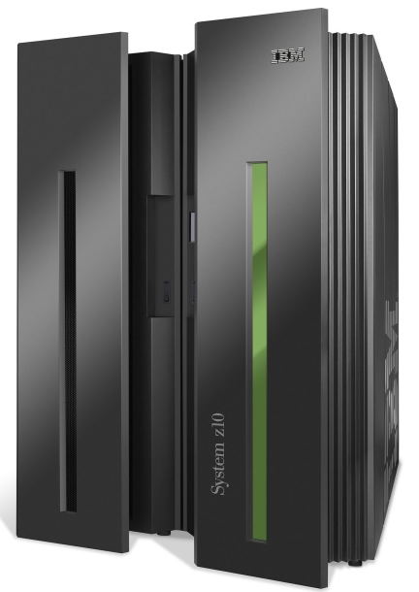
Computer Industry
App
App
App
App
App
App
App
App
App
App
App
Proprietary
Applications
Open Interface
Proprietary
Operating System
Windows
(OS)
Linux
Mac
OS
or
or
Disaggregation
Open Interface
Proprietary
Hardware
Microprocessor

Slide 4
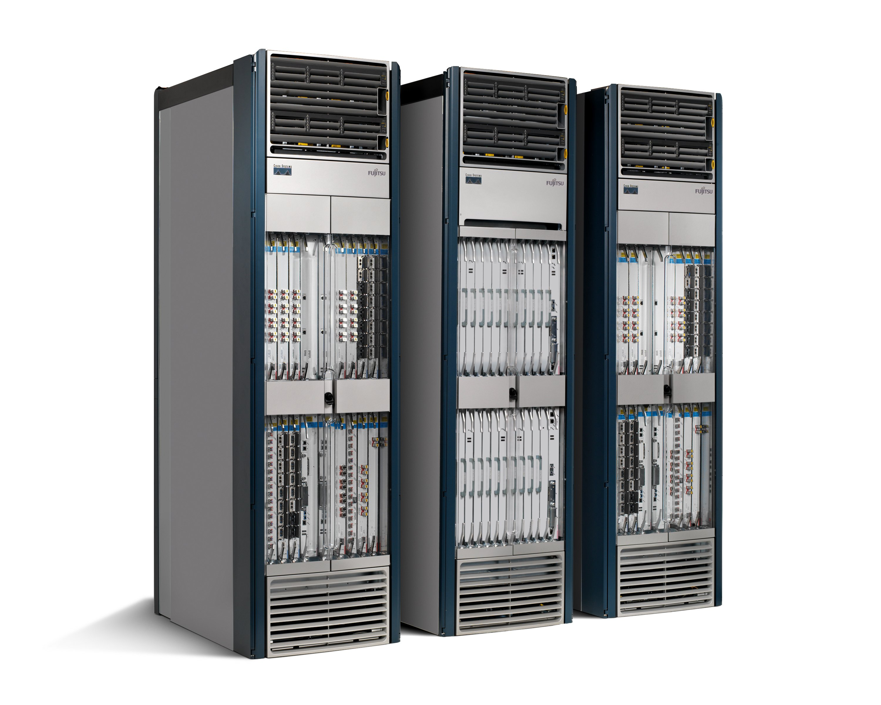
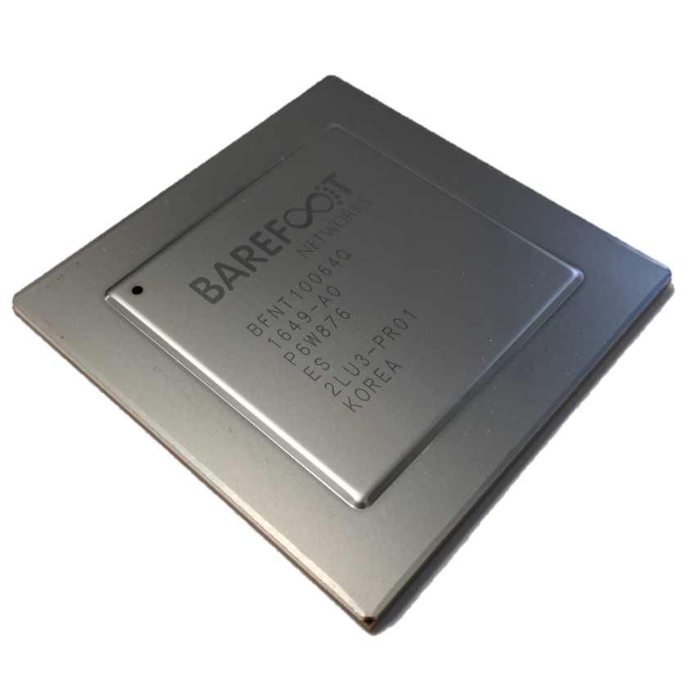
Networking Industry
App
App
App
App
App
App
App
App
App
App
App
Proprietary
Features
Open Interface
NOX
Beacon
ONIX
POX
ONOS
Flood
light
Trema
ODL
Ryu
Control
Plane 1
Control
Plane 2
Proprietary
Operating System
Disaggregation
Open Interface
Merchant
Switch Chips
Proprietary
Hardware

Slide 5
SDN inevitable because…
Rise of Linux.
Rise of whitebox servers and data centers.
Rise of merchant switching silicon.

Slide 6
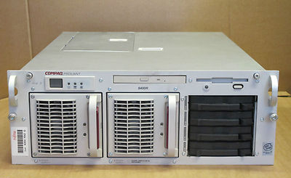

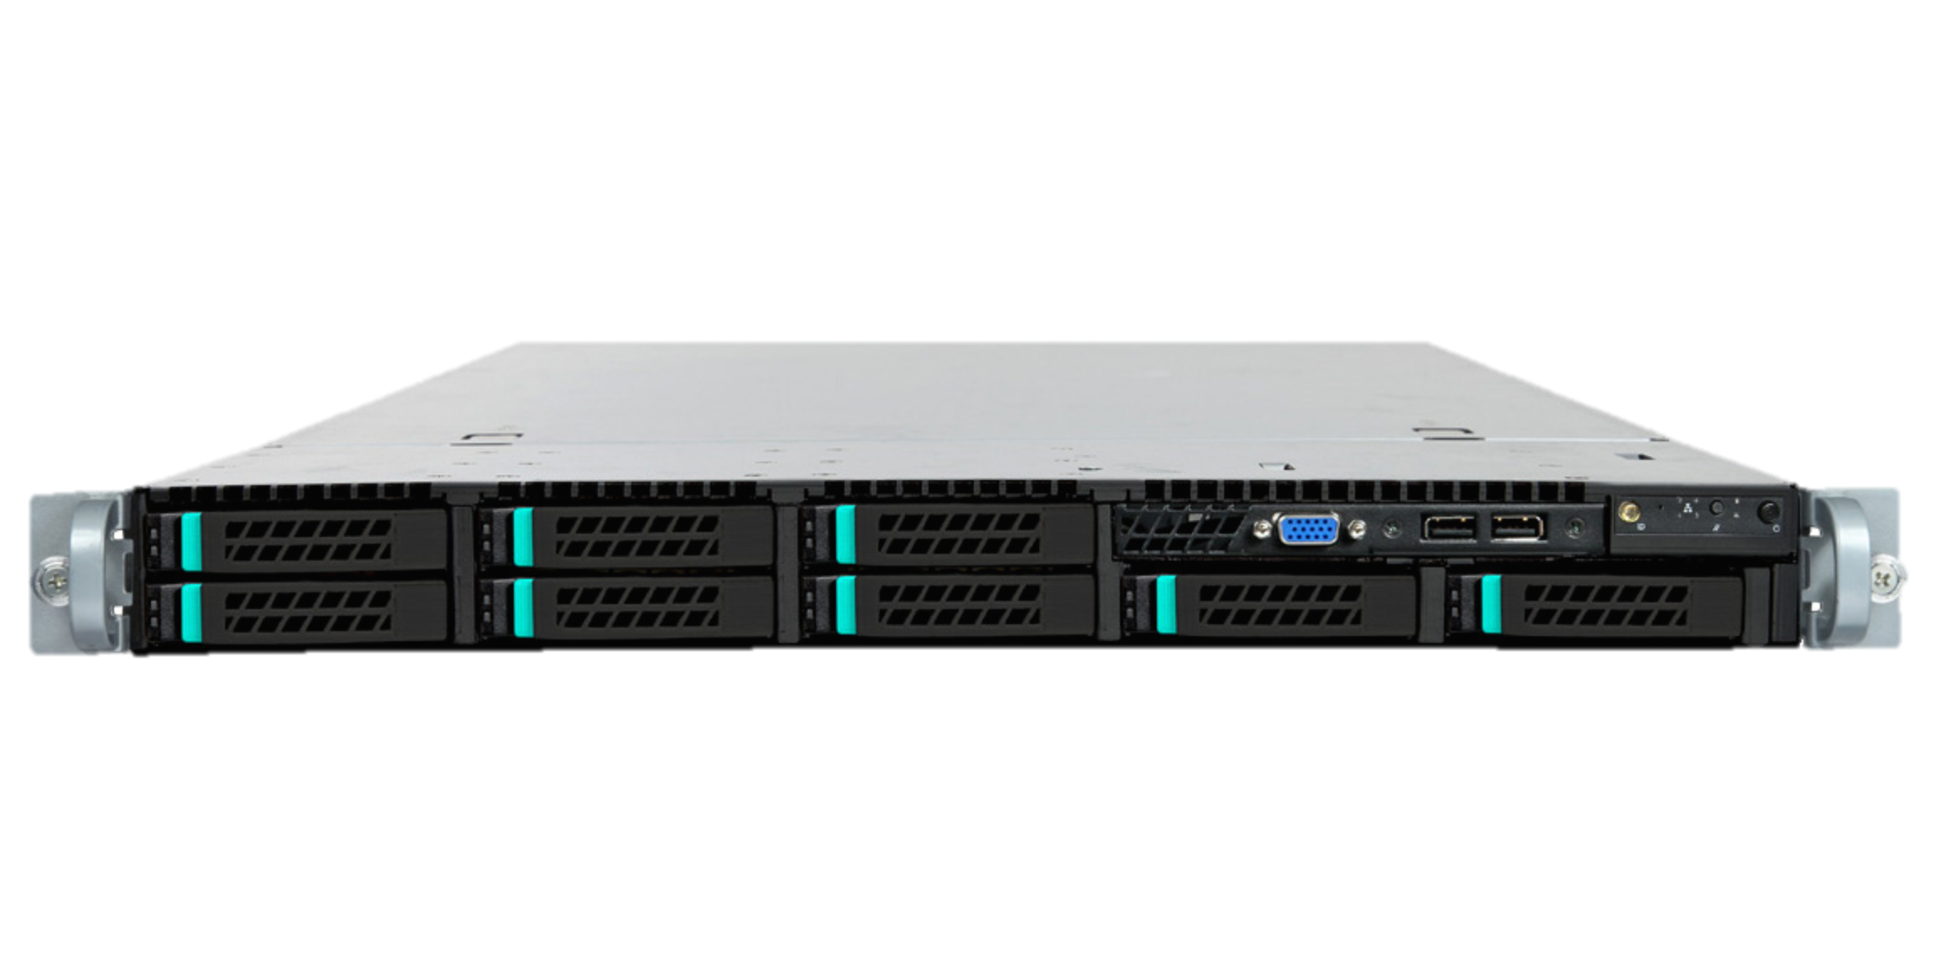
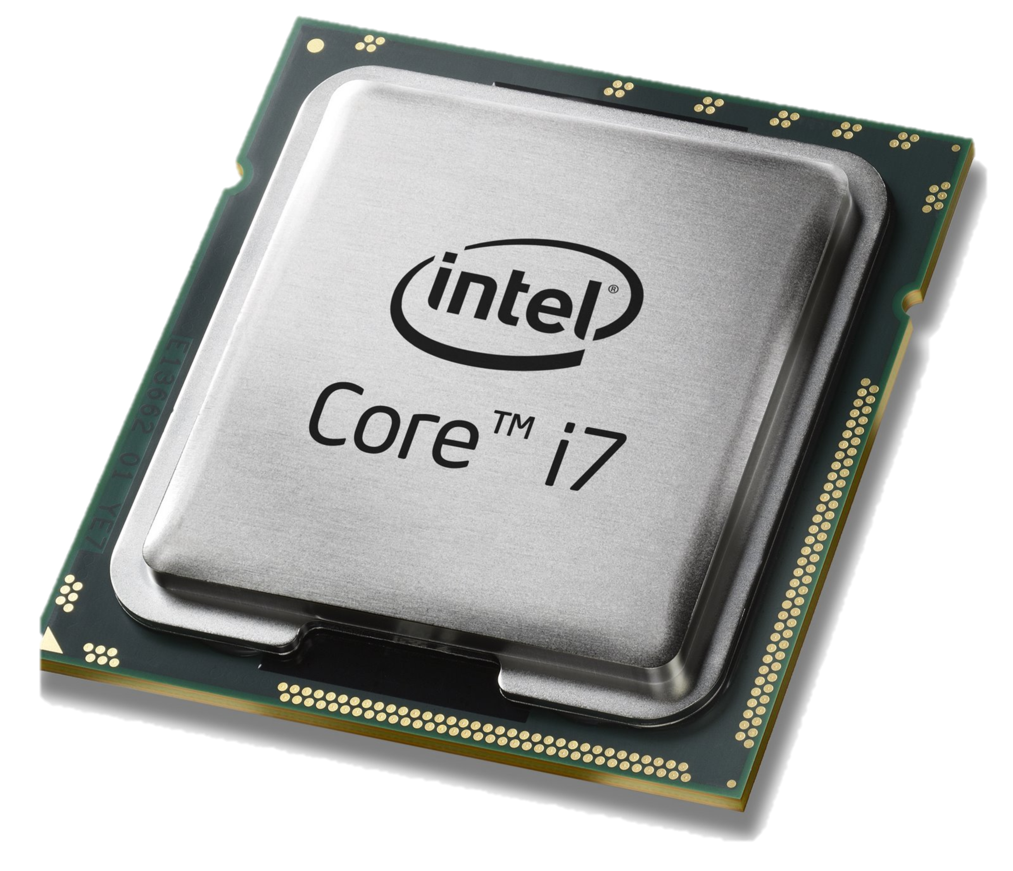
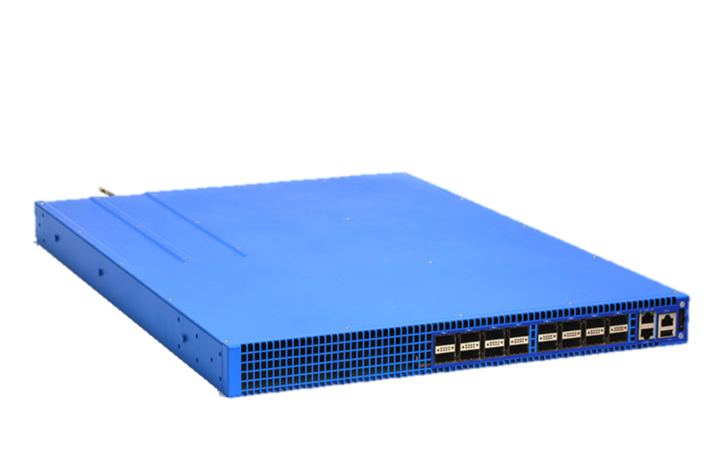
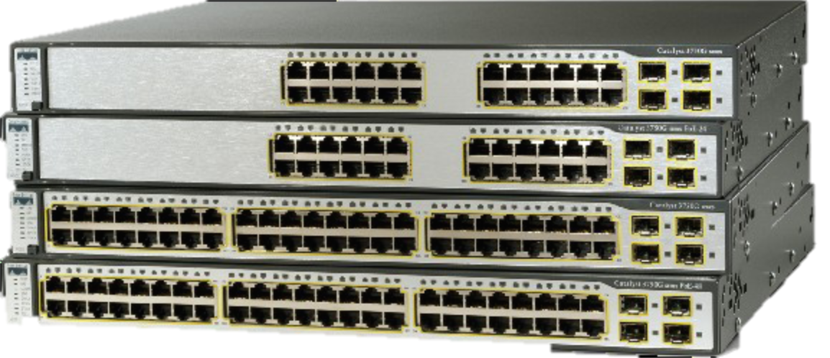
Servers
Applications
Applications
Linux
OS
CPU
x86
Legacy
Whitebox
Network switches
Control Programs
Applications
Linux
OS
CPU + ASIC
x86 + ASIC
Legacy
Whitebox

Slide 7

Example: Big Data Center
Cost
500,000 servers
25,000 switches
$10k per legacy switch = $250M
$2k disaggregated switch = $50M
Savings in 5 data centers = $1Bn
Control
Centralized remote control is easier
“Centralize if you can, distribute if you can’t”
Customized, differentiated network
Home grown traffic engineering
50% utilization → 95% utilization

Slide 8
All networking equipment is disaggregating
Basestation
5G GW
Optical and Metro Transport
WiFi AP
Residential broadband access
Enterprise network equipment: switch, router, firewall
“Software is eating the world (of networking)”

Slide 9
Android/Linux
3/4 new smartphones
2/3 servers
2/3 websites
2/3 mainframes
99% supercomputers
IBM, Compaq, Dell run Linux
Google incorporated
1st MSDC with
switch chip + Linux
# Virtual Ethernet ports
> # Physical ports
Linux v1
v2
1st WAN with
Switch chip + Linux
dNOSS
OVN
ONAP
NEC
+
HP
Stratum
OCP
Server
OCP
Switch
OCP
Wedge
SONiC
P4
Runtime
OVS
HP
Open
Switch
ONIE
ONL
ODL
ONOS
Rise of Merchant Switch Chips
FBOSS
OpenNFV
CORD
1994
1996
1998
2008
2010
2011
2012
2013
2015
2016
2017/8

Slide 10
Now I can tailor my network to meet my needs!
I can….
Quickly deploy new protocols.
Monitor precisely what my forwarding plane is doing.
Fold expensive middlebox functions into the network, for free.
Try out beautiful new ideas. Tailor my network to meet my needs.
Differentiate. Now I own my intellectual property.

Slide 11
But wait a minute…

Slide 12
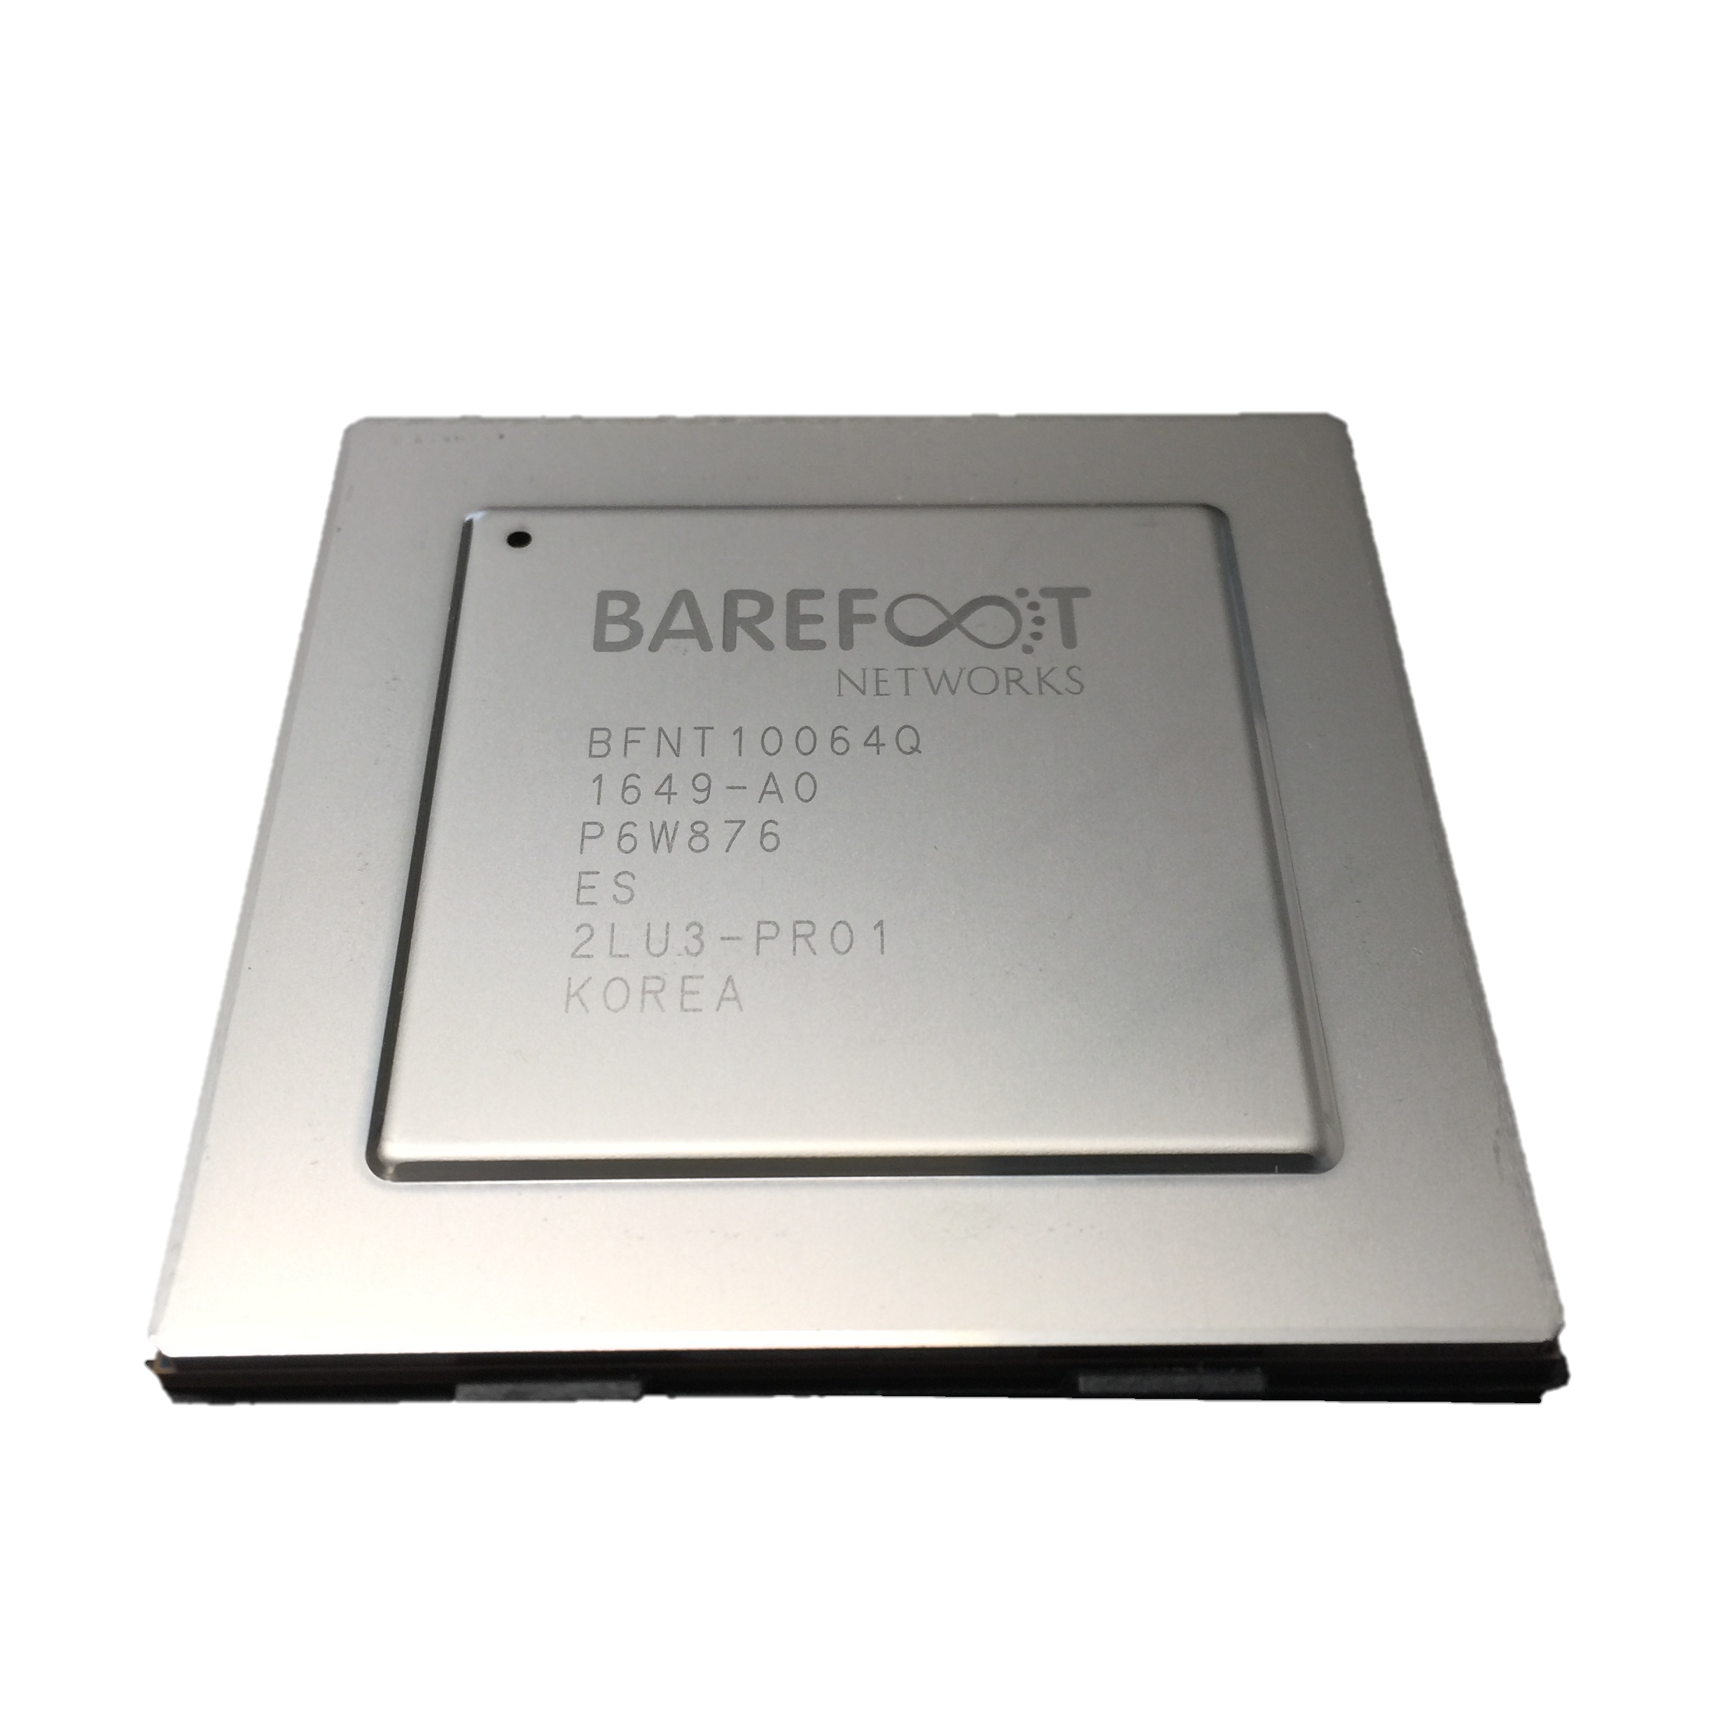
OSPF
BGP
New
etc.
Switch OS
Driver

Slide 13

Feature
Software
Team
Feature
Network Owner
Network Equipment Vendor
Weeks
Feature
ASIC
Team
Years
Years

Slide 14
When you need a new feature…
Equipment vendor can’t just send you a software upgrade
New forwarding features take years to develop
By then, you’ve figured out a kludge to work around it
Your network gets more complicated, more brittle
Eventually, when the upgrade is available, it either
  No longer solves your problem, or
  You need a fork-lift upgrade, at huge expense.

Slide 15

Network systems are built “bottoms-up”
Switch OS
Driver
“This is how I process packets …”
Fixed-function switch

Slide 16
“Programmable switches are 10-100x slower than fixed-function switches”
Conventional wisdom in networking

Slide 17
SDN
Act 2
In which network system developers take
charge of their forwarding plane too

Slide 18
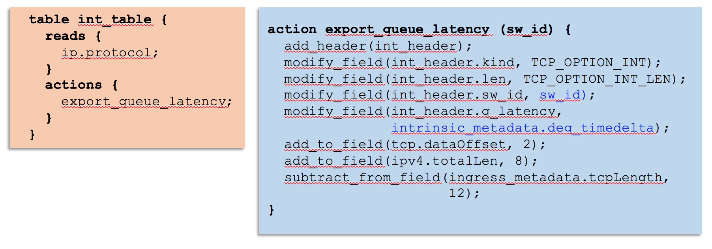
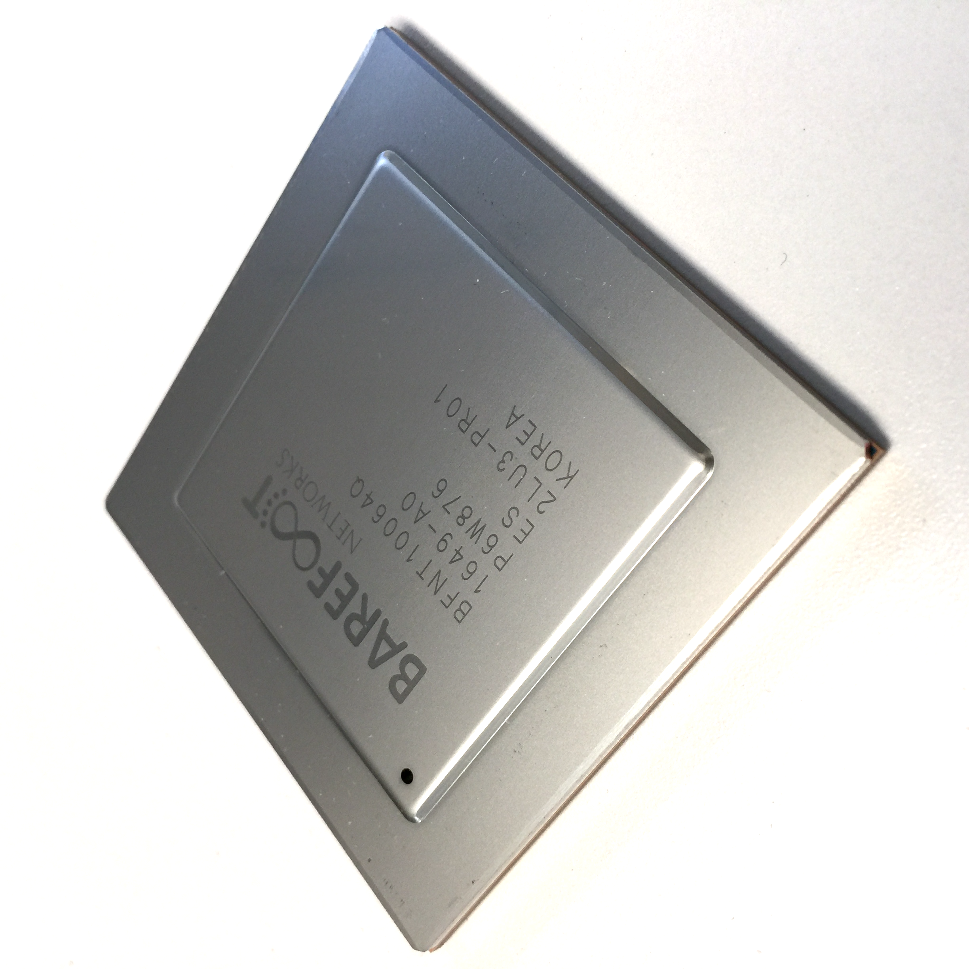
Network systems are starting to be programmed “top-down”
“This is precisely how you must process packets”
Switch OS
Driver
Programmable Switch

Slide 19
Why are programmable forwarding planes happening now?

Slide 20
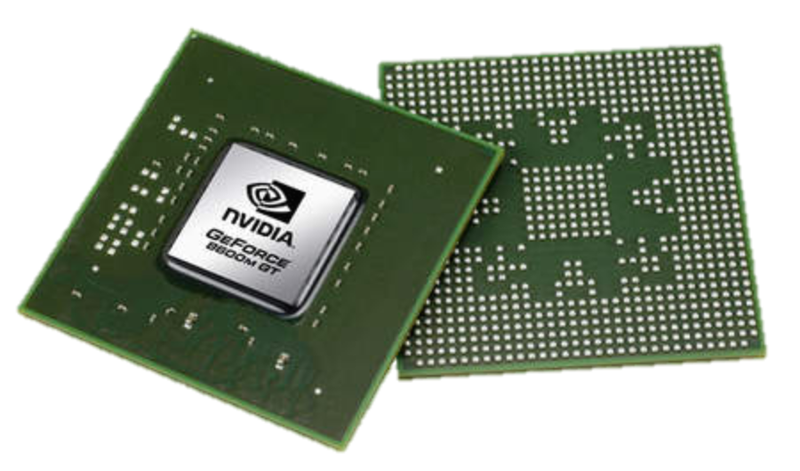
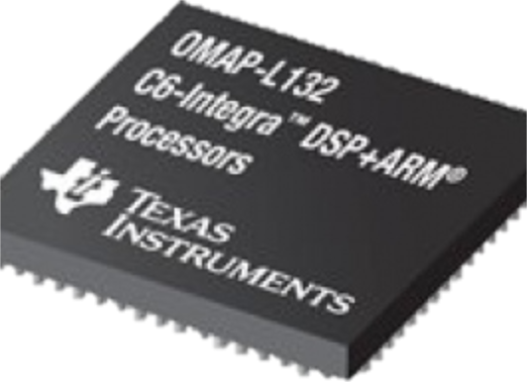
Domain Specific Processors
Signal
Processing
Machine
Learning
Computers
Graphics
Networking
Java
OpenCL
Matlab
TensorFlow
>>>
Language
Compiler
Compiler
Compiler
Compiler
Compiler
?
?
CPU
GPU
DSP
TPU

Slide 21
Domain Specific Processors
Signal
Processing
Machine
Learning
Computers
Graphics
Networking
Java
OpenCL
Matlab
TensorFlow
>>>
P4
Compiler
Compiler
Compiler
Compiler
Compiler
?
CPU
GPU
DSP
TPU
PISA

Slide 22
PISA: Protocol Independent Switch Architecture
Match+Action
Stage
Memory
ALU
Programmable
Parser
Programmable Match-Action Pipeline

Slide 23
PISA: Protocol Independent Switch Architecture

Slide 24
Example P4 Program
Parser Program
Header and Data Declarations
Tables and Control Flow
parser parse_ethernet {
extract(ethernet);
return switch(ethernet.ethertype) {
0x8100 : parse_vlan_tag;
0x0800 : parse_ipv4;
0x8847 : parse_mpls;
default: ingress;
}
header_type ethernet_t { … }
header_type l2_metadata_t { … }
header ethernet_t ethernet;
header vlan_tag_t vlan_tag[2];
metadata l2_metadata_t l2_meta;
table port_table { … }
control ingress {
apply(port_table);
if (l2_meta.vlan_tags == 0) {
process_assign_vlan();
}
}
Memory
ALU
Programmable
Parser
Programmable Match-Action Pipeline

Slide 25
To learn more, visit P4.org

Slide 26
Barefoot Tofino 6.5Tb/s Switch
December 2016
Same power.
Same cost.
The world’s fastest switch in production.
Forwarding defined in software (P4).
Programs always run at line-rate.

Slide 27
How programmability is being used
Reducing complexity
1

Slide 28
Reducing complexity
switch.p4
Switch OS
Driver
IPv4 and IPv6 routing
- Unicast Routing
- Routed Ports & SVI
- VRF
- Unicast RPF
- Strict and Loose
- Multicast
- PIM-SM/DM & PIM-Bidir
Ethernet switching
- VLAN Flooding
- MAC Learning & Aging
- STP state
- VLAN Translation
Load balancing
- LAG
- ECMP & WCMP
- Resilient Hashing
- Flowlet Switching
Fast Failover
– LAG & ECMP
Tunneling
- IPv4 and IPv6 Routing & Switching
- IP-in-IP (6in4, 4in4)
- VXLAN, NVGRE, GENEVE & GRE
- Segment Routing, ILA
MPLS
- LER and LSR
- IPv4/v6 routing (L3VPN)
- L2 switching (EoMPLS, VPLS)
- MPLS over UDP/GRE
ACL
- MAC ACL, IPv4/v6 ACL, RACL
- QoS ACL, System ACL, PBR
- Port Range lookups in ACLs
QOS
- QoS Classification & marking
- Drop profiles/WRED
- RoCE v2 & FCoE
- CoPP (Control plane policing)
NAT and L4 Load Balancing
Security Features
- Storm Control, IP Source Guard
Monitoring & Telemetry
Ingress Mirroring and Egress Mirroring
Negative Mirroring
Sflow
INT
Counters
Route Table Entry Counters
VLAN/Bridge Domain Counters
Port/Interface Counters
Protocol Offload
- BFD, OAM
Multi-chip Fabric Support
- Forwarding, QOS
Compiler
Programmable Switch

Slide 29
Reducing complexity
My switch.p4
Switch OS
Driver
Compiler
Programmable Switch

Slide 30
How programmability is being used
Adding new features
2

Slide 31
Protocol complexity 20 years ago
Ethernet
ethtype
ethtype
IPv4
IPX

Slide 32
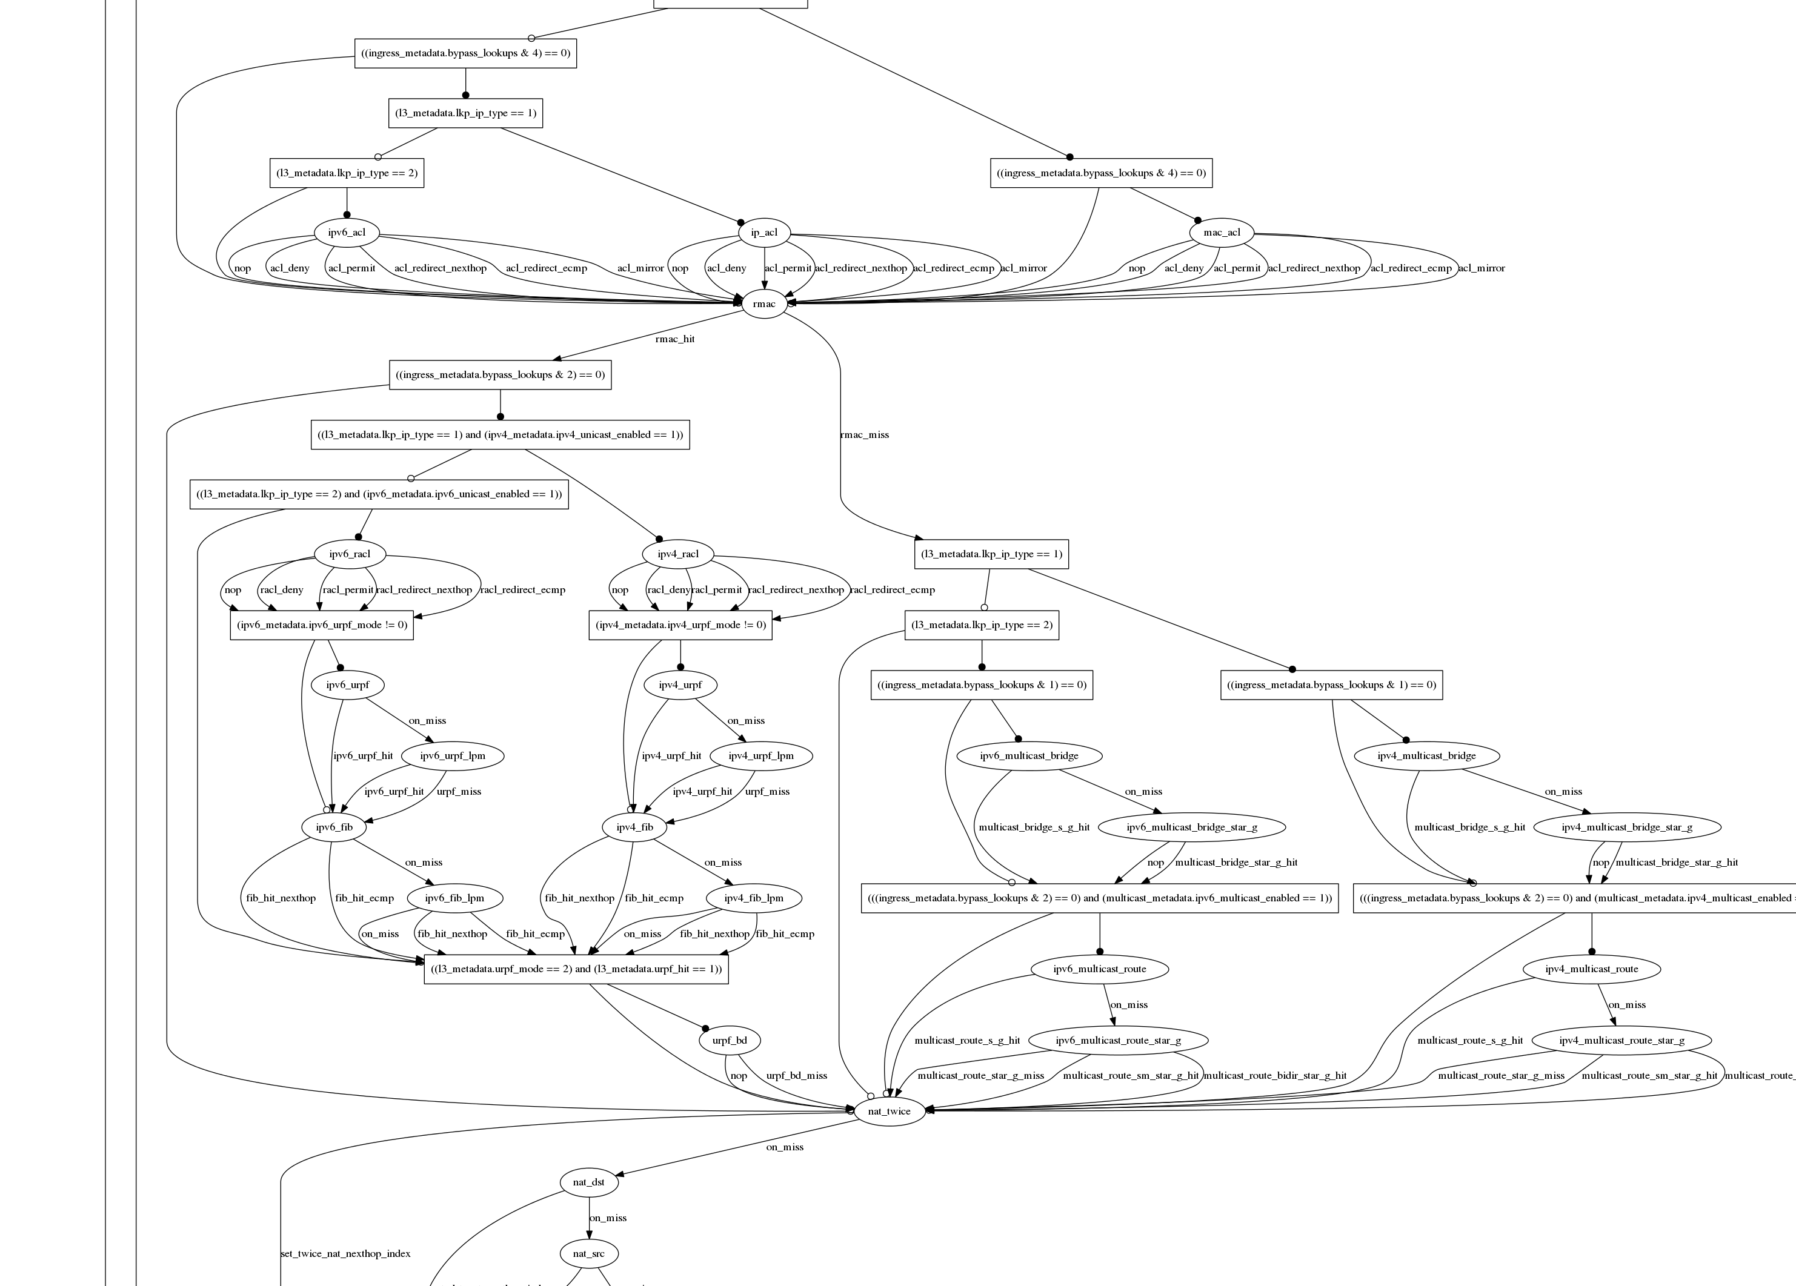
Datacenter switch today
switch.p4

Slide 33
Adding features: Some examples so far
New encapsulations and tunnels
New ways to tag packets for special treatment
New approaches to routing: e.g. source routing in MSDCs
New approaches to congestion control
New ways to process packets: e.g. processing ticker-symbols

Slide 34
New applications: Some examples so far
Layer-4 Load Balancer¹
  Replace 100 servers or 10 dedicated boxes with one programmable switch
  Track and maintain mapping for 5-10 million http flows
Fast stateless firewall
  Add/delete and track 100s of thousands of new connections per second
Cache for Key-value store²
  Memcache in-network cache for 100 servers
  1-2 billion operations per second
[1] “SilkRoad: Making Stateful Layer-4 Load Balancing Fast and Cheap Using Switching ASICs.” Rui Miao et al. Sigcomm 2017.
[2] “NetCache: Balancing Key-Value Stores with Fast In-Network Caching”, Xin Jin et al. SOSP 2017

Slide 35
How programmability is being used
Network telemetry
3

Slide 36
“I visited Switch 1 @780ns,
Switch 9 @1.3µs, Switch 12 @2.4µs”
1
“Which path did my packet take?”
# | Rule
1
2
3
…
75 | 192.168.0/24
…
“In Switch 1, I followed rules 75 and 250. In Switch 9, I followed rules 3 and 80. ”
2
“Which rules did my packet follow?”

Slide 37
3
“How long did my packet queue at each switch?”
“Delay: 100ns, 200ns, 19740ns”
Queue
4
“Who did my packet share the queue with?”
Time

Slide 38
3
“How long did my packet queue at each switch?”
“Delay: 100ns, 200ns, 19740ns”
Aggressor flow!
Queue
4
“Who did my packet share the queue with?”
Time

Slide 39
We’d like the network to answer these questions
“Which path did my packet take?”
“Which rules did my packet follow?”
“How long did it queue at each switch?”
“Who did it share the queues with?”
1
2
3
4
A PISA device programmed using P4 can answer all four questions at line rate, for the first time. Without generating additional packets.

Slide 40
INT: Inband Network Telemetry
Add: SwitchID, Arrival Time,
Queue Delay, Matched Rules, …
Original Packet
Log, Analyze
Replay
Visualize

Slide 41
/* INT: add switch id */
action int_set_header_0() {
add_header(int_switch_id_header);
modify_field(int_switch_id_header.switch_id,
global_config_metadata.switch_id);
}
/* INT: add ingress timestamp */
action int_set_header_1() {
add_header(int_ingress_tstamp_header);
modify_field(int_ingress_tstamp_header.ingress_tstamp, i2e_metadata.ingress_tstamp);
}
/* INT: add egress timestamp */
action int_set_header_2() {
add_header(int_egress_tstamp_header);
modify_field(int_egress_tstamp_header.egress_tstamp,
eg_intr_md_from_parser_aux.egress_global_tstamp);
}
P4 code snippet: Insert switch ID, ingress and egress timestamp
Log, Analyze
Replay
Visualize

Slide 42
How programmability is being used
1
Reducing complexity
Adding new features
Network telemetry
2
3

Slide 43
In summary…
SDN is about who is in charge!
  Act 1: Network owners and operators took charge of how their networks are controlled.
  Act 2: They also decide how packets are processed.
Chip technology: Programmable forwarding now has the same power, performance and cost as fixed function.
New ideas: Beautiful new ideas now owned by the programmer, not the chip designer.

Slide 44
Thank you!

