Slide 1


OpenFlow: Enabling Technology Transfer to Networking Industry
Cisco Nerd Lunch, July 2009
Nikhil Handigol
nikhilh@cs.stanford.edu

Slide 2
Interesting Problems in Networking Research
Mobility management
Network security
Energy management
Flow management and measurement
Packet processing
…

Slide 3
Technology Transfer
Academia to Industry
Accelerates innovation in the field
Desirable to both academia and industry
  Academic research can have impact
  Industry can benefit from academic research, improve products

Slide 4
Problem with Networking Research
Lack of technology transfer from academia to industry
  No dearth of smart people
  No lack of ideas
Lack of ideas tested at scale
  No way for academia to test ideas at scale
  No reason for industry to invest in untested ideas

Slide 5
Possible Solutions
Separate testbed of programmable open source switches and routers
  Expensive
  No real traffic
Make Cisco boxes open source ☺
  Not practical
Can we strike a middle ground?

Slide 6
Our Approach
A clean separation between the substrate and an open programming environment
A simple hardware substrate that generalizes, subsumes and simplifies the current substrate

Slide 7

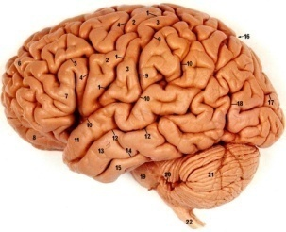
Step 1:
Separate intelligence from datapath
Operators, users, 3rd party developers, researchers, …
New function!

Slide 8
Our Approach
A clean separation between the substrate and an open programming environment
A simple hardware substrate that generalizes, subsumes and simplifies the current substrate

Slide 9
Step 2: Cache decisions in minimal flow-based datapath
“If header = x, send to port 4”
“If header = y, overwrite header with z, send to ports 5,6”
“If header = ?, send to me”
Flow
Table

Slide 10
Our Solution: OpenFlow
OpenFlow is an open external API to a flow-table
Allows separation of control and data path via a simple, well defined interface
Defined to be easy to add to existing hardware switches, routers, APs, …

Slide 11
OpenFlow Basics
Notes:
11

Slide 12

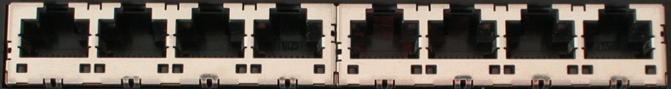
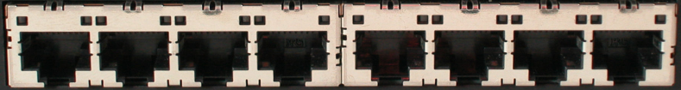
Ethernet Switch

Slide 13
Control Path
Control Path (Software)
Data Path (Hardware)

Slide 14
OpenFlow Controller
OpenFlow Protocol (SSL)
Control Path
OpenFlow
Data Path (Hardware)

Slide 15
OpenFlow Basics
Flow 1.
Rule
(exact & wildcard)
Action
Statistics
Flow 2.
Rule
(exact & wildcard)
Action
Statistics
Flow 3.
Rule
(exact & wildcard)
Action
Statistics
Rule
(exact & wildcard)
Flow N.
Default Action
Statistics
Exploit the flow table in switches, routers, and chipsets
Notes:
15

Slide 16
Flow Table Entry
OpenFlow Protocol Version 1.0
Rule
Action
Stats
Packet + byte counters
Forward packet to port(s)
Encapsulate and forward to controller
Drop packet
Send to normal processing pipeline
Switch
Port
MAC
src
MAC
dst
Eth
type
VLAN
ID
IP
Src
IP
Dst
IP
Prot
TCP
sport
TCP
dport
+ mask what fields to match

Slide 17
Examples
Switching
Switch
Port
MAC
src
MAC
dst
Eth
type
VLAN
ID
IP
Src
IP
Dst
IP
Prot
TCP
sport
TCP
dport
Action
*
*
00:1f:..
*
*
*
*
*
*
*
port6
Flow Switching
Switch
Port
MAC
src
MAC
dst
Eth
type
VLAN
ID
IP
Src
IP
Dst
IP
Prot
TCP
sport
TCP
dport
Action
port3
00:2e..
00:1f..
0800
vlan1
1.2.3.4
5.6.7.8
4
17264
80
port6
Firewall
Switch
Port
MAC
src
MAC
dst
Eth
type
VLAN
ID
IP
Src
IP
Dst
IP
Prot
TCP
sport
TCP
dport
Forward
*
*
*
*
*
*
*
*
*
22
drop

Slide 18
Examples
Routing
Switch
Port
MAC
src
MAC
dst
Eth
type
VLAN
ID
IP
Src
IP
Dst
IP
Prot
TCP
sport
TCP
dport
Action
*
*
*
*
*
*
5.6.7.8
*
*
*
port6
VLAN
Switch
Port
MAC
src
MAC
dst
Eth
type
VLAN
ID
IP
Src
IP
Dst
IP
Prot
TCP
sport
TCP
dport
Action
port6,
port7,port9
*
*
*
*
vlan1
*
*
*
*
*

Slide 19



OpenFlow Usage
Dedicated OpenFlow Network
Controller
Atul’s code
OpenFlow
Switch
PC
Rule
Action
Statistics
OpenFlow
Protocol
OpenFlow
Switch
OpenFlow
Switch
Rule
Action
Statistics
Rule
Action
Statistics
Atul
OpenFlowSwitch.org
Notes:
19

Slide 20
Usage examples
Atul’s code:
  Static “VLANs”
  His own new routing protocol: unicast, multicast, multipath, load-balancing
  Network access control
  Home network manager
  Mobility manager
  Energy manager
  Packet processor (in controller)
  IPvAtul
  Network measurement and visualization
  …
Notes:
20

Slide 21

Separate VLANs for Production and Research Traffic
Controller
Research VLANs
Flow Table
Production VLANs
Normal L2/L3 Processing

Slide 22

Virtualize OpenFlow Switch
Controller A
Researcher A VLANs
Controller B
Flow Table
Researcher B VLANs
Controller C
Flow Table
Researcher C VLANs
Flow Table
Production VLANs
Normal L2/L3 Processing

Slide 23

Virtualizing OpenFlow
Jimit’s
Controller
Jie’s
Controller
Atul’s
Controller
OpenFlow
Protocol
OpenFlow
Switch
OpenFlow FlowVisor
& Policy Control
OpenFlow
Protocol
OpenFlow
Switch
OpenFlow
Switch

Slide 24



Virtualizing OpenFlow
HTTP
Load-balancer
Broadcast
Multicast
OpenFlow
Protocol
OpenFlow
Switch
OpenFlow
FlowVisor & Policy Control
OpenFlow
Protocol
OpenFlow
Switch
OpenFlow
Switch

Slide 25
OpenFlow Deployment

Slide 26
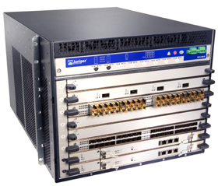
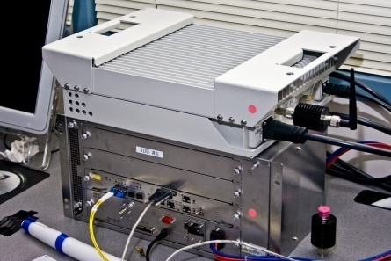
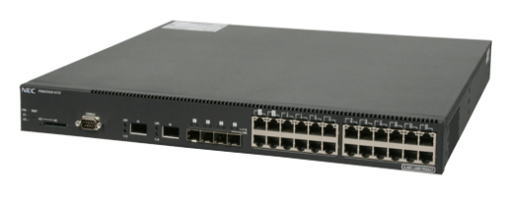
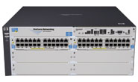
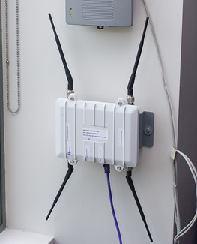

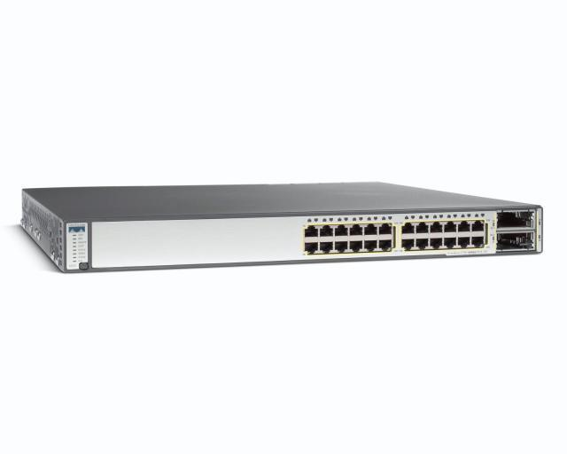
OpenFlow Hardware
Juniper MX-series
NEC IP8800
WiMax (NEC)
HP Procurve 5400
Quanta LB4G
PC Engines
coming soon...
Cisco Catalyst 3K

Slide 27
OpenFlow Deployments
Stanford Deployments
  Wired: CS Gates building, EE CIS building, EE Packard building
  WiFi: 100 OpenFlow APs across SoE
  WiMAX: OpenFlow service in SoE
Other deployments
  Internet2 (NetFPGA switches)
  JGN2plus, Japan (NEC switches)
  10-15 research groups have switches

Slide 28
Summer Plan

Slide 29
Summer Plan
Step-1: Software Implementation
OpenFlow as an IOS subsystem in the C3750E switch
Thorough testing and debugging
Fully functional OpenFlow switch, though not efficient

Slide 30
Summer Plan
Step-2: Hardware Implementation
Explore feasibility
Implement as many features in hardware as possible
Eg. Exploit ACLs
  Define packet matching rules
  Define basic actions such as packet dropping and packet forwarding

Slide 31
Thank you!

