Slide 1
Should a load-balancer choose the path as well as the server?
Nikhil Handigol
Stanford University
Joint work with Nick McKeown and Ramesh Johari

Slide 2
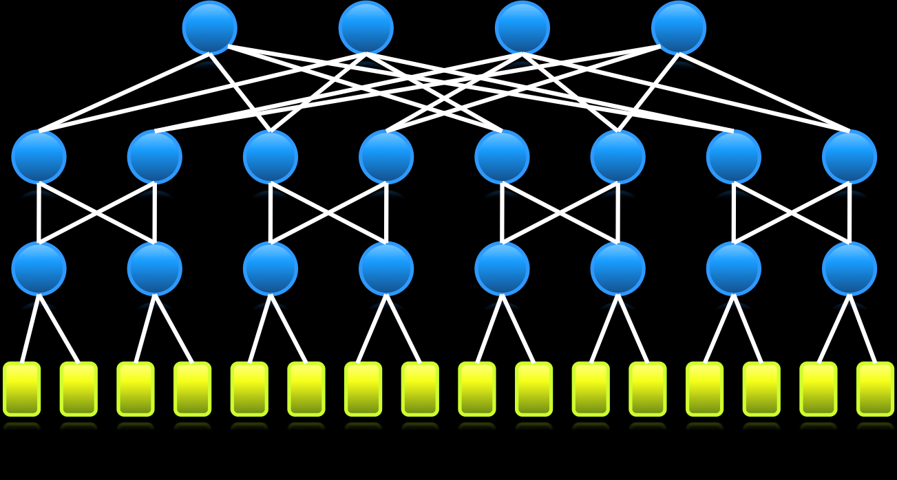
Datacenter
Wide-area
Enterprise
Notes:
Load-balancing has become an indispensable component of pretty much any large scale Internet service, be it in datacenter networks, CDNs, or enterprise networks.

Slide 3
Client
LOAD-BALANCER
Can’t choose path :’(
Servers
Notes:
The typical perception…. Middlebox sitting in front of a cluster of replicated machines… sprays incoming requests across the servers.
Over time, services and networks have evolved tremendously…
10s of thousands of machines interconnected by very large networks… For example, think of CDNs…
The load-balancers have remained the same…
choose a server for each incoming request using *some* logic, i.e. load-balancing algorithm…
The load-balancing algorithms range from very simple schemes…
However, load-balancers still don’t act on the network that sits between… They don’t, and in fact simply can’t, choose which path in the network…
The path is chosen by an entirely different entity…
Is this a problem? If it is, can we do anything about it at all? That’s what we’re going to explore in this talk.

Slide 4
Outline and goals
A new architecture for distributed load-balancing
joint (server, path) selection
Demonstrate a nation-wide prototype
Interesting preliminary results

Slide 5
I’m here to ask for your help!
Notes:
Most importantly, I am here also to ask for your help, to explore how I can apply my ideas to Netflix’s services. We’ll come back to this towards the end.
Can I have a show of hands…

Slide 6
OpenFlow Controller
OpenFlow Protocol (SSL)
Control Path
Control Path
OpenFlow
Data Path (Hardware)
Notes:
OpenFlow is an API to program …
added as a feature…
allows a external controller to manage the datapath…

Slide 7
Software Defined Networking
Feature
Feature
Network OS
Feature
Feature
OS
Custom Hardware
Feature
Feature
OS
Feature
Feature
Custom Hardware
OS
Feature
Feature
Custom Hardware
OS
Custom Hardware
Feature
Feature
OS
Custom Hardware
Notes:
With this feature, the control path logic, in other words the brains of the network, can be moved to a separate controller, typically running as an application over a network OS. This architecture is called Softwared Defined Networking, or SDN.

Slide 8
Load Balancing is just
Smart Routing
Notes:
My work stems from the idea that … smart routing of requests and responses based on …. So, with sufficient visibility and control over my network…
In other words, load-balancing can be implemented as a primitive… rather than…

Slide 9
Load-balancing as a network primitive
Load-balancing logic
Load-balancing decision
Load-balancing decision
Load-balancing decision
Load-balancing decision
Load-balancing decision
Network OS
Custom Hardware
Custom Hardware
Custom Hardware
Custom Hardware
Custom Hardware
Notes:
With the SDN architecture, we can now implement the load-balancing as an application of the network. We can implement the load-balancing policy in software at a logically centralized place, and simply cache the load-balancing decisions in the network in a distributed fashion.

Slide 10
Aster*x Controller
Notes:
Based on these ideas, I built a prototype distributed load-balancer called Aster*x.
The main component of Aster*x is …

Slide 11
Notes:
We have implemented Aster*x and run it over a network spanning 9 campuses in the US.
I’m now going to show you a video of a live demo of Aster*x…

Slide 12
http://www.openflow.org/videos
Notes:
As I mentioned earlier, Aster*x runs over a nationwide network… first system deployed at this scale
And the most amazing thing is, the core of the system was written in less than 500 lines of code.

Slide 13
So far…
A new architecture for distributed load-balancing
joint (server, path) selection
Aster*x – a nation-wide prototype
Promising results that joint (server, path) selection might have great benefits
Notes:
Let’s quickly recap what we’ve seen so far…
First, I described a new load-balancing architecture, that allows for joint…
Then, we saw a demo video of Aster*x a nation-wide…
During the demo, we saw some promising results that showed that…

Slide 14
What next?
Notes:
The Aster*x architecture allows for a lot of exciting new possibilities. One of the questions I’m excited about is how it can be applied for different types of services and applications… particularly, in streaming media services like Netflix.
In the demo, we saw Aster*x being used for a web service. But the factors at play and the metrics that determine the performance are presumably quite different in streaming media applications.

Slide 15
How big is the pie?
Characterizing and quantifying the performance of joint (server, path) selection
Notes:
In the remaining time, I’m going to talk about a followup problem I’ve been working on.
The problem of characterizing…
We saw some promising results in the demo…
How much better exactly is joint…

Slide 16
Load-balancing Controller
MININET-RT
Notes:
So, what all do I need for this study? First of all, I need a network…. Generate topologies…
Servers…
Clients…
A control framework…

Slide 17
Load-balancing Controller
Internet
Notes:
The nice thing is…
Okay, we now have a system … that we can use to test what we want.
Remember, our goal is to … quantify the performance difference between different load-balancing strategies in real-world settings.
But the Internet is an extremely complex system and it’s hard to capture all the complex behavior
… something easy to understand and easy to reason about.
I’m now going to describe the model and parameter-set we chose for our evaluation. I will then describe some of the results we observed with …

Slide 18
Model
Clients
ISP
CDN
Notes:
Before I go into the details… let me say upfront that …
This is our model – there is a network operated by a single ISP or network admin. And there are replicated servers on the network operated by a single CDN… there are clients that generate requests..
Even with this very simple model, there’s a huge parameter space that needs to be fixed…

Slide 19
Parameters
Topology
Intra-AS topologies
BRITE (2000 topologies)
CAIDA (1000 topologies)
Rocketfuel (~100 topos.)
20-50 nodes
Uniform link capacity

Slide 20
Parameters
Servers
5-10 servers
Random placement
Service
Simple HTTP service
Serving 1 MB file
Additional server-side computation

Slide 21
Parameters
Clients
3-5 client locations
Random placement
Request pattern
Poisson process
Mean rate: 5-10 req/sec

Slide 22
Load-balancing strategies?

Slide 23
Design space
Simple but suboptimal
Disjoint-Shortest-Path
Disjoint-Traffic-Engineering
Complex but optimal
Joint

Slide 24
Anatomy of a request-response
Client
Load-Balancer
Server
Request
Choose
Response Time
Retrieve
Response 1st byte
Response last byte
Deliver
Last byte ack

Slide 25
Disjoint-Shortest-Path
CDN selects the least loaded server
Load = retrieve + deliver
ISP independently selects the shortest path

Slide 26
Disjoint-Traffic-Engineering
CDN selects the least loaded server
Load = retrieve + deliver
ISP independently selects path to minimize max load
Max bandwidth headroom

Slide 27
Joint
Single controller jointly selects the best (server, path) pair
Total latency = retrieve + estimated deliver

Slide 28
Disjoint-Shortest-Path vs Joint
Disjoint-Shortest-Path performs ~2x worse than Joint

Slide 29
Disjoint-Traffic-Engg. vs Joint
Disjoint-Traffic-Engineering performs almost as well as Joint

Slide 30
Is Disjoint truly disjoint?
Client
Load-Balancer
Server
Request
Choose
Response Time
Retrieve
Response 1st byte
Response last byte
Deliver
Last byte ack
Server response time contains network information

Slide 31
The bottleneck effect
A single bottleneck resource along the path determines the performance.

Slide 32
The CDN-ISP game
Clients
ISP
CDN
Notes:
We analyzed the interaction using a game theoretic formulation…

Slide 33
The CDN-ISP game
System load monotonically decreases
Both push system in the same direction

Slide 34
Summary of observations
Disjoint-SP is ~2x worse than Joint
Disjoint-TE performs almost as well as Joint
(despite decoupling of server selection and traffic engineering)
Game theoretic analysis supports the empirical observation

Slide 35
How we could collaborate
Netflix video - ~30% Internet traffic
Important to efficiently utilize the available resources
I want to apply my research work to Netflix’s service
“How can we jointly optimize (server, path) selection to achieve near-optimal performance?”
How can we work together on this?

Slide 36
Questions – Video Streaming
Can you share video streaming data?
How can I model the “Netflix network”? Topology? B/W?
Where is the bottleneck? Servers? Network?
Where are the servers located? How many?
What is the client request pattern?
What is the video stream size distribution? Duration? Bandwidth?
How do you choose a server for a given request?
How do you choose a path for a given request?

Slide 37
Questions – Video Streaming
Can you share video streaming data?
Cost structure – What is the cost model? Why do you outsource video streaming to CDNs?
How do you deal with non-streaming part of the service (UI)?

Slide 38
Questions – AWS Deployment
Can we work together to characterize the AWS deployment? E.g., Size of deployment, incoming request pattern, inter-VM traffic
Are there web-level SLAs? Does AWS pose challenges?
What are the scaling bottlenecks? CPU? Network? Other?

Slide 39
Let’s chat more!

Slide 40
Conclusion
A new architecture for distributed load-balancing
joint (server, path) selection
Aster*x - a nation-wide prototype
Interesting preliminary results
Future – application to streaming media services

Slide 41
Extra slides…

Slide 42
Questions – AWS Deployment
Can you share Netflix AWS deployment data?
How many VMs? What size?
What is the service structure? How many tiers of services?
Do you have any SLAs to meet? Any problems there?
Would joint VM placement + routing help?
What is the avg. NIC/CPU utilization on the VMs?
Is the network ever a bottleneck?
Do you do any MapReduce-style computation?

Slide 43
Sample topologies
BRITE
CAIDA

