Slide 1
Should a load-balancer choose the path as well as the server?
Nikhil Handigol
Stanford University
Joint work with Nick McKeown and Ramesh Johari

Slide 2
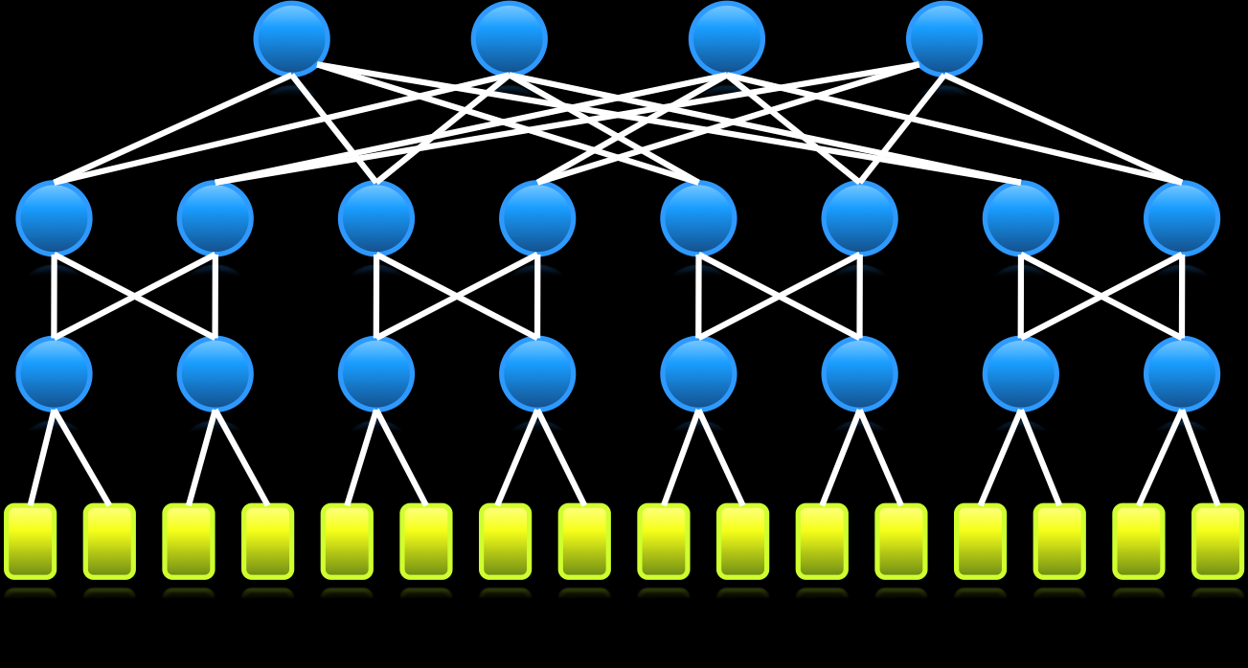
Datacenter
Wide-area
Enterprise
Notes:
Load-balancing has become an indispensable component of pretty much any large scale Internet service, be it in datacenter networks, CDNs, or enterprise networks.

Slide 3
Client
LOAD-BALANCER
Can’t choose path :’(
Servers
Notes:
The typical perception…. Middlebox sitting in front of a cluster of replicated machines… sprays incoming requests across the servers.
Over time, services and networks have evolved tremendously…
10s of thousands of machines interconnected by very large networks… For example, think of CDNs…
The load-balancers have remained the same…
choose a server for each incoming request using *some* logic, i.e. load-balancing algorithm…
The load-balancing algorithms range from very simple schemes…
However, load-balancers still don’t act on the network that sits between… They don’t, and in fact simply can’t, choose which path in the network…
The path is chosen by an entirely different entity…
Is this a problem? If it is, can we do anything about it at all? That’s what we’re going to explore in this talk.

Slide 4
Outline and goals
A new architecture for distributed load-balancing
joint (server, path) selection
Demonstrate a nation-wide prototype
Interesting preliminary results

Slide 5
OpenFlow Controller
OpenFlow Protocol (SSL)
Control Path
Control Path
OpenFlow
Data Path (Hardware)
Notes:
A typical switch has 2 components…
OpenFlow is an API to program …
added as a feature…
allows a external controller to manage the datapath…

Slide 6
Software Defined Networking
Feature
Feature
Network OS
Feature
Feature
OS
Custom Hardware
Feature
Feature
OS
Feature
Feature
Custom Hardware
OS
Feature
Feature
Custom Hardware
OS
Custom Hardware
Feature
Feature
OS
Custom Hardware
Notes:
With this feature, the control path logic, in other words the brains of the network, can be moved to a separate controller, typically running as an application over a network OS. This architecture is called Softwared Defined Networking, or SDN.

Slide 7
Load Balancing is just
Smart Routing
Notes:
My work stems from the idea that … smart routing of requests and responses based on …. So, with sufficient visibility and control over my network…
In other words, load-balancing can be implemented as a primitive… rather than…

Slide 8
Load-balancing as a network primitive
Load-balancing logic
Load-balancing decision
Load-balancing decision
Load-balancing decision
Load-balancing decision
Load-balancing decision
Network OS
Custom Hardware
Custom Hardware
Custom Hardware
Custom Hardware
Custom Hardware
Notes:
With the SDN architecture, we can now implement the load-balancing as an application of the network. We can implement the load-balancing policy in software at a logically centralized place, and simply cache the load-balancing decisions in the network in a distributed fashion.

Slide 9
Aster*x Controller
Notes:
Based on these ideas, I built a prototype distributed load-balancer called Aster*x.
The main component of Aster*x is …

Slide 10
Notes:
We have implemented Aster*x and run it over a network spanning 9 campuses in the US.
I’m now going to show you a video of a live demo of Aster*x…

Slide 11
http://www.openflow.org/videos
Notes:
As I mentioned earlier, Aster*x runs over a nationwide network… first system deployed at this scale
And the most amazing thing is, the core of the system was written in less than 500 lines of code.

Slide 12
So far…
A new architecture for distributed load-balancing
joint (server, path) selection
Aster*x – a nation-wide prototype
Promising results that joint (server, path) selection might have great benefits
Notes:
Let’s quickly recap what we’ve seen so far…
First, I described a new load-balancing architecture, that allows for joint…
Then, we saw a demo video of Aster*x a nation-wide…
During the demo, we saw some promising results that showed that…

Slide 13
What next?
Notes:
The Aster*x allows for a lot of exciting new possibilities. One of the questions I’m excited about is how it can be applied in other contexts like DC…
For example, one of the characteristics … load-balancing policy can be defined in software… now imagine a cloud DC… each tenant can define their own load-balancing policy that best suits their needs…

Slide 14
How big is the pie?
Characterizing and quantifying the performance of joint (server, path) selection
Notes:
In the remaining time, I’m going to talk about a followup problem I’ve been working on.
The problem of characterizing…
We saw some promising results in the demo…
How much better exactly is joint…

Slide 15
Load-balancing Controller
MININET-RT
Notes:
So, what all do I need for this study? First of all, I need a network…. Generate topologies…
Servers…
Clients…
A control framework…

Slide 16
Load-balancing Controller
Internet
Notes:
The nice thing is…
Okay, we now have a system … that we can use to test what we want.
Remember, our goal is to … quantify the performance difference between different load-balancing strategies in real-world settings.
But the Internet is an extremely complex system and it’s hard to capture all the complex behavior
… something easy to understand and easy to reason about.
I’m now going to describe the model and parameter-set we chose for our evaluation. I will then describe some of the results we observed with …

Slide 17
Model
Clients
ISP
CDN
Notes:
Before I go into the details… let me say upfront that …
This is our model – there is a network operated by a single ISP or network admin. And there are replicated servers on the network operated by a single ISP… there are clients that generate requests..
Even with this very simple model, there’s a huge parameter space that needs to be fixed…

Slide 18
Parameters
Topology
Intra-AS topologies
BRITE (2000 topologies)
CAIDA (1000 topologies)
Rocketfuel (~100 topos.)
20-50 nodes
Uniform link capacity

Slide 19
Parameters
Servers
5-10 servers
Random placement
Service
Simple HTTP service
Serving 1 MB file
Additional server-side computation

Slide 20
Parameters
Clients
3-5 client locations
Random placement
Request pattern
Poisson process
Mean rate: 5-10 req/sec

Slide 21
Load-balancing strategies?

Slide 22
Design space
Simple but suboptimal
Disjoint-Shortest-Path
Disjoint-Traffic-Engineering
Complex but optimal
Joint

Slide 23
Anatomy of a request-response
Client
Load-Balancer
Server
Request
Choose
Response Time
Retrieve
Response 1st byte
Response last byte
Deliver
Last byte ack

Slide 24
Disjoint-Shortest-Path
CDN selects the least loaded server
Load = retrieve + deliver
ISP independently selects the shortest path

Slide 25
Disjoint-Traffic-Engineering
CDN selects the least loaded server
Load = retrieve + deliver
ISP independently selects path to minimize max load
Max bandwidth headroom

Slide 26
Joint
Single controller jointly selects the best (server, path) pair
Total latency = retrieve + estimated deliver

Slide 27
Disjoint-Shortest-Path vs Joint
Disjoint-Shortest-Path performs ~2x worse than Joint

Slide 28
Disjoint-Traffic-Engg. vs Joint
Disjoint-Traffic-Engineering performs almost as well as Joint

Slide 29
Is Disjoint truly disjoint?
Client
Load-Balancer
Server
Request
Choose
Response Time
Retrieve
Response 1st byte
Response last byte
Deliver
Last byte ack
Server response time contains network information

Slide 30
The bottleneck effect
A single bottleneck resource along the path determines the performance.

Slide 31
The CDN-ISP game
Clients
ISP
CDN
Notes:
We analyzed the interaction using a game theoretic formulation…

Slide 32
The CDN-ISP game
System load monotonically decreases
Both push system in the same direction

Slide 33
Summary of observations
Disjoint-SP is ~2x worse than Joint
Disjoint-TE performs almost as well as Joint
(despite decoupling of server selection and traffic engineering)
Game theoretic analysis supports the empirical observation

Slide 34
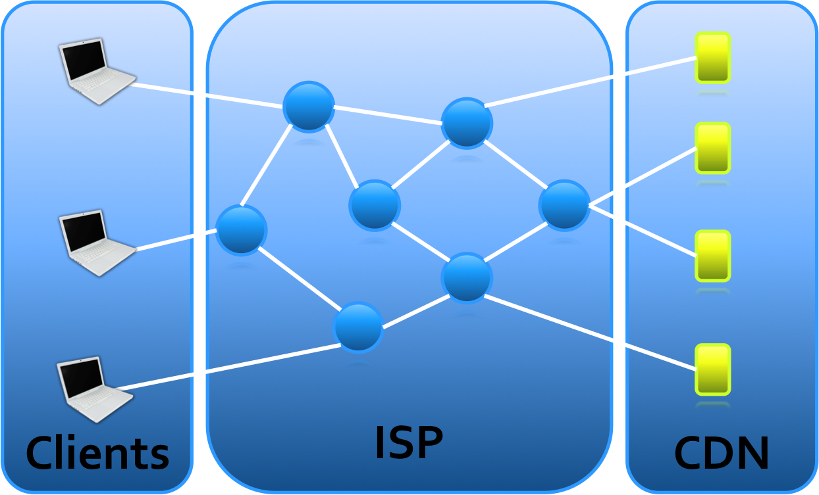
Questions
How should I change the model to mimic a real CDN?

Slide 35
Questions
How can I get real data?
What network topologies should I use?
How should I decide the no. of servers and their location?
How should I decide the client request pattern?

Slide 36
Conclusion
A new architecture for distributed load-balancing
joint (server, path) selection
Aster*x - a nation-wide prototype
Interesting preliminary results
Future – Evaluation with real data

Slide 37
Let’s chat more!

Slide 38
Sample topologies
BRITE
CAIDA

