Slide 1


ATRIUM
Open SDN Distribution
Saurav Das
Principal System Architect, ONF
With contributions from ONF Atrium Management team and many others …

Slide 2

Project Atrium Goals
Integration
Create vertically-integrated open-source stacks
From open-source components, OF1.3 & Hardware
Enable network operators to download distribution
from a single location
Interoperability
Enable multiple hardware vendors to plugin to stack
Allows end-users to select different hardware classes
for common use-cases.
Deployments
Work hand-in-hand with operators on deployable use
cases leading to trials.
- Give operators confidence in pure SDN solutions

Slide 3
SDN Provides a Lot of Choices

Slide 4
Solution: Vertically Integrated Stack
== SDN Distribution

Slide 5
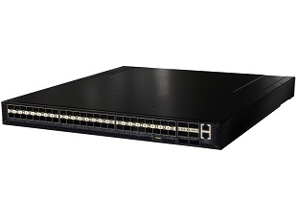
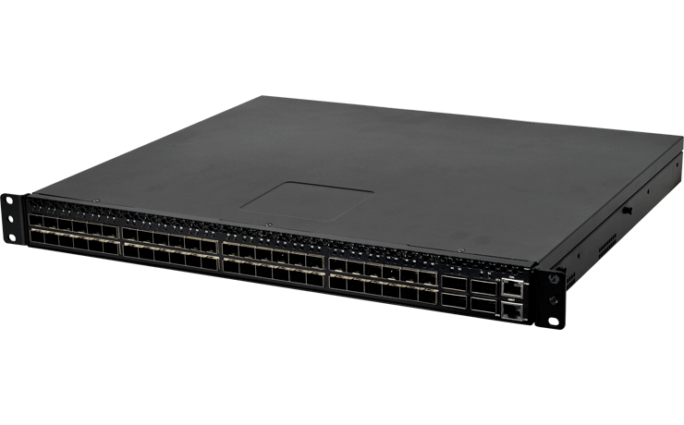
What is Atrium today?
Quagga BGP
vlan x
vlan y
ONOS
Peering Application
E-BGP
E-BGP
vlan z
OFDPA Driver
OpenFlow 1.3
Accton 5710
OCP
Software
-
ONL
ONIE
Indigo OF Agent
OF-DPA API
OF-DPA
Quanta LY2
BRCM SDK API
BRCM ASIC
OCP Bare Metal Hardware
OCP: Open Compute Project; ONL: Open Network Linux; ONIE: Open Network Install Env;
BRCM: Broadcom Merchant Silicon ASICs; OF-DPA: OpenFlow Datapath Abstraction

Slide 6
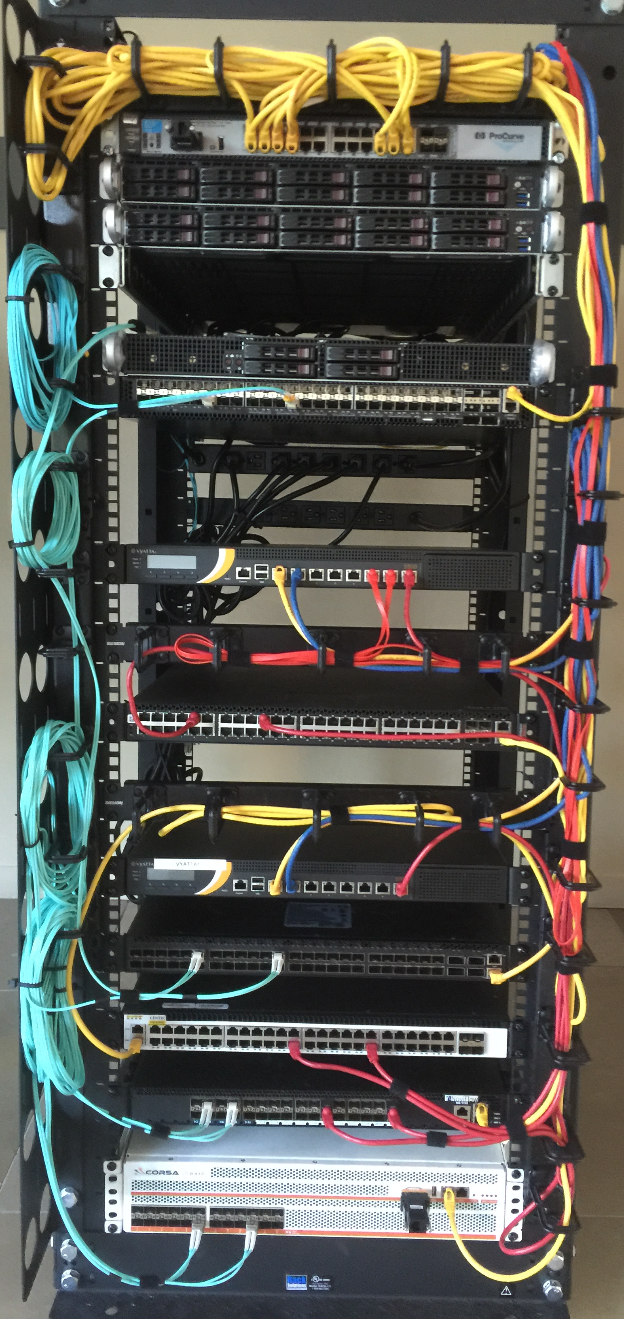







What is Atrium today?

Slide 7
A Closer Look at Interoperability
Different combinations of
Match-Action Tables form
Different OF 1.3 pipelines
How can a controller manage these differences?
How can an application work across these differences?
Accton, Quanta (BRCM ASIC)
NoviFlow, Netronome
(NPU/NFP)
Corsa
(FPGA)
Pica8
(BRCM ASIC)
Centec
(ASIC)

Slide 8
Solution: Flow Objectives API
Write the app once
without pipeline details
SDN Application
Flow Objectives
Controller
OFDPA Driver
SoftRouter Driver
Corsa Driver
Pica8
Driver
Centec Driver
adapt to specific
Pipeline using
device driver
OpenFlow 1.3
OpenFlow 1.3
Switch
Accton, Quanta (BRCM ASIC)
NoviFlow, Netronome
(NPU/NFP)
Corsa
(FPGA)
Pica8
(BRCM ASIC)
Centec
(ASIC)

Slide 9
Example: Filtering Objective
Filter ➔ only Permit or Deny options
On match fields of packet header
Permit: MAC 1, VLAN 1, IP 1, 2, 3
Router port: X
Permit: MAC 1, VLAN 2, IP 4, 5
Flow Objectives
Corsa Driver
OF-DPA Driver
T0
mac
T2
port-vlan
T4/5
T6
ip
T0
port
T1
Port-vlan
T2
mac
T4
ip

Slide 10
Example: Next Objective
Next ➔ next hop for forwarding
Similar to OF 1.3 group, but …
bkt
Corsa Driver
Indirect group
NEXT- HOP
bkt
Flow Objectives
Group chain
OF-DPA Driver
→ Flow-actions
NoviFlow & Pica8 Drivers

Slide 11
Atrium Demo @ SDN Solution Showcase
AS65301
AS65302
AS65303
Q1
Accton
Netronome
AS65000
AS65001
NoviFlow
AS65202
AS65203
AS65002
AS65201
Q2
V2
V1
Corsa
Quanta
Hosts (1.0.0.1)
Hosts (2.0.0.1)
AS65101
AS65102
Pica8
Centec
bgp1> sh ip bgp
BGP table version is 0, local router ID is 192.168.10.101
Status codes: s suppressed, d damped, h history, * valid, > best, i - internal,
r RIB-failure, S Stale, R Removed
Origin codes: i - IGP, e - EGP, ? - incomplete
Network Next Hop Metric LocPrf Weight Path
*> 1.0.0.0/24 192.168.10.1 1 0 65001 i
* 2.0.0.0/24 192.168.22.1 0 65201 65202 65203 65002 i
* 192.168.13.1 0 65301 65302 65303 65002 i
*> 192.168.11.1 0 65101 65102 65002 i
Total number of prefixes 2
bgp1> sh ip bgp summary
BGP router identifier 192.168.10.101, local AS number 65000
RIB entries 3, using 336 bytes of memory
Peers 5, using 22 KiB of memory
Neighbor V AS MsgRcvd MsgSent TblVer InQ OutQ Up/Down State/PfxRcd
1.1.1.1 4 65000 30090 31109 0 0 0 1d01h43m 0
192.168.10.1 4 65001 31095 31114 0 0 0 1d01h43m 1
192.168.11.1 4 65101 30775 30784 0 0 0 21:07:07 1
192.168.13.1 4 65301 28322 28339 0 0 0 18:11:55 1
192.168.22.1 4 65201 25959 25974 0 0 0 21:23:24 1
Total number of neighbors 5

Slide 12
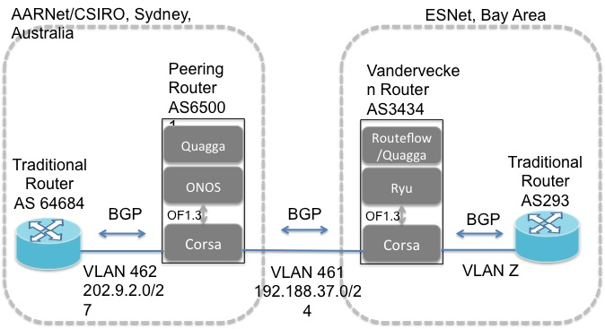
Atrium Pre-release Deployment

Slide 13
Atrium Post-release Operator Engagements

Slide 14
What’s Next?
Continued Improvements
Hardening & Stability
Performance
Missing features: untagged, runtime-config, static-routes
Hardware Automated Test Infrastructure
New Features
IGP & ECMP support
Requests from operators (eg. Route filtering)
Other platforms
- OpenDaylight support
LEARN MORE & JOIN THE COMMUNITY:
https://groups.opensourcesdn.org/wg/Atrium/dashboard

Slide 15
Summary
Integration
Atrium 1st release brings together ONOS, Quagga, OCP components (ONL, ONIE) and OFDPA with white-boxes + vendor equipment
Open SDN Distribution (2015/A release: June 30th)
Interoperability
ONF builds 7 routers!
Key architectural contribution: Flow Objectives & Device Drivers
Deployments
Pre release deployment in Sydney.
More coming as we engage operators
Acknowledgements
All the switch vendors, ONF management team, ON.Lab support
Ali Al-Shabibi & Jonathan Hart (ON.Lab)
Rob Sherwood (Big Switch Networks)

