Slide 1



CORD: Fabric
An Open-Source Leaf-Spine L3 Clos Fabric
Saurav Das
Principal System Architect, ONF
In collaboration with:

Slide 2
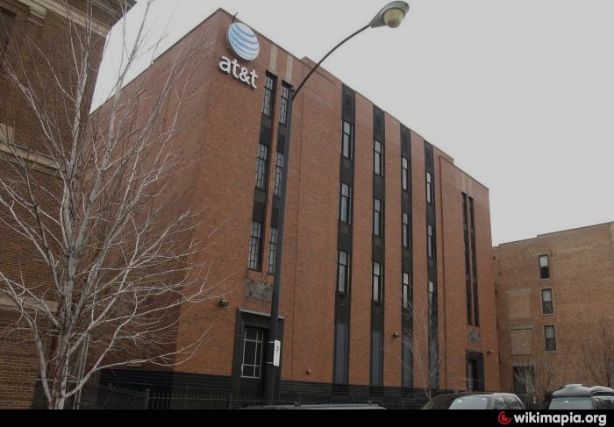


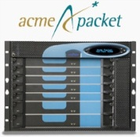
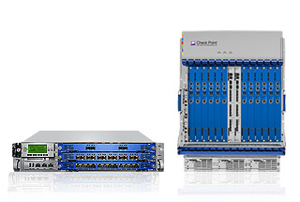
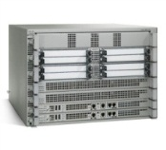
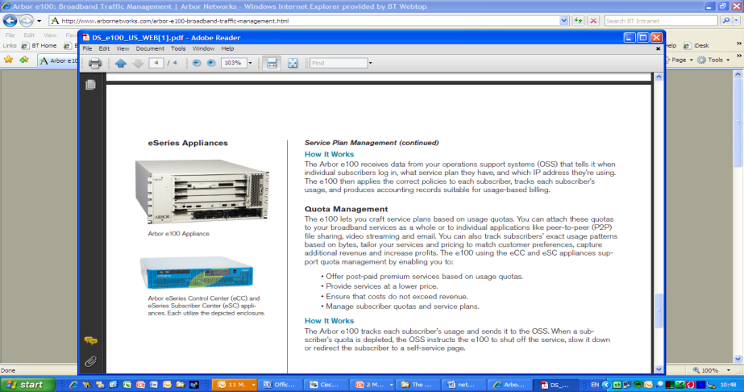
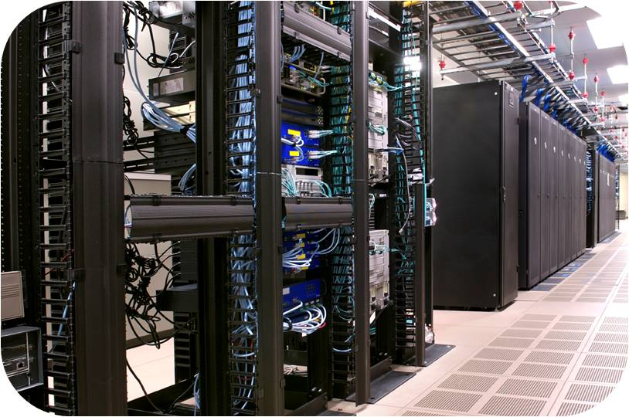
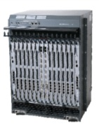
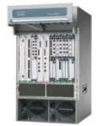
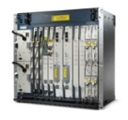

Problem: Today’s Telco Central Offices (COs)
Message
Router
CDN
Session Border
Controller
Large number of COs
DPI
Firewall
Carrier
Grade NAT
SGSN/GGSN/PDN-GW
PE Router
BNG
Evolved over 40-50 years
Fragmented non-commodity hardware.
Physical install per appliance per site
Nearly 300+ unique deployed appliances.
Huge source of CAPEX/OPEX
Not geared for Agility/ Programmability
Does not benefit from Commodity Hardware
Huge source of CAPEX/OPEX
Notes:
Before I talk about CORD in detail, let me explain the fundamental problem it is solving.
Today’s Central offices house fragmented, non-commodity infrastructure. Each CO hosts more than 300 unique deployed appliances, each requiring a physical install and specialized management.
It’s not surprising then that the Telco central offices are a huge source of CAPEX and OPEX and their design/infrastructure is not geared for programmability and agility.

Slide 3
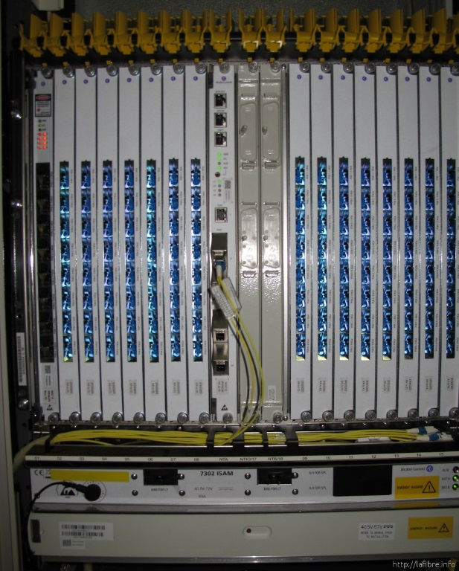

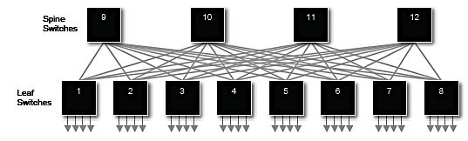



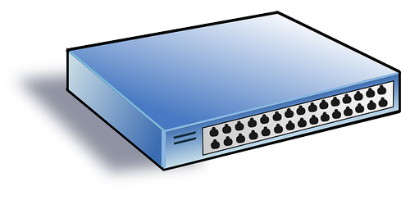

CORD: Central Office Re-architected as Datacenter
Applications
SDN Control Plane- ONOS
NFVI Orch- XOS
Spine
Switches
Control
Fabric
GPON OLT
IO
Leaf Switches
IO
IO
Metro Core
Link
PON
OLT
MACs
vOLT
vBNG
LDAP
Access
Link
vCPE
DHCP
RADIUS
ONT
GPON
Simple CPE
Commodity hardware
Data

Slide 4
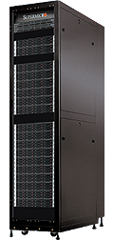
Open-Source Leaf-Spine Fabric
Fabric Control Application: Addressing, ECMP Routing, Recovery, Interoperability, API support
HA, scales to 16 racks, OF 1.3, Topo-Discovery, Configuration, GUI, CLI, Troubleshooting, ISSU
ONOS Controller Cluster
Open Source
SDN-based
Bare-metal
White Box
White Box
White Box
White Box
White Box
White Box
White Box
White Box
White Box
Fast
I/O
White Box
White Box
White Box
White Box
White Box
Slow
I/O:
PON
OLT
MACs
Metro
Core
Links
Access
Links
CORD Pod – up to 16 Racks

Slide 5
Open-Source Leaf-Spine Fabric
Spine Switch
Leaf/Spine Switch Software Stack
White Box SDN Switch
GE mgmt.
to controller
OpenFlow 1.3
OCP
Software
-
ONL
ONIE
Indigo OF Agent
32 x 40G ports downlink to leaf switches
40G QSFP+
OF-DPA API
OF-DPA
Leaf Switch
6 -12 x 40G ports uplink to different spine switches
ECMP across all uplink ports
BRCM SDK API
BRCM ASIC
OCP Bare Metal Hardware
White Box SDN Switch
OCP: Open Compute Project
ONL: Open Network Linux
ONIE: Open Network Install Environment
BRCM: Broadcom Merchant Silicon ASICs
OF-DPA: OpenFlow Datapath Abstraction
GE mgmt.
48 x 10G ports downlink to servers
in the same rack (subnet)
10G Base T or 10G SFP+

Slide 6

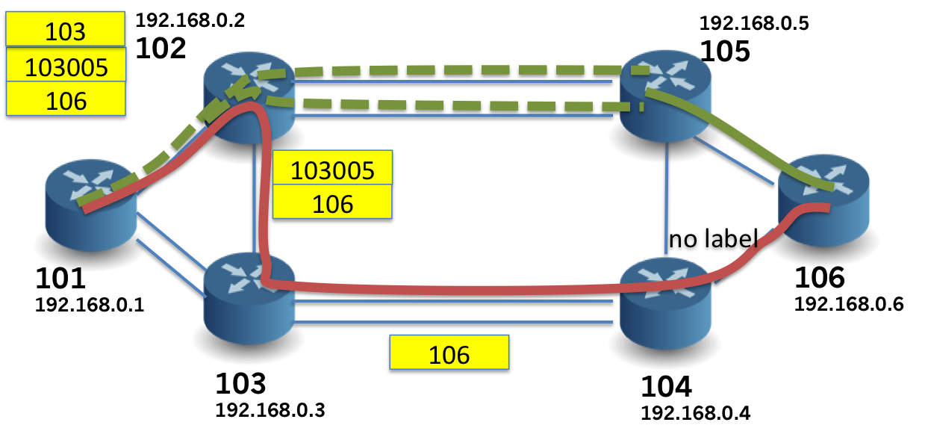

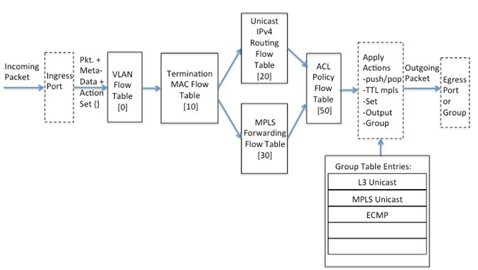
SPRING-OPEN
Segment Routing on
Bare Metal Hardware
Learn more:
https://wiki.onosproject.org/display/ONOS/Segment+Routing

Slide 7
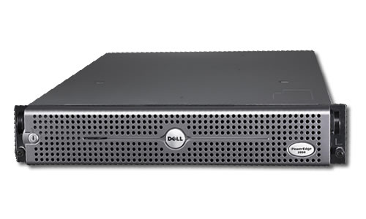
First Step: PoC Demo at Solution Showcase
Segment Routed
Fabric Control
ONOS Controller Cluster
SDN controlled
L3 Leaf-Spine Clos fabric.
Dell
Dell
Dell
Dell
Dell
Dell
Dell
Dell
4 racks, 2 servers/rack, Dell 4810 bare metal,
ONOS Cardinal controller cluster

Slide 8
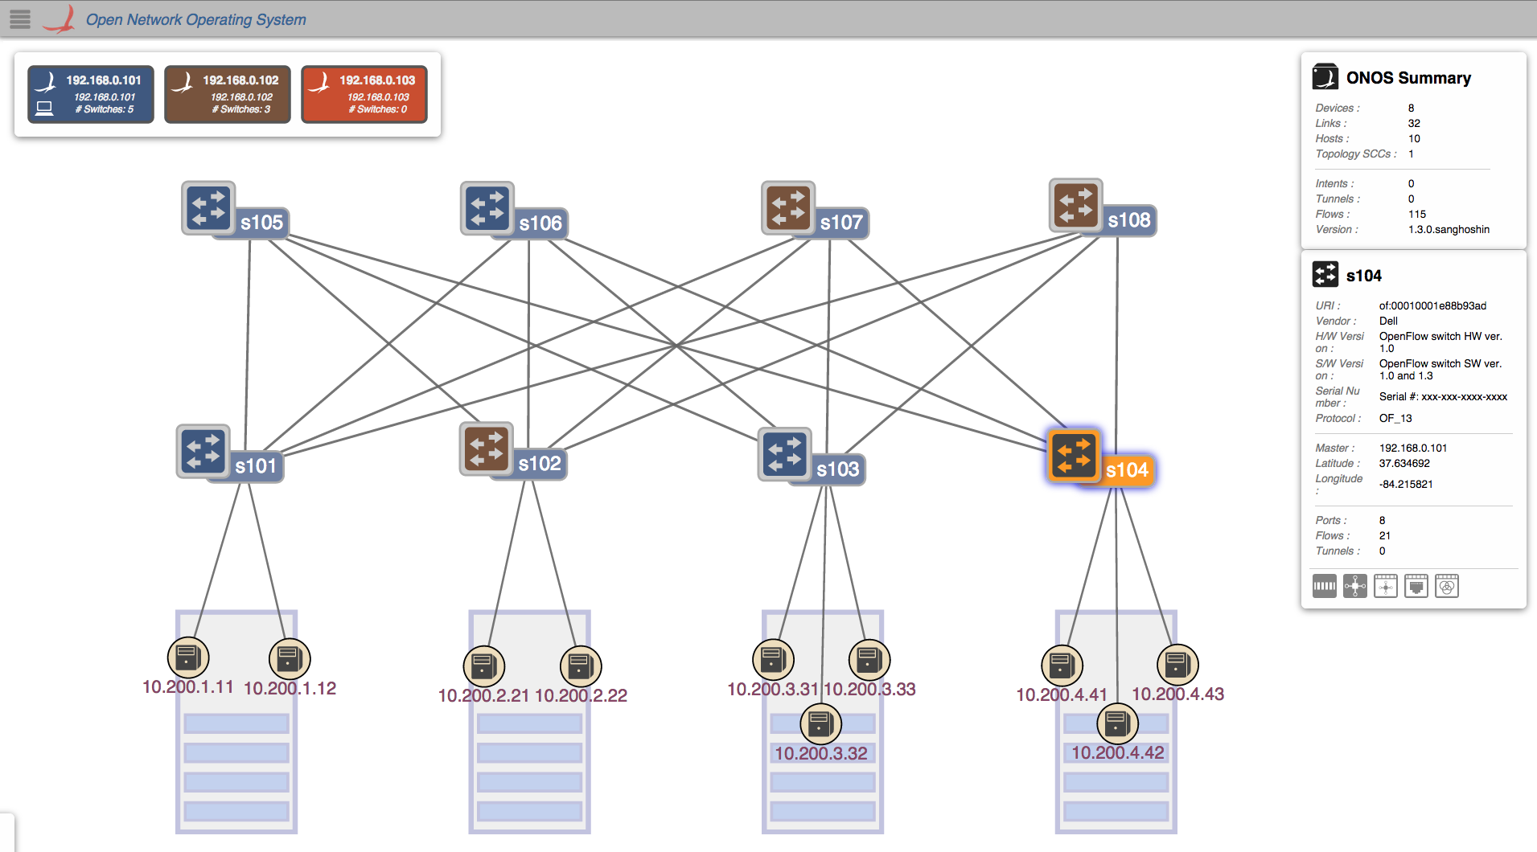
CORD: Fabric
103

Slide 9
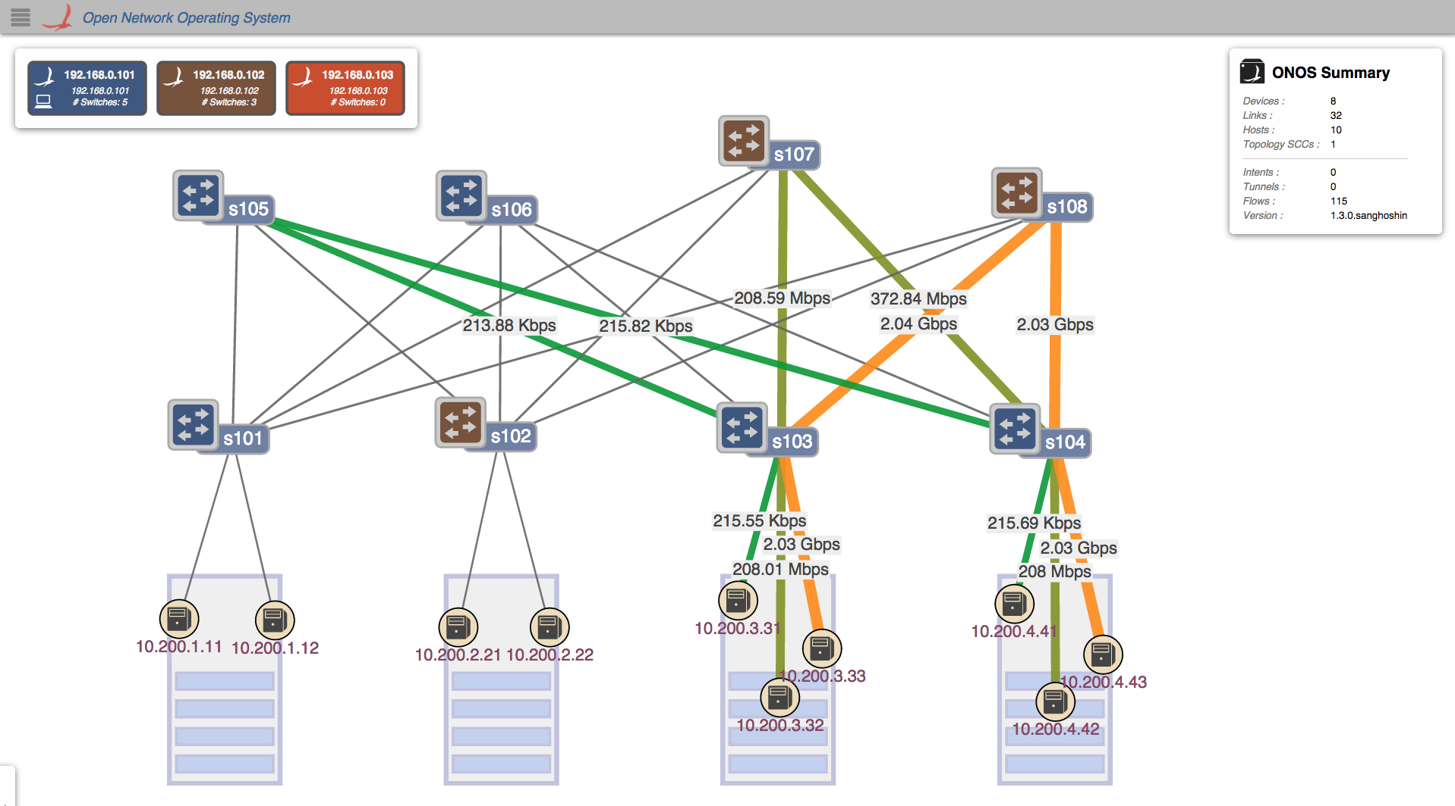
ECMP Routing

Slide 10
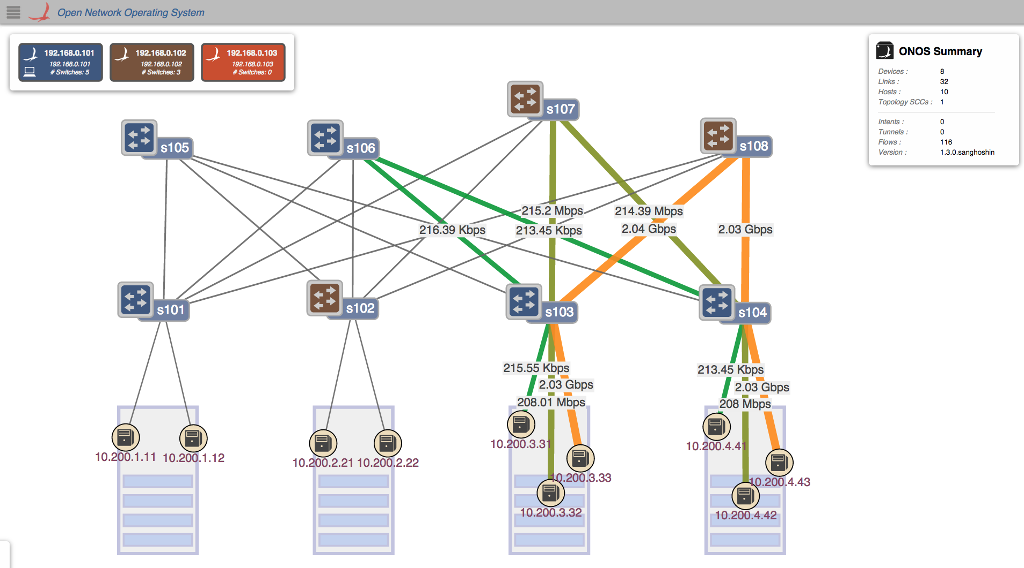
Policy Driven Traffic Engineering

Slide 11
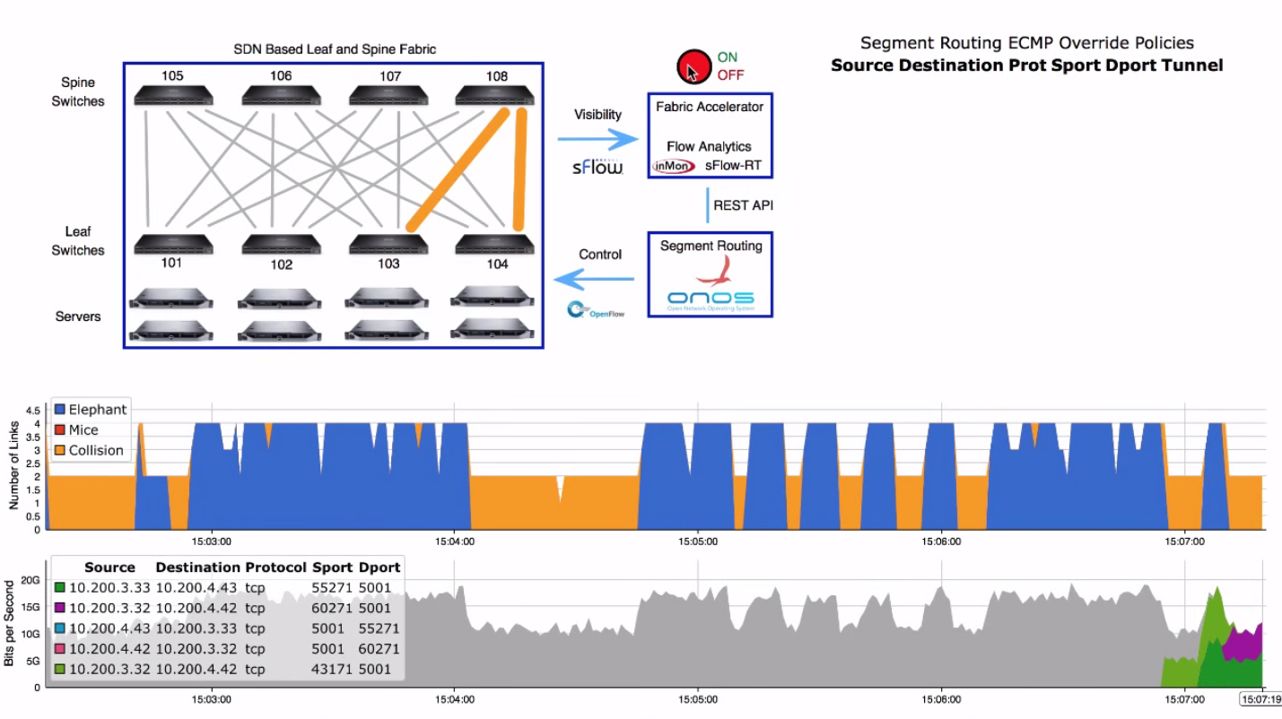
Analytics Driven Traffic Engineering

Slide 12
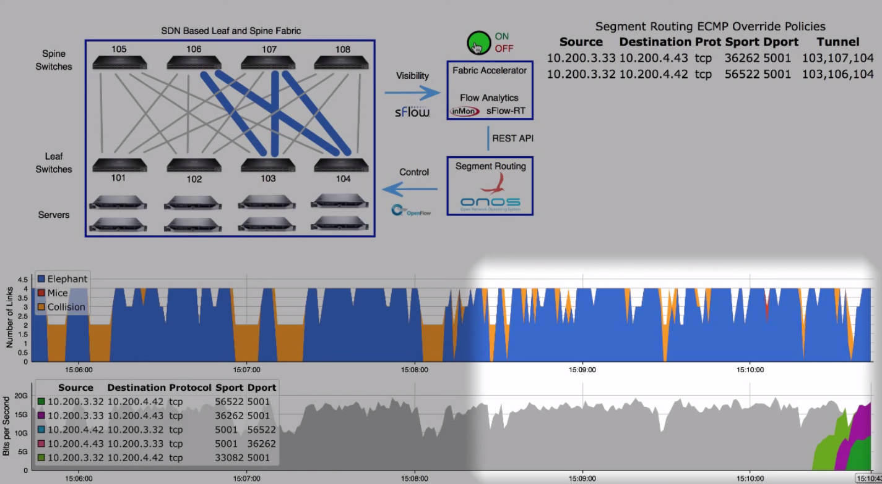
Analytics Driven Traffic Engineering

Slide 13
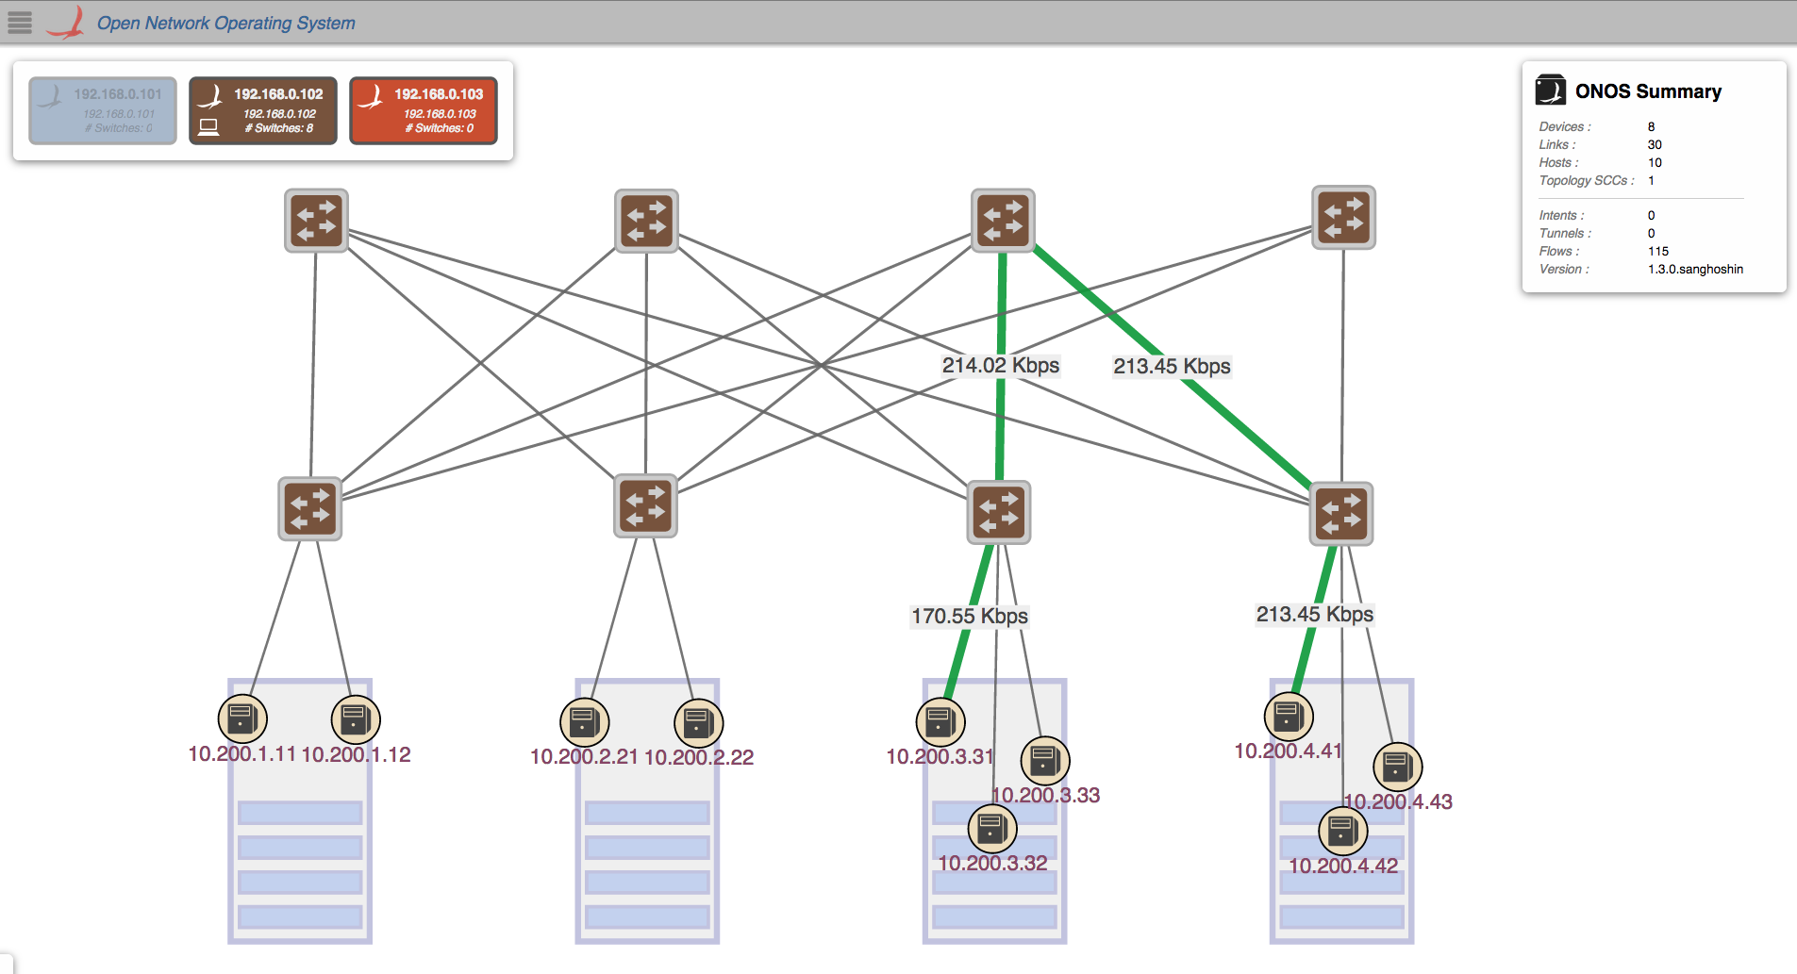
Control Plane Failure Recovery

Slide 14
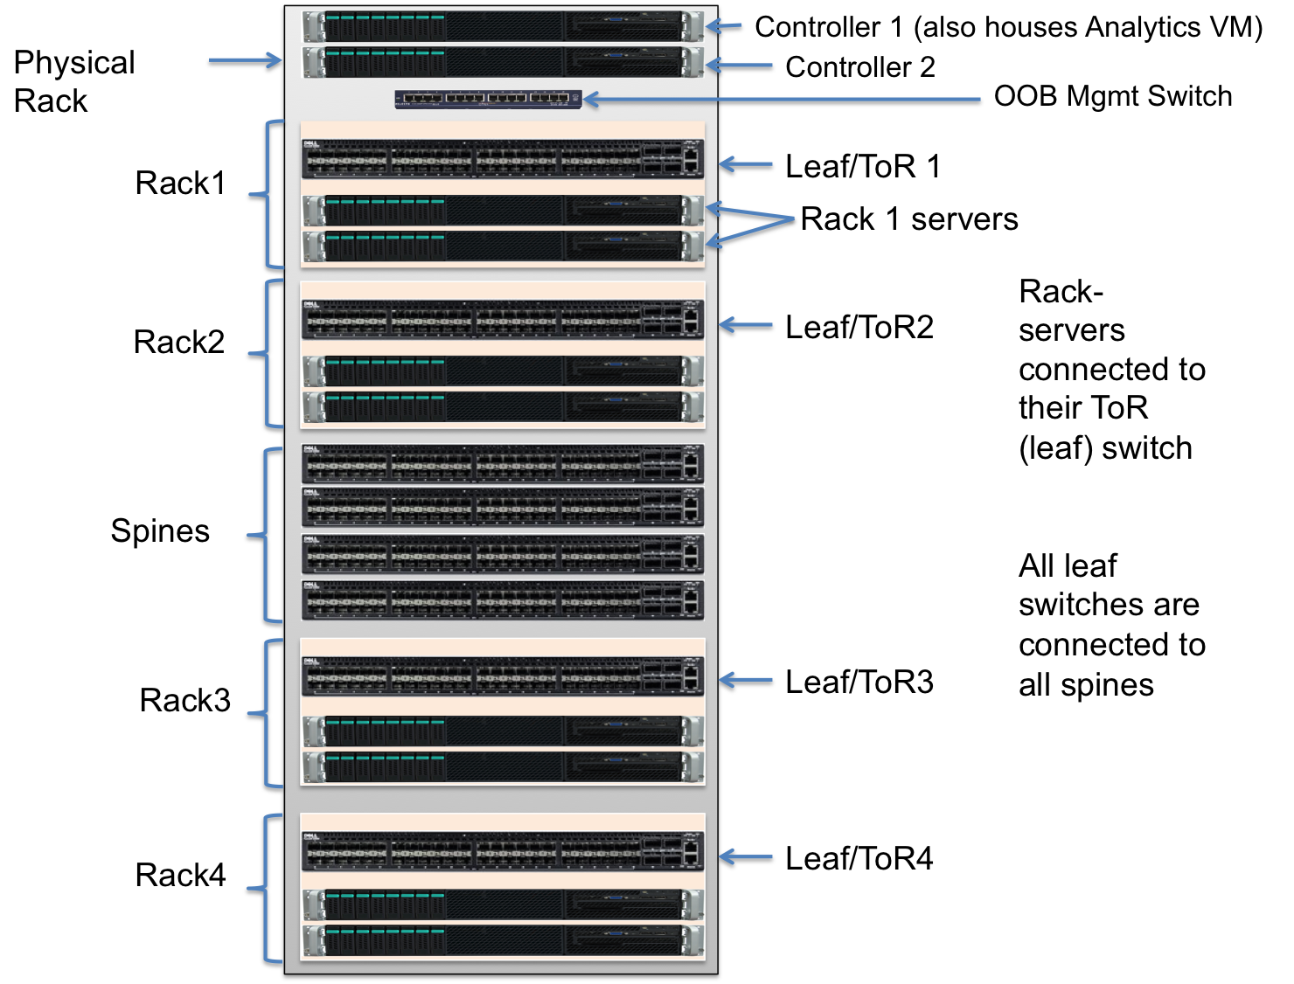
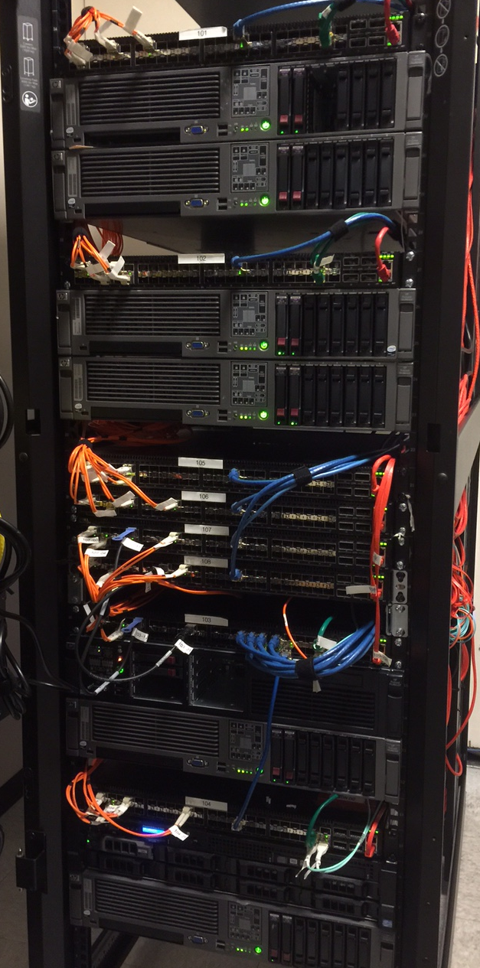

Slide 15
CORD Roadmap – From demo to deployment
AT&T and ONOS project
define CORD Solution POC
CORD Lab trials
CORD trial deployments
– phase 2
Lab trials with CORD POD
Jan’15
June’15
Dec’15
June’16
Dec’16
2017
CORD POC demo at ONS
CORD trial deployments
– phase 1
Service Provider deployments
Deployments by multiple Service Providers
Note- these timelines are ON.Lab’s projections and forward looking

Slide 16
Summary
CORD Fabric
  Open-source
  Spine-leaf architecture: L3 Clos
  Bare metal hardware
  SDN based – no use of distributed protocols
  OF 1.3 multi-tables & ECMP groups
  ONOS cluster controllers
  IP/MPLS network using Segment Routing
  sFlow based analytics for TE of elephant flows
Next?
  Integration with vCPE-vOLT-NFaaS
  Special CORD requirements eg. QinQ
  Pod based deployment requirements eg. BGP peering
  Move to open source hardware i.e OCP/ONL/ONIE/OF-DPA

