Slide 1
Central Office Re-architected
as a Datacenter (CORD)
CORD Fabric
Saurav Das
Principal Architect
Open Networking Foundation

Slide 2

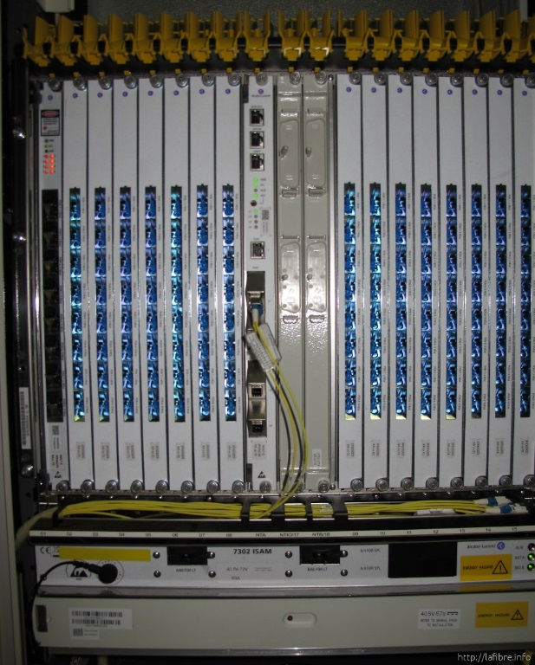

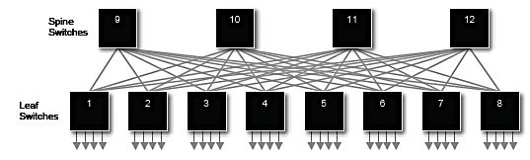



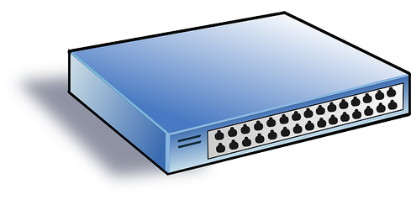

CORD: Central Office Re-architected as Datacenter
Applications
SDN Control Plane- ONOS
NFVI Orch- XOS
Spine
Switches
Control
Fabric
GPON OLT
IO
Leaf Switches
IO
IO
Metro Core
Link
PON
OLT
MACs
vOLT
vBNG
LDAP
Access
Link
vCPE
DHCP
RADIUS
ONT
GPON
Simple CPE
Commodity hardware
Data

Slide 3
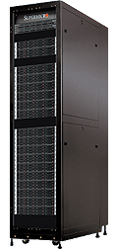
Open-Source Multi-Purpose Leaf-Spine Fabric
API
Fabric Control Application: Addressing, ECMP Routing, Recovery, Interoperability, API support
HA, scales to 16 racks, OF 1.3, Topo-Discovery, Configuration, GUI, CLI, Troubleshooting, ISSU
ONOS Controller Cluster
Open Source
SDN-based
Bare-metal
White Box
White Box
White Box
White Box
White Box
White Box
White Box
White Box
White Box
Fast
I/O
White Box
White Box
White Box
White Box
White Box
Slow
I/O:
PON
OLT
MACs
Metro
Core
Links
Access
Links
CORD fabric – designed to scale up to 16 Racks

Slide 4
Open Hardware & Software Stacks
Spine Switch
Leaf/Spine Switch Software Stack
White Box SDN Switch
Accton 6712
GE mgmt.
to controller
OpenFlow 1.3
OCP
Software
-
ONL
ONIE
Indigo OF Agent
32 x 40G ports downlink to leaf switches
40G QSFP+/DAC
OF-DPA API
OF-DPA
Leaf Switch
8 x 40G ports uplink to different spine switches
ECMP across all uplink ports
BRCM SDK API
BRCM ASIC
OCP Bare Metal Hardware
White Box SDN Switch
Accton 6712
OCP: Open Compute Project
ONL: Open Network Linux
ONIE: Open Network Install Environment
BRCM: Broadcom Merchant Silicon ASICs
OF-DPA: OpenFlow Datapath Abstraction
GE mgmt.
24 x 40G ports downlink to servers
via 4 X 10G breakout DAC

Slide 5







Project Atrium Stack
Quagga BGP
vlan x
vlan y
ONOS
Peering Application
E-BGP
E-BGP
vlan z
OFDPA Driver
OpenFlow 1.3
OCP
Software
-
ONL
ONIE
Indigo OF Agent
OF-DPA API
OF-DPA
BRCM SDK API
BRCM ASIC
OCP Bare Metal Hardware
OCP: Open Compute Project; ONL: Open Network Linux; ONIE: Open Network Install Env;
BRCM: Broadcom Merchant Silicon ASICs; OF-DPA: OpenFlow Datapath Abstraction

Slide 6
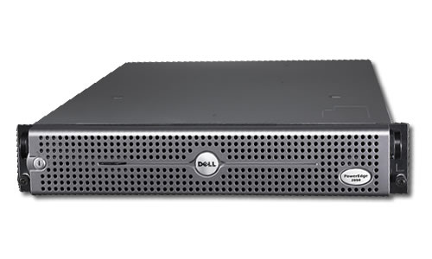
Field-Trial Specification
2 racks, 2 ToRs/rack, 2 spines, servers dual homed to ToRs
40G uplinks
Spine 2
Spine 1
Rack 1 Leaf 1
Rack 2 Leaf 1
Rack 1 Leaf 2
Rack 2 Leaf 2
GE L2 Switch
GE L2 Switch
1 X GE mgmt
2 X 10GE
(bonded)
dual-homed server to ToRs (leafs)
Rack includes
OLTs
Servers
OVS
C
C
VM

Slide 7
Outline
OpenFlow 1.3
Segment Routing
Leaf-Spine Fabric
Broadcom’s OF-DPA
Analytics driven Traffic Engineering
ONOS & Flow-Objectives

Slide 8
The single flow table abstraction
Rule
Action
Stats
Packet + byte counters
Forward packet to zero or more ports
Encapsulate and forward to controller
Send to normal processing pipeline
Modify Fields
Any extensions you add!
Switch
Port
VLAN
ID
VLAN
pcp
MAC
src
MAC
dst
Eth
type
IP
Src
IP
Dst
IP
ToS
IP
Prot
L4
sport
L4
dport
…
exact/wildcard, + bitmasks for some fields
Notes:
Rules: Each rule has a set of fields that it can match on, from Layer 1, the physical port, up to layer 4, the socket port. Each of these can be wildcarded or exact-matched, and some special fields can have bitmasks applied – for example Layer-3 IP prefix matching. You have the option of configuring highly specific rules with exact-match flow entries, very general ones with wildcards, or a mix.
Note that a later field may only have meaning if a previous field had a specific value; for example, a TCP field only makes sense if the IP version is 4.
Actions: Actions encode what to do with a packet. You can drop the packets, send it to one port, or multicast it to multiple ports. You can send it to the controller for further processing. In a hybrid switch, you can even send the packet to a normal processing pipeline. You can modify fields, and even extend the protocol with new actions.
Stats: OpenFlow defines packet and byte counters for each rule, which can be used for accounting, monitoring, flow balancing, or even security purposes.
[TODO: Possibly start with an example of a full wild card and a full exact match flow.]

Slide 9
Issue #1 with OpenFlow 1.0
Small Table Size
OpenFlow Client
Vlan
Table
Data Path (Hardware)
L2
Table
L3
Table
ACL
Table
128k
32k
2k
Notes:
Why is it important to look at 1.0 – because most controllers and switches out there are still 1.0, even though 3 years later we are at v1.4

Slide 10
Issue #2 with OpenFlow 1.0
Table-space (or flow-space) explosion
  Cross-Product Problem
def:
A condition where multiple independent header fields affect a packet’s forwarding, which forces the use of many flow entries in a single table.

Slide 11
Issue #2 with OpenFlow 1.0
Table space explosion
OF 1.0 Single Table
A, B, C, Y could be MAC or IP addresses, VLAN tags, MPLS labels etc.
A, Y1
A, Y2
A, Y3
A, Y4
A, Y5
Y1,
Y2,
Y3,
Y4
Y5
A
B, Y1
B, Y2
B, Y3
B, Y4
B, Y5
B
C
C, Y1
C, Y2
C, Y3
C, Y4
C, Y5
Single-table abstraction may use table space inefficiently compared to multiple tables

Slide 12
Issue #3 with OpenFlow 1.0
Limited match options
Supported:
MAC, VLAN, IP, L4 ports
Missing:
IPv6
QinQ
MPLS
SCTP
Optical circuits
Notes:
The second type of issue with OpenFlow 1.0 is the limited set of pre-defined fields, that can’t easily be extended.
The older, more obvious stuff is supported: MAC, VLAN, IP, and L4 ports. But none of the newer WAN and data center stuff is supported, like IPv6, MPLS, and QinQ, or stacked VLAN tags. There’s other stuff you’d like to support, like optical circuit flows, or some arbitrary new version of IP, which the protocol has no way to represent.

Slide 13
Issue #4 with OpenFlow 1.0
Limited forwarding options
Supported:
broadcast, multicast, drop
Missing:
packet spreading
forwarding to a virtual port
general byte modifications
link aggregation
sw1
sw2
multipath spreading
sw2
sw1
sw3
Notes:
The third major limitation is the lack of forwarding options. Basic stuff is supported, like broadcast and multicast and drop, but you can’t easily spread packets across ports.
For example, two links might be aggregated together, but to use those links, you’d have to use a whole bunch of flow entries to spread packets across them. Similarly, you might want to distribute traffic evenly to two destinations.
Ideally, you’d use one entry and it would spread the packets, either round-robin, or based on some content hash.
There are other things you’d like to do, like forward to a virtual port (to implement tunnels), or do general byte modifications.

Slide 14
OpenFlow has evolved towards production readiness.
state
behavior
Interface
msg
1.0
Q4 ‘09
flows
forward {0, 1, n}
single message queue
w/optional barriers
ports
match Eth, VLAN, IP, L4
+ Group Tables
+ forward 1-in-n (ECMP)
+ match QinQ, MPLS, SCTP
+ match virtual ports
1.1
Q1 ‘11
+ Multiple Tables/Pipelines:
1.2
Q4 ‘11
+ IPv6
+ multiple controllers
+ extensible match
+ extensible actions
1.3
Q2 ‘12
+ per-flow metering
+ tunnel-id
+ multiple channels (auxiliary connections)
1.4
Q4 ‘13
+ optical ports
+ synchronized tables
+ bundle messages
Notes:
Fortunately, over time, OpenFlow has evolved to address these all of these limitations that I mentioned.
1.1 was a huge change. Really should have been called 2.0, because it added a multiple-tables model. This enables much more efficient flow table usage, but it raises potential issues with a mismatch between the pipeline you want and the pipeline a device can implement.
1.2 added a bunch of nice extra features:
[explain]
1.3 starts to approach feature completion, where you pretty much have everything you could want, and full extensibility for anything not already there.
[BDH note: I don’t have much to add beyond the names.]

Slide 15
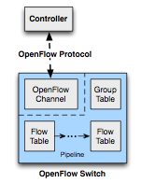
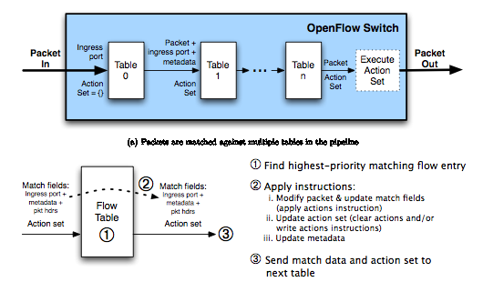
Multiple Tables in OF1.3
Untyped, Feed-forward, Skip ahead, Early exit
Notes:
Don’t take this as gospel. One choice of many. Tries to provide generality for future hardware and encourage more flexible forwarding to be exposed by the switch firmware.

Slide 16
Outline
OpenFlow 1.3
Segment Routing
Leaf-Spine Fabric
Broadcom’s OF-DPA
Analytics driven Traffic Engineering
ONOS & Flow-Objectives

Slide 17

Routing Service: Scenario # 1
Default Routing using Node Segments, ECMP and PHP
10.10.4.0/24
102
104
PHP
101
106
10.10.6.0/24
10.10.1.0/24
Still 106
Global label 106 imposed on pkts dst. to the 10.10.6 subnet
105
ECMP Paths
103
10.10.3.0/24
101, 102 … 106 are Node Segments allocated out of the SRGB, and bound to the router loopback addresses.
Notes:
This scenario depicts the default routing service -> SPF with ECMP in a BGP-free core using node-segments.
Consider 6 routers, with their loopback addresses bound to node-segments (or global labels) 101 – 106.
The topology displays two ECMP paths from 101 to 106 >> 101-102-104-106 and 101-103-105-106.
Packets destined to the 10.10.6/24 subnet originating in the 10.10.1/24 subnet will reach router 101. The ‘BGP-next-hop’ for such packets will be router 106.
The BGP-next-hop (106) is resolved into a shortest-path that uses ECMP and the node-segment 106.
The node-segment gets imposed on the packet (source-routing), and then it gets hashed onto the links that go to 102 or 103.
Lets assume this packet takes the upper path.
At 102, the node-segment 106 is still active, and so the label is left alone (or swapped with same label-id) and the packet is forwarded to the shorted path to 106 (which is to 104). Note how SR is different from normal MPLS forwarding (label swap with locally significant labels).
At 104, the node-segment 106 is still active, and so the packet is forwarded to the shortest-path to 106 (which is directly connected). Before sending out of the interface to 106, the label is penultimate-hop-popped (PHP).
At 106, the naked packet (no label) is forwarded via an IP-lookup in the IP table.
Note that forwarding using the IP table is done only at 101 and 106, where as 102 and 104 forward using the MPLS label (aka BGP-free-core).
Also note that this scenario supports L3VPNs (and L2VPNs) using multiple labels like normal MPLS forwarding.

Slide 18
Routing Service: Scenario # 2
Policy Routing
Anycast Node Segment 999
10.10.4.0/24
102
106
102
104
101
106
10.10.6.0/24
10.10.1.0/24
link X
104
106
103
105
10.10.3.0/24
Policy#1 – Traffic from .3 to .6 should avoid link X
Policy#2 – Flow ‘f’ from .1 to .6 should stay in upper plane
Notes:
On this slide we show two scenarios for policy-routing (which do not take the default SPF routing option).
The operator can configure these policies on the controller.
Policy #1 Traffic for 10.10.3/24 to 10.10.6/24 should avoid link X
Normally this traffic would take the shortest path to .6, which is the 103, 105, 106 path.
But avoiding link X (between 105 and 106) means that the traffic should use the 104-106 link.
Thus this traffic should take the shortest ECMP path to 104 and then take the 104-106 link.
This can be implemented with a label stack {104, 106} imposed at 103.
The 104 segment implies that at 103, the packet is hashed over two possible interfaces (ones going to 102 or 105)
Lets assume this packet takes the upper path to 102.
At 102, the active segment is still 104, so 102 determines the shortest path to 104, which is directly connected.
Before exiting, 102 removes the 104 label (PHP).
At 104, the active segment is now 106, and so 104 determined the shortest path to 106, which is directly connected.
Before exiting, 104 removes the 106 label (PHP).
At 106, the packet is looked up in the IP table.
Policy has thus been successfully implemented.
Policy #2 requires that a particular kind of traffic (designated flow ‘f’) from the 10.10.1/24 subnet to 10.10.6/24 subnet, should take the upper of the ECMP paths to the destination. Note that without policy routing, this traffic (like all other traffic) would have taken either of the ECMP paths to the destination (like Scenario # 1).
We can identify flow ‘f’ by using the ACL table at 101, and then override the default routing process, by imposing a label-stack {102, 106} on packets belonging to this flow. Before exiting, 101, the label for 102 is removed.
At 102, the packet is shortest path routed to the active-segment 106, which implies sending the packet to 104.
At 104, the active segment is still 106, so the packet is shortest-path routed to 106. Before exiting, the label 106 is PHP’d.
Note that the anycast-segment 999 is configured on all of the routers in the upper-plane (actually its configured on the controller). It implies that this packet can be sent to any of the routers in the anycast-segment. In this particular example, the packet can be sent to 102 or 104. Using a label-stack {999, 106} would work because 999 implies sending to 102 or 104. But in this sparse topology, this stack will violate the policy in the event of failure of 102. In such a case, the packet will be shortest path-ed to 104, which will use the lower plane (103-105-104), and thus violate the policy. But if the topology included more routers in the upper plane, for example say router 110 (not shown), directly connected to 101, then a label-stack using the anycast-segment {999,106} would work, and it would have the advantage that the policy would not be ‘tied’ to any one router (like 102). On the failure of 102, the flow would automatically reroute to the shortest path to any other router (like 110) that is part of the anycast set, while not violating the policy of staying in the upper plane.

Slide 19
Routing Service: Scenario # 3
TE Support: Load-balancing among non-ECMP Paths
10.10.4.0/24
12009
106
102
104
101
106
10.10.6.0/24
10.10.1.0/24
105
Non-ECMP paths
Same adjacency segment 12009 assigned to both outgoing links for load-balancing at 102, to 104 or 103
103
10.10.3.0/24
Once at 104 or 103, it’s just SPF to 106
Notes:
This is the first of two scenarios that support planned traffic-engineering.
Planned traffic engineering often requires load-balancing traffic across tunnels, that don’t take the normal shortest-path to the destination. For example, in the scenario above, assume two tunnels taking paths 102-104-106 and 102-103-105-106. Clearly these are non-ECMP paths. But traffic arriving at 102, and destined for 106 can still be load-balanced over these paths by using adjacency-segments.
In segment routing, adjacency segments have only local significance. For example, the outgoing links at 102 to 104 and 103 can have the same adjacency-segment 12009 configured on them. 12009 has significance only ay 102, ie. only 102 would have a forwarding entry in its FIB that matches on 12009. The resultant action would be to hash on to the two links that are part of the same adjacency-segment. Once one of the links is chosen, the label 12009 is popped off.
At 103 (or 104), the active segment is 106, and so the packet is shortest-path-ed to 106.

Slide 20
Routing Service: Scenario # 4
TE Support: Explicit Routing
10.10.4.0/24
102
103
105
102
104
106
10.10.6.0/24
10.10.1.0/24
101
Desired Explicit Path
Deep-stacks can cause problems in merchant silicon
Cannot push many labels all at once
Can cause loss of entropy if hw cannot read down to L3/L4 headers
Solution: use Segment stitching
103
105
Requires label stack:
102
103
105
104
106
Pop 105
Push
104
106
Stitching Segments
Notes:
Here is another scenario that supports planned traffic engineering – a strict explicit path.
The path desired takes a circuitous route 102-103-105-104-106. In segment routing it can only be satisfied with a label stack that is 5 labels deep.
Deep label stacks could cause problems in merchant silicon. For example,
We may not be able to push all 5 labels at the same time
Even if we can, the deep stack may result in subsequent routers not being able to ‘read’ the packet down to the L3/L4 headers. When that happens, the packet cannot be hashed based on L3/L4 headers leading to a loss of entropy (although ECMP is not a concern in this particular example).
There are a couple of options open to us to realize this segment route.
One option is to split the explicit path as two segments and stitch them at some point along the path.
For example, 101 imposes a smaller label stack {102, 103, 105}. At 103, when the packet is about to be sent out of the link to 105, the label 105 is popped and the rest of the path is imposed via pushing labels {104, 106}.
Another option is to use label-swapping (not shown). For example, the links along the path have the following adjacency segments defined on them.
@101, link to 102 => 3000
@102, link to 103 => 666
@103, link to 105 => 13002
@105, link to 104 => 971
The packet then could take the following path,
Before 101, impose single label 3000
@ 101, swap 3000 for 666 and send out of link to 102
@ 102, swap 666 for 13002 and send out of link to 103
@ 103, swap 13002 for 971 and send out of link to 105
.. and so on
Note that this is technically not segment routing as it is not ‘source-routed’, but it is a service that can be provided by the routing-service in the controller.
It is also a good example of how you can use software to get around the limitations of hardware.

Slide 21
Routing Service: Scenario # 5
Service Chaining
10.10.4.0/24
103
9002
105
16555
106
102
104
106
10.10.6.0/24
10.10.1.0/24
101
Desired Chain
103
105
Adjacency
Segment 16555
Adjacency
Segment 9002
Firewall
DPI
Note: Could have used segment-stitching or label-swapping to avoid deep label stack
Notes:
This example covers a service chaining scenario that has relevance within or across data-centers. In principle, it can be viewed as the NFVI layer that supports VNFs.
Here services (or VNFs) like firewalls and load-balancers are attached to segment-routers. The operator can define a service chain which goes through two services attached to routers 103 and 105 before being routed to the 10.10.6/24 subnet.
The services are represented as adjacency segments 9002 and 16555 on the links that connect them to routers 103 and 105 respectively. As before, the adjacency segments have relevance only at the routers they are configured on. So when a packet reaches router 103, the active segment (topmost label) is 9002, which makes router 103, remove the label 9002 and send the packet out of link attached to the firewall. When/if the packet returns to 103, the active segment is 105. The router 103 then forwards the packet on the shortest path to 105 (which is the link that is directly connected to 105), and pops off the label ‘105’.
At 105, the active segment is 16555, which means that the router pops off the label 16555 and forwards the packet out of the link that connects it to the DPI engine.
When the packet returns, the active segment is 106, which makes the router 105 send it out of the interface connecting it to 106 (and pop off the label 106).
At 106, the packet is looked up in the IP table.
As in the previous example, we could have used segment-stitching or label-swapping to avoid a deep-label-stack.

Slide 22

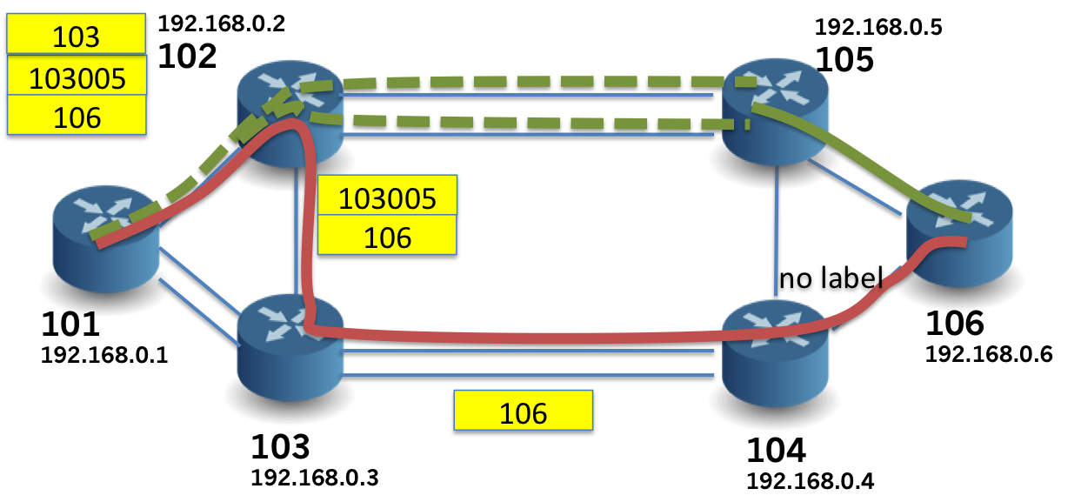


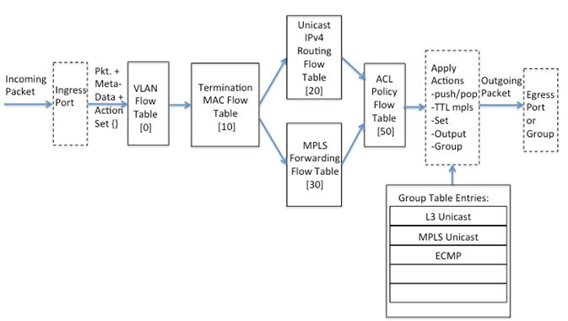
SPRING-OPEN
Segment Routing on
Bare Metal Hardware
Learn more:
https://wiki.onosproject.org/display/ONOS/Segment+Routing

Slide 23
Outline
OpenFlow 1.3
Segment Routing
Leaf-Spine Fabric
Broadcom’s OF-DPA
Analytics driven Traffic Engineering
ONOS & Flow-Objectives

Slide 24
PoC Demo @ ONS June‘15
Segment Routed
Fabric Control
ONOS Controller Cluster
SDN controlled
L3 Leaf-Spine Clos fabric.
Dell
Dell
Dell
Dell
Dell
Dell
Dell
Dell
4 racks, 2 servers/rack, Dell 4810 bare metal,
ONOS Cardinal controller cluster

Slide 25
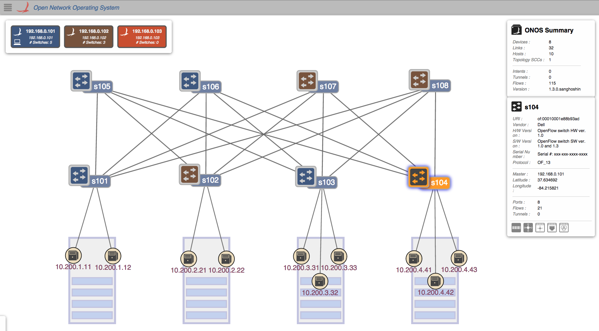
CORD: Fabric
103

Slide 26
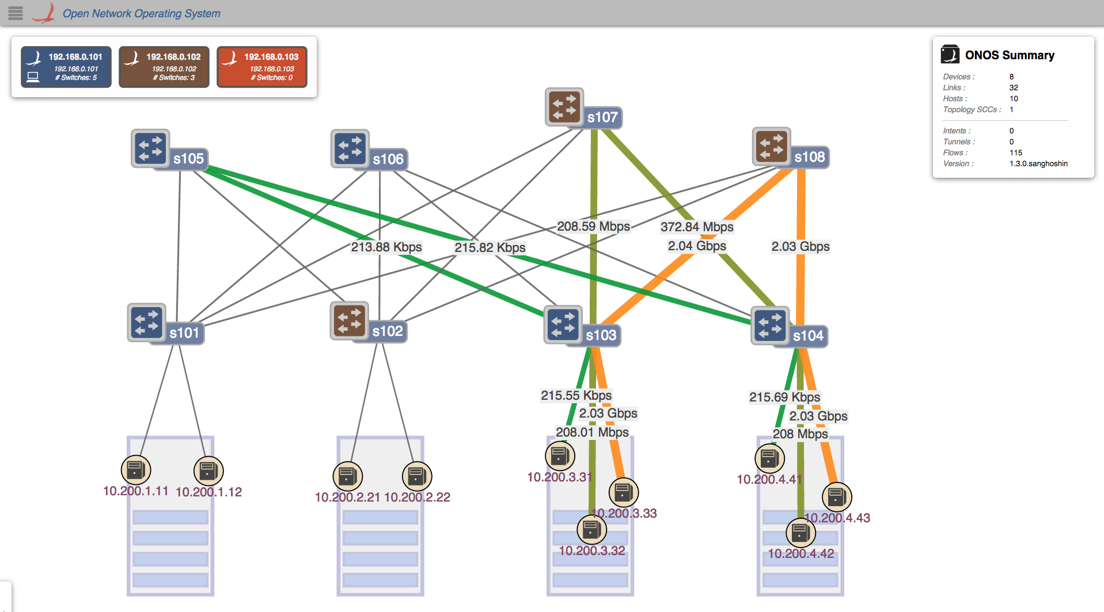
ECMP Routing

Slide 27
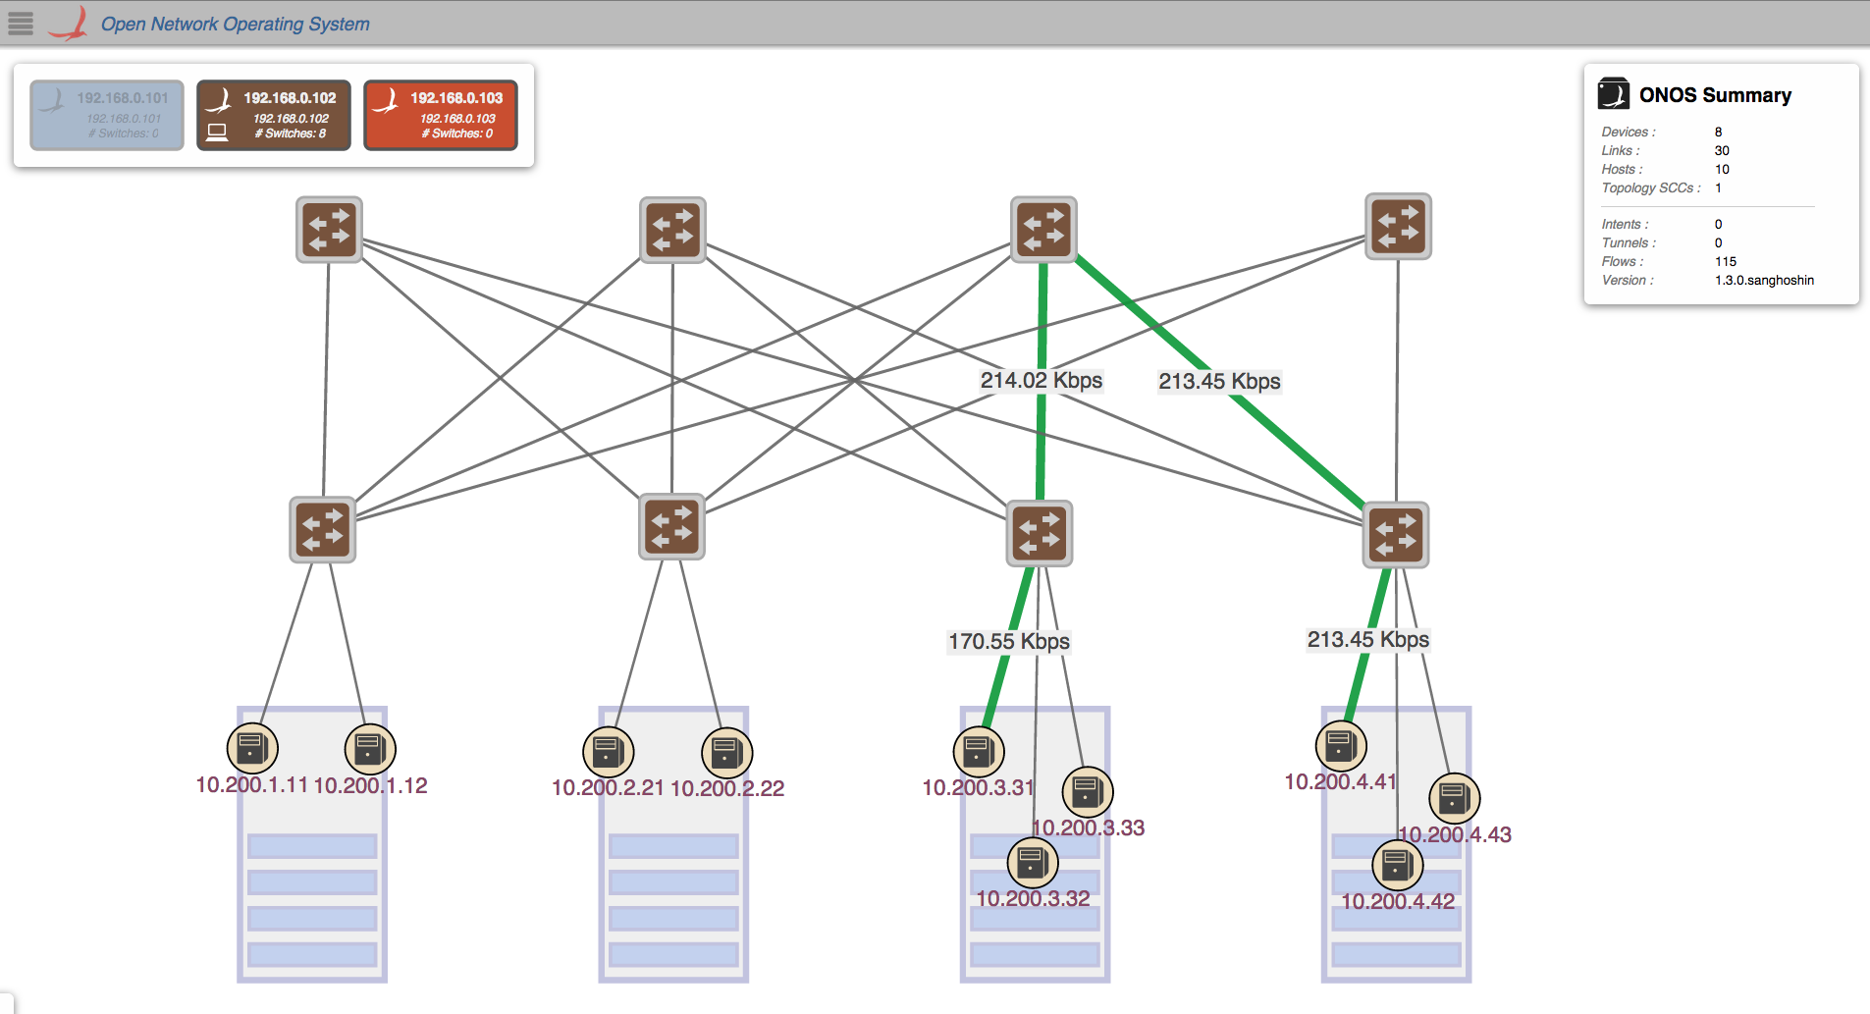
Control Plane Failure Recovery

Slide 28
Outline
OpenFlow 1.3
Segment Routing
Leaf-Spine Fabric
Broadcom’s OF-DPA
Analytics driven Traffic Engineering
ONOS & Flow-Objectives

Slide 29
From vCPE to S1, or from S1 to S2, etc.
Server
Fabric
Server
Virtual net
IP
Infrastr.
IP
Dst IP
lookup
SR Label Lookup
Dst IP Lookup
Tunnel decap
Tunnel encap
S1B
OVS
Leaf
Spine
Leaf
OVS
S2C
MAC DA
spine
MAC DA
Leaf
MAC SA
leaf
MAC DA
leaf
MAC DA
OVS
MAC SA
OVS
represents
Dst. leaf sw
SR Label
MAC SA
spine
MAC SA
leaf
OVS IP addrs.
IP
infrastucture
IP
infrastucture
IP
infrastucture
IP
infrastucture
UDP
UDP
UDP
UDP
VXLAN
VNI=S2
VXLAN
VNI=S2
VXLAN
VNI=S2
VXLAN
VNI=S2
MAC DA
of Service 2
MAC DA
of S2C
MAC DA
of S2C
MAC DA
of S2C
MAC DA
of S2C
MAC DA
of S2C
MAC SA
of S1B
MAC SA
of S1B
MAC SA
of S1B
MAC SA
of S1B
MAC SA
of S1B
MAC SA
of S1B
Payload
Payload
Payload
Payload
Payload
Payload
This example shows how a Service 1 instance (S1B) reaches a Service 2 instance (S2C)

Slide 30
L2 Bridging withing a Rack

Slide 31
L3 Across Racks – IP/MPLS

Slide 32
From PON to vCPE
I/O
Fabric
Server
Double VLAN lookup
SR Label Lookup
PW Label Lookup
Double VLAN lookup
OLT
Leaf
Spine
Leaf
OVS
vCPE
Router
macs
MAC DA
spine
MAC SA
leaf
MAC DA
represents
Dst. leaf sw
SR Label
MAC SA
represents
Dst. server
PW Label
PW Label
vCPE mac
MAC DA
MAC DA
MAC DA
MAC DA
subscriber mac
MAC SA
MAC SA
MAC SA
MAC SA
MAC DA
802.1ad
PON S-Tag
0x88a8
PON S-Tag
PON S-Tag
PON S-Tag
MAC SA
Cust C-Tag
0x8100
Cust C-Tag
Cust C-Tag
Cust C-Tag
Cust C-Tag
Payload
Payload
Payload
Payload
Payload
Can preserve 2 tags, or just C-tag, or remove both tags
This slide presumes that a vCPE has been allocated for a subscriber, where the subscriber can be identified by the double-tag, and the vCPE location has been communicated to the fabric controller
Notes:
Plan for single leaf /dual leaf arrangement without any spine?

Slide 33
802.1ad and Pseudowires

Slide 34
Outline
OpenFlow 1.3
Segment Routing
Leaf-Spine Fabric
Broadcom’s OF-DPA
Analytics driven Traffic Engineering
ONOS & Flow-Objectives

Slide 35
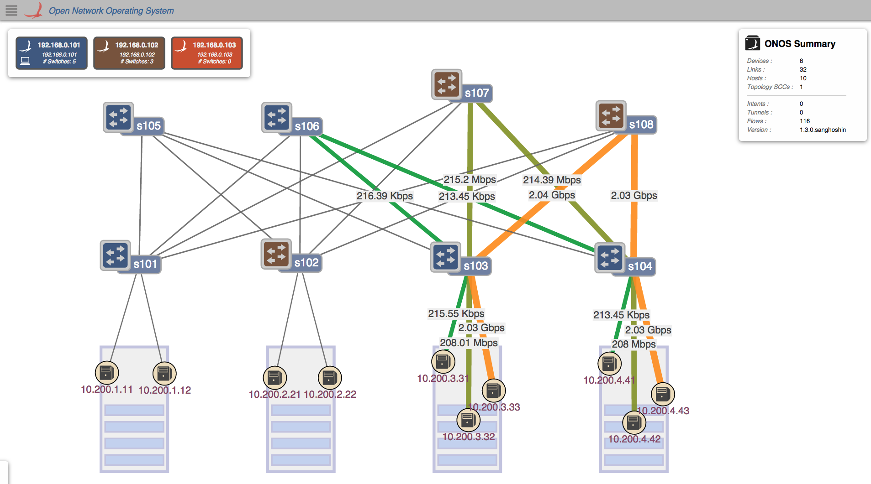
Policy Driven Traffic Engineering

Slide 36
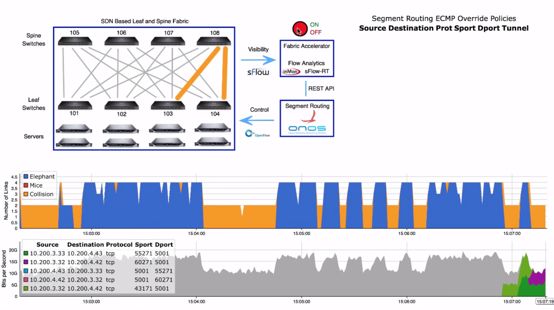
Analytics Driven Traffic Engineering

Slide 37
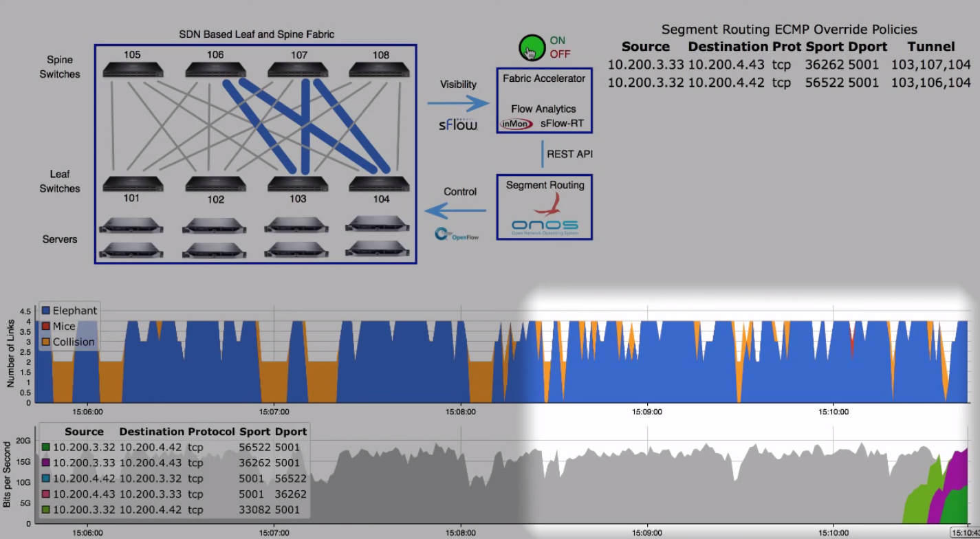
Analytics Driven Traffic Engineering

Slide 38
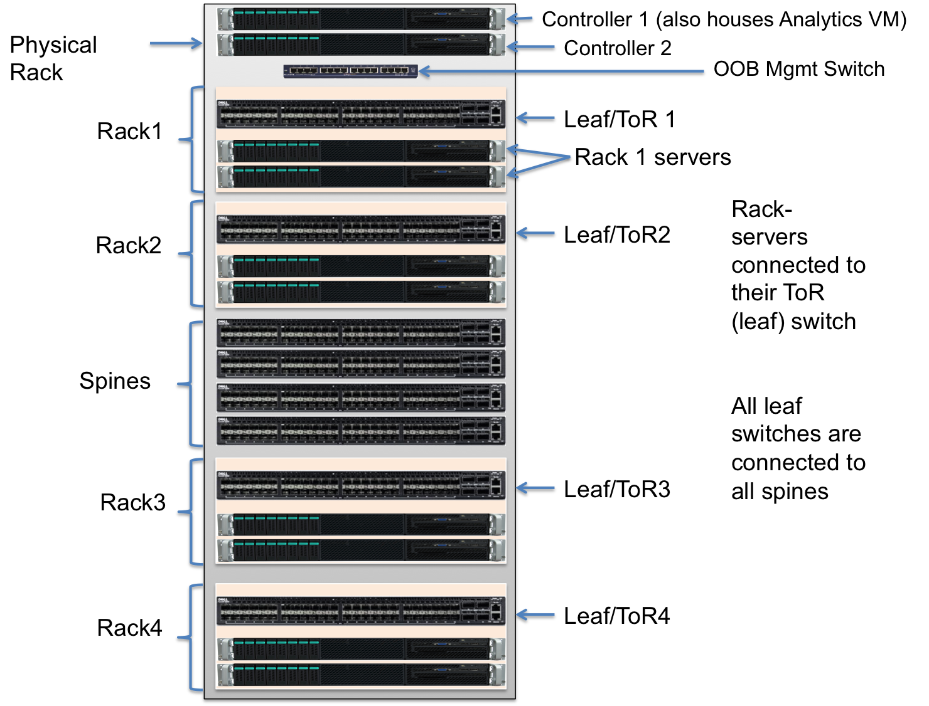
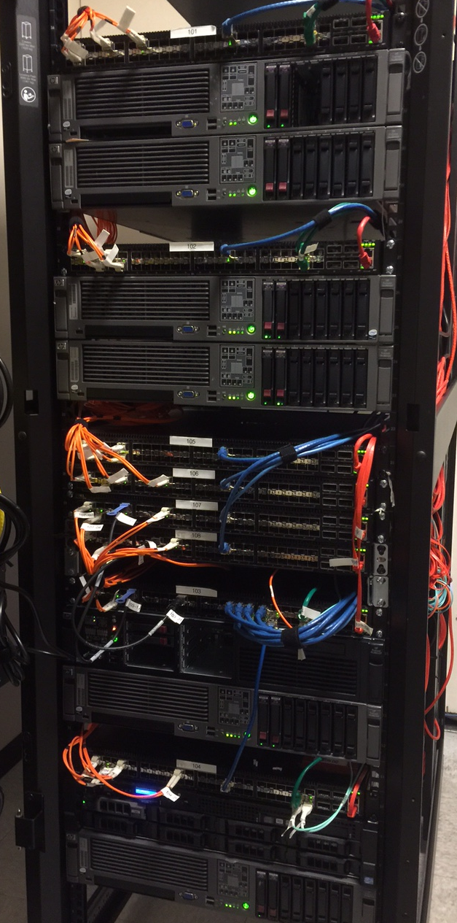

Slide 39
Outline
OpenFlow 1.3
Segment Routing
Leaf-Spine Fabric
Broadcom’s OF-DPA
Analytics driven Traffic Engineering
ONOS & Flow-Objectives

Slide 40
A Closer Look at Interoperability
Different combinations of
Match-Action Tables form
Different OF 1.3 pipelines
How can a controller manage these differences?
How can an application work across these differences?
Accton, Quanta (BRCM ASIC)
NoviFlow, Netronome
(NPU/NFP)
Corsa
(FPGA)
Pica8
(BRCM ASIC)
Centec
(ASIC)

Slide 41
Solution: Flow Objectives API
Write the app once
without pipeline details
SDN Application
Flow Objectives
Controller
OFDPA Driver
SoftRouter Driver
Corsa Driver
Pica8
Driver
Centec Driver
adapt to specific
Pipeline using
device driver
OpenFlow 1.3
OpenFlow 1.3
Switch
Accton, Quanta (BRCM ASIC)
NoviFlow, Netronome
(NPU/NFP)
Corsa
(FPGA)
Pica8
(BRCM ASIC)
Centec
(ASIC)

Slide 42
Example: Filtering Objective
Filter ➔ only Permit or Deny options
On match fields of packet header
Permit: MAC 1, VLAN 1, IP 1, 2, 3
Router port: X
Permit: MAC 1, VLAN 2, IP 4, 5
Flow Objectives
Corsa Driver
OF-DPA Driver
T0
mac
T2
port-vlan
T4/5
T6
ip
T0
port
T1
Port-vlan
T2
mac
T4
ip

Slide 43
Example: Next Objective
Next ➔ next hop for forwarding
Similar to OF 1.3 group, but …
bkt
Corsa Driver
Indirect group
NEXT- HOP
bkt
Flow Objectives
Group chain
OF-DPA Driver
→ Flow-actions
NoviFlow & Pica8 Drivers

Slide 44
ONOS Architecture
I-BGP Speaker/RIB
I-BGP Speaker/RIB
Applications
(distributed)
Segment Routing
BGP Router
Optical
SDN-IP
Flow Objectives
Driver X
Driver Y
Driver Z
Intent
Service
Device Service
Topology Service
Core Services (distributed)
Mastership Service
Host Service
Flow Rule Service
Group
Service
Packet Service
Link Service
Stats Service
Host Provider
LLDP Provider
Providers
Netconf Provider
PCEP
Provider
OpenFlow Provider (1.0, 13)
TL-1
Providers

Slide 45
Summary
CORD Fabric
  Open-source
  Spine-leaf architecture: L3 Clos
  Bare metal hardware
  SDN based – no use of distributed protocols
  OF 1.3 multi-tables & groups
  ONOS cluster controllers
  IP/MPLS network using Segment Routing
  sFlow based analytics for TE of elephant flows
Current Status
  Move to open source hardware i.e OCP/ONL/ONIE/OF-DPA
  Integration with vCPE-vOLT-NFaaS
  Special CORD requirements eg. 802.1ad & Pseudowires
  Pod based deployment requirements eg. BGP/OSPF (vRouter)

