Slide 1

Why OpenFlow/SDN Can Succeed
Where GMPLS Failed
Saurav Das, Guru Parulkar & Nick McKeown
Stanford University
European Conference on Optical Communications (ECOC)
18th Sept, 2012

Slide 2
What is the Transport Network good at?
Guarantees:
Bandwidth
Latency
Jitter
Path
Bandwidth on Demand
Scheduled
On- Demand
Recovery

Slide 3
The Future?
All Services
INTERNET
INTERNET
Enterprise Private -Lines
Private-Nets
PSTN
TRANSPORT Network
Cellular
Backhaul
As much as 60% of AT&T’s Transport Network directly or indirectly supports the Internet
A. Gerber, R. Doverspike. “Traffic Types and Growth in Backbone Networks”. OFC/NFOEC 2011

Slide 4
What is the Transport Network good at?
Guarantees:
Bandwidth
Latency
Jitter
Path
Bandwidth on Demand
Scheduled
On- Demand
Recovery
What does the Internet want?
-- Give me a
Big Fat Dumb Pipe

Slide 5
Client Network
In theory…
UNI
Client Network
Transport Network
Client Network
UNI
UNI
UNI
Client
Network
In practice: There is no commercial deployment of an IP network in the world that dynamically interacts with a transport network using UNI/GMPLS

Slide 6
Why did GMPLS fail? -- I
Transport Network
Packet Network
UNI
Router vendors can just say NO
Political Reason
SDN can help..

Slide 7
Why did GMPLS fail? -- II
Transport Network
Packet Network
UNI
Routers can do it all
Technical Reason
But it will cost you..
Economic Reason

Slide 8
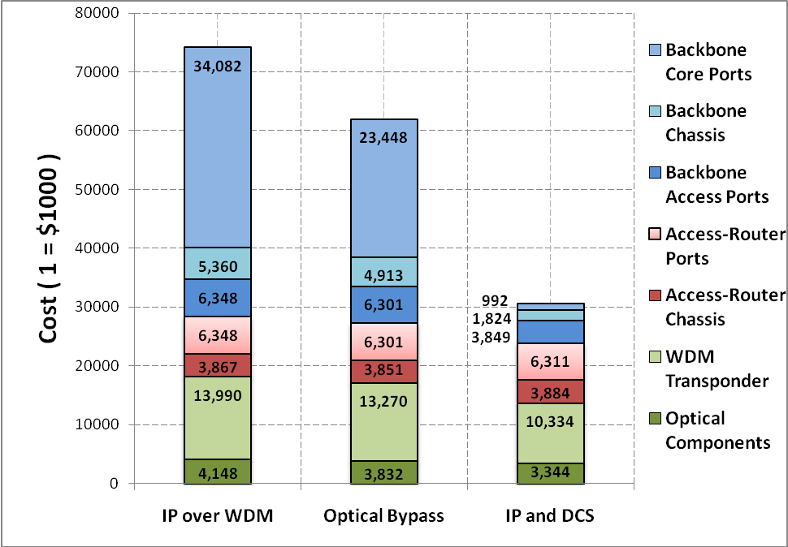
SDN + Dynamic Circuits can help..
1
59%
See “Rethinking IP Core Networks” under Publications www.openflow.org/wk/index.php/PAC.C

Slide 9
Why did GMPLS fail? -- III
GMPLS Control Plane
IP/MPLS Control Plane
OSPF-TE
RSVP-TE
UNI
OSPF-TE
RSVP-TE + many many more
EMS
EMS
EMS
Proprietary Interface
Proprietary Interface
Vendor Islands
Transport Network
IP Network
We Didn’t Make it Easy
9

Slide 10
Example Network Application
Control Function: Treat different kinds of traffic differently
Function Impl.: Use both packets and circuits,
at the same time.
Traffic-type | Delay/Jitter | Bandwidth | Recovery
VoIP | Lowest Delay | Low | Medium
Video | Zero Jitter | High | Highest
Web | Best-effort | Medium | Lowest
VOIP
VOIP
VIDEO
HTTP
HTTP
“Aggregation and Traffic Engineering in a Converged Packet-Circuit Network” OFC/NFOEC 2011

Slide 11
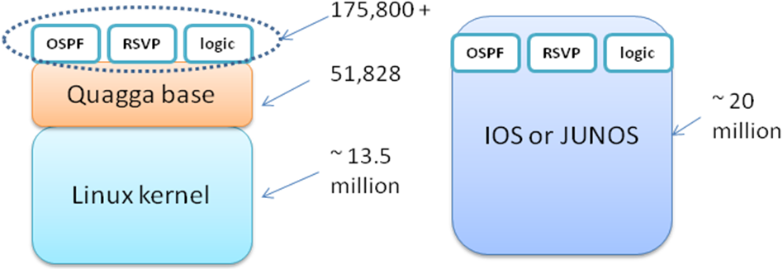
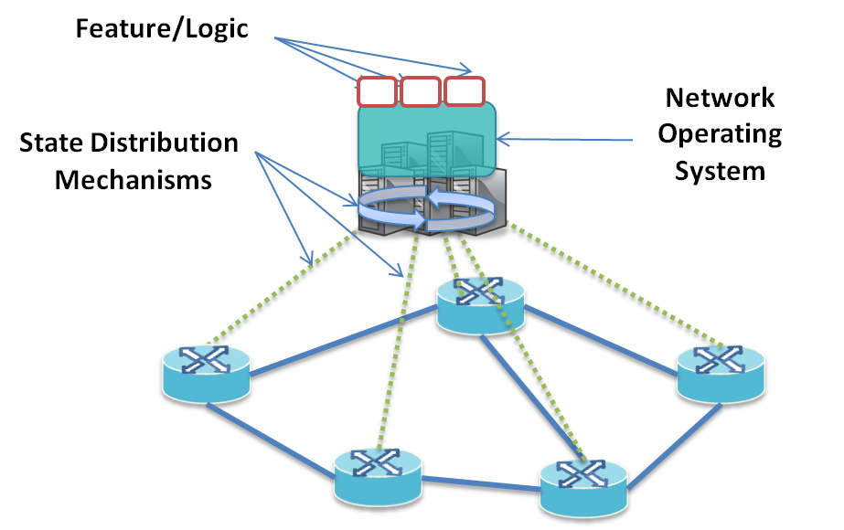
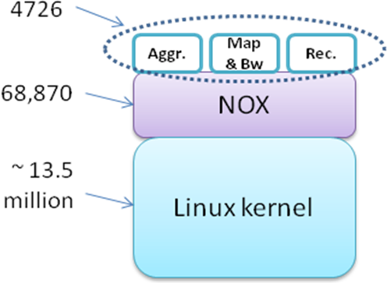
SDN-Two Orders of Magnitude Lesser LOC

Slide 12
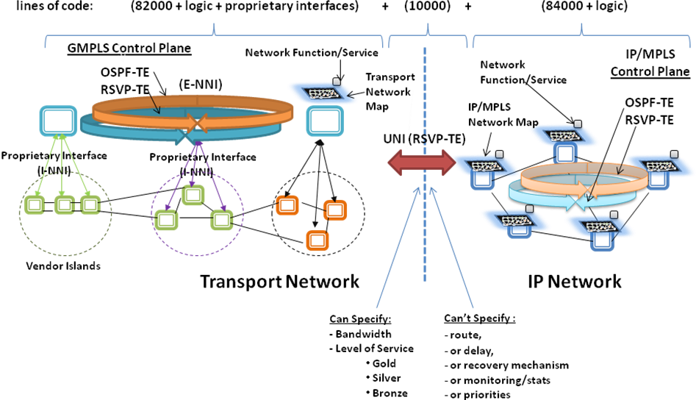
Why did GMPLS fail? -- IV
Services are tied to Protocols – not easily extensible

Slide 13

Adding a service
What would it take in today’s networks?
DEPLOYMENT
Carrier need/idea
Extensions…
Ask vendors to implement solution
B
C
J
3-5 year process
Limited Field Trials
..if it gets off the ground
Long time later
non-interoperable pre-standard solutions
Carrier Lab Trials
Standard
XJBC
B
C
J

Slide 14
Adding a service
Protocols may interoperate; Services don’t
Auto-Route
Auto-Bandwidth
Priorities
Load-Share
DS-TE
FRR
Re-opt
Auto-Route
Auto-Bandwidth
Priorities
Load-Share
DS-TE
FRR
Re-opt
Auto-Route
Auto-Bandwidth
Priorities
Load-Share
DS-TE
FRR
Re-opt
TE
TE
TE
LDP
I-BGP + RR
MP-BGP
RSVP-TE
OSPFv2
LDP
I-BGP + RR
MP-BGP
RSVP-TE
OSPFv2
LDP
I-BGP + RR
MP-BGP
RSVP-TE
OSPFv2
Juniper
Cisco
Brocade

Slide 15
Why is SDN the Right Abstraction?
Extensibility of Applications/Services
2. Common Map Abstraction
NetOS
Unified
Control
Plane
Interface: OpenFlow Protocol
Packet and Circuit Switches
Common Flow Abstraction
The Common Map Abstraction hides the complexity of the control plane from the applications/services. In effect it decouples the applications from the protocols, thereby allowing the applications/services to be implemented in a simple, centralized, extensible way.
15

Slide 16
Network Functions
routing, access-control, mobility, traffic-engineering, guarantees, recovery, bandwidth-on-demand …
Network - API
2. Common Map Abstraction
Network Operating System (netOS)
Unified Control Plane
State Collection, Dissemination &
Application Isolation
Built for Performance Scale & Reliability
Configuration, Control over Forwarding & Monitoring
Switch - API
Common Flow Abstraction
Tables for identifiers and actions
L4
L3
L2.5
L2
L1
L0
Flow is any combination
IP Router
Wavelength Switch
Multi-layer
Switch
TDM
Switch
EthernetSwitch

Slide 17
Transport Network
Packet Network
UNI
Don’t want to give info
Don’t want to give up control

Slide 18
Virtualization
App
App
App
App
App
App
Common Map
here
Common Map
here
ISP# 1’s NetOS
ISP# 2’s NetOS
Programmability
Packet Network
TN
Slice
Control Plane Isolation
TN
Slice
Packet Network
Transport Service Provider’s Virtualization Plane
Transport Network
Data Plane Isolation
- circuits!
Virtualization == Isolation + Programmability

Slide 19
Don’t want to give info
Don’t want to give up control
-- give up some
-- only the part in the slice
-- retain overall control via the virtualization plane
What’s the incentive?
--- a new service
Otherwise
-- stuck with UNI/GMPLS which no IP network uses
-- stuck being a dumb-pipe seller

Slide 20
Why did GMPLS fail? -- V
Transport network operators
dislike giving up precise (manual) control
to an automated software control plane
irrespective of how intelligent it may be
&
decades worth of established procedures
Is there a gradual adoption path?

Slide 21
Gradual Adoption Path
ISP ‘A’ Client Controller
ISP ‘B’ Client Controller
ISP ‘C’ Client Controller
C
C
Transport Service Provider’s Virtualization Plane
D
D
D
D
CK
D
D
P
D
D
CK
D
D
D
CK
D
D
D
D
D
D
D
P
CK
D
CK
D
P
D
D
P
D
D
D
D
D
Notes:
can be sliced

Slide 22
Summary
Why did GMPLS fail ?
Router vendors can say NO
SDN can help
Routers can do it all
SDN + Optical switching can help reduce costs significantly
Did not make it simple
SDN can be two orders of magnitude simpler
Services tied to protocols - not easily extensible
SDN abstracts away distributed control, so applications can be centralized – helps service/application extensibility
Conservative nature of operators
SDN based Virtualization for sharing limited information, providing a new service and presenting a gradual adoption path

