Slide 1

Virtualizing the Transport Network Why it matters & how OpenFlow can help
Saurav Das
OFELIA Workshop, ECOC
18th Sept, 2011

Slide 2
Outline
Motivation
Unified Control Architecture
Three Challenges

Slide 3
IP Network
Transport Network

Slide 4
The Future?
All Services
INTERNET
INTERNET
Enterprise Private -Lines
Private-Nets
PSTN
TRANSPORT Network
Cellular
Is there a need for circuit switching in the Transport Network?

Slide 5
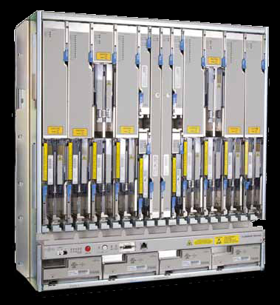
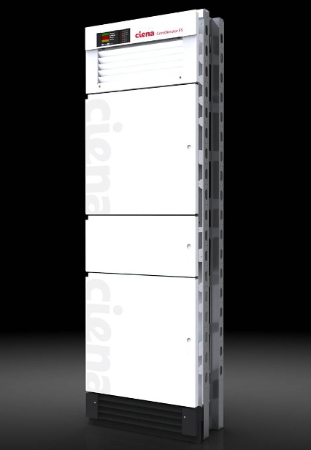
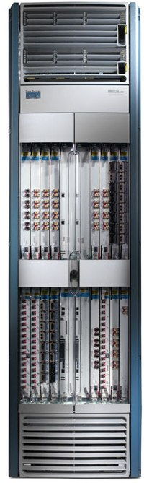
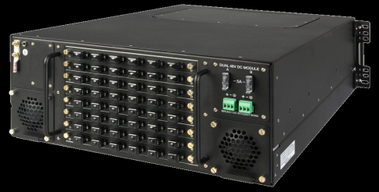
Packet and Circuit Switches
 | Glimmerglass IOS600 | Fujitsu Flashwave 7500 | Ciena CoreDirector | Cisco CRS-1
 | Fiber Switch | WDM Switch | TDM Switch | Packet Switch
B/w | 1 | 1 | 1 | 1
Power | 1 W/Gbps | 5 | 51 | 332
Volume | 1 in³/Gbps | 4 | 41 | 65
Price | 1 $/Gbps | 3 | 5 | 53

Slide 6
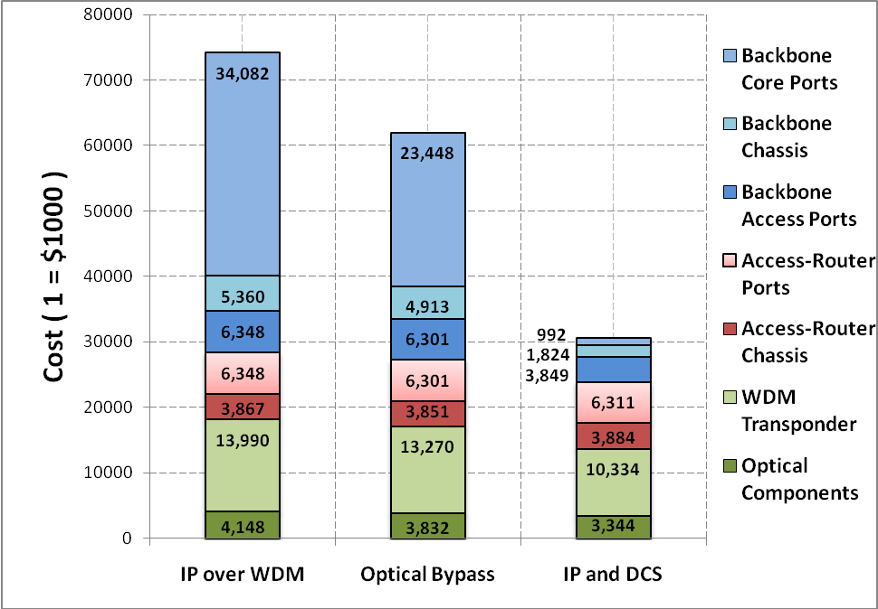
Capex Results
1
59%

Slide 7
Outline
Motivation
IP and Transport must work together for mutual benefit
But does NOT happen today!
Unified Control Architecture
Common Flow Abstraction
Common Map Abstraction

Slide 8

The Flow Abstraction
CommonDest
Flow
End – to – End Flow
Flow Identifiers
L4: TCP src/dst port
L3: IP src/dst addr, IP proto
L2.5:
L2:
L4:
L3: IP dst prefix for China
L2.5:
L2:

Slide 9
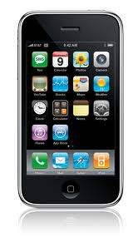
The Flow Abstraction
Common Src Flow
Web traffic from a Handset
All packets between 2 routers
Flow Identifiers
L4:
L3: IP src prefix for branch
L2.5:
L2:
L4: TCP dst port 80
L3: IP proto
L2.5:
L2: MAC src
L4:
L3:
L2.5: MPLS Label ID
L2:
What is a Flow?
Classification of packets that have a logical association
Action & Maintaining Flow State
Flow based Accounting & Resource Management

Slide 10
1. Common Flow Abstraction
Flow Identifiers
L1:
L0: (p2, p5, p7, p9) λ5
L1:
L0: (p2, p5, p7, p9) (λ5, λ8, λ3)
L1:
L0: (p2, λ5), (p5, λ8), (p7, λ3)
Notes:
Once SDN starts to treat packets as flows, it’s a small step to note that circuits are also flows – they carry data from one point to another

Slide 11
1. Common Flow Abstraction
Flow Identifiers
L1: p3, ts6, num3
L0:
L1: p3, ts6, num3
p4, ts3, num3
p7, ts9, num3
L0:
Notes:
Once SDN starts to treat packets as flows, it’s a small step to note that circuits are also flows – they carry data from one point to another

Slide 12
1. Common Flow Abstraction
L4
L3
L2.5
L2
L1
L0
Packet Switch
Wavelength Switch
Multi-layer
Switch
Time-slot
Switch
Packet Switch

Slide 13
2. Common Map Abstraction
routing, access-control, mobility, traffic-engineering, guarantees, recovery, bandwidth-on-demand …
Unified Control Plane

Slide 14
Unified Control Architecture
routing, access-control, mobility, traffic-engineering, guarantees, recovery, bandwidth-on-demand …
2. Common Map Abstraction
Unified Control Plane
Common Flow Abstraction

Slide 15
Outline
Motivation
IP and Transport must work together for mutual benefit
But does NOT happen today!
Unified Control Architecture
Common Flow Abstraction
Common Map Abstraction
Three Challenges
Has to be simple!

Slide 16
Implementation of the Architecture
2. Common Map Abstraction
NOX
Unified
Control
Plane
Interface: OpenFlow Protocol
Packet &
Circuit Switches
Common Flow Abstraction
Converged Network

Slide 17
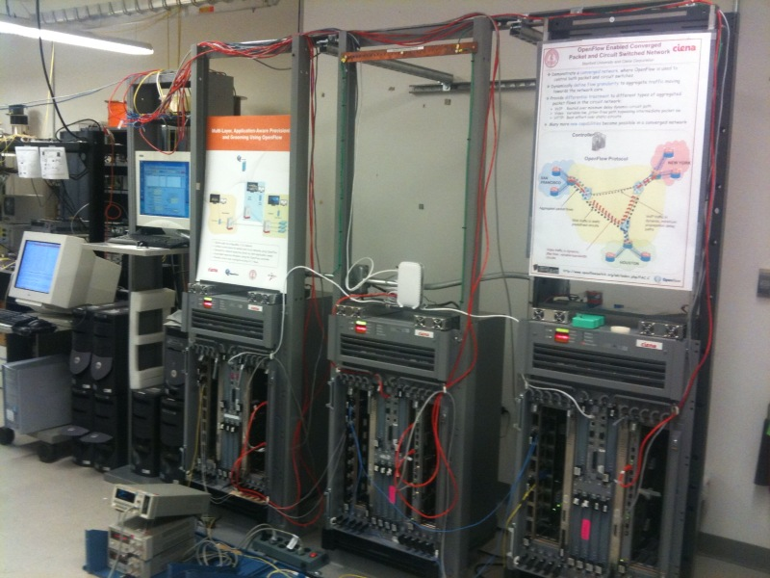
Prototype
Packet switches
NOX
Hybrid Packet-Circuit Switches

Slide 18

Prototype – Emulated WAN
NOX
OpenFlow Protocol
NEW YORK
SAN
FRANCISCO
GE links
OC-48 links (2.5 Gbps)
HOUSTON

Slide 19
Example Network Application
Control Function: Treat different kinds of traffic differently
Function Impl.: Use both packets and circuits,
at the same time.
Traffic-type | Delay/Jitter | Bandwidth | Recovery
VoIP | Lowest Delay | Low | Medium
Video | Zero Jitter | High | Highest
Web | Best-effort | Medium | Lowest
VOIP
VOIP
VIDEO
HTTP
HTTP

Slide 20
Why is it Simpler?
Application across packet and circuits
4500 lines of code
2. Common Map Abstraction
NOX
Unified
Control
Plane
Interface: OpenFlow Protocol
Packet and Circuit Switches
Common Flow Abstraction
Converged Network

Slide 21
Why is it Simpler?
GMPLS Control Plane
NOX
IP/MPLS Control Plane
OSPF-TE
RSVP-TE
UNI
Interface: OpenFlow Protocol
OSPF-TE
RSVP-TE
EMS
EMS
EMS
Proprietary Interface
Proprietary Interface
Vendor Islands
Transport Network
Converged Network
IP Network

Slide 22
Why is it Simpler?
∑ = 175,000 + x LOC
GMPLS Control Plane
15000!
IP/MPLS Control Plane
OSPF-TE
RSVP-TE
35000^
45000^
UNI
OSPF-TE
RSVP-TE
35000*
EMS
EMS
EMS
45000#
Proprietary Interface
Proprietary Interface
Vendor Islands
Transport Network
IP Network
Sources: * Quagga # Tequila ! MUPBED ^ DRAGON

Slide 23
Outline
Motivation
IP and Transport must work together for mutual benefit
But does NOT happen today!
Unified Control Architecture
Common Flow Abstraction
Common Map Abstraction
Three Challenges
Has to be simple! >>> Two orders of magnitude simpler
Need to share information

Slide 24
Share Nothing
GMPLS Control Plane
UNI
EMS
EMS
EMS
IP/MPLS Control Plane
Transport Network
IP Network
IP and Transport networks
will not share information.

Slide 25
How to build the Common Map?
Application across packet and circuits
2. Common Map Abstraction
NOX
Unified
Control
Plane
SLICING PLANE
Interface: OpenFlow Protocol
Packet and Circuit Switches
Common Flow Abstraction
Converged Network

Slide 26
ISP ‘A’ Client Controller
ISP ‘B’ Client Controller
ISP ‘C’ Client Controller
C
C
OpenFlow Protocol
Under Transport Service Provider (TSP) control
Slicing Plane
Slice == Bandwidth + Control over Switching
OpenFlow Protocol
D
D
D
D
Isolated
Client
Slices
of the Transport Network
CK
D
D
P
D
D
CK
D
D
D
CK
D
D
D
D
D
D
D
P
CK
D
CK
D
P
D
D
P
D
D
D
D
D

Slide 27

Common Map
App
App
App
App
App
App
ISP# 1’s NetOS
TSP’s NMS/EMS
ISP# 2’s NetOS
TSP’s Slicing Plane
PKT
E
T
H
E
T
H
PKT
E
T
H
E
T
H
P
K
T
T
D
M
S
O
N
E
T
P
K
T
T
D
M
E
T
H
E
T
H
S
O
N
E
T
P
K
T
T
D
M
S
O
N
E
T
E
T
H
PKT
E
T
H
E
T
H
PKT
E
T
H
E
T
H
Transport Service Provider’s (TSP) virtualized network
Internet Service Provider’s
(ISP# 1) OF enabled network
with slice of TSP’s network
PKT
E
T
H
E
T
H
PKT
E
T
H
E
T
H
Internet Service Provider’s (ISP# 2) OF enabled network with another slice of TSP’s network

Slide 28
ISP# 1’s network
PKT
PKT
E
T
H
E
T
H
E
T
H
E
T
H
PKT
E
T
H
E
T
H
Packet (virtual) topology
..and spare bandwidth in the slice
PKT
Notice the spare interfaces
E
T
H
E
T
H
P
K
T
T
D
M
S
O
N
E
T
P
K
T
T
D
M
E
T
H
E
T
H
S
O
N
E
T
P
K
T
T
D
M
S
O
N
E
T
E
T
H
PKT
E
T
H
E
T
H
PKT
Actual topology
E
T
H
E
T
H

Slide 29
ISP# 1’s network
PKT
PKT
E
T
H
E
T
H
E
T
H
E
T
H
PKT
E
T
H
E
T
H
Packet (virtual) topology
PKT
E
T
H
E
T
H
P
K
T
T
D
M
S
O
N
E
T
P
K
T
T
D
M
E
T
H
E
T
H
S
O
N
E
T
P
K
T
T
D
M
S
O
N
E
T
E
T
H
PKT
E
T
H
E
T
H
PKT
Actual topology
E
T
H
E
T
H
ISP# 1 redirects bw between the spare interfaces to dynamically create new links!!

Slide 30
ISP# 2’s network
PKT
E
T
H
E
T
H
PKT
E
T
H
E
T
H
PKT
E
T
H
E
T
H
Packet (virtual) topology
PKT
Only static link bw paid for up-front
E
T
H
E
T
H
P
K
T
T
D
M
S
O
N
E
T
P
K
T
T
D
M
E
T
H
E
T
H
S
O
N
E
T
P
K
T
T
D
M
S
O
N
E
T
E
T
H
PKT
E
T
H
E
T
H
Actual topology
PKT
E
T
H
E
T
H
ISP# 2 uses variable bandwidth packet links!!

Slide 31
Outline
Motivation
IP and Transport must work together for mutual benefit
But does NOT happen today!
Unified Control Architecture
Common Flow Abstraction
Common Map Abstraction
Three Challenges
Has to be simple! >> Two orders of magnitude simpler
Need to share information >> Slicing & Switching-as-a-Service
Conservative nature of operators

Slide 32
Transport network operators
dislike giving up precise (manual) control
to an automated software control plane
irrespective of how intelligent it may be
&
decades worth of established procedures
Is there a gradual adoption path?

Slide 33
Gradual Adoption Path
ISP ‘A’ Client Controller
ISP ‘B’ Client Controller
ISP ‘C’ Client Controller
C
C
OpenFlow Protocol
C
Under Transport Service Provider (TSP) control
Slicing Plane
OpenFlow Protocol
D
D
D
D
CK
D
D
P
D
D
CK
D
D
D
CK
D
D
D
D
D
D
D
P
CK
D
CK
D
P
D
D
P
D
D
D
D
D
Notes:
Final step = lets say you are a transport service provider. You are notorious for your dislike of giving up manual control over your network to an automated intelligent control plane, no matter how intelligent that control plane may be. How am I going to force-feed SDN down your throat? “Look throw away everything you are doing now – I can write this really cool software that can control your whole network” == not going to work – not without a gradual adoption path.
With today's technology, it is possible to carve out a slice of the network and put it under SDN control. Importantly the ‘slice’ is not just bandwidth but also some control over switching-elements that are part of the slice. Initially the controller is under the TSP’s control. As time goes on and confidence is gained, the transport service provider installs a slicing plane – the purpose of the slicing plane is to guarantee that the controller can in no way mess with the rest of the network. Once that is certain, the TSP can turns the controller over to an ISP – it might be the ISP in the same organization thereby making the first foray into IP and transport convergence. Or it could be a customer ISP to whom you just provided a new service. If that goes well, then over time more parts of the transport network can be sliced

Slide 34
Summary
Motivation
IP and Transport must work together for mutual benefit
But does NOT happen today!
Unified Control Architecture
Common Flow Abstraction
Common Map Abstraction
Three Challenges
Has to be simple! >> Two orders of magnitude simpler
Need to share information >> Slicing & Switching-as-a-Service
Conservative nature of operators >> Gradual Adoption Path

Slide 35

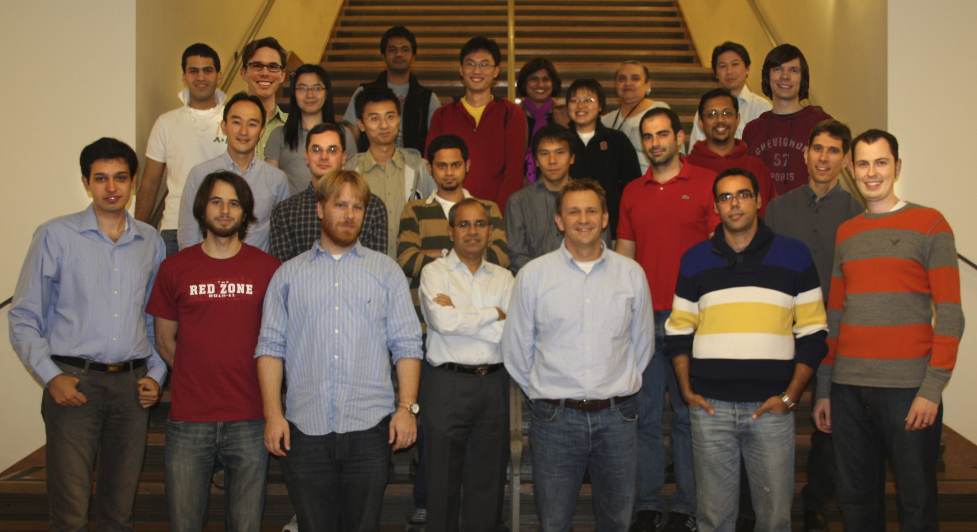
Software Defined Networks
Thanks!

