Slide 1



Application-Aware Aggregation & Traffic Engineering in a
Converged Packet-Circuit Network
http://openflow.org
Saurav Das, Yiannis Yiakoumis, Guru Parulkar
Nick McKeown
Stanford University
Preeti Singh, Daniel Getachew, Premal Desai
Ciena Corp.
OFC/NFOEC, March 2011

Slide 2
IP & Transport Networks do not interact
IP links are static
and supported by static circuits or lambdas in the Transport network

Slide 3
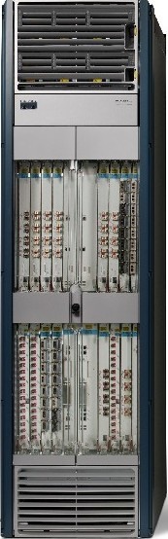
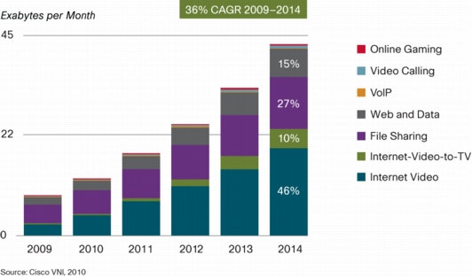
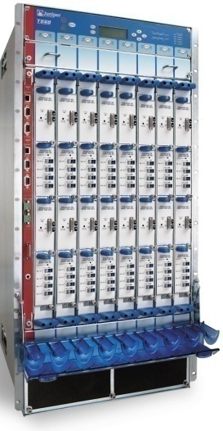
What does it mean for the IP network?
IP backbone network design - Routers hardwired by lambdas
  4X to 10X over-provisioned
    Traffic surges
    Traffic re-rerouted around failures
  Dependence on complex, expensive, power-hungry and
  sometimes fragile backbone routers
Bigger Routers
- More over-provisioned links
*April, 02

Slide 4
Bigger Routers – Can Optics Help?

Slide 5
Overprovisioning – Can Circuits Help?
Dependence on over-provisioned links
Over-provisioning masks → packet switching simply not very good at providing bandwidth, delay, jitter and loss guarantees
Dynamic Circuit Switching
  Guaranteed bandwidth
  Bandwidth-on-demand
  Good for video flows (>50% of all traffic by 2014)
  Guaranteed low latency & jitter-free paths
  Fast Recovery: helps availability
  Help meet SLAs – lower need for over-provisioned IP links
REQUIRES Dynamic Interaction with the Transport network

Slide 6
IP & Transport Networks do not interact
The Transport network has no visibility into IP traffic patterns and application requirements
and remains static and manually controlled

Slide 7
What does it mean for the Transport n/w?
IP
Without interaction with a higher layer
there is really no need to support dynamic services
and thus no need for an automated control plane
and so the Transport n/remains manually controlled via NMS/EMS
and pretty much remains bandwidth-sellers
DWDM
Can the Internet help?
most services are moving to the IP anyway
wide variety of services
different requirements that can take advantage of dynamic-circuit characteristics
REQUIRES Dynamic Interaction with the IP network
*April, 02

Slide 8
IP network
Perform better;
Reduce burden of meeting SLAs via over-provisioning
NEEDED: A control plane solution for dynamic interaction between packets and circuits
Become dynamic;
Offer new services
Transport network

Slide 9
OpenFlow/Software Defined Network(SDN)
2. At least one Network OS
probably many.
Open- and closed-source
3. Well-defined open API
Routing
TE
Network OS
1. Open vendor agnostic protocol
OpenFlow
Simple Packet
Forwarding
Hardware
Simple Packet
Forwarding
Hardware
Simple Packet
Forwarding
Hardware
Simple Packet
Forwarding
Hardware
Simple Packet
Forwarding
Hardware

Slide 10



OpenFlow Enabled Converged
Packet and Circuit Switched Network
Controller
OpenFlow Protocol
NEW YORK
SAN
FRANCISCO
Aggregated packet flows
VoIP traffic in dynamic, minimum propagation delay paths
Web traffic in static predefined circuits
Video traffic in dynamic,
jitter-free, variable-bandwidth circuits
HOUSTON

Slide 11
Programming with OpenFlow
Router
Router
R
A
S
R
A
S
Virtual Link
Packet
Switch Fabric
Packet
Switch Fabric
Transport NE
Transport NE
R
A
S
IN OUT
IN OUT
R
A
S
VoIP Circuit
Packet
Switch Fabric
Circuit
Circuit
Packet
Switch Fabric
Video Circuit

Slide 12
Programming with OpenFlow
IP 11.13.0.0
UDP 1234
+ VLAN20, P1
P1, VLAN20
VCG 3
VCG3
P1
VC4
1
P2
VC4
4
P1
VC4
10
IP 11.13.0.0 TCP 5060
+ VLAN77, P1
P1, VLAN77
VCG5
VCG5
P3
VC3
1
OpenFlow
(software)
OpenFlow
(software)
R
A
S
R
A
S
IN OUT
Packet Switch Fabric
Packet
Switch Fabric
TDM
Circuit
Switch Fabric
VCG3
VCG5
GE ports
TDM ports

Slide 13
Why OpenFlow?
Dynamicity vs. Routing protocol convergence
Multilayer complexity
Features/Services tied to protocols
API?
Giving providers the choice

Slide 14
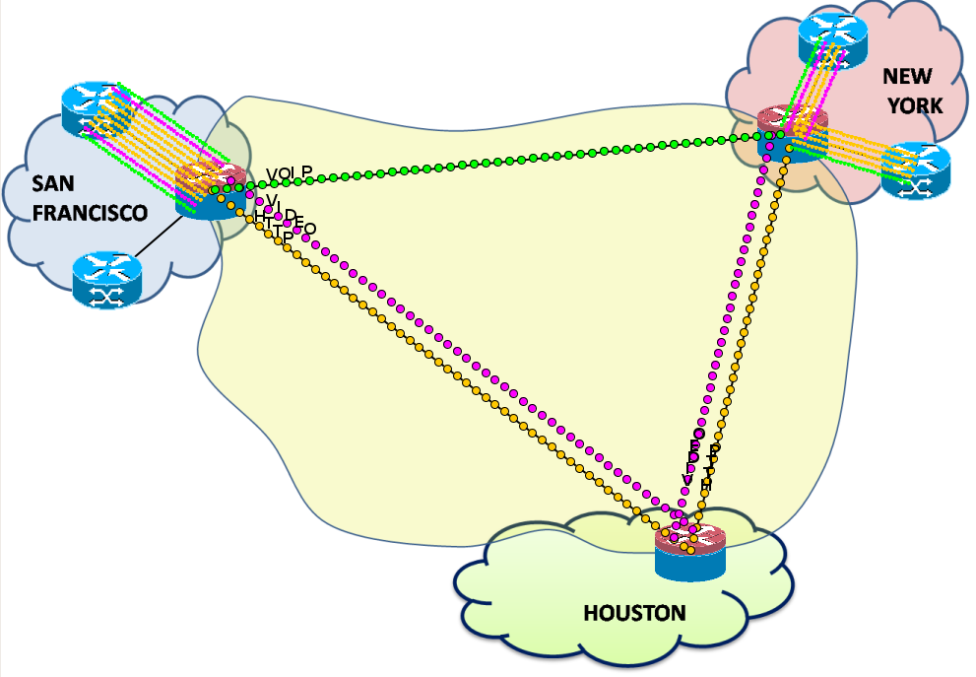
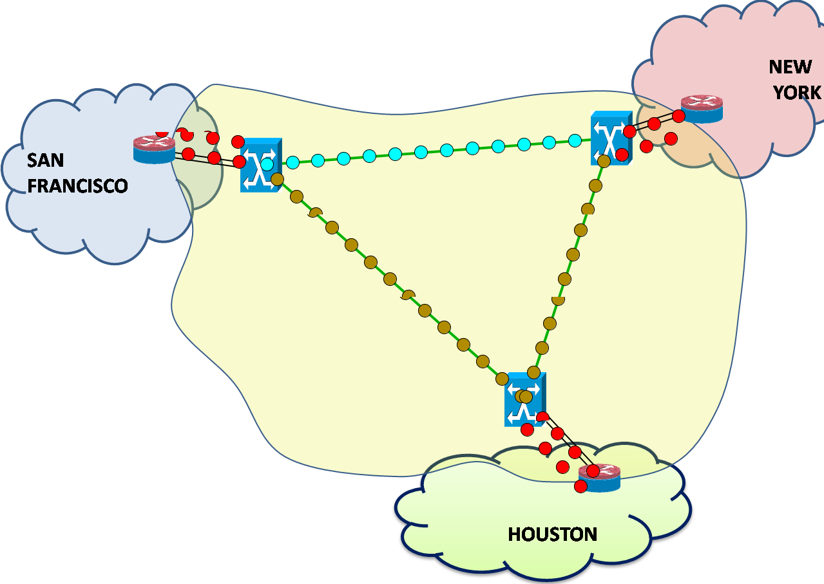
Dynamicity vs. Routing protocol convergence

Slide 15
2. Multilayer Complexity
IP/ MPLS
Distributed Signaling – OSPF-TE
Distributed Routing – RSVP-TE
SONET/SDH
Distributed Signaling – OSPF-TE
Distributed Routing – RSVP-TE
OTN
OpenFlow
Distributed Signaling – OSPF-TE
Distributed Routing – RSVP-TE
MPLS-TP
Distributed Signaling – OSPF-TE
Distributed Routing – RSVP-TE
WDM
Distributed Signaling – OSPF-TE
Distributed Routing – RSVP-TE

Slide 16
3. Features/Services tied to protocols
Today, glacial process of innovation made worse by captive standards process
Deployment
Idea
Standardize
Wait 10 years
OpenFlow breaks the bond between new feature/services and the need to change the protocol

Slide 17

4. API ?
1.Configuration via CLI
2. Control of
Forwarding State via distributed protocols
Today
3. Monitor/ Stats via SNMP, NMS, NetFlow etc.
Well-defined open API
Network OS
With OpenFlow/SDN
1.Configuration
2. Control of
Forwarding State
3. Monitor/ Stats

Slide 18
5. Giving providers the choice
Bandwidth - on - Demand
Dynamic
Optical
Bypass
Unified Recovery
Application-Aware QoS
Traffic Engineering
Networking
Applications
NETWORK OPERATING SYSTEM
Unified
Control
Plane
VIRTUALIZATION (SLICING) PLANE
OpenFlow Protocol
Switch Abstraction
Packet & Circuit Switch
Packet & Circuit Switch
Underlying Data
Plane Switching
Packet Switch
Wavelength Switch
Multi-layer
Switch
Time-slot
Switch
Packet Switch

Slide 19
Summary
IP and Transport Networks need to interact for mutual benefit
OpenFlow/SDN provides a simple mechanism for interaction via a common multi-layer control plane and API
Service Providers can develop networking applications that take advantage of the benefits of packets and dynamic circuits

Slide 20
BACKUP

Slide 21
Step 1:
Separate Control from Datapath
Routing
Network OS

Slide 22
Step 2:
Cache flow decisions in datapath
Routing
“If header = x, send to port 4”
“If header = y, overwrite header with z, send to ports 5,6”
Network OS
“If header = ?, send to me”
Flow
Table

Slide 23
The Flow Table
Exploit the flow table in switches, routers, and chipsets
Flow 1.
Rule
(exact & wildcard)
Action
Statistics
Flow 2.
Rule
(exact & wildcard)
Action
Statistics
Flow 3.
Rule
(exact & wildcard)
Action
Statistics
Rule
(exact & wildcard)
Flow N.
Default Action
Statistics
e.g. Port, VLAN ID,
L2, L3, L4, …
e.g. unicast, mcast,
map-to-queue, drop
Count packets & bytes
Expiration time/count

Slide 24
Flexible and Generalized Flows:
Backward Compatible
Ethernet Switching
Switch
Port
MAC
src
MAC
dst
Eth
type
VLAN
ID
IP
Src
IP
Dst
IP
Prot
TCP
sport
TCP
dport
Action
*
*
00:1f:..
*
*
*
*
*
*
*
port6
IP Routing
Switch
Port
MAC
src
MAC
dst
Eth
type
VLAN
ID
IP
Src
IP
Dst
IP
Prot
TCP
sport
TCP
dport
Action
*
*
*
*
*
*
5.6.7.8
*
*
*
port6
Application Firewall
Switch
Port
MAC
src
MAC
dst
Eth
type
VLAN
ID
IP
Src
IP
Dst
IP
Prot
TCP
sport
TCP
dport
Action
*
*
*
*
*
*
*
*
*
22
drop

Slide 25
Flexible and Generalized Flows:
Across Layers
Fully define a flow
Switch
Port
MAC
src
MAC
dst
Eth
type
VLAN
ID
IP
Src
IP
Dst
IP
Prot
TCP
sport
TCP
dport
Action
port3
00:2e..
00:1f..
0800
vlan1
1.2.3.4
5.6.7.8
4
17264
80
port6
VLAN + App
Switch
Port
MAC
src
MAC
dst
Eth
type
VLAN
ID
IP
Src
IP
Dst
IP
Prot
TCP
sport
TCP
dport
Action
*
*
*
*
vlan1
*
*
*
*
80
port6,
port7
Port + Ethernet + IP
Switch
Port
MAC
src
MAC
dst
Eth
type
VLAN
ID
IP
Src
IP
Dst
IP
Prot
TCP
sport
TCP
dport
Action
port3
00:2e..
*
0800
*
*
5.6.7.8
4
*
*
port 10

Slide 27
Aggregation & Mapping
VOIP
VIDEO
HTTP

Slide 28
VOIP
Aggregation & Mapping
VIDEO
Routing
HTTP

Slide 29
VOIP
Aggregation & Mapping
VIDEO
Routing
Variable Bandwidth
HTTP

Slide 30
VOIP
Aggregation & Mapping
VIDEO
Routing
Variable Bandwidth
HTTP
Recovery

Slide 31
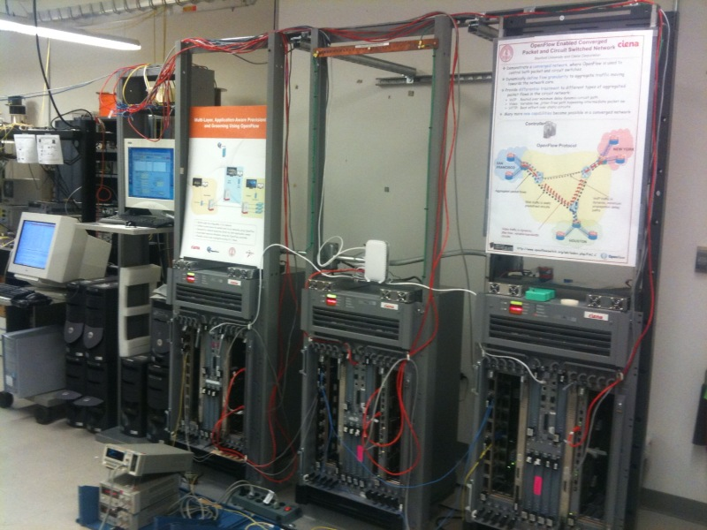

Slide 32
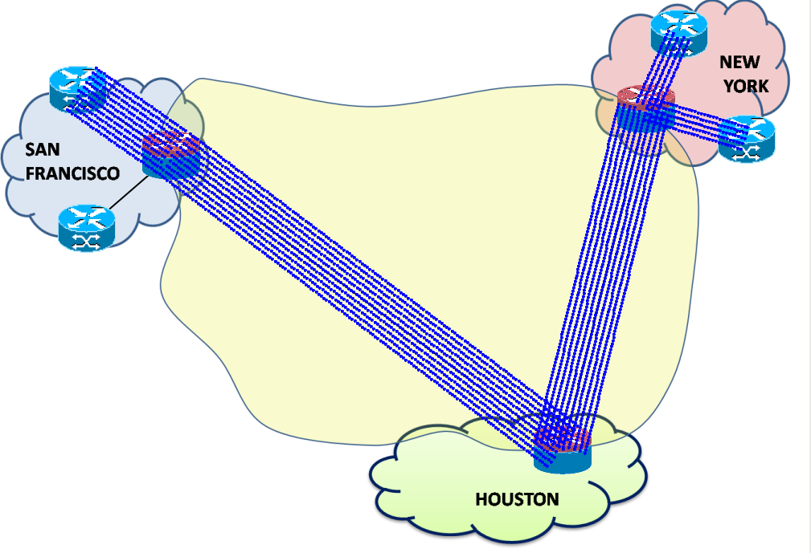
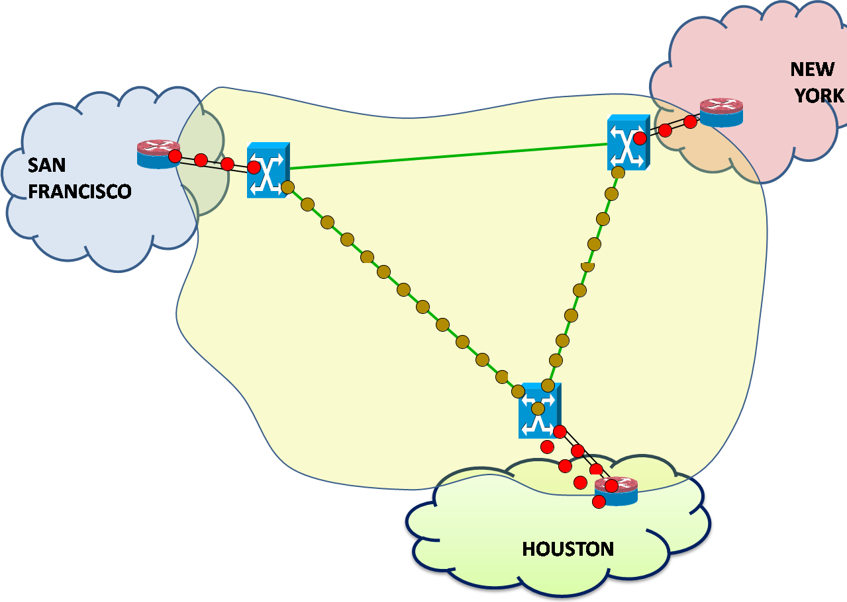

Slide 33
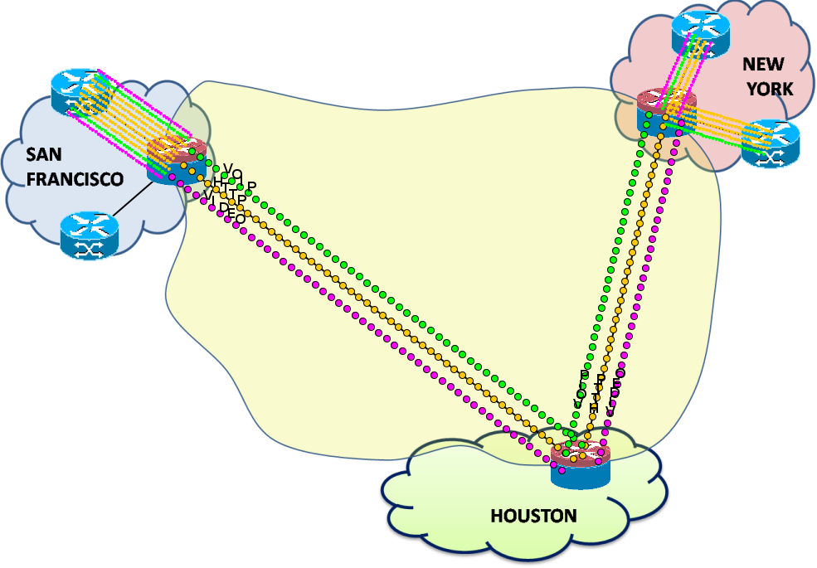

Slide 34
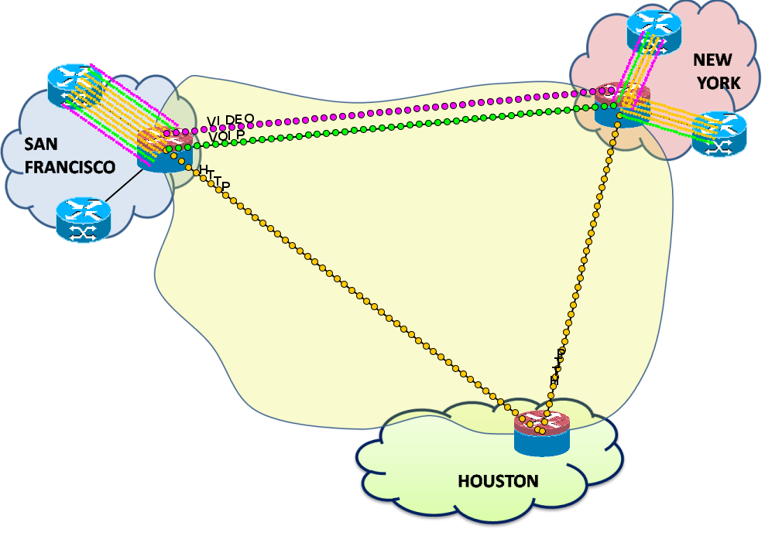
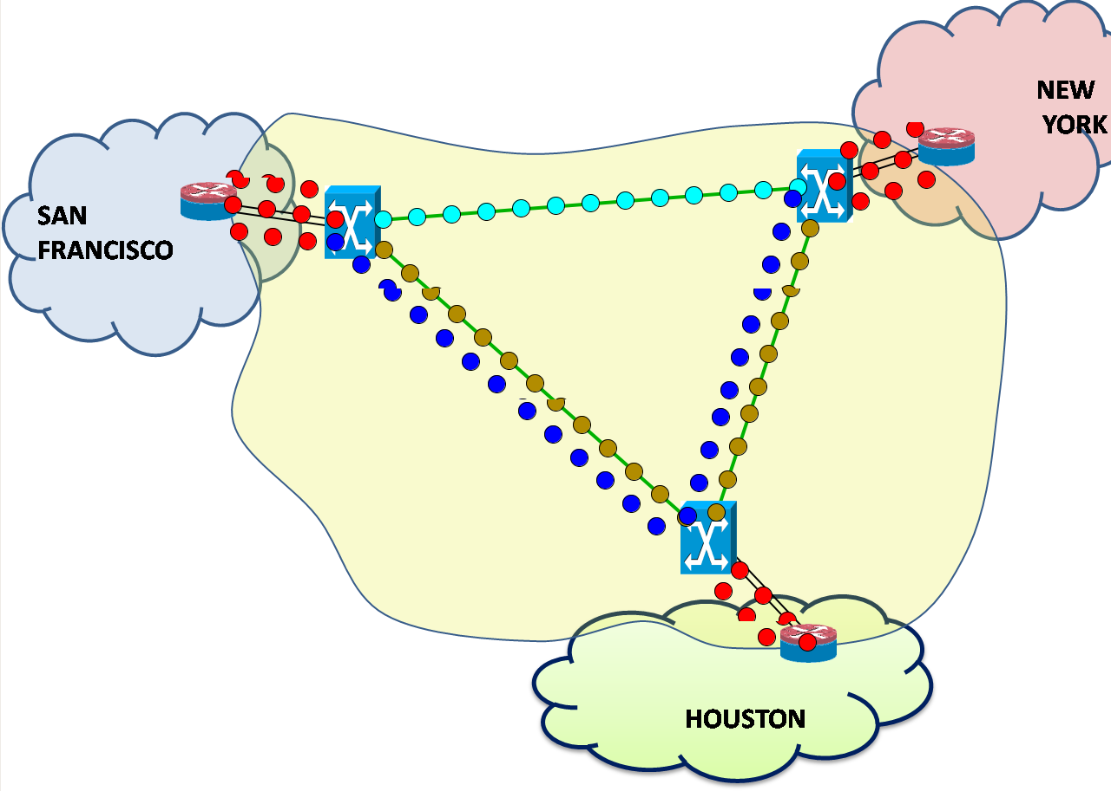

Slide 35
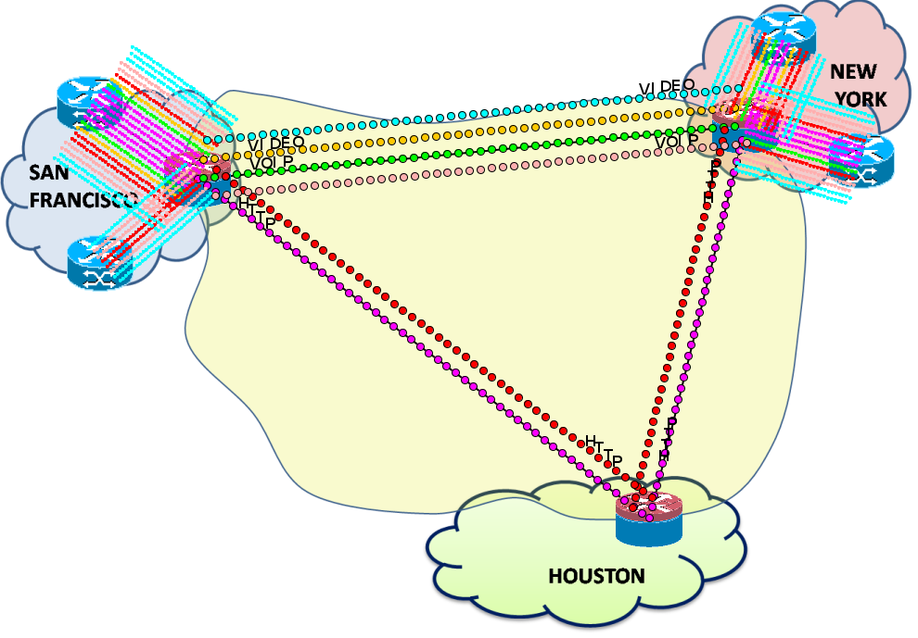
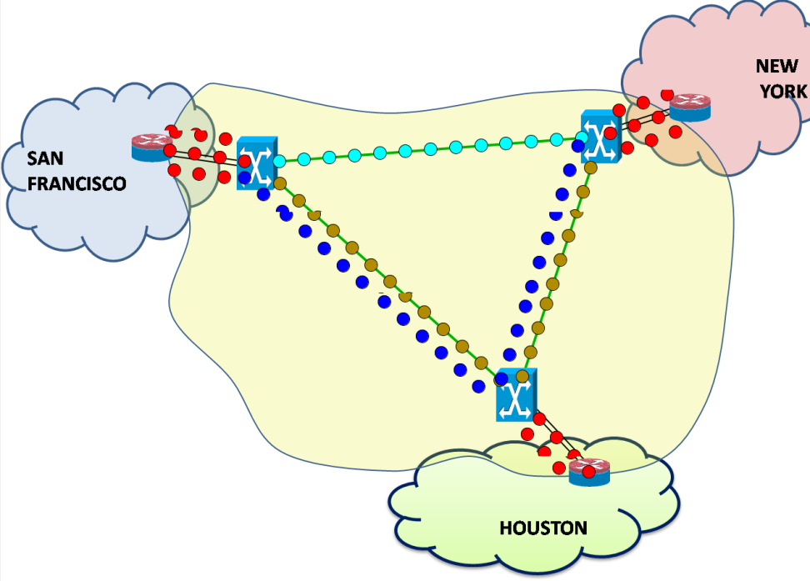

Slide 36
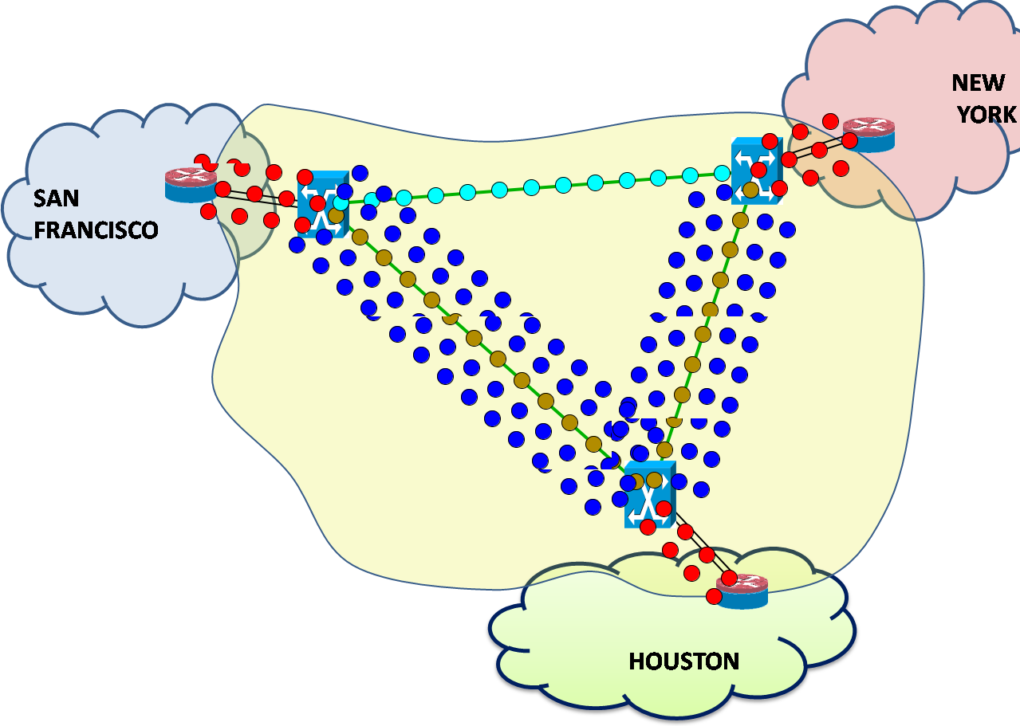
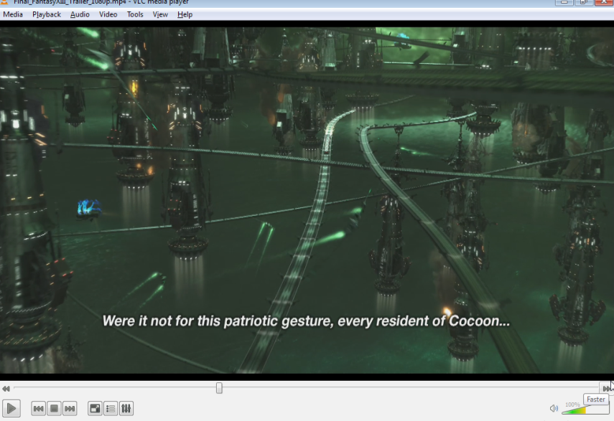

Slide 37
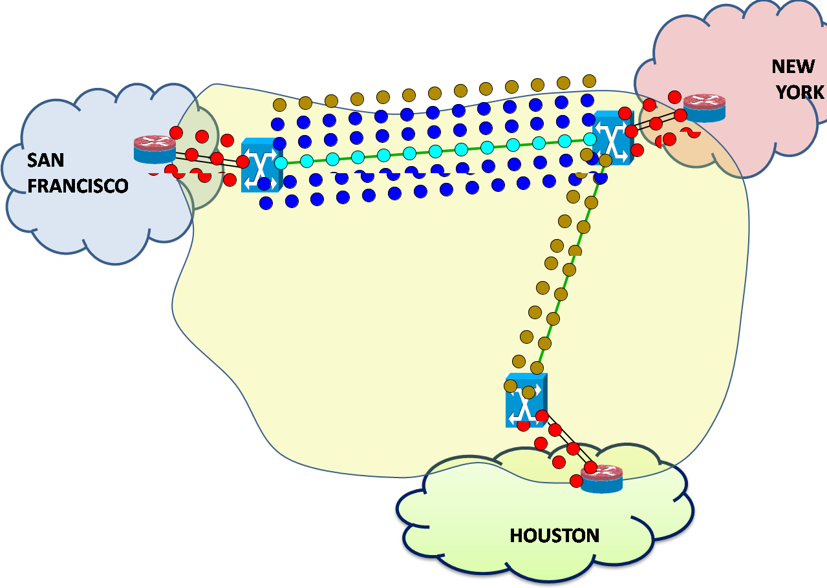

Slide 38

What about Scalability of Control Plane?
Different Possibilities
Control Plane
OpenFlow Protocol
Data Plane
Research and Prototyping
Enterprise/DataCenter
Networks
Onix: A distributed control platform for large-scale production networks. Teemu Koponen, et al. OSDI October 2010.
Carrier Networks

