Slide 1
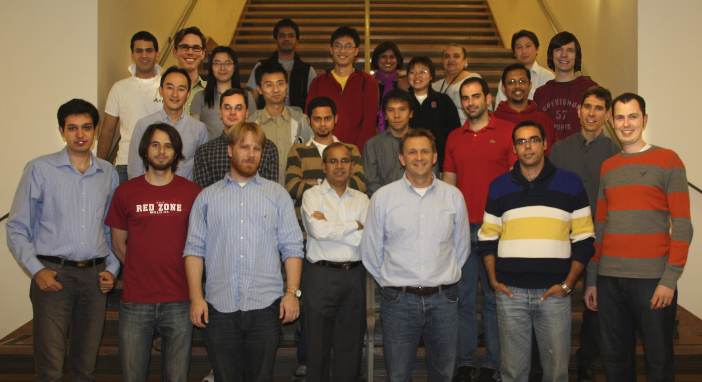
Software Defined Networks
Saurav Das Guru Parulkar Nick McKeown
With contributions from many others…
A Presentation to the OIF
12th July, 2011

Slide 2
Outline
2 Abstractions
2 Research Examples
2 Burning Questions
2 Trends

Slide 3
Outline
2 Abstractions
Flow Abstraction
Map Abstraction

Slide 4
1. Flow Abstraction
CommonDest
Flow
End – to – End Flow
Flow Identifiers
L4: TCP src/dst port
L3: IP src/dst addr, IP proto
L2.5:
L2:
L4:
L3: IP dst prefix for China
L2.5:
L2:

Slide 5
1. Flow Abstraction
Common Src Flow
Web traffic from a Handset
All packets between 2 routers
Flow Identifiers
L4:
L3: IP src prefix for branch
L2.5:
L2:
L4: TCP dst port 80
L3: IP proto
L2.5:
L2: MAC src
L4:
L3:
L2.5: MPLS Label ID
L2:
What is a Flow?
Classification of packets that have a logical association
Action & Maintaining Flow State
Flow based Accounting & Resource Management

Slide 6
1. Flow Abstraction
Flow Identifiers
L1:
L0: (p2, p5, p7, p9) λ5
L1:
L0: (p2, p5, p7, p9) (λ5, λ8, λ3)
L1:
L0: (p2, λ5), (p5, λ8), (p7, λ3)
Notes:
Once SDN starts to treat packets as flows, it’s a small step to note that circuits are also flows – they carry data from one point to another

Slide 7
1. Flow Abstraction
Flow Identifiers
L1: p3, ts6, num3
L0:
L1: p3, ts6, num3
p4, ts3, num3
p7, ts9, num3
L0:
Notes:
Once SDN starts to treat packets as flows, it’s a small step to note that circuits are also flows – they carry data from one point to another

Slide 8
1. Flow Abstraction
L4
L3
L2.5
L2
L1
L0
Packet Switch
Wavelength Switch
Multi-layer
Switch
Time-slot
Switch
Packet Switch

Slide 9
Outline
2 Abstractions
Flow Abstraction
Map Abstraction

Slide 10
2. Map Abstraction
routing, access-control, mobility, traffic-engineering, guarantees, recovery, bandwidth-on-demand …
Control Plane

Slide 11
Control Architecture
routing, access-control, mobility, traffic-engineering, guarantees, recovery, bandwidth-on-demand …
2. Map Abstraction
Control Plane
Flow Abstraction

Slide 12
Outline
2 Abstractions
Flow Abstraction
Map Abstraction
Software Defined Networks (SDN)

Slide 13
What is SDN?
App
App
App
Network Operating System
App
App
App
Operating
System
Forwarding Hardware
App
App
App
Operating
System
App
App
App
Forwarding Hardware
Operating
System
App
App
App
Forwarding Hardware
Operating
System
Forwarding Hardware
App
App
App
Operating
System
Forwarding Hardware
Notes:
Came out of completely different context and motivation – won’t describe why or where it came from but will describe what it is

Slide 14
The “Software-defined Network”
The “Software Defined Network”
B. Network-wide Operating System
(extensible, built to scale)
C. Well-defined open API
App
App
App
2. Map Abstraction
Network Operating System
Open interface to hardware
Forwarding Hardware
Forwarding Hardware
Flow Abstraction
Forwarding Hardware
Forwarding Hardware
Forwarding Hardware

Slide 15
Outline
2 Abstractions & SDN
2 Research Examples
MPLS
Packet-Optical

Slide 16
MPLS and Flows
MPLS has Flow Abstraction
Flow state in Head-end LER
Label Switched Path (LSP)
Label Edge Router (LER)
Label Switch
Router (LSR)
Incoming packets
Classification
Into FECs
LSPs
MPLS network
IP network

Slide 17
MPLS Services
Why do Service Providers use MPLS?
Really about 2 services
MPLS VPNs
MPLS - TE
Motivation
Highly profitable
No easy way
Older ways not used
Motivation
Deterministic Behavior
Efficient Resource Utilization
Older ways not used
Notes:
TE –traffic revise

Slide 18
MPLS Services
MPLS lacks Map Abstraction
OSPF-TE
LDP
I-BGP
RSVP-TE
LMP
MP-BGP
Label Switched Path (LSP)

Slide 19
Introducing Map Abstraction in MPLS
Services
Network Applications
TE
Routing
Discovery
Label Distribution
Recovery
Simpler Control Plane
NETWORK OPERATING SYSTEM
OSPF-TE
LDP
I-BGP
OpenFlow
RSVP-TE
LMP
MP-BGP
Simpler
Data Plane
Label Switched Path (LSP)
P
PUSH

Slide 20
Prototype System
MPLS-TE
Auto – route; Auto – bandwidth
Traffic – aware LSPs; Priorities
TE-LSP configuration
MPLS GUI
MPLS API
CSPF Routing
MPLS Stats
GUI (Envi)
showing real-time
network state
Network Operating System (NOX)
OpenFlow
Open vSwitch
with standard MPLS data plane
Open vSwitch
(with MPLS)
Open vSwitch
(with MPLS)
Open vSwitch
(with MPLS)
Open vSwitch
(with MPLS)
Open vSwitch
(with MPLS)
Open vSwitch
(with MPLS)
Open vSwitch
(with MPLS)
Open vSwitch
(with MPLS)
Open vSwitch
(with MPLS)
Open vSwitch
with standard MPLS data plane
Mininet Environment

Slide 21
Video of a
Demonstration
showing MPLS-TE service with the Map Abstraction
http://www.youtube.com/watch?v=EpttFVKUrzs&feature=channel_video_title

Slide 22
TE-LSP Features
Auto-route
Auto-bandwidth
Priorities
Load-share
Diffserv aware Traffic Engineering (DS-TE)
MPLS FRR
Explicit Routes
Re-optimization timers
4000 lines of code
Vs.
80,000 + ?

Slide 23
Outline
2 Abstractions & SDN
2 Research Examples
MPLS
Packet-Optical

Slide 24
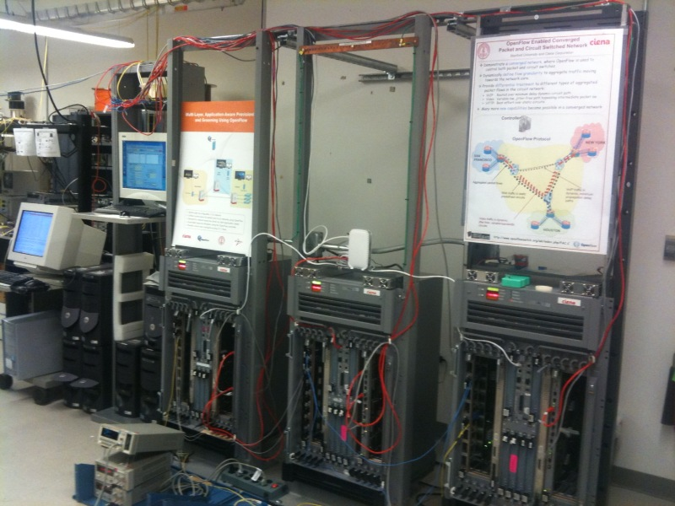
Prototype
Packet switches
NOX
Hybrid Packet-Circuit Switches

Slide 25
Prototype – Emulated WAN
NOX
OpenFlow Protocol
NEW YORK
SAN
FRANCISCO
GE links
OC-48 links (2.5 Gbps)
HOUSTON

Slide 26
Implementation of Control Architecture
Application across packet and circuits
2. Common Map Abstraction
NOX
Unified
Control
Plane
Interface: OpenFlow Protocol
Packet &
Circuit Switches
Common Flow Abstraction
Converged Network

Slide 27
Example Network Application
Control Function: Treat different kinds of traffic differently
Function Impl.: Use both packets and circuits,
at the same time.
Traffic-type | Delay/Jitter | Bandwidth | Recovery
VoIP | Lowest Delay | Low | Medium
Video | Zero Jitter | High | Highest
Web | Best-effort | Medium | Lowest
VOIP
VOIP
VIDEO
HTTP
HTTP

Slide 28
Video of a
Demonstration
of network application
on Prototype
http://www.youtube.com/watch?v=Yq3yLPtOxpc&feature=relmfu

Slide 29
Programming Flow Tables
IP_dst = 10.3.3.1/32
IP_src = 10.44.0.10/16
IP_src = 10.44.0.10/16,
TCP 80
Out p2
Out p2
Out p2
+vlan30,
Out p2
p2
P2, vlan30
Out VPort3
Out VPort3
VPort3
P11
VC4
1
IP_dst = 10.3.2.0/20
IP_src = 10.44.0.10/16,
UDP 1234
Out p2
Out p2
+vlan50,
Out p2
P2, vlan50
Out VPort7
IP_dst = 10.3.36.1/24
VPort7
P22
VC4
7
IP_src = 10.44.0.10/16,
TCP 5060
Out p2
Out p2
+vlan75,
Out p2
P2, vlan75
Out VPort9
P22
VC4
4
IP_dst = 10.3.13.24/28
Out p2
P33
VC4
10
IP_dst = 10.3.100.1/24
Out p2
IP_dst = 10.3.66.60/32
Out p2
VPort9
P33
VC4
1
IP_dst = 10.3.55.200/32
Out p2
IP_dst = 10.3.0.0/16
Out p2
IP_dst = 10.3.78.80/27
Out p2
IP_dst = 10.3.3.189/32
Out p2
Packet
Switch Fabric
Packet
Switch Fabric
TDM
Switch Fabric
GE
ports
TDM ports
Virtual Port

Slide 30
Why is it Simpler?
Application across packet and circuits
2000 lines of code
2. Common Map Abstraction
NOX
Unified
Control
Plane
Interface: OpenFlow Protocol
Packet and Circuit Switches
Common Flow Abstraction
Converged Network

Slide 31
Outline
2 Abstractions & SDN
2 Research Examples – MPLS & Packet-Optical
2 Burning Questions
Is Common Map practical?
What about Scale?

Slide 32
1. Is Common Map practical?
Extensibility
Map Building & State- Distribution abstracted away
2. Common Map Abstraction
NOX
Unified
Control
Plane
2. Full View
Interface: OpenFlow Protocol
Packet and Circuit Switches
Common Flow Abstraction
Converged Network

Slide 33
1. Is Common Map practical?
Some well-known problems:
Q: IP and Transport networks will not share information.
How to build a common map?
Q: Transport network operators dislike giving up (manual) control. Is there a gradual adoption path?
Answer to both: Slicing
Slice == Bandwidth + Switching

Slide 34
Gradual Adoption Path
ISP ‘A’ Client Controller
ISP ‘B’ Client Controller
ISP ‘C’ Client Controller
C
C
OpenFlow Protocol
C
Under Transport Service Provider (TSP) control
Slicing Plane
OpenFlow Protocol
D
D
D
D
CK
D
D
P
D
D
CK
D
D
D
CK
D
D
D
D
D
D
D
P
CK
D
CK
D
P
D
D
P
D
D
D
D
D
Notes:
Final step = lets say you are a transport service provider. You are notorious for your dislike of giving up manual control over your network to an automated intelligent control plane, no matter how intelligent that control plane may be. How am I going to force-feed SDN down your throat? “Look throw away everything you are doing now – I can write this really cool software that can control your whole network” == not going to work – not without a gradual adoption path.
With today's technology, it is possible to carve out a slice of the network and put it under SDN control. Importantly the ‘slice’ is not just bandwidth but also some control over switching-elements that are part of the slice. Initially the controller is under the TSP’s control. As time goes on and confidence is gained, the transport service provider installs a slicing plane – the purpose of the slicing plane is to guarantee that the controller can in no way mess with the rest of the network. One that is certain, the TSP can turns the controller over to an ISP – it might be the ISP in the same organization thereby making the first foray into IP and transport convergence. Or it could be a customer ISP to whom you just provided a new service.

Slide 35
Common Map
App
App
App
App
App
App
ISP# 1’s NetOS
TSP’s NMS/EMS
ISP# 2’s NetOS
TSP’s Slicing Plane
PKT
E
T
H
E
T
H
PKT
E
T
H
E
T
H
P
K
T
T
D
M
S
O
N
E
T
P
K
T
T
D
M
E
T
H
E
T
H
S
O
N
E
T
P
K
T
T
D
M
S
O
N
E
T
E
T
H
PKT
E
T
H
E
T
H
PKT
E
T
H
E
T
H
Transport Service Provider’s (TSP) virtualized network
Internet Service Provider’s
(ISP# 1) OF enabled network
with slice of TSP’s network
PKT
E
T
H
E
T
H
PKT
E
T
H
E
T
H
Internet Service Provider’s (ISP# 2) OF enabled network with another slice of TSP’s network
TSP’s private line customer

Slide 36
ISP# 1’s network
PKT
PKT
E
T
H
E
T
H
E
T
H
E
T
H
PKT
E
T
H
E
T
H
Packet (virtual) topology
..and spare bandwidth in the slice
PKT
Notice the spare interfaces
E
T
H
E
T
H
P
K
T
T
D
M
S
O
N
E
T
P
K
T
T
D
M
E
T
H
E
T
H
S
O
N
E
T
P
K
T
T
D
M
S
O
N
E
T
E
T
H
PKT
E
T
H
E
T
H
PKT
Actual topology
E
T
H
E
T
H

Slide 37
ISP# 1’s network
PKT
PKT
E
T
H
E
T
H
E
T
H
E
T
H
PKT
E
T
H
E
T
H
Packet (virtual) topology
PKT
E
T
H
E
T
H
P
K
T
T
D
M
S
O
N
E
T
P
K
T
T
D
M
E
T
H
E
T
H
S
O
N
E
T
P
K
T
T
D
M
S
O
N
E
T
E
T
H
PKT
E
T
H
E
T
H
PKT
Actual topology
E
T
H
E
T
H
ISP# 1 redirects bw between the spare interfaces to dynamically create new links!!

Slide 38
ISP# 2’s network
PKT
E
T
H
E
T
H
PKT
E
T
H
E
T
H
PKT
E
T
H
E
T
H
Packet (virtual) topology
PKT
Only static link bw paid for up-front
E
T
H
E
T
H
P
K
T
T
D
M
S
O
N
E
T
P
K
T
T
D
M
E
T
H
E
T
H
S
O
N
E
T
P
K
T
T
D
M
S
O
N
E
T
E
T
H
PKT
E
T
H
E
T
H
Actual topology
PKT
E
T
H
E
T
H
ISP# 2 uses variable bandwidth packet links!!

Slide 39
Outline
2 Abstractions & SDN
2 Research Examples – MPLS & Packet-Optical
2 Burning Questions
Is Common Map practical?
What about Scale?

Slide 40
2. What about Scale?
Different Possibilities
Control Plane
OpenFlow Protocol
Data Plane
Research and Prototyping
Enterprise/DataCenter
Networks
Carrier Networks

Slide 41
2. What about Scale?
Limiting Resources
Memory
Compute
Consistency overhead
DHTs
DBs
Resilience &
Coordination
Mechanisms
Zookeeper
Dynamo
Cassandra
MongoDB
Etc.
Source: Martin Casado, Nicira

Slide 42
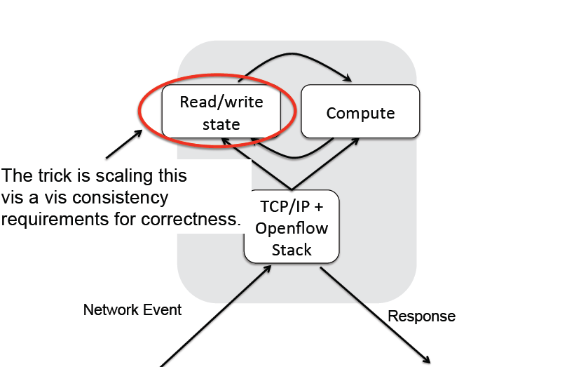
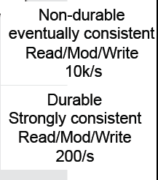
2. What about Scale?
Source: Martin Casado, Nicira

Slide 43
Why Does This Approach Scale?
0 - 10/s
Modification of Control Program
Strong Consistency
Per Network Event
Eventual Consistency
10¹ – 10³/s
Per Flow
No Consistency
10³ – 10⁶/s
Per Packet
No Consistency
10⁶ – 10⁸/s
Source: Scott Shenker, Berkeley

Slide 44
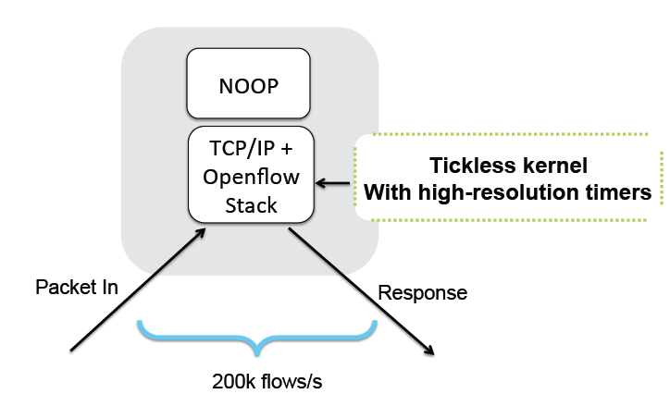
Some Published Numbers
Onix: A distributed control platform for large-scale production networks. Teemu Koponen, et al. OSDI October 2010.
1 Onix instance – 64 switches
Cluster of 5 Onix instances
Latency < 300 us
Throughput ~ 200,000 flows/sec
Convergence time:
same or better than IGP

Slide 45
Outline
2 Abstractions & SDN
2 Research Examples – MPLS & Packet-Optical
2 Burning Questions
Is Common Map practical?
What about Scale?
2 Trends
Research & Educational Networks (RENs)
Commercial Networks

Slide 46
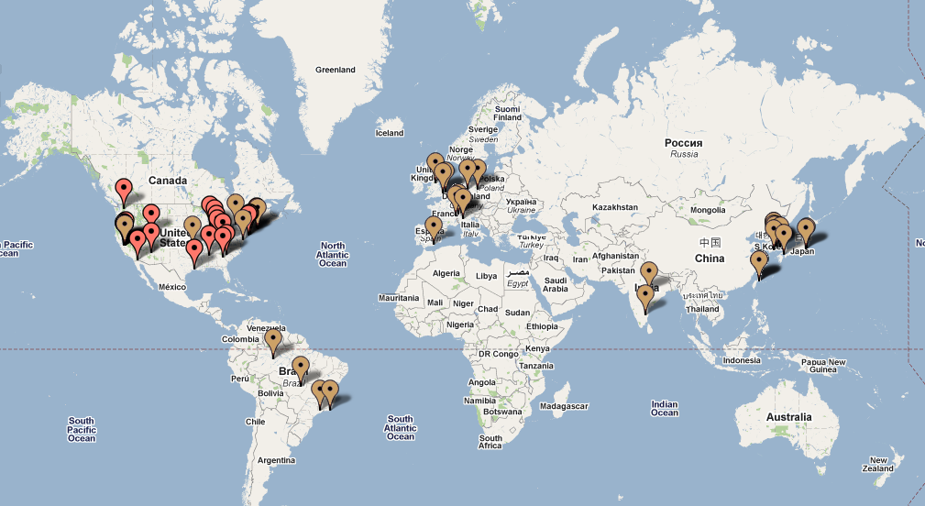
Trials (April 2010)
70+ trials/deployments in 13 countries

Slide 47
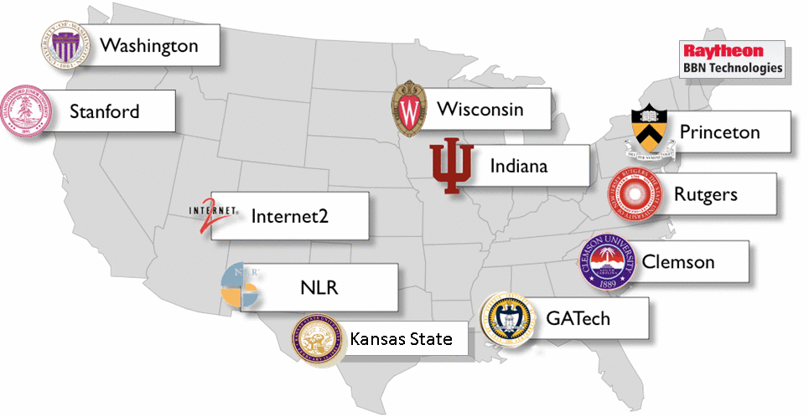
NSF GENI OpenFlow Deployment

Slide 48
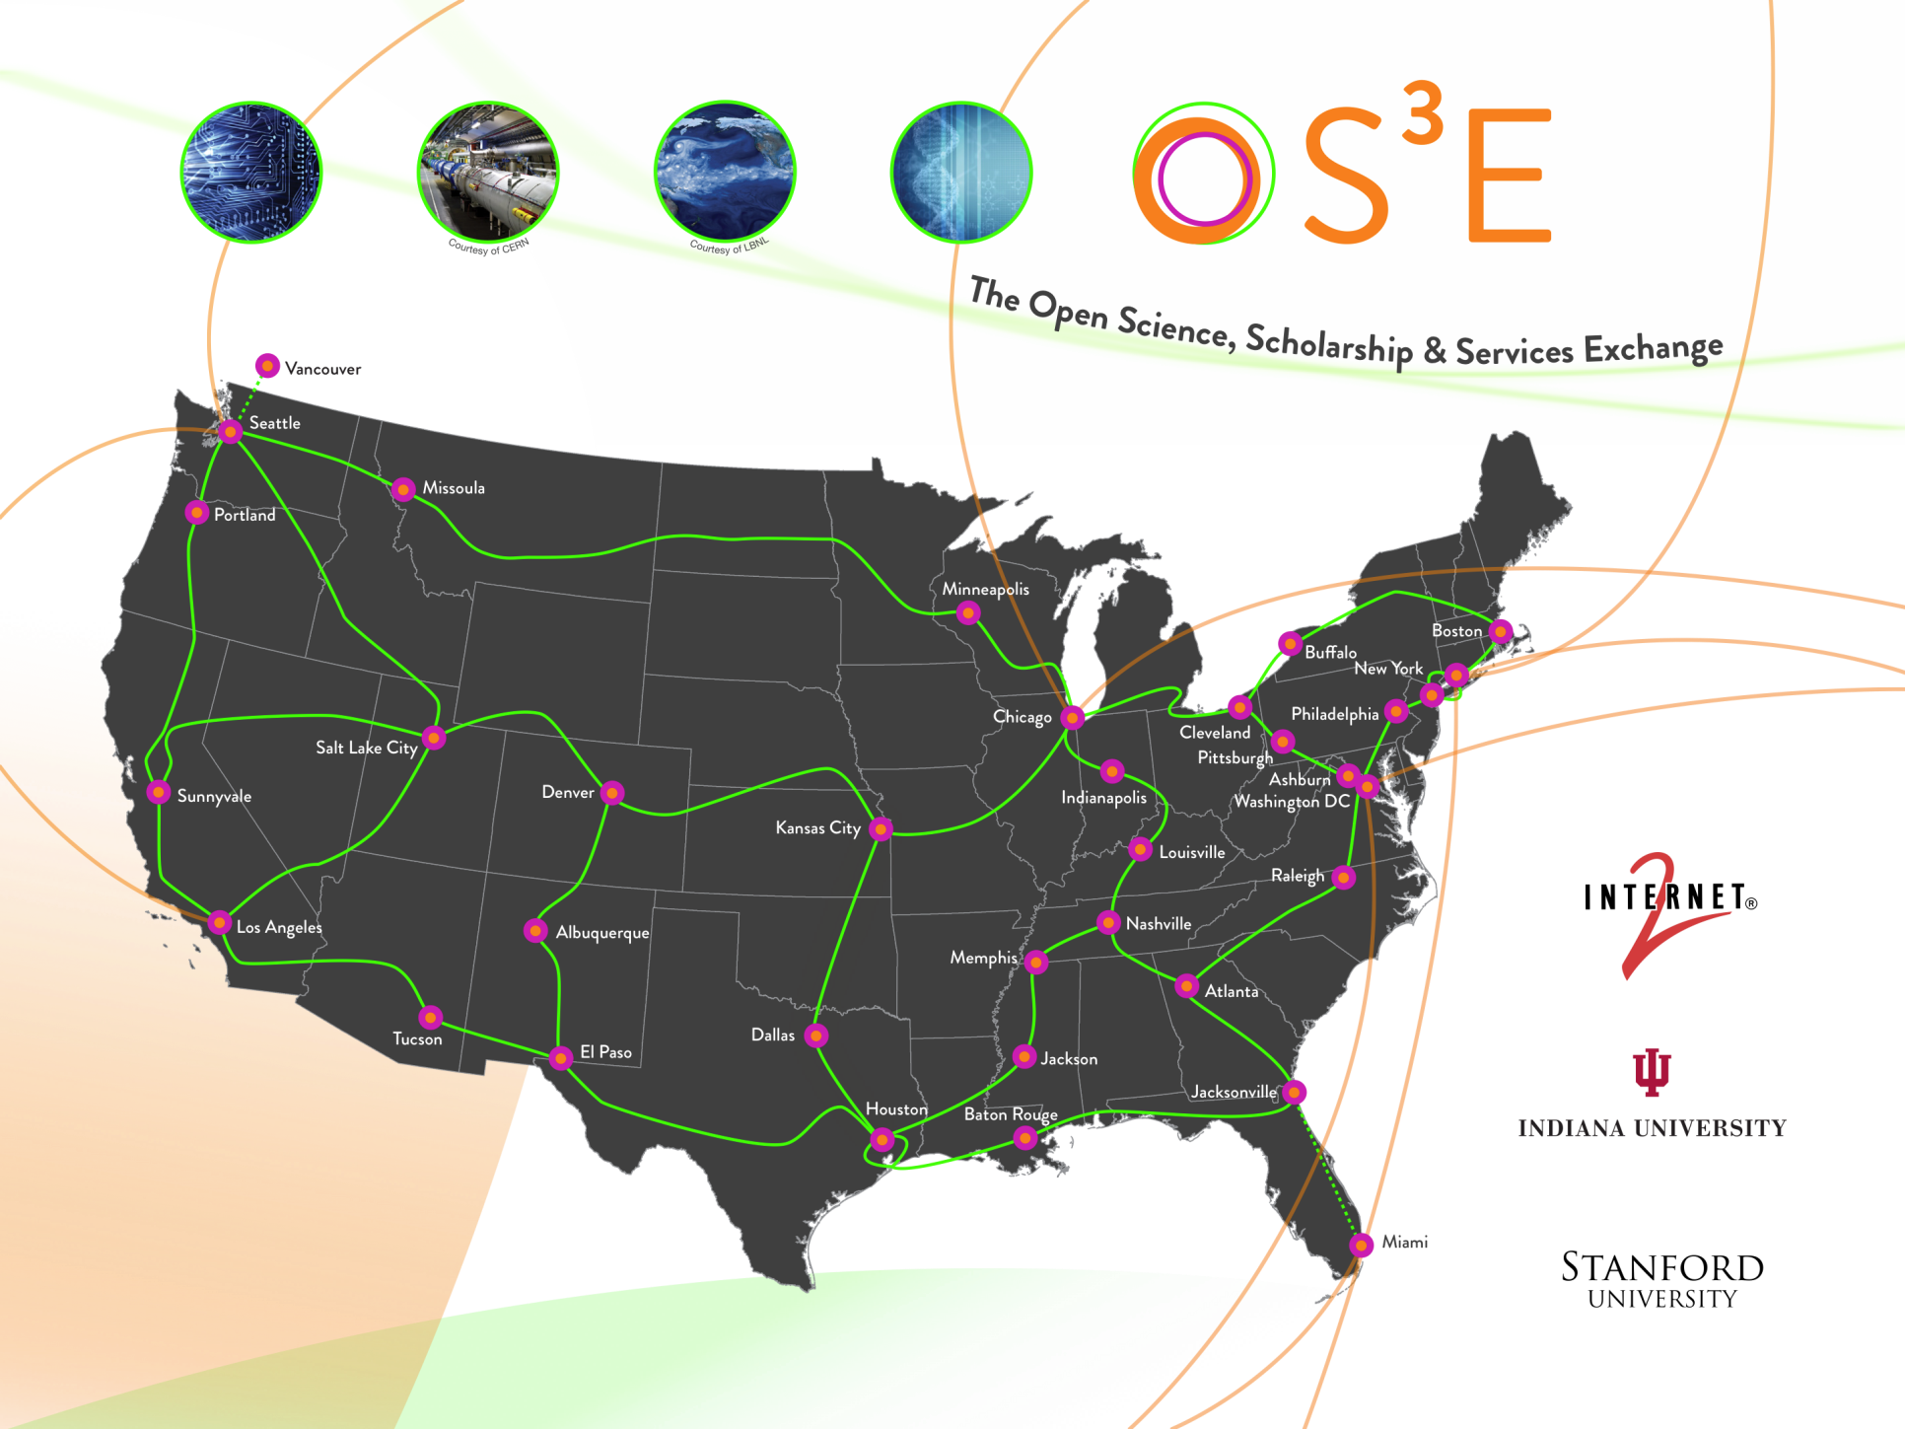
Internet2 NDDI

Slide 49
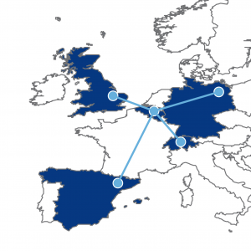
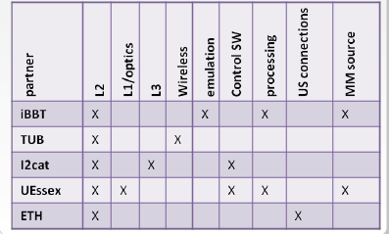
OFELIA
OpenFlow in Europe: Linking Infrastructure and Applications

Slide 50
Outline
2 Abstractions & SDN
2 Research Examples – MPLS & Packet-Optical
2 Burning Questions
Is Common Map practical?
What about Scale?
2 Trends
Research & Educational Networks (RENs)
Commercial Networks

Slide 51
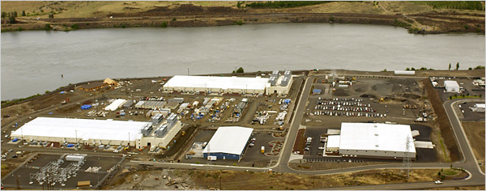
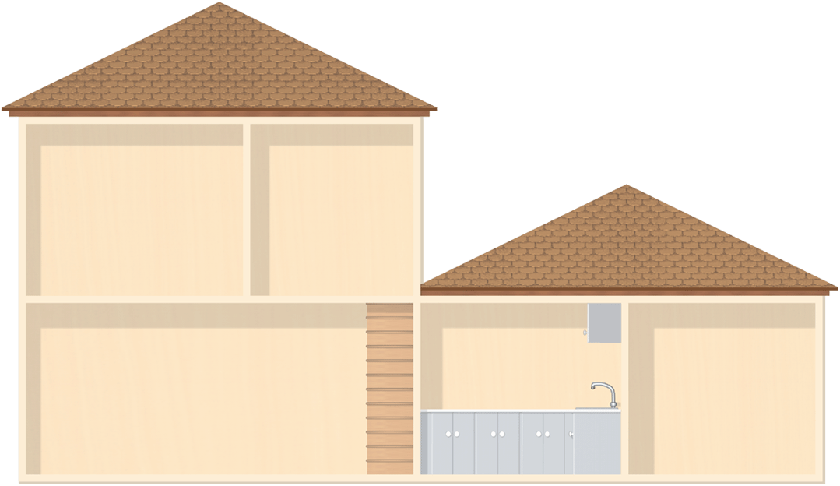
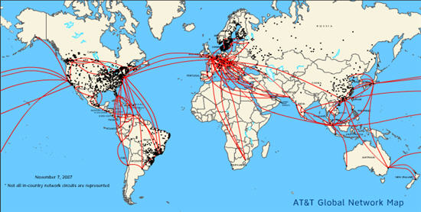
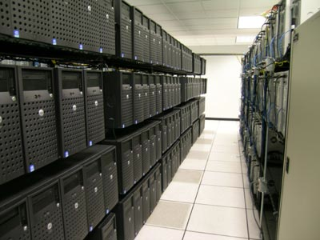
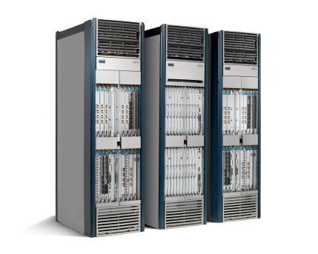
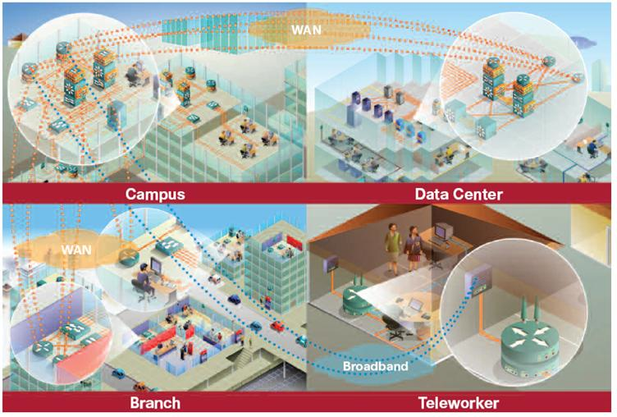
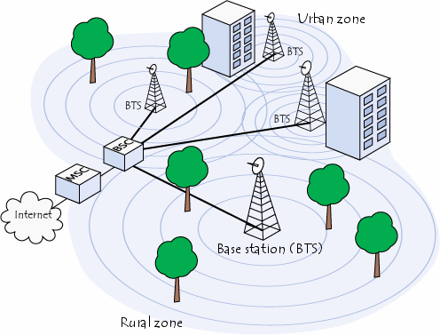
Home Network
Carrier Network
Data Center Network
Enterprise Network
Cellular Network
SDN Target Domains of Use

Slide 52
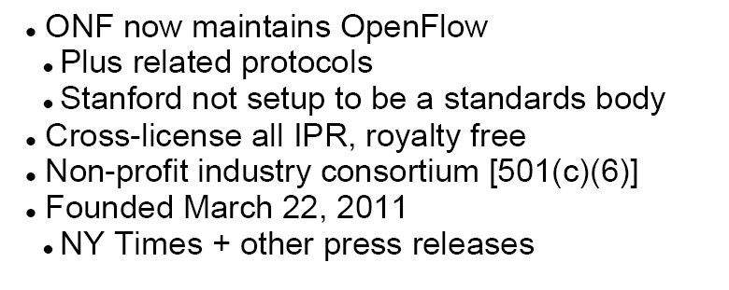
Open Networking Foundation (ONF)
Mission
Publish Open Interfaces & Promote SDN

Slide 53
Trend
App
App
App
App
App
App
Controller 1
Controller
2
Windows
(OS)
Linux
Mac
OS
Controller 1
Controller
2
Windows
(OS)
Linux
Mac
OS
NOX
(Network OS)
Network OS
Windows
(OS)
Linux
Mac
OS
Virtualization layer
Virtualization or “Slicing”
x86
(Computer)
OpenFlow
Computer Industry
Network Industry

Slide 54
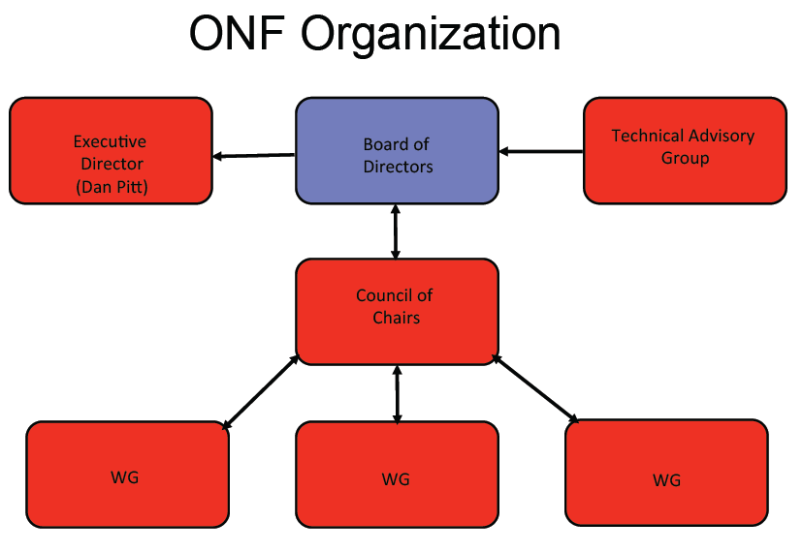

Slide 56
ONF Membership
Deutsche Telekom
Verizon
Google
Microsoft
Facebook
Yahoo!
Big Switch Networks
Pronto Systems
Midokura
Nicira Networks
Plexxi Inc.
Comcast
NTT
Brocade
Cisco
Extreme Networks
Force10 Networks
Juniper Networks
Huawei Technologies
NEC
Netgear
Dell
HP
IBM
Mellanox Technologies
Riverbed Technology
Infoblox
Ixia
Ciena
Ericsson
Fujitsu
Vello Systems
Nokia Siemens Networks
Broadcom
Intel
Marvell
Netronome
Citrix
VMware
Metaswitch Networks
IP Infusion
CompTIA

Slide 57
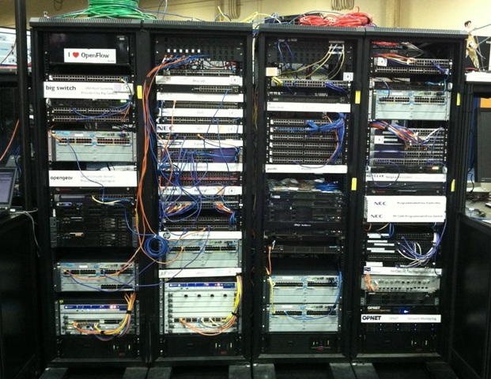
Interop, May 2011
Demos: 16 companies demonstrated OpenFlow
Best of show: NEC OpenFlow switch

Slide 58
Summary
2 Abstractions
Flow Abstraction
Map Abstraction
2 Research Examples
MPLS
Packet-Optical
2 Burning Questions
Is Common Map practical? → Slicing
What about Scale? → Distributed Systems
2 Trends
Research & Educational Networks (RENs)
Commercial Networks → ONF
Software Defined Networks (SDN)

Slide 59
One
Last Video
http://www.youtube.com/watch?v=ie9EW4HmSwI

