Slide 1

pac.c A Unified Control Architecture for Packet & Circuit Networks
Saurav Das
EE PhD Oral Defense
30th June, 2011

Slide 2
Outline
Problem Statement
Proposed Solution: Unified Control Architecture
Prototype & Demonstration to validate
Simplicity & Extensibility compared to existing solution
Capex (Capital Expenditure) Analysis to validate
Cost Efficiency compared to existing network design
MPLS based virtual-circuits

Slide 3
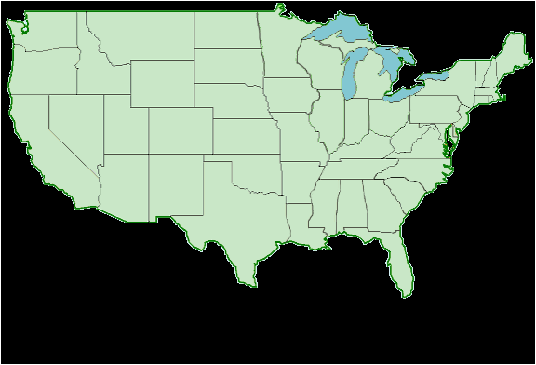
Wide Area IP Network

Slide 5
Logical Link between two Routers over the Wide-Area
Physical Router Link
Other Clients
Physical Router Link
TDM Switch
WDM Line System
40-160
wavelengths
channels
Optical Fiber
OtherClients
WDM Switch
Each channel runs at
10 or 40 Gbps.
100 Gbps coming soon!

Slide 6
IP Network
Transport Network

Slide 7
Problem Statement
Today, IP and Transport networks are separate
planned, designed and operated separately
by separate teams
Owning and operating two separate networks: inefficient!
Is there a way to run one network instead of two separate ones?
Maybe – let’s look at some options?

Slide 8


Option I: Eliminate Packet Switching
Packet switching
is here to stay
@ the edge
www.netflix.com
101.12.12.1
Link
Circuit
www.facebook.com
131.1.10.222
Circuit Switches

Slide 9
Option II: Eliminate Circuit Switching
All Services
INTERNET
INTERNET
Enterprise Private -Lines
Private-Nets
PSTN
TRANSPORT Network
Cellular
Is there a need for circuit switching in the Transport Network?

Slide 10
Option II: Eliminate Circuit Switching
Fundamental
Packet switching
is more expensive
than Circuit switching

Slide 11
Circuit Switch
Control
Scheduler
Input Linecard
Output Linecard
(λ, t, Port)
(λ’, t’, Port’)
Phy
TSI/
(DE) MUX
Phy
O/E
Framing
Coding
Err det/corr.
Switching Fabric

Slide 12
Circuit Switch
Control
Scheduler
(λ, t, port)
Input Linecard
Output Linecard
(λ’, t’, port’)
Phy
TSI/
(DE) MUX
Phy
Phy
Parse
Lookup
MOD
QoS
Phy
O/E
Framing
Coding
Err det/corr.
(pkt., port)
Set
Push
Pop
Decr
etc.
Queuing,
Sampling
Mirroring
Hashing
(pkt.’, port’)
Protocol
Queuing
Policing
Scheduler
ACLs, Routing,
Policy- Routing
QoS – WFQ, pQ, FIFO
Congestion - RED
Control
Packet Switch

Slide 13
Packet and Circuit Switches
 | Fiber Switch | WDM Switch | TDM Switch | Packet Switch
 | Fabric | Mux/Demux Fabric | Phy TSI Fabric | Phy Parsing Lookup Modifications Fabric ACLs Queuing Policing Policy Routing Congestion Avoidance QoS Sampling & Mirroring Hashing

Slide 14
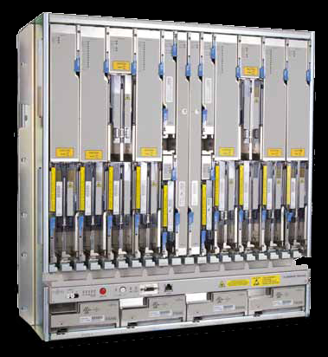
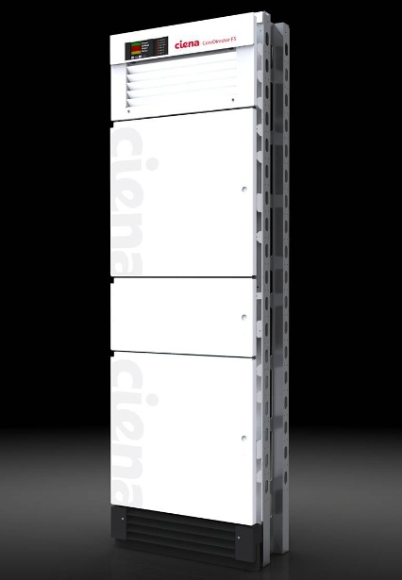
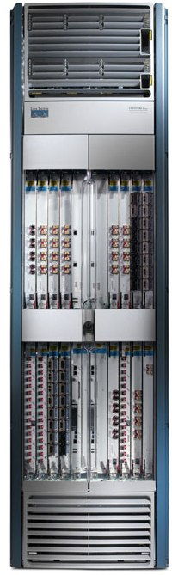
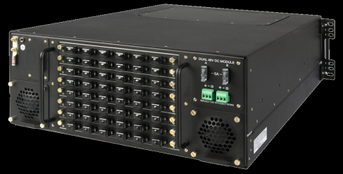
Packet and Circuit Switches
 | Glimmerglass IOS600 | Fujitsu Flashwave 7500 | Ciena CoreDirector | Cisco CRS-1
 | Fiber Switch | WDM Switch | TDM Switch | Packet Switch
B/w | 1.92 Tbps | 1.6 Tbps | 640 Gbps | 640 Gbps

Slide 15
Packet and Circuit Switches
 | Glimmerglass IOS600 | Fujitsu Flashwave 7500 | Ciena CoreDirector | Cisco CRS-1
 | Fiber Switch | WDM Switch | TDM Switch | Packet Switch
B/w | 1.92 Tbps | 1.6 Tbps | 640 Gbps | 640 Gbps
Power | 85 W | 360 W | 1440 W | 9630 W
Volume | 7” x 17” x 28” | 23” x 22” x 22” | 84” x 26” x 21“ | 84” x 24” x 36”
Price | < 50 | 110.38 | 83.73 | 884.35

Slide 16
Packet and Circuit Switches
 | Glimmerglass IOS600 | Fujitsu Flashwave 7500 | Ciena CoreDirector | Cisco CRS-1
 | Fiber Switch | WDM Switch | TDM Switch | Packet Switch
B/w | 1 | 1 | 1 | 1
Power | 1 W/Gbps | 5 | 51 | 332
Volume | 1 in³/Gbps | 4 | 41 | 65
Price | 1 $/Gbps | 3 | 5 | 53

Slide 17
Option III: Convergence
`

Slide 18
Outline
Problem Statement: want one network, not two!
3 possible options
But really only one (convergence) makes sense.
Proposed Solution: Unified Control Architecture
Common Flow Abstraction
Common Map Abstraction

Slide 19

The Flow Abstraction
CommonDest
Flow
End – to – End Flow
Flow Identifiers
L4: TCP src/dst port
L3: IP src/dst addr, IP proto
L2.5:
L2:
L4:
L3: IP dst prefix for China
L2.5:
L2:

Slide 20

The Flow Abstraction
Common Src Flow
Web traffic from a Handset
All packets between 2 routers
Flow Identifiers
L4:
L3: IP src prefix for branch
L2.5:
L2:
L4: TCP dst port 80
L3: IP proto
L2.5:
L2: MAC src
L4:
L3:
L2.5: MPLS Label ID
L2:
What is a Flow?
Classification of packets that have a logical association
Action & Maintaining Flow State
Flow based Accounting & Resource Management

Slide 21
1. Common Flow Abstraction
Flow Identifiers
L1:
L0: (p2, p5, p7, p9) λ5
L1:
L0: (p2, p5, p7, p9) (λ5, λ8, λ3)
L1:
L0: (p2, λ5), (p5, λ8), (p7, λ3)
Notes:
Once SDN starts to treat packets as flows, it’s a small step to note that circuits are also flows – they carry data from one point to another

Slide 22
1. Common Flow Abstraction
Flow Identifiers
L1: p3, ts6, num3
L0:
L1: p3, ts6, num3
p4, ts3, num3
p7, ts9, num3
L0:
Notes:
Once SDN starts to treat packets as flows, it’s a small step to note that circuits are also flows – they carry data from one point to another

Slide 23
Circuit Switch
Control
Scheduler
Cross-Connect Table
(λ, t, port)
(λ’, t’, port’)
Phy
TSI/
(DE) MUX
Phy
Phy
Parse
Lookup
MOD
QoS
Phy
(pkt., port)
(pkt.’, port’)
Scheduler
Lookup Table
Control
Packet Switch

Slide 24
1. Common Flow Abstraction
L4
L3
L2.5
L2
L1
L0
Packet Switch
Wavelength Switch
Multi-layer
Switch
Time-slot
Switch
Packet Switch

Slide 25
Outline
Problem Statement: want one network, not two!
3 possible options
But really only one (convergence) makes sense.
Proposed Solution: Unified Control Architecture
Common Flow Abstraction
Common Map Abstraction

Slide 26
2. Common Map Abstraction
routing, access-control, mobility, traffic-engineering, guarantees, recovery, bandwidth-on-demand …
Unified Control Plane

Slide 27
Unified Control Architecture
routing, access-control, mobility, traffic-engineering, guarantees, recovery, bandwidth-on-demand …
2. Common Map Abstraction
Unified Control Plane
Common Flow Abstraction

Slide 28
Outline
Problem Statement: want one network, not two!
3 possible options
But really only one (convergence) makes sense.
Proposed Solution: Unified Control Architecture
Common Flow Abstraction
Common Map Abstraction
Prototype & Demonstration to validate
Simplicity & Extensibility compared to industry-solution

Slide 29
Unified Control Architecture
routing, access-control, mobility, traffic-engineering, guarantees, recovery, bandwidth-on-demand …
2. Common Map Abstraction
Unified Control Plane
Common Flow Abstraction

Slide 30
Implementation of the Architecture
2. Common Map Abstraction
NOX
Unified
Control
Plane
Interface: OpenFlow Protocol
Packet &
Circuit Switches
Common Flow Abstraction
Converged Network

Slide 31
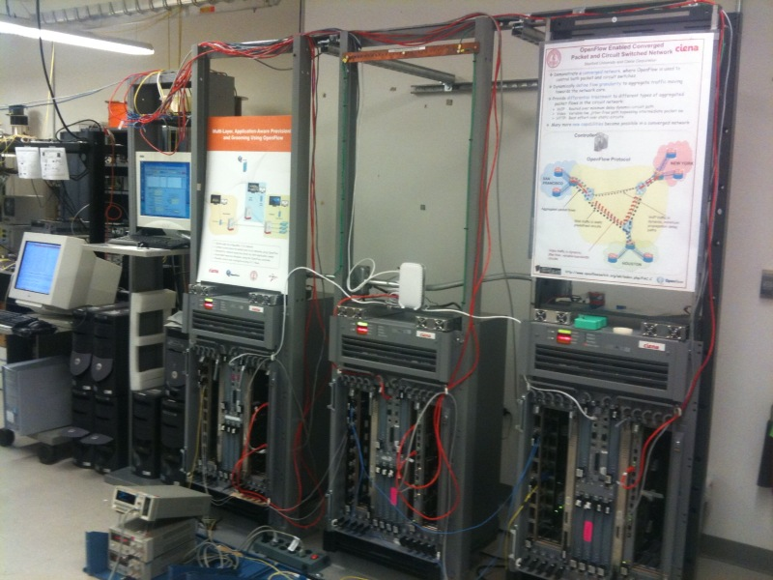
Prototype
Packet switches
NOX
Hybrid Packet-Circuit Switches

Slide 32
Prototype – Emulated WAN
NOX
OpenFlow Protocol
NEW YORK
SAN
FRANCISCO
GE links
OC-48 links (2.5 Gbps)
HOUSTON

Slide 33
Implementation of the Architecture
Application across packet and circuits
2. Common Map Abstraction
NOX
Unified
Control
Plane
Interface: OpenFlow Protocol
Packet &
Circuit Switches
Common Flow Abstraction
Converged Network

Slide 34
Example Network Application
Control Function: Treat different kinds of traffic differently
Function Impl.: Use both packets and circuits,
at the same time.
Traffic-type | Delay/Jitter | Bandwidth | Recovery
VoIP | Lowest Delay | Low | Medium
Video | Zero Jitter | High | Highest
Web | Best-effort | Medium | Lowest
VOIP
VOIP
VIDEO
HTTP
HTTP

Slide 35
Video of a
Demonstration
of network application
on Prototype

Slide 36
Why is it Simpler?
Application across packet and circuits
2000 lines of code
2. Common Map Abstraction
NOX
Unified
Control
Plane
Interface: OpenFlow Protocol
Packet and Circuit Switches
Common Flow Abstraction
Converged Network

Slide 37
Why is it Simpler?
GMPLS Control Plane
NOX
IP/MPLS Control Plane
OSPF-TE
RSVP-TE
UNI
Interface: OpenFlow Protocol
OSPF-TE
RSVP-TE
EMS
EMS
EMS
Proprietary Interface
Proprietary Interface
Vendor Islands
Transport Network
Converged Network
IP Network

Slide 38
Why is it Simpler?
∑ = 175,000 LOC
GMPLS Control Plane
15000!
IP/MPLS Control Plane
OSPF-TE
RSVP-TE
35000^
45000^
UNI
OSPF-TE
RSVP-TE
35000*
EMS
EMS
EMS
45000#
Proprietary Interface
Proprietary Interface
Vendor Islands
Transport Network
IP Network
Sources: * Quagga # Tequila ! MUPBED ^ DRAGON

Slide 39
Why is it Simpler?
Why is it the Right Abstraction?
Application across packet and circuits
2000 lines of code
2. Common Map Abstraction
NOX
Unified
Control
Plane
Interface: OpenFlow Protocol
Packet and Circuit Switches
Common Flow Abstraction
Converged Network

Slide 40
Why is it the Right Abstraction?
∑ = 175,000 LOC
GMPLS Control Plane
15000!
IP/MPLS Control Plane
OSPF-TE
RSVP-TE
35000^
45000^
UNI
OSPF-TE
RSVP-TE
35000*
EMS
EMS
EMS
45000#
Proprietary Interface
Proprietary Interface
Vendor Islands
Transport Network
IP Network
Sources: * Quagga # Tequila ! MUPBED ^ DRAGON

Slide 41
Why is it the Right Abstraction?
∑ = 175,000 LOC
GMPLS Control Plane
15000
IP/MPLS Control Plane
OSPF-TE
RSVP-TE
35000
45000
UNI
OSPF-TE
RSVP-TE
35000
EMS
EMS
EMS
45000
Proprietary Interface
Proprietary Interface
Gold
Silver
Bronze
Vendor Islands
Can’t Specify :
route,
or delay,
or recovery mechanism
or monitoring/stats
or priorities
Diffserv based TE +
Policy Based Routing
Transport Network
IP Network

Slide 42
Why is it the Right Abstraction?
Extensibility
2. Common Map Abstraction
Full View
Control Function not tied to Distribution Mechanism
NOX
Unified
Control
Plane
Interface: OpenFlow Protocol
Packet and Circuit Switches
Common Flow Abstraction
Converged Network

Slide 43
Outline
Problem Statement: want one network, not two!
3 possible options
But really only one (convergence) makes sense.
Proposed Solution: Unified Control Architecture
Prototype & Demonstration to validate
Simplicity & Extensibility compared to existing solution
Capex Analysis to validate
Cost Efficiency compared to existing network design

Slide 44
Capex Analysis
Objective:
Cost effectiveness of running a converged network of packet and circuit switches
Based on the Unified Control Architecture
Reference network: IP over WDM (no circuit switching)
Converged network: over 50% hardware cost savings.

Slide 47
IP over WDM Design Methodology
Need IP and WDM topologies
Need a traffic matrix
Dimensioning
Route ‘demand’ traffic matrix over IP topology
Dimension for recovery
Dimension for traffic uncertainty
Tabulation
# 10G core-interfaces needed per IP edge
# 10G core-access intfs needed per PoP
# Core routers & # Access routers needed per pop
IP Cost Model
Route IP edge demands over fiber-topology
tabulate demand on a fiber-edge
derive WDM system demand per fiber edge
WDM Cost Model

Slide 48
Capex: IP over WDM

Slide 49
Circuit Based Recovery
Backbone/Core Switching
Backbone/Core Routers
Access Routers
Aggregation

Slide 50
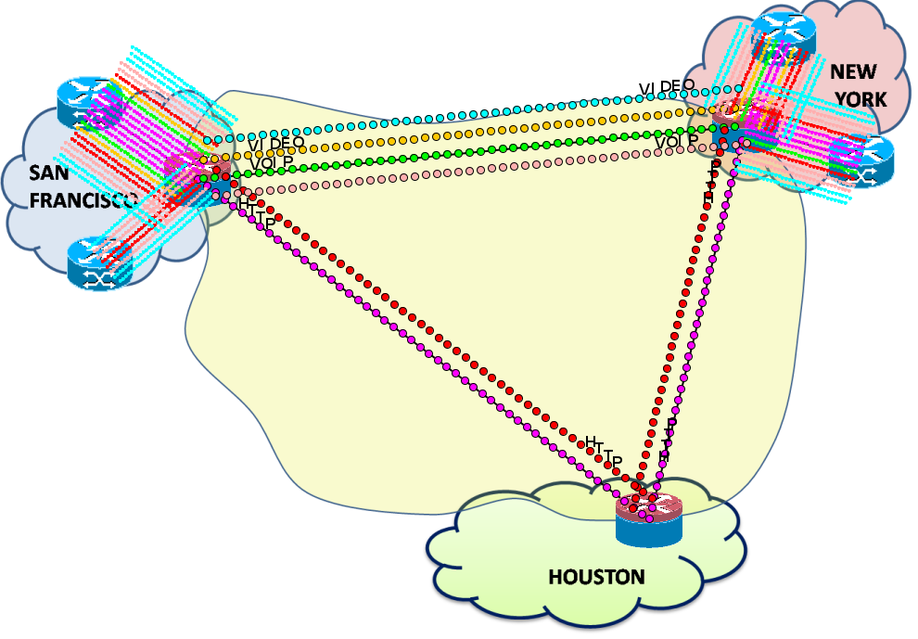
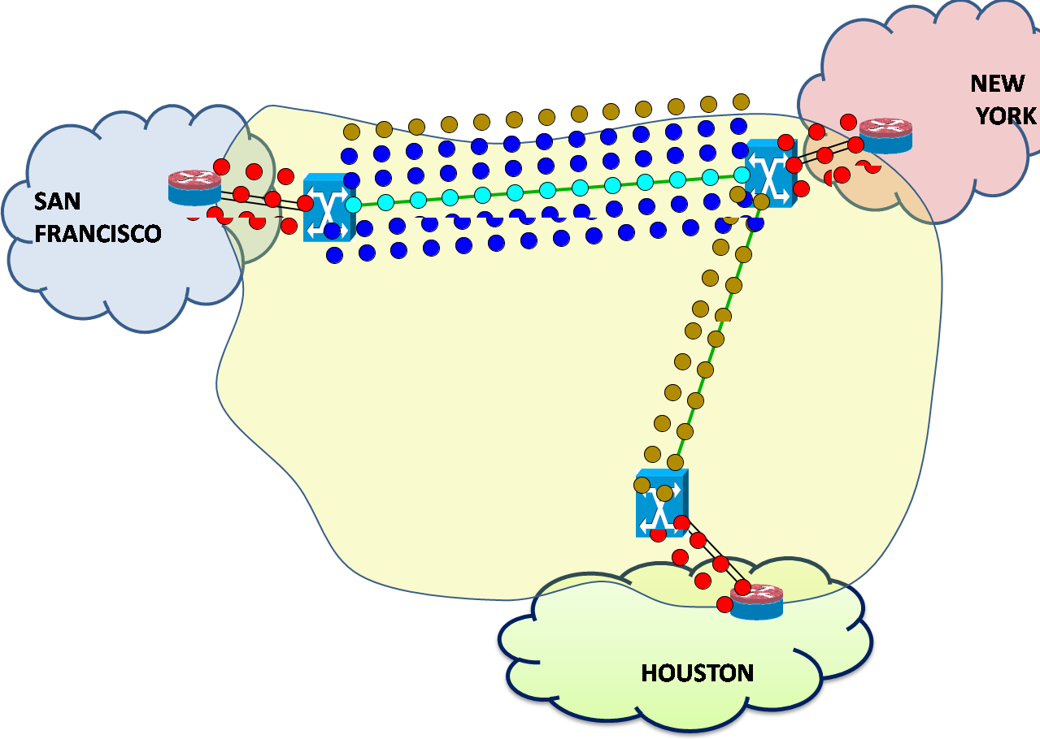
Circuit Based Recovery
Demonstrated

Slide 51
Circuits for Traffic – Uncertainty
Backbone/Core Switching
Backbone/Core Routers
Access Routers
Aggregation

Slide 52

Circuits for Traffic – Uncertainty
PKT
PKT
E
T
H
E
T
H
E
T
H
E
T
H
PKT
E
T
H
E
T
H
Packet (virtual) topology
..and spare bandwidth in the circuit network
PKT
Notice the spare interfaces
E
T
H
E
T
H
P
K
T
T
D
M
S
O
N
E
T
P
K
T
T
D
M
E
T
H
E
T
H
S
O
N
E
T
P
K
T
T
D
M
S
O
N
E
T
E
T
H
PKT
E
T
H
E
T
H
PKT
Actual topology
E
T
H
E
T
H

Slide 53
Circuits for Traffic – Uncertainty
PKT
PKT
E
T
H
E
T
H
E
T
H
E
T
H
PKT
E
T
H
E
T
H
Packet (virtual) topology
PKT
E
T
H
E
T
H
P
K
T
T
D
M
S
O
N
E
T
P
K
T
T
D
M
E
T
H
E
T
H
S
O
N
E
T
P
K
T
T
D
M
S
O
N
E
T
E
T
H
PKT
E
T
H
E
T
H
PKT
Actual topology
E
T
H
E
T
H
Redirecting bw between the spare interfaces to dynamically create new links!!

Slide 54
Circuits for Backbone Switching
Backbone/Core Switching
Backbone/Core Packet-Optical Switches
Backbone/Core Routers
Access Routers
Aggregation

Slide 55
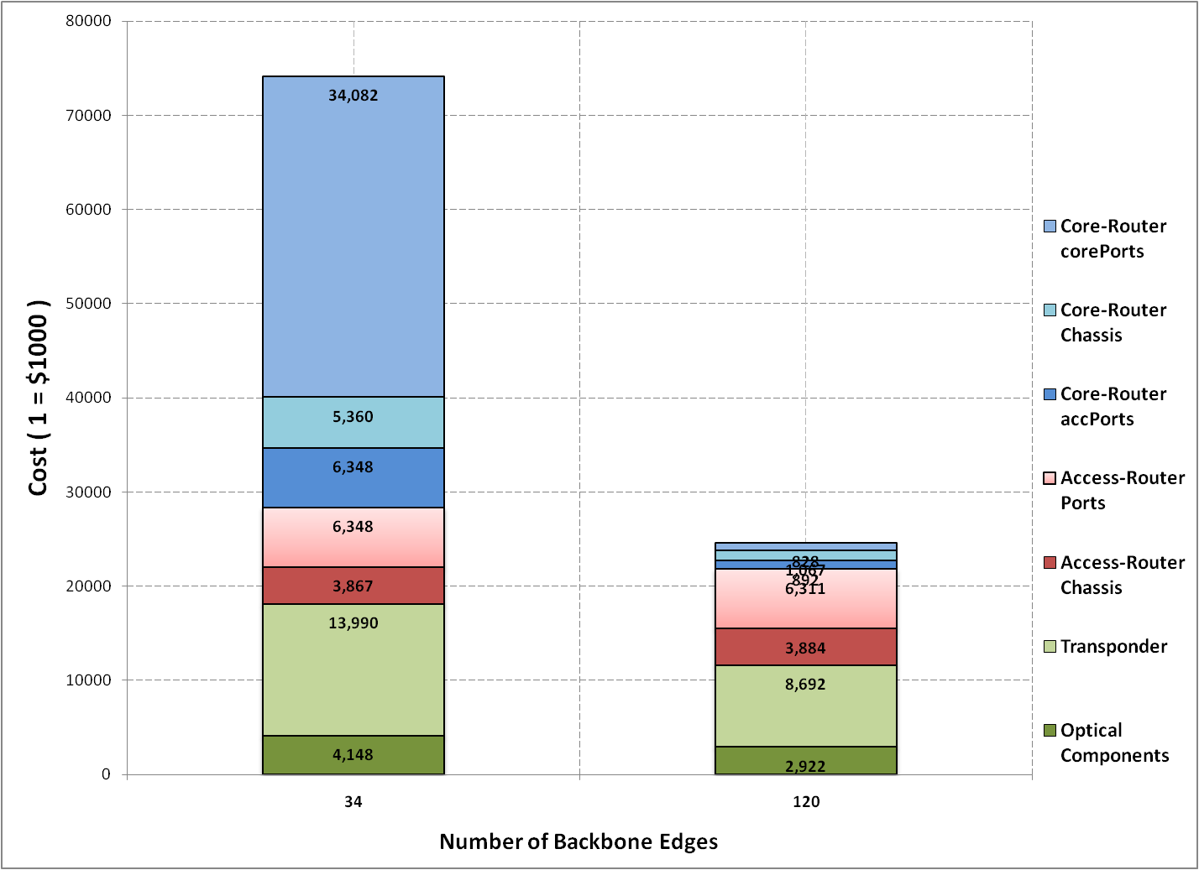
Capex Results
1
67%

Slide 56
Outline
Problem Statement: want one network, not two!
3 possible options
But really only one (convergence) makes sense.
Proposed Solution: Unified Control Architecture
Prototype & Demonstration to validate
Simplicity & Extensibility compared to existing solution
Capex Analysis to validate
Cost Efficiency compared to existing network design
MPLS based virtual-circuits

Slide 57
Packets and MPLS Virtual-Circuits (LSPs)
MPLS has Flow Abstraction
Flow state in Head-end LER
Label Switched Path (LSP)
Label Edge Router (LER)
Label Switch
Router (LSR)
Incoming packets
Classification
Into FECs
LSPs
MPLS network
IP network

Slide 58
Packets and MPLS Virtual-Circuits (LSPs)
MPLS lacks Map Abstraction
OSPF-TE
LDP
I-BGP
RSVP-TE
LMP
MP-BGP
Label Switched Path (LSP)

Slide 59
Introducing Map Abstraction in MPLS
Services
Network Applications
TE
Routing
Discovery
Label Distribution
Recovery
Simpler Control Plane
NETWORK OPERATING SYSTEM
OSPF-TE
LDP
I-BGP
OpenFlow
RSVP-TE
LMP
MP-BGP
Simpler
Data Plane
Label Switched Path (LSP)
P
PUSH

Slide 60
Prototype System
MPLS-TE
Auto – route; Auto – bandwidth
Traffic – aware LSPs; Priorities
TE-LSP configuration
MPLS GUI
MPLS API
CSPF Routing
MPLS Stats
GUI (Envi)
showing real-time
network state
Network Operating System (NOX)
OpenFlow
Open vSwitch
with standard MPLS data plane
Open vSwitch
(with MPLS)
Open vSwitch
(with MPLS)
Open vSwitch
(with MPLS)
Open vSwitch
(with MPLS)
Open vSwitch
(with MPLS)
Open vSwitch
(with MPLS)
Open vSwitch
(with MPLS)
Open vSwitch
(with MPLS)
Open vSwitch
(with MPLS)
Open vSwitch
with standard MPLS data plane
Mininet Environment

Slide 61
Video of a
Demonstration
showing MPLS-TE service with the Map Abstraction

Slide 62
TE-LSP Features
Auto-route
Auto-bandwidth
Priorities
Load-share
Diffserv aware Traffic Engineering (DS-TE)
MPLS FRR
Explicit Routes
Re-optimization timers
4000 lines of code
Vs.
80,000 + ?

Slide 63
Summary
Packet and Circuit switching both have a place – must find a way to converge operation
Proposed a Unified Control Architecture (pac.c)
Prototype and Demonstration to Validate Simplicity and Extensibility
Capex Analysis to Validate Cost Savings from Convergence
Introduced Map Abstraction into MPLS based virtual-circuit networks.

Slide 64
Publications
Saurav Das, Guru Parulkar, Nick McKeown
Unifying Packet and Circuit Switched Networks
Globecom BIPN workshop, November 2009
Saurav Das, Yiannis Yiakoumis, Guru Parulkar, Preeti Singh, Dan Getachew, Premal Desai, Nick McKeown,
Demonstrated at GENI Engineering Conference, July 2010
Application-Aware Aggregation and Traffic Engineering in a Converged Packet-Circuit Network, OFC/NFOEC March 2011
Saurav Das, Ali Reza Sharafat, Guru Parulkar, Nick McKeown,
Demonstrated at Google, January 2011
MPLS with a Simple OPEN Control Plane
OFC/NFOEC, March 2011
Saurav Das, Guru Parulkar, Preeti Singh, Daniel Getachew, Lyndon Ong, Nick McKeown,
Demonstrated at SuperComputing, November 2009
Packet and Circuit Network Convergence with OpenFlow,
OFC/NFOEC, March 2010
Vinesh Gudla, Saurav Das, Anujit Shastri, Guru Parulkar, Shinji Yamashita, Leonid Kazovsky, Nick McKeown, Experimental Demonstration of OpenFlow Control of Packet and Circuit Switches,
OFC/NFOEC, March 2010

Slide 65
Acknowledgements
Guru and Nick
Fouad and David
Yiannis, Ali and Vinesh
Lyndon, Preeti, Dan G. & others at Ciena/Ciena-India
Shinji Yamashita at Fujitsu, Ori Gerstel at Cisco
Andreas, Hans-Martin, Joakhim at T-Systems/DT
Everyone in McKeown Group
My support system – my wife, my wonderful kids, my friends.
Boris & Jacob
My parents

