Slide 1
OpenFlow/SDN Advanced Tutorial June, 2013
Srini Seetharaman Deutsche Telekom Innovation center
Notes:
Before the talk starts, I would like to check with audience about the environment setup.

Slide 2
Hands-on Tutorial Background Info

Slide 3
Bootstrap
Install VirtualBox or Vmware player or Vmware Fusion
Import the tutorial VM appliances available at:
64-bit: (Login: ubuntu, Passwd: ubuntu) http://yuba.stanford.edu/~srini/OpenFlow_tutorial_64bit.ova
32-bit: (Login: ubuntu, Passwd: ubuntu) http://yuba.stanford.edu/~srini/OpenFlow_tutorial_32bit.ova
Install X-Windows if you do not already have it
Mac user: Install xquartz
Windows user: Install xming
Start the VM, and “ssh -X” to its host-only IP address
VirtualBox: Ensure the vboxnet0 interface is configured for “host-only”
File->Preferences->Network and “Add host-only network” button with default settings.

Slide 4
Inside the Virtual Machine
openvswitch: Virtual switch programmable using OpenFlow
mininet: Network emulation platform
$sudo mn --topo single,3 --mac --switch ovsk --controller remote
wireshark: Graphical tool for viewing packets with OF protocol plug-in
Start wireshark: $sudo wireshark
Start capture packets going through interface “lo” and Decode as OFP
dpctl: Command-line utility for checking switch status and manually inserting flow entries.
Check supported commands in manual: $ man dpctl
Multiple OpenFlow controllers with sample apps prepackaged
NOX, POX, Ryu, and OpenDayLight
Notes:
Bootstrap and setup VM should be done offline.
Hands-on tutorial will includes:
-- introduction to the tools
-- start mininet OF network
-- dpctl: checkout switch status, flow status, add flow, delete flow, etc. (ping test)
--start OF ryu (do nothing): use wireshark to observe OF messages
-- Ryu controller and applications.

Slide 5
Setup 1: Mininet-based Single Switch
Controller
port6633
OpenFlow Tutorial
3hosts-1switch
Topology
c0
loopback
(127.0.0.1:6633)
OpenFlow Switch
loopback
(127.0.0.1:6634)
dpctl
(user space process)
s1
s1-eth0
s1-eth1
s1-eth2
h1-eth0
h2-eth0
h3-eth0
h1
10.0.0.1
h2
10.0.0.2
h3
10.0.0.3
virtual hosts
$ sudo mn --topo single,3 --mac --switch ovsk --controller remote

Slide 6
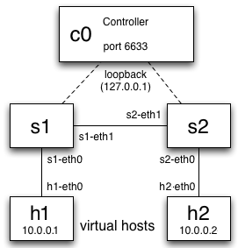
Setup 2: Linear topology with 2 switches
OpenFlow Tutorial
2hosts-2switch
Topology
$ sudo mn --topo linear --switch ovsk --controller remote

Slide 7
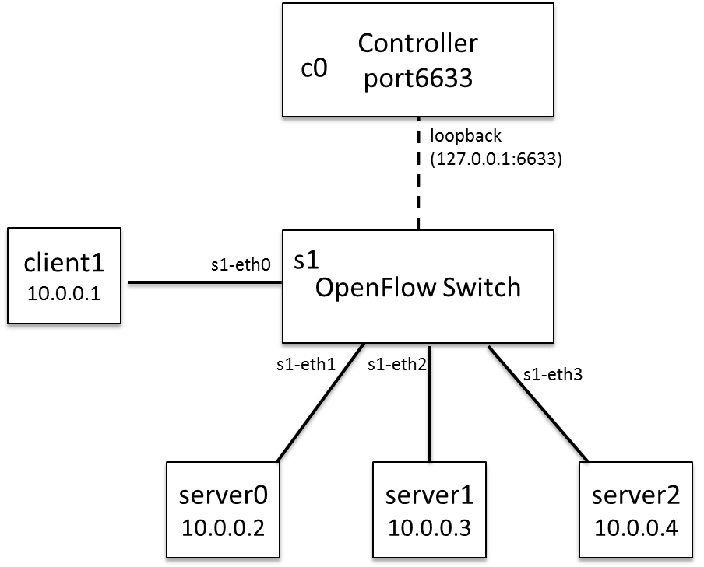
Setup 3: Web Server Farm in Mininet
$ sudo mn --topo single,4 --mac --switch ovsk --controller remote
SERVER SETUP:
h2 python -m CGIHTTPServer &
h3 python -m CGIHTTPServer &
h4 python -m CGIHTTPServer &
ARP INIT FOR REACHABILITY:
h1 arp -s 10.0.0.5 00:00:00:00:00:05
h2 arp -s 10.0.0.5 00:00:00:00:00:05
h3 arp -s 10.0.0.5 00:00:00:00:00:05
h4 arp -s 10.0.0.5 00:00:00:00:00:05
PREP (AFTER STARTING CONTROLLER):
h1 ping h2
h3 ping h4
CLIENT REQUEST:
h1 curl http://10.0.0.5:8000/cgi-bin/serverip.cgi

Slide 8
dpctl and wireshark workflow
Before controller is started, execute the following
$ dpctl show tcp:127.0.0.1:6634
$ dpctl dump-flows tcp:127.0.0.1:6634
mininet> h1 ping h2
$ dpctl add-flow tcp:127.0.0.1:6634 in_port=1,actions=output:2
$ dpctl add-flow tcp:127.0.0.1:6634 in_port=2,actions=output:1
mininet> h1 ping h2
Start controller and check OF messages on wireshark (enabling OFP decode)
Openflow messages exchanged between switch and controller: openflow/include/openflow/openflow.h
/* Header on all OpenFlow packets. */
struct ofp_header {
uint8_t version; /* OFP_VERSION. */
uint8_t type; /* one of the OFPT_ constants.*/
uint 16_t length; /*Length including this ofp_header. */
uint32_t xid; /*Transaction id associated with this packet..*/
};
All ports of switch shown, but no flows installed. Ping fails because ARP cannot go through
Ping works now!
Notes:
Bootstrap and setup VM should be done offline.
Hands-on tutorial will includes:
-- introduction to the tools
-- start mininet OF network
-- dpctl: checkout switch status, flow status, add flow, delete flow, etc. (ping test)
-- start OF ryu (do nothing): use wireshark to observe OF messages
-- Ryu controller and applications.
Summays

Slide 9
Top 3 features in most controllers
Event-driven model
Each module registers listeners or call-back functions
Example async events include PACKET_IN, PORT_STATUS, FEATURE_REPLY, STATS_REPLY
Packet parsing capabilities
When switch sends an OpenFlow message, module extracts relevant information using standard procedures
switch.send(msg), where msg can be
PACKET_OUT with buffer_id or fabricated packet
FLOW_MOD with match rules and action taken
FEATURE_REQUEST, STATS_REQUEST, BARRIER_REQUEST

Slide 10
OpenDayLight controller

Slide 11
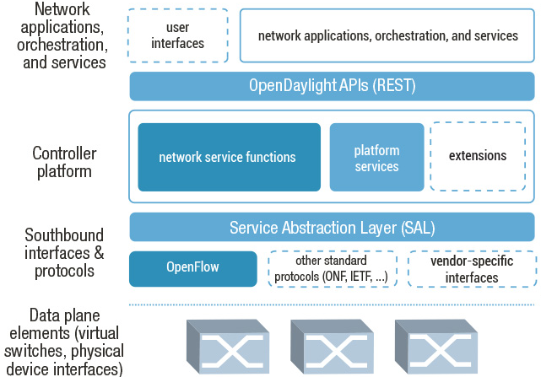
Controller Architecture

Slide 12
Java, Maven, OSGi, Interface
Java allows cross-platform execution
Maven allows easier building
OSGi:
Allows dynamically loading bundles
Allows registering dependencies and services exported
For exchanging information across bundles
Java Interfaces are used for event listening, specifications and forming patterns

Slide 13
Setup
INSTALL OPENDAYLIGHT (Dependency Maven, JDK1.7)
git clone https://git.opendaylight.org/gerrit/p/controller.git
mv controller opendaylight; cd opendaylight
cd opendaylight/distribution/opendaylight/
mvn clean install
cd target/distribution.opendaylight-0.1.0-SNAPSHOT-osgipackage/opendaylight/
./run.sh
IMPORT OPENDAYLIGHT TO ECLIPSE
Install Eclipse with Maven Integration Version 1.2.0
File => Import => Maven => Existing Maven Projects
Browse ~/opendaylight/opendaylight/distribution/opendaylight
In distribution.opendaylight, right click on opendaylight-assembleit.launch and select “Run”. Then “Run” opendaylight-application.launch

Slide 14
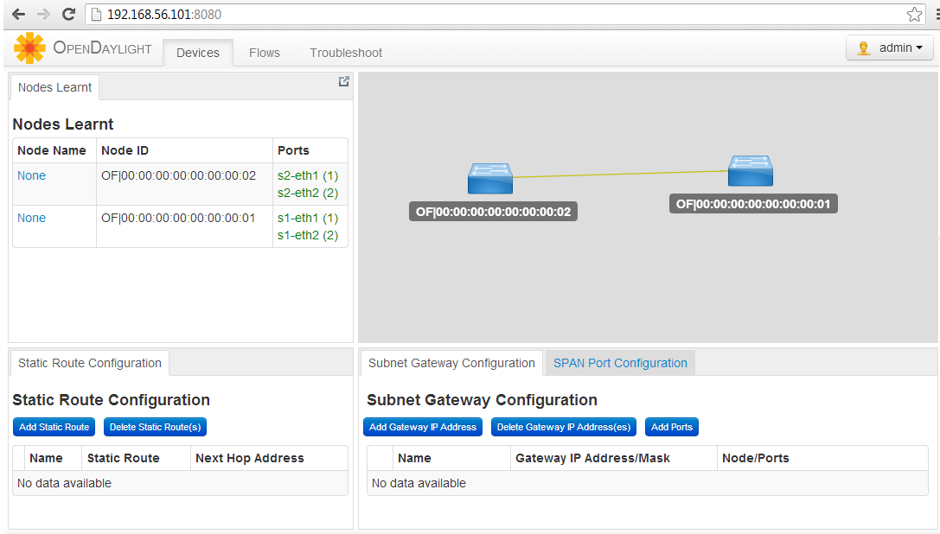
OpenDayLight web interface

Slide 15
Writing a new application
Clone an existing module (e.g., arphandler) in Eclipse project explorer
Include the new app in opendaylight/distribution/opendaylight/pom.xml and in the Eclipse“Run Configurations”
Update set/unset bindings in the module’s class so as to access other bundle objects
List dependencies imported and interfaces implemented in the module’s Activator.java
Update dependencies and services exported in the new bundle’s pom.xml
Implement the interface functions to handle the async events or use other bundle objects to edit state
Add needed northbound REST API and associate with the web bundle
Done

Slide 16
Useful Interfaces and Bundles
Bundle | Exported interface | Description
arphandler | IHostFinder | Component responsible for learning about host location by handling ARP.
hosttracker | IfIptoHost | Track the location of the host relatively to the SDN network.
switchmanager | ISwitchManager | Component holding the inventory information for all the known nodes (i.e., switches) in the controller.
topologymanager | ITopologyManager | Component holding the whole network graph.
usermanager | IUserManager | Component taking care of user management.
statisticsmanager | IStatisticsManager | Component in charge of using the SAL ReadService to collect several statistics from the SDN network.

Slide 17
Useful Interfaces and Bundles
Bundle | Exported interface | Description
sal | IReadService | Interface for retrieving the network node's flow/port/queue hardware view
sal | ITopologyService | Topology methods provided by SAL toward the applications
sal | IFlowProgrammerService | Interface for installing/modifying/removing flows on a network node
sal | IDataPacketService | Data Packet Services SAL provides to the applications
web | IDaylightWeb | Component tracking the several pieces of the UI depending on bundles installed on the system.

Slide 18
POX controller

Slide 19
Intro to POX controller General execution: $ ~/pox/pox.py <dir>.<name> Example: $ ~/pox/pox.py forwarding.hub
Parses messages from switch and throws following events
FlowRemoved
FeaturesReceived
ConnectionUp
FeaturesReceived
RawStatsReply
PortStatus
PacketIn
BarrierIn
SwitchDescReceived
FlowStatsReceived
AggregateFlowStatsReceived
TableStatsReceived
PortStatsReceived
QueueStatsReceived
Packets parsed by pox/lib
arp
dhcp
dns
eapol
eap
ethernet
icmp
igmp
ipv4
llc
lldp
mpls
rip
tcp
udp
vlan
Example msg sent from controller to switch
ofp_packet_out
header:
version: 1
type: 13
length: 24
xid: 13
buffer_id: 272
in_port: 65535
actions_len: 1
actions:
type: 0
len: 8
port: 65531
max_len: 65535

Slide 20
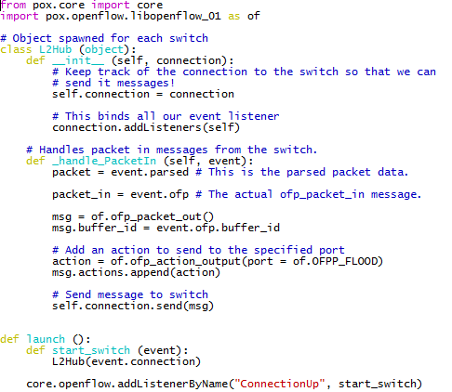
Application 1: Hub (inspect file pox/pox/misc/of_tutorial.py)
Hub
(3)
(4)
POX
(2)
(5)
OF Switch
(B)
(1)
(6)
(C)
(A)

Slide 21
Application 2: MAC-learning switch (convert pox/pox/misc/of_tutorial.py to L2 switch)
Build on your own with this logic:
On init, create a dict to store MAC to switch port mapping
self.mac_to_port = {}
On packet_in,
Parse packet to reveal src and dst MAC addr
Map src_mac to the incoming port
self.mac_to_port[dpid] = {}
self.mac_to_port[dpid][src_mac] = in_port
Lookup dst_mac in mac_to_port dict to find next hop
If found, create flow_mod and send
Else, flood like hub.
Execute: pox/pox.py misc.of_tutorial
msg = of.ofp_flow_mod()
msg.match = of.ofp_match.from_packet(packet)
msg.buffer_id = event.ofp.buffer_id
action = of.ofp_action_output(port = out_port)
msg.actions.append(action)
self.connection.send(msg)

Slide 22
App 3: Stateless Load-balancer
Set virtual_ip (10.0.0.5), virtual_mac (00…:05)`
Initialize list of servers and their MAC
On packet_in for virtual_ip from “Y”,
Pick server “X” in round-robin fashion
Insert flow
Match: Same as the incoming packet
Action (DST_ip -> 10.0.0.2):
Rewrite dst_mac, dst_ip of packet to that of “X”
Forward to port towards “X”
Proactively Insert reverse flow
Match: Src (IP, MAC, TCP_Port) = X, Dst = Y,
Action:
Rewrite src_mac, src_ip to that of virtual_ip
Forward to port towards “Y”

Slide 23
Ryu controller

Slide 24
Intro to RYU: OpenFlow Controller
Firewall
Topology
Viewer
Statistics
app
lib
simple_ switch
ofctl_ rest
quantum plugin
app_manager
base
RYU Controller
handler
dpset
event
controller
ofp_event
ofp_handler
1.0
1.3
1.2
controller
OF Switch
OF Switch
of_parser
of_header
lib
OF Switch
ofproto
Components:
Provides interface for control and state and generates events
Communicates using message passing
Libraries:
Functions called by components
Ex: OF-Config, Netflow, sFlow, Netconf, OVSDB

Slide 25
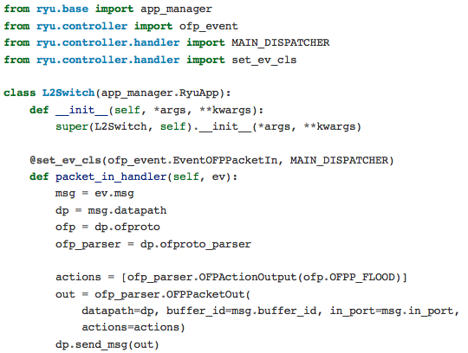
Application 1: Hub ryu-manager --verbose ryu/ryu/app/tutorial_l2_hub.py
Hub
(3)
(4)
RYU
(2)
(5)
OF Switch
(A)
(1)
(6)
(B)
(C)

Slide 26
Application 2: MAC-learning switch
Build on your own with this logic:
On init, create a dict to store MAC to switch port mapping
self.mac_to_port = {}
On packet_in,
Parse packet to reveal src and dst MAC addr
Map src_mac to the incoming port
self.mac_to_port[dpid] = {}
self.mac_to_port[dpid][src_mac] = in_port
Lookup dst_mac in mac_to_port dict to find next hop
If found, create flow_mod and send
Else, flood like hub.
Pssst… solution in tutorial_l2_switch.py

Slide 27
The End

