Slide 1
SDN, open-source and ONOS
Nick McKeown
Stanford University

Slide 2
What is happening?

Slide 3
The rise of open-source software
The rise of merchant switching chips
The need for operators to reduce cost and differentiate

Slide 4
Software in 2014
Smartphone: Open 75%, Closed 25%
Browser: Open 63%, Closed 37%
Websites: Open 67%, Closed 33%
DC servers: Open 70%, Closed 30%
Tablet: Open 62%, Closed 38%
Mainframes: Open 60%, Closed 40%
Supercomputers: Open 99%
Open-source still growing fast

Slide 5
Why open-source
Many more developers and QA
More agile, reliable and secure
Used where essential but “non-differentiating”

Slide 6
“Software will eat the world”
Marc Andreessen

Slide 7
The rise of open-source software
The rise of merchant switching chips
The need for operators to reduce cost and differentiate

Slide 8
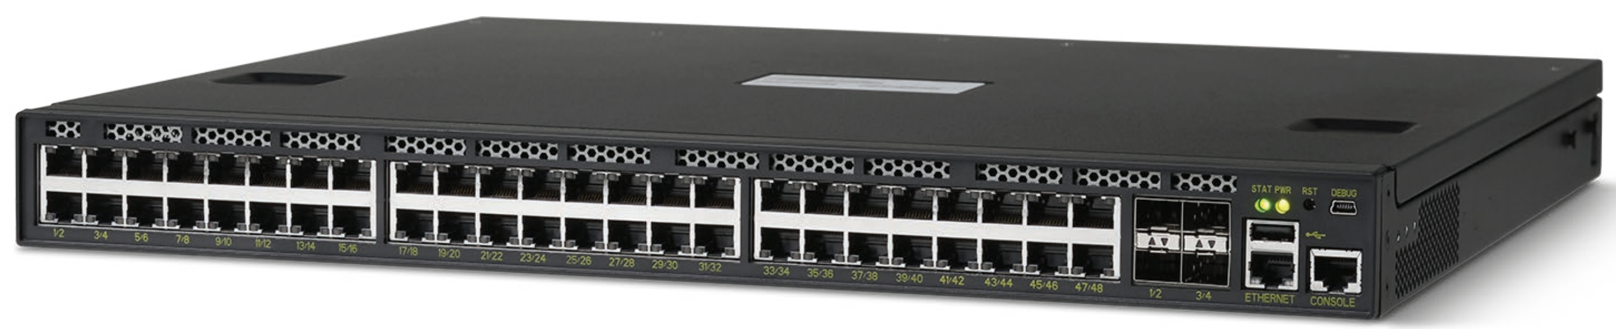

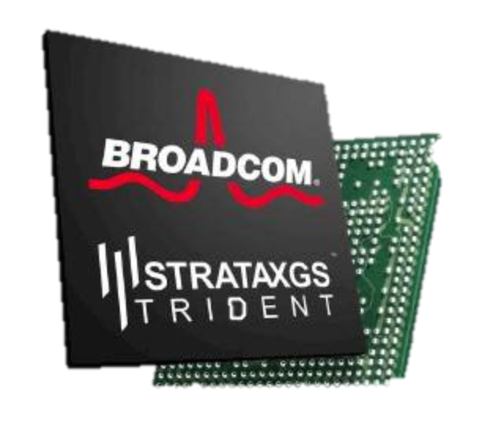
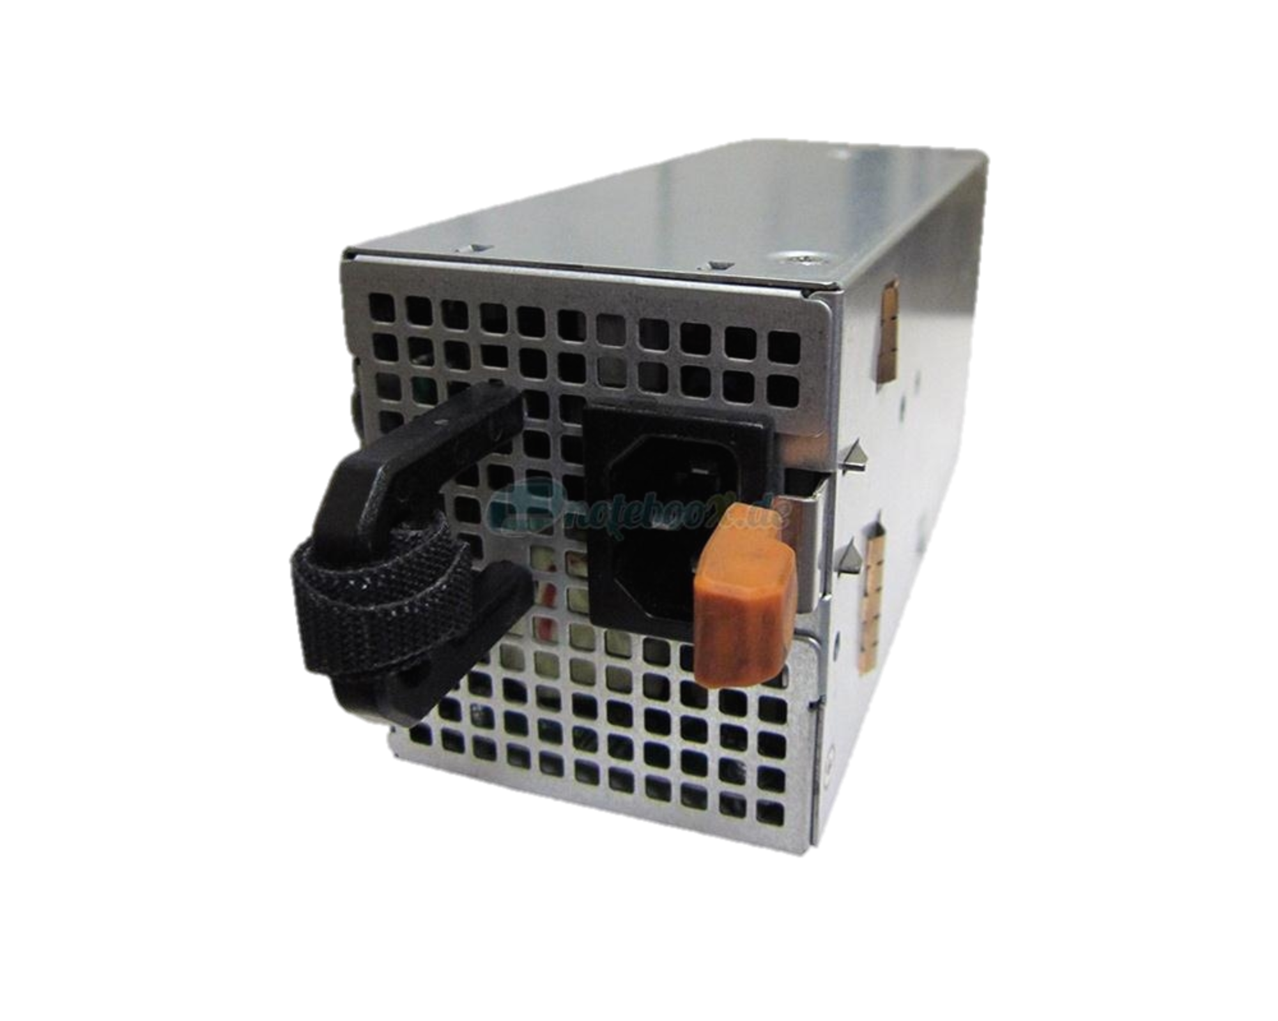

2012: The baremetal switch
Linux
Sheet metal
CPU
DRAM
xChip
Power supply + fans

Slide 9
Programmable h/w + open-source + apps
App
App
App
Proprietary
Software
Open-source
Software
Linux
Sheet metal
Open-source
P4
Programmable
Hardware
CPU
DRAM
xChip
Power supply + fans
Notes:
2.5Billion transistors --- 100,000 times bigger. 4GHz --- 10,000 times faster
Taiwan

Slide 10
It’s happening fast!

Slide 11
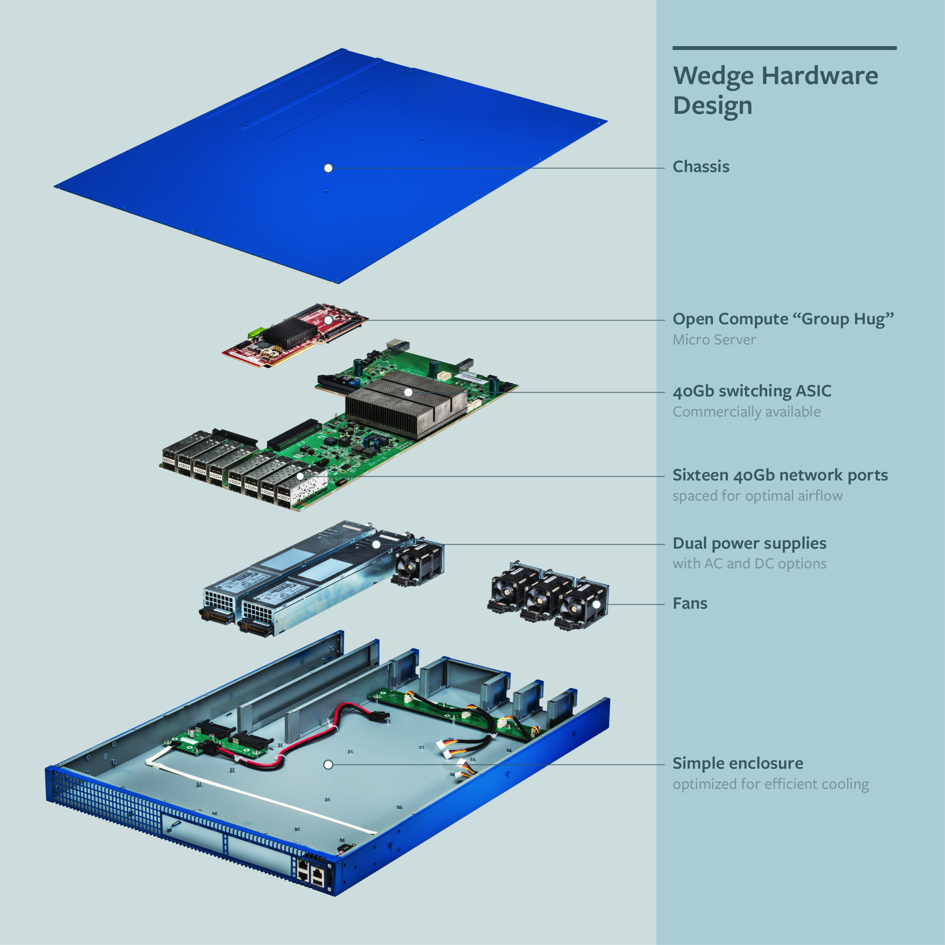
OCP: Wedge switch
BCM xChip: 1.2Tb/s

Slide 12
App
App
App
Proprietary
Software
Open-source
ONOS, ODL
NOX, POX, Ryu
Floodlight, Beacon
Network Control Plane
Optional Remote API
Open-source
FBOSS, OVS, Indigo, SwLight.
Forwarding Agent
Open-source
ONL
Linux
Open-source
OF-DPA
Open-source
ONIE
API/Driver
Boot Loader
Open-source
P4
CPU
DRAM
xChip
Power supply + fans

Slide 13
The rise of open-source software
The rise of merchant switching chips
The need for operators to reduce cost and differentiate

Slide 14
The Problem
Global IP traffic growing 40-50% per year
End-customer monthly bill remains unchanged
Therefore, cost of ownership needs to reduce 40-50% per Gb/s per year
But in practice, reduces by <20% per year
Revenue
$30/month
Total cost
Growth in traffic
time

Slide 15
Simpler hardware + open-source + apps
Reduce capital cost
  Move to simpler hardware + open-source control plane
Reduce operational cost
  Streamline protocols, features and software
Increase price
  Differentiate with new proprietary software services

Slide 16
The Internet was deliberately designed …
simple and streamlined
To be simple and streamlined.
To have decentralized control: Lots of individually controlled pieces.
Which led to …
Explosive organic growth of the Internet.
A great business for companies selling routers.
A great business

Slide 17
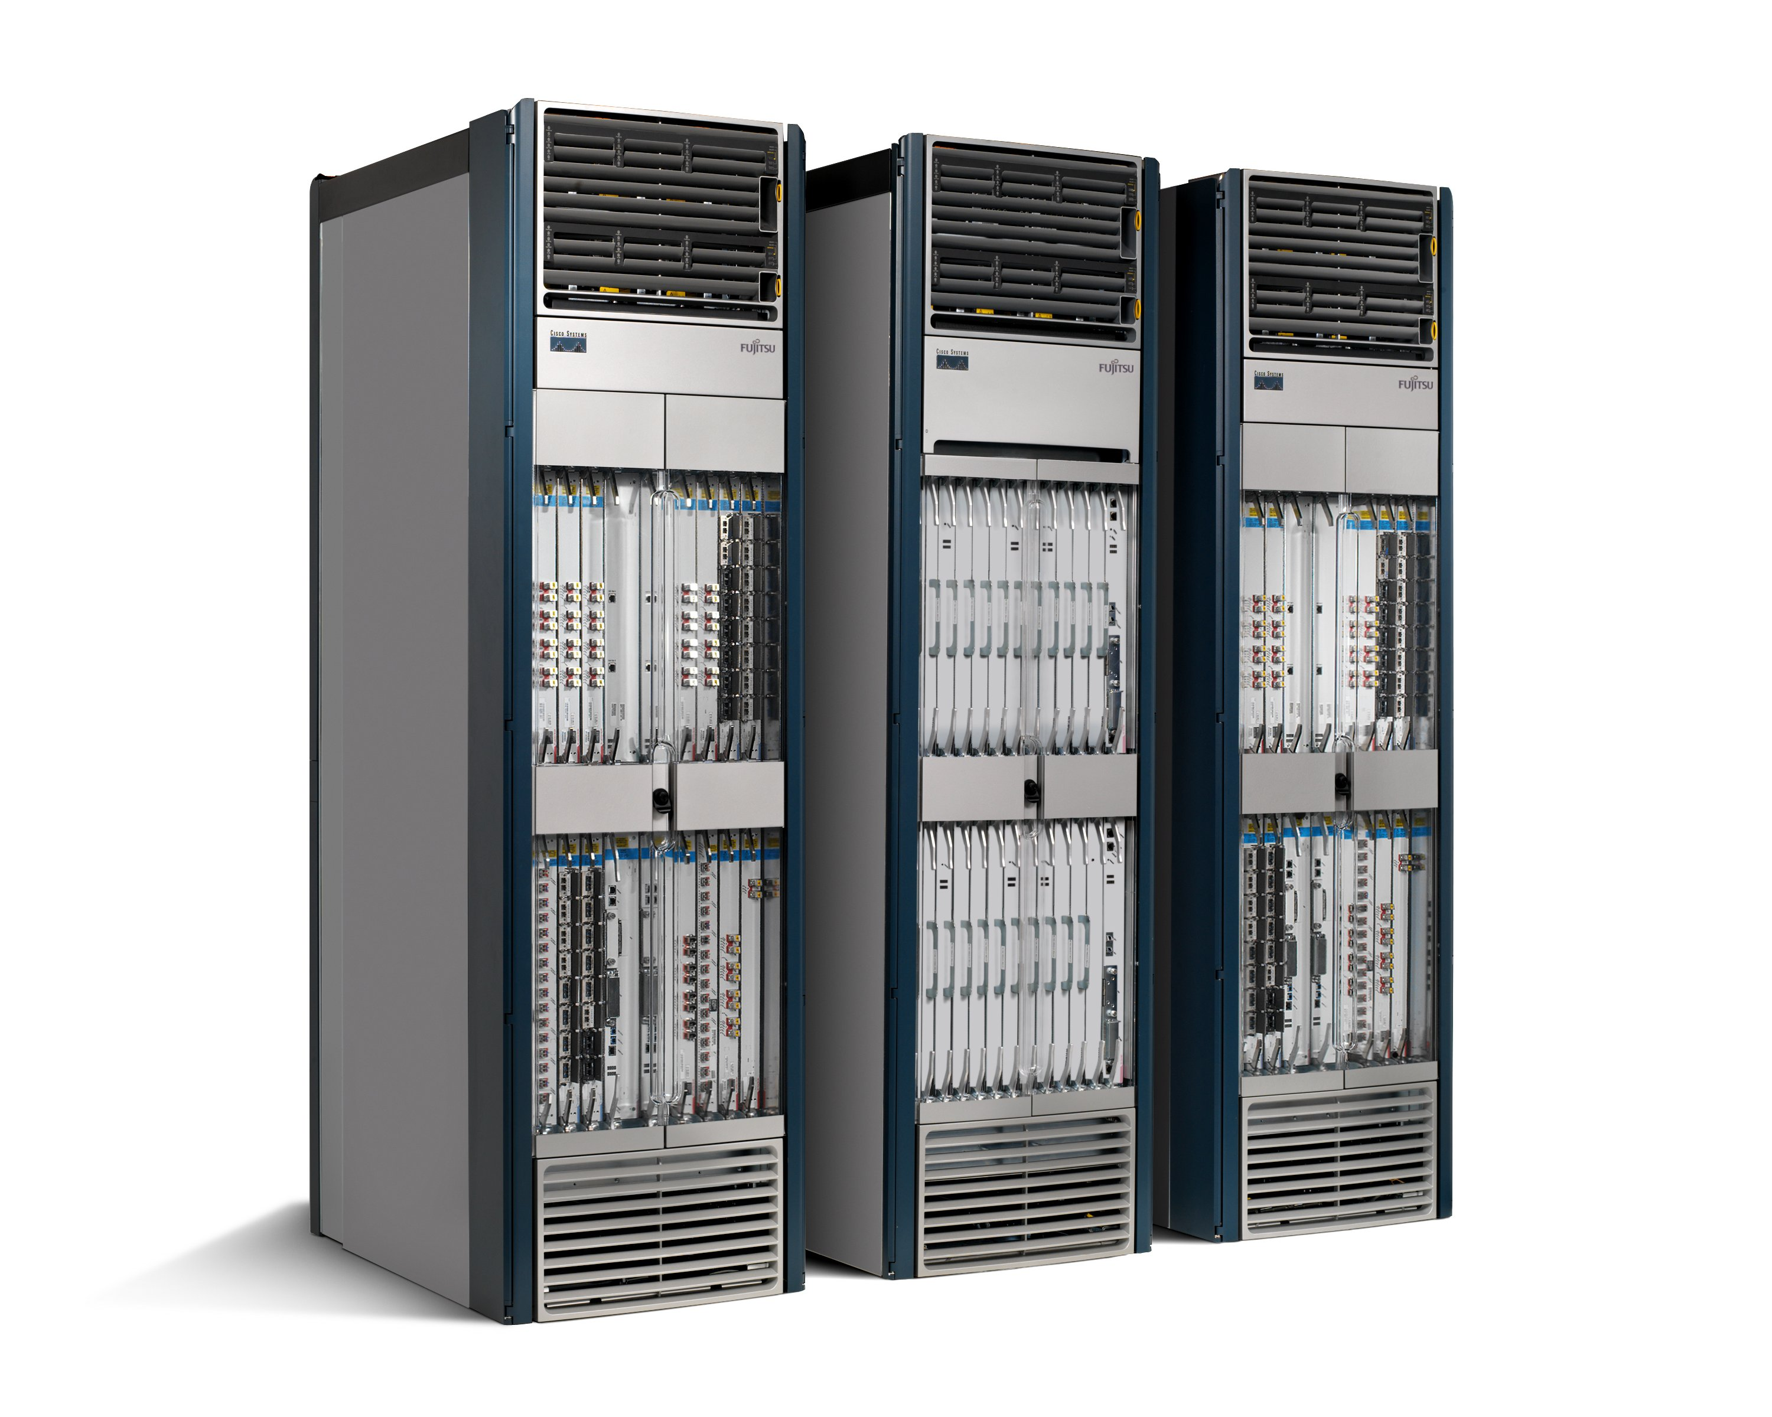
Strategy 1: Vertical integration
Network Management
Proprietary
Features
“CLI”
Proprietary
Operating System
Proprietary
Hardware

Slide 18
Strategy 2: High barrier to entry

Slide 19
Number of published Internet Standards

Slide 20
Proprietary
Features
50+ million lines of code
Proprietary
Operating System
Proprietary
Hardware
Tens of billions of gates
“Great business” triumphed over “simple and streamlined”.

Slide 21
SDN and NFV inevitable because…
Rise of Linux.
Rise of simpler servers and switches.
NFV: Rise of virtualization.
SDN: Rise of merchant switching silicon.

Slide 22
Software Defined Network (SDN)
Control
Program
Control
Program
Control
Program
Global Network Map
Remote Control Plane
Control
Packet
Forwarding
Control
Packet
Forwarding
Control
Control
Packet
Forwarding
Packet
Forwarding
Control
Packet
Forwarding

Slide 23
Network Function Virtualization (NFV)
Public Internet
Middlebox
Middlebox
Middlebox
Middlebox
Packet
Forwarding
Packet
Forwarding
Packet
Forwarding
Packet
Forwarding
Packet
Forwarding

Slide 24

Network Function Virtualization (NFV)
Public Internet
VM
VM
VM
Middlebox
Packet
Forwarding
VM
VM
VM
Packet
Forwarding
Packet
Forwarding
Packet
Forwarding
Packet
Forwarding
Packet
Forwarding

Slide 25
Overall System Management
Routing, Traffic Engineering,
Mobility, VPN
DPI, Load Balance, SPAM
New Services
Proprietary
Software
(Remote) Open Source Control Plane
Open Source
Software
Linux
Linux
Linux
Linux
Linux
Programmable
Hardware
Server
Switch
Radio
PIC
VM

Slide 26
Why ONOS?
Network operators need an open-source control plane (it is non-differentiating)
…with HA and scalability built-in from the ground-up
Which is why we are here today

Slide 27
“Because there is no army that can hold back an economic principle whose time has come.”
John Donovan, AT&T (2014)

Slide 28
When we look back in 20 years…
“Software will eat the world”
  SDN and NFV are a natural consequence of a bigger trend.
Network infrastructure will be:
  Simpler hardware + open-source infrastructure + proprietary apps
Network operators will have developed and will own proprietary software
Standards will still matter, but with diminished value

Slide 29
<The End>

